Slide 1
Supervised Practice Workshop & DICAS Overview
Guide to the NEW application guidance–Fall 2024
Dr. Kiresich, RD
Dr. Isom, RD

Slide 2
Pathway to Becoming an RD/RDN
Masters Degree starting January/2024
DPD classes from an accredited university
Can be done at the undergraduate level (like CPP) or through a GP (graduate program in dietetics)
1000 hours of supervised practice
Various supervised practice types available (see next slide)
Registration exam
Continuing education units (75 every 5 years)

Slide 3
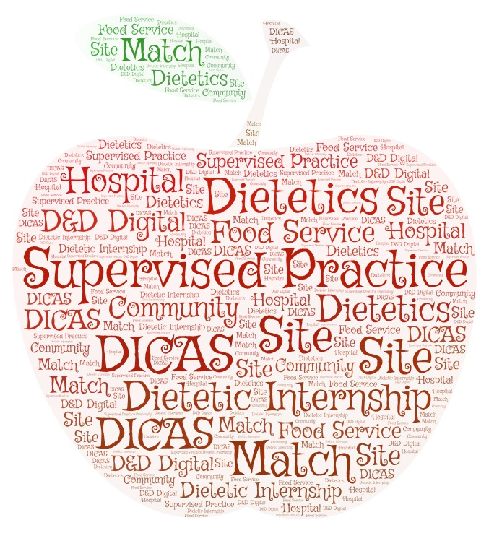
Types of supervised practice
Traditional Internship
Coordinated Internship
Combined
Future Graduate/Graduate Program (FG/GP – used to be called FEM)
Distance Internship
Notes:
Internships vary on types as well as:
Emphasis
Full time vs. part time
Degree or credit toward a degree
Reputation
Pass rate
Location
Cost
Length of rotations
Requirements
Start and stop dates
Preceptors

Slide 4
Traditional
Apply as a separate program, even if you already attend the university
Program arranges all rotations and coordinates with all preceptors
Program also arranges all contracts
Set time to start and end
Majority accept applications in February only
DICAS
Smaller amount take fall applications
Will likely require you HAVE completed a Master’s Degree or WILL COMPLETE a Master’s Degree within the timeframe of the supervised practice program

Slide 5
Coordinated or Combined
Acceptance into the program guarantees you supervised practice
Check requirements, typically apply SEPARATELY to each part: (1) the graduate degree and (2) the DI (DICAS)
Must meet entry requirements for both
Program also provides a degree
Loma Linda University (BS, MS, MPH) – NO DICAS
USC Leonard Davis School of Gerontology (MS)
Fresno State – MS
VA Greater Los Angeles – option (MPH, MS)
CSU Northridge - MS

Slide 6
GP Graduate Program in Dietetics (FG or FEM old names)
Acceptance into the program guarantees you supervised practice and Degree completion
These program have competencies in BOTH didactic Dietetics Practice & supervised practice
= classes and supervised practice
These may or may not require the DPD to be complete
If they DO NOT require DPD Verification, the prerequisites are extensive
Examples of GP
Iowa State University MPP
Utah State University MDA
University of the Pacific: MSCN
Berkeley Master in Nutritional Sci and Dietetics

Slide 7
Distance
Administered in one location, but allows you to obtain most or all your supervised practice where you live
Often intern is responsible for finding own preceptors
Student must be proactive to secure (all) clinical preceptors in S. Cal
Unless they already have contracts – contact supervised practice program directly for a possible list of local preceptors
Generally, allows for more flexibility than other internships
Often have many more openings for interns (15 vs. 60)
Some distance programs are not accepted in some states
A distance can be a GP (Iowa State, Utah State)

Slide 8
Applying for Dietetic supervised practice programs
Step 1: Review the complete list of programs and make a list of those that you want to learn more about.
https://www.eatrightpro.org/acend/accredited-programs/accredited-programs-directory
Location
Traditional or Coordinated
Number of applicants received
Number of applicants accepted
Minimum GPA required
Average GPA of current students
Length of program
Part-Time vs. Full-Time
Concentration or Specialty
Rotations
Tuition – Student Financial Aid Accepted?
GRE required?
Other program requirements
Interview required?
Deadline?
When does the program start?
AllAccessDietetics.com

Slide 9
Where to apply
Review your WANTS, program components, and your Qualifications
DI: Cost, Financial Aid Available, Location, Format (Distance, combined, etc), timeline, type of degree, entry requirements
You: GPA, Experience, $$, Time-available, mobility, interests

Slide 11
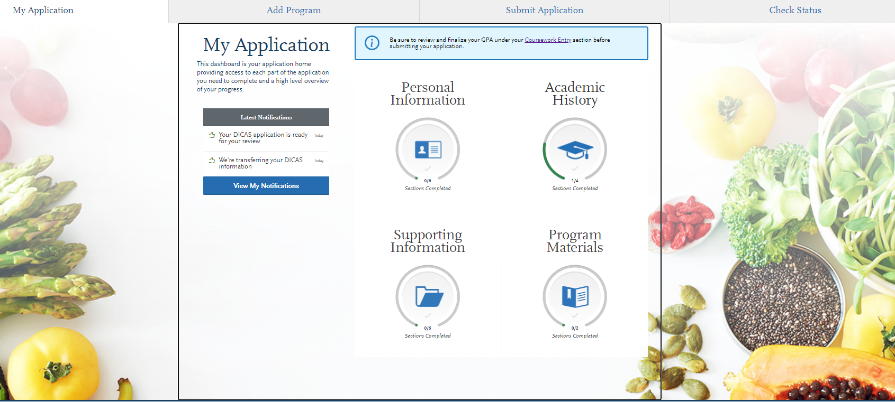

Slide 12
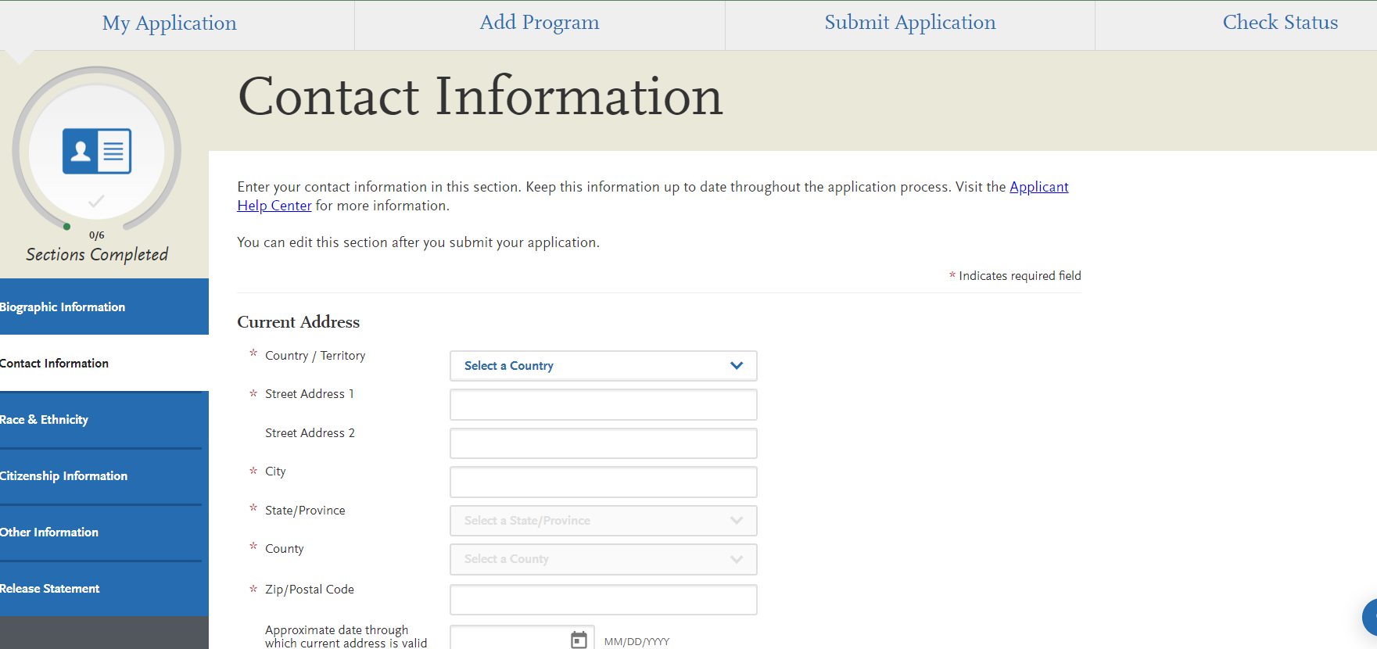
Applicant information:

Slide 13
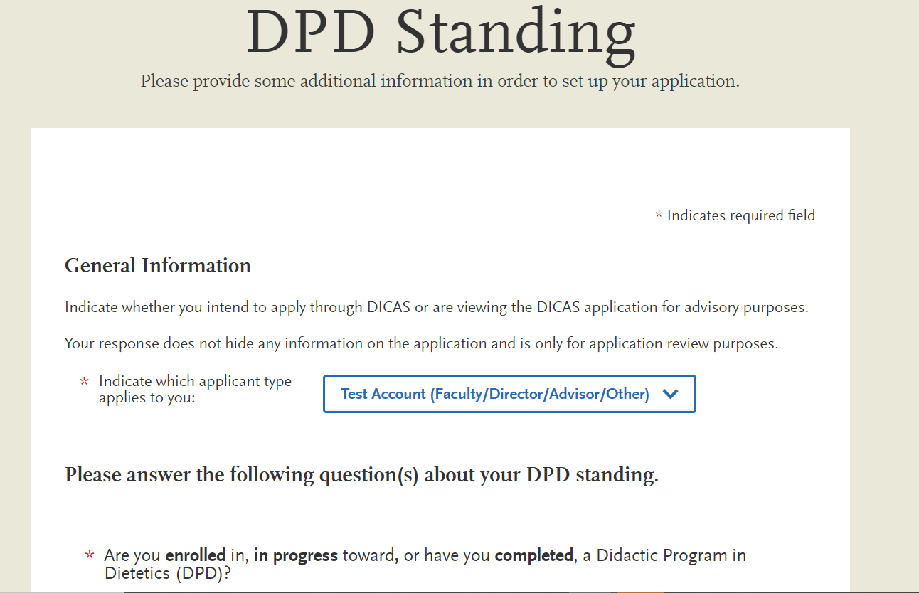

Slide 14
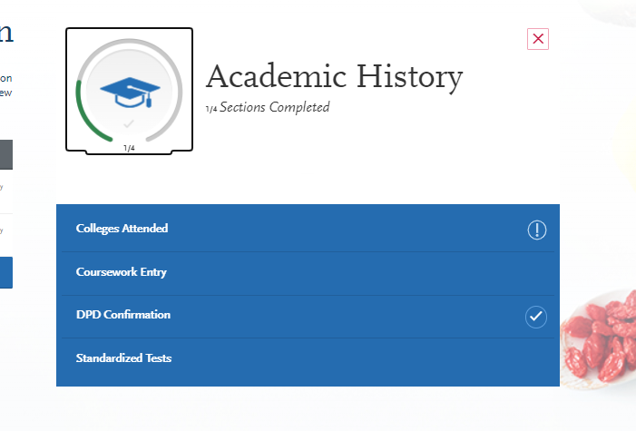
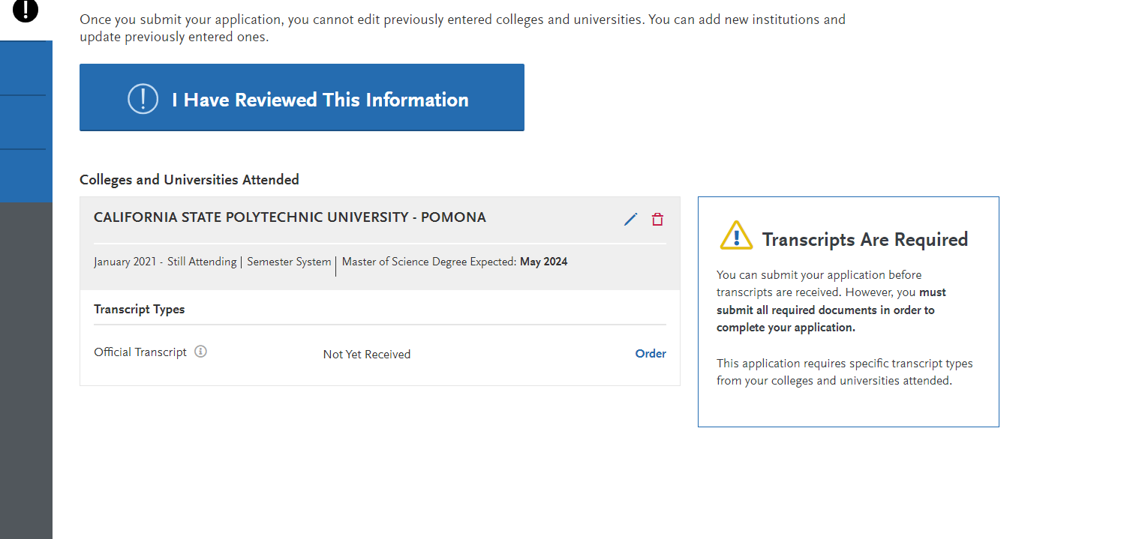
Transcripts

Slide 15
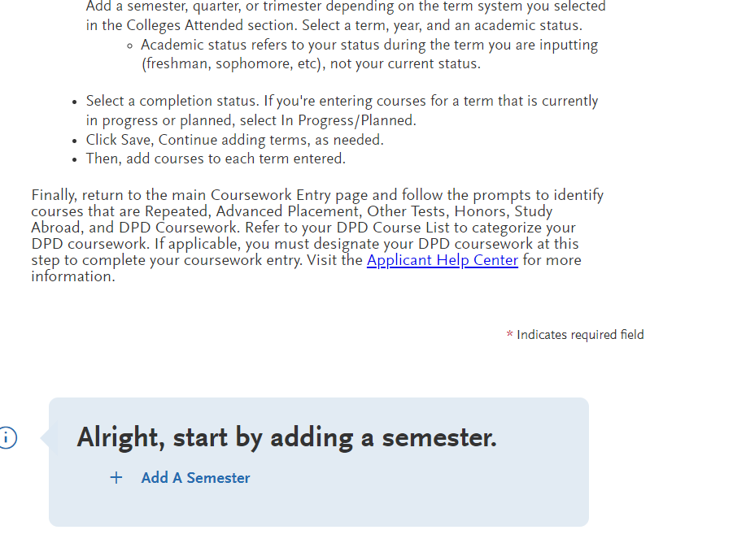
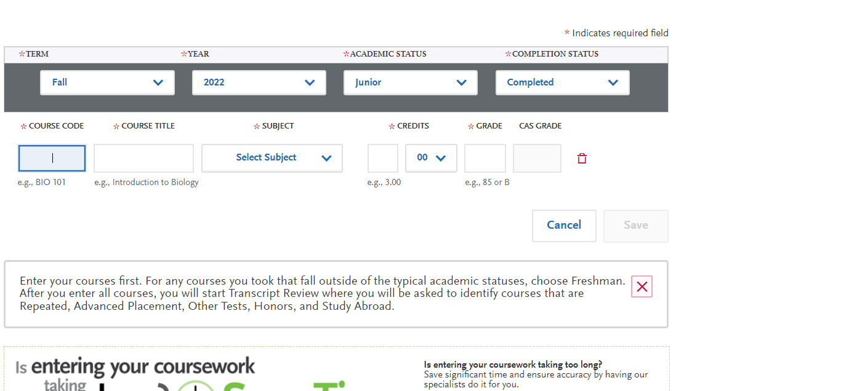
For each school, you will enter this information

Slide 16
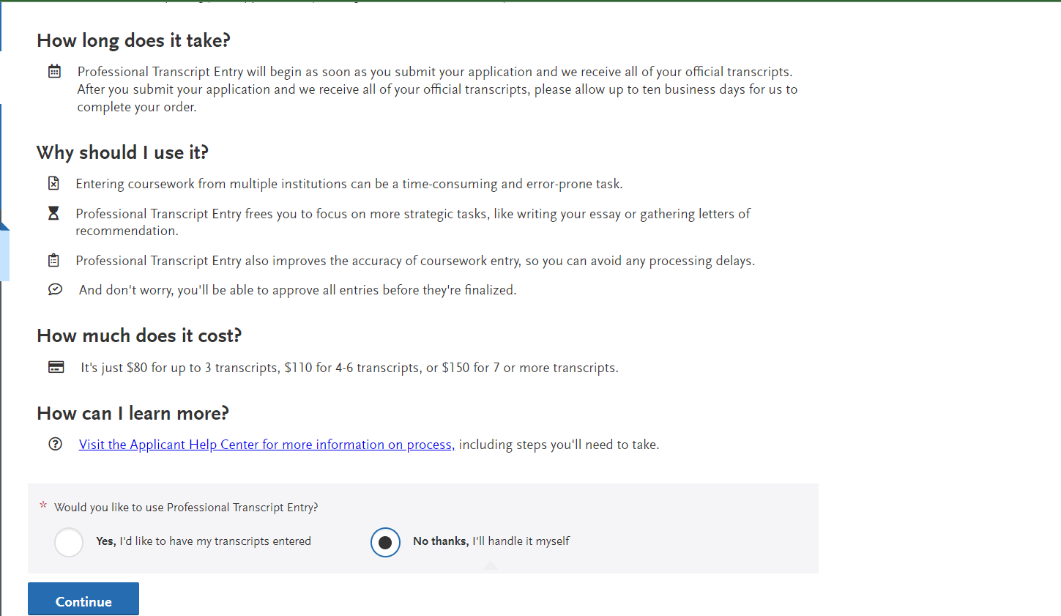
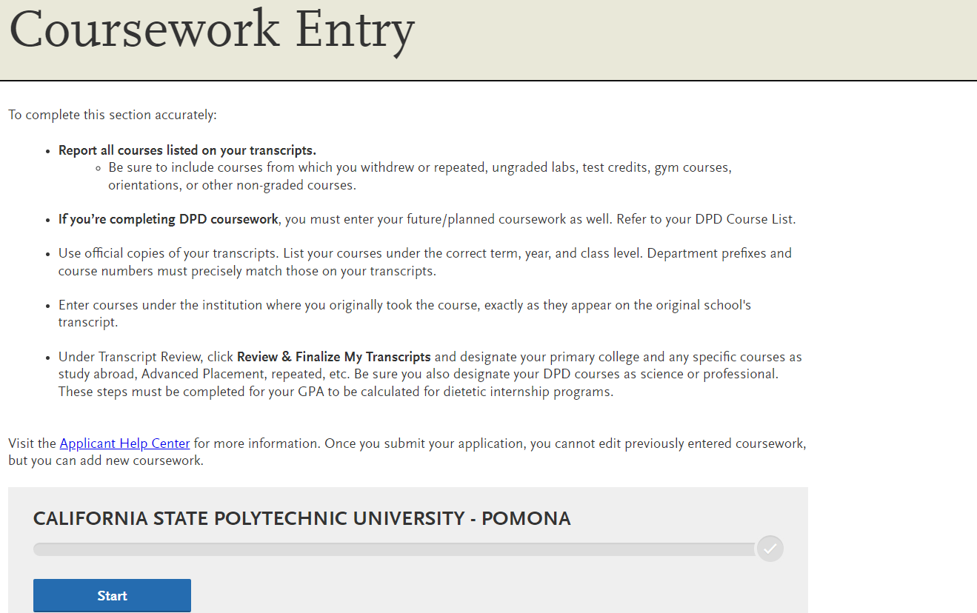

Slide 17
Tips for DPD Transfer Classes

Slide 18
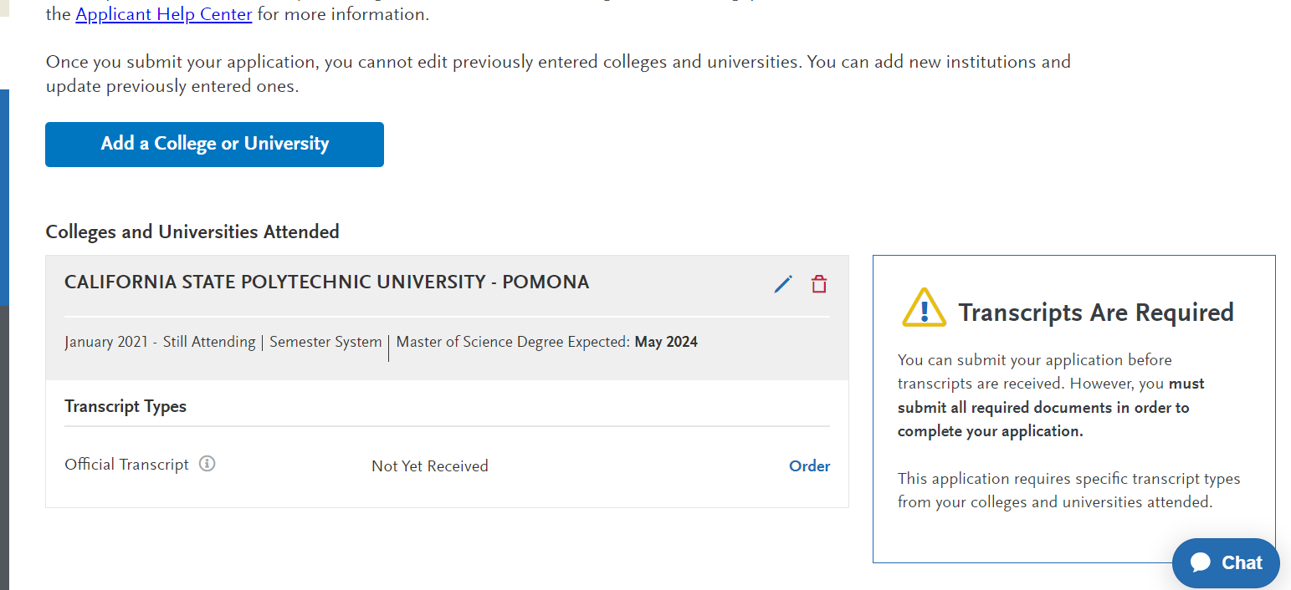
Tips for DPD Transfer Classes

Slide 19
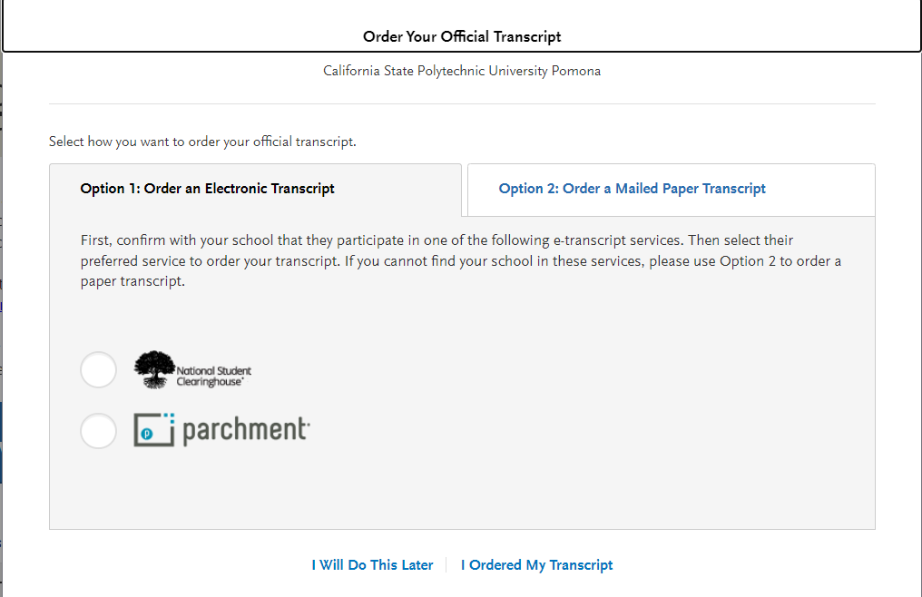
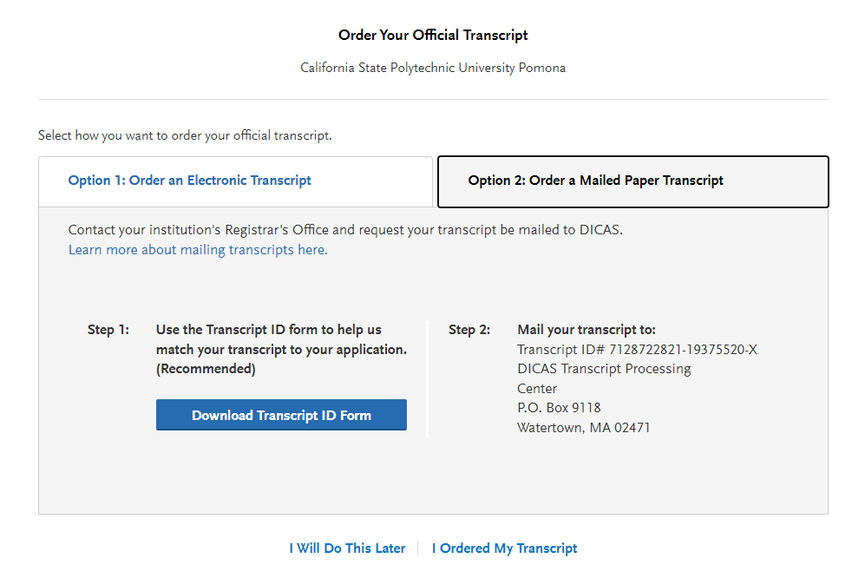

Slide 20
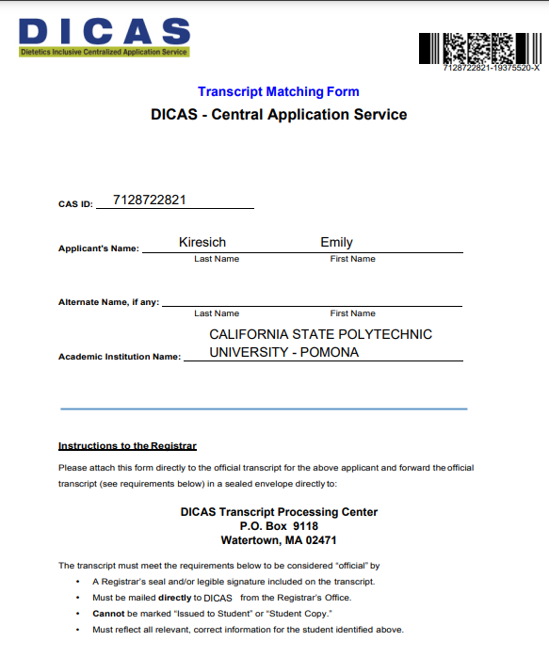
**Essential Step** you must include this form as an upload for ALL Transcripts you order for DICAS

Slide 21
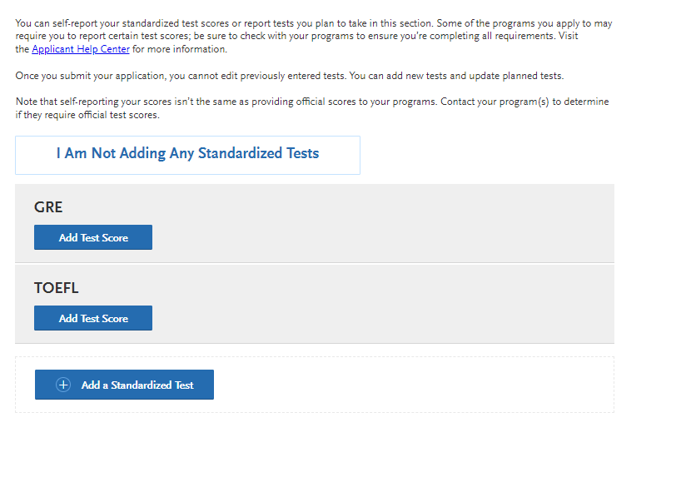
Test scores – DO NOT send your results to DICAS

Slide 22
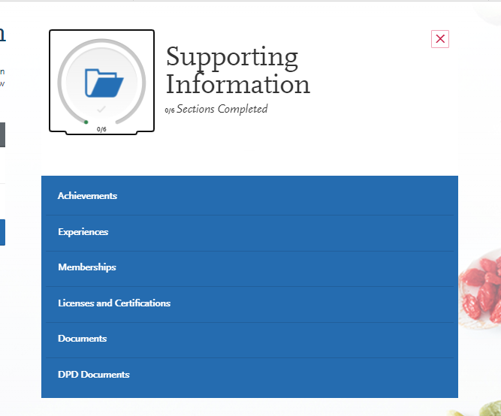
This is why having a good resume is helpful – you can get all of this from a good resume

Slide 23
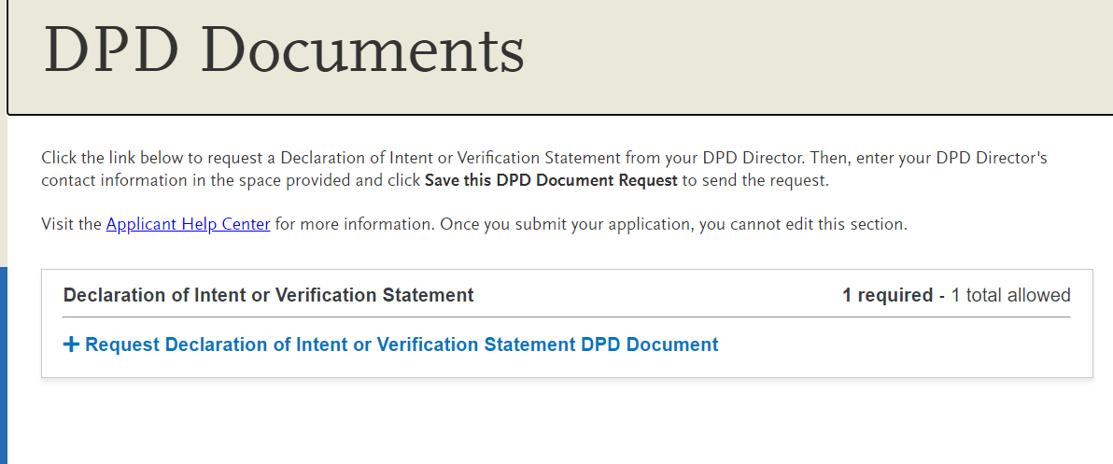
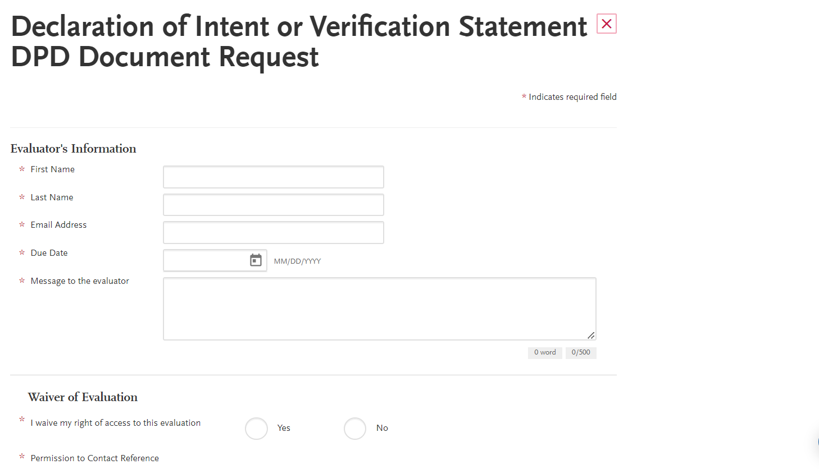
Add Emily Kiresich
dpd@cpp.edu

Slide 24
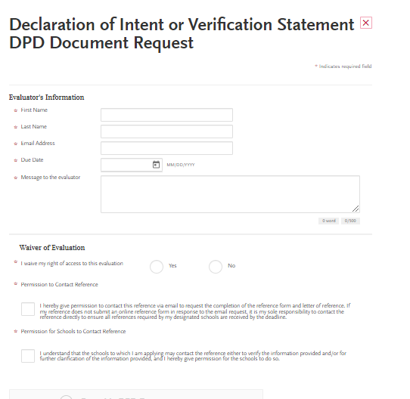
Declaration of Intent or Verification Statement Evaluator: Emily Kiresich Email: dpd@cpp.edu Due Date: you need to put the date your application(s) due

Slide 25
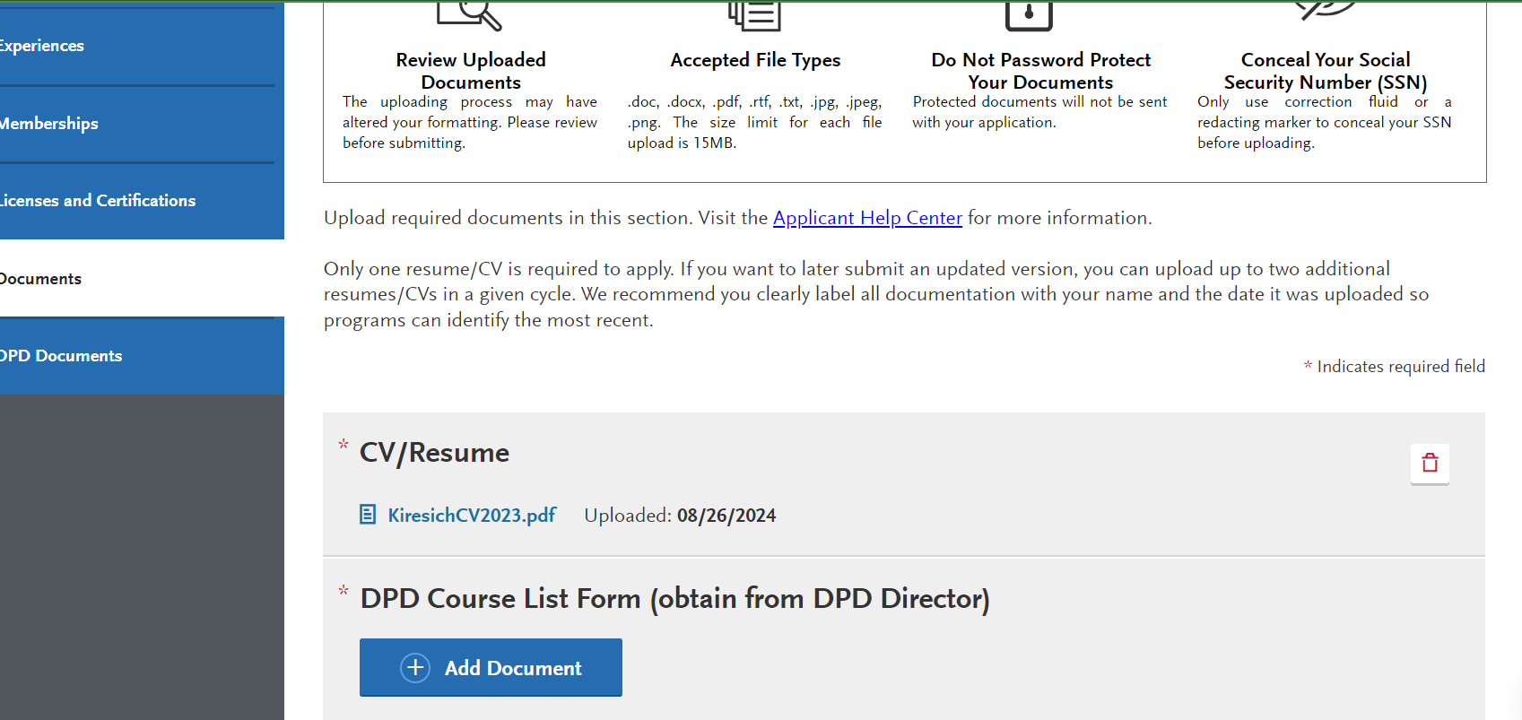
DPD Course List found on Didactic Program in Dietetics Page at CPP Choose the year your declared Dietetics as an option (check DPR)

Slide 26
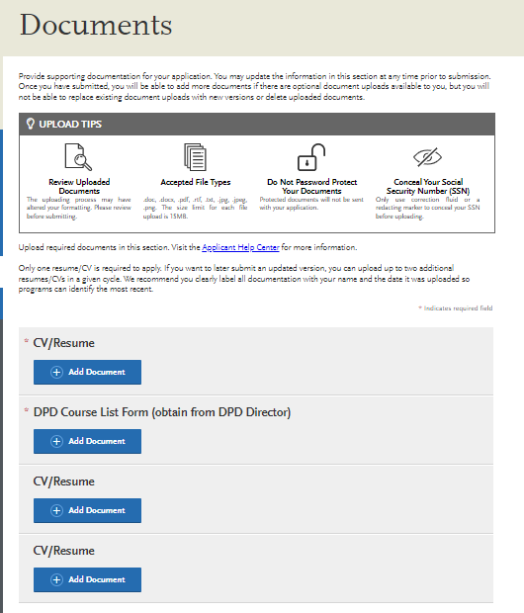
Document uploads
DPD Course list found on CPP DPD Website by YEAR
Your catalog year is one of the following:
the year you started at CPP or
the year you declared Dietetics as the option, or
The year you selected between the year you started and now
You can check your Bronco Direct

Slide 27
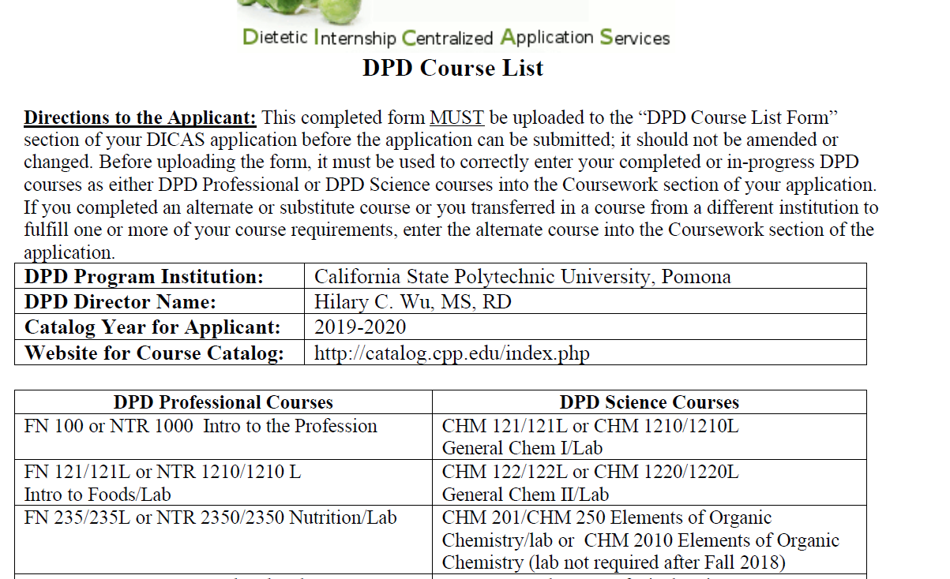
DPD course list
Found on the Dietetics Page under “Supervised Practice application process”

Slide 28
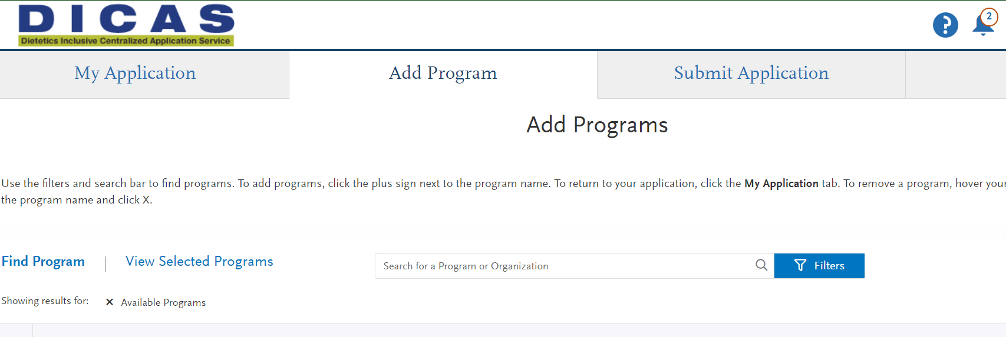
Adding a Program to your DICAS application:

Slide 29
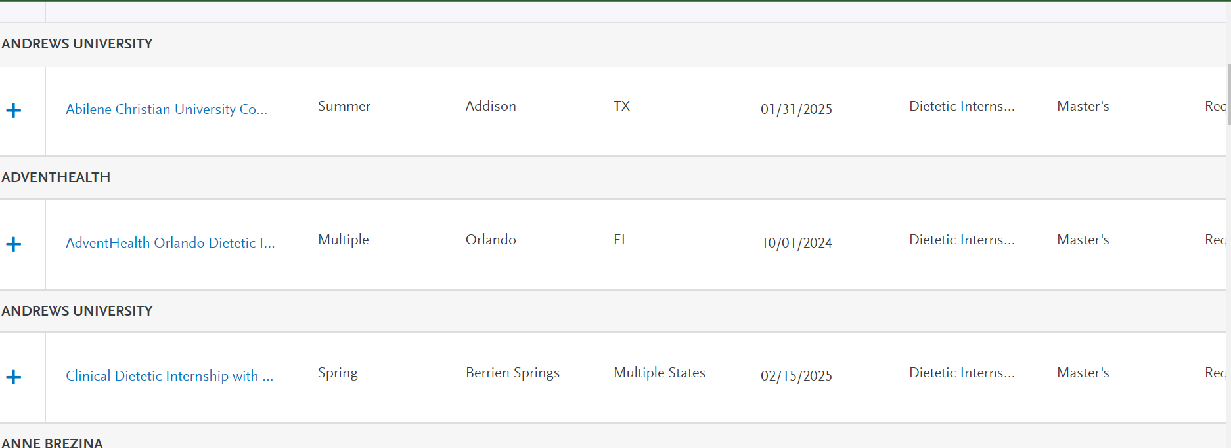
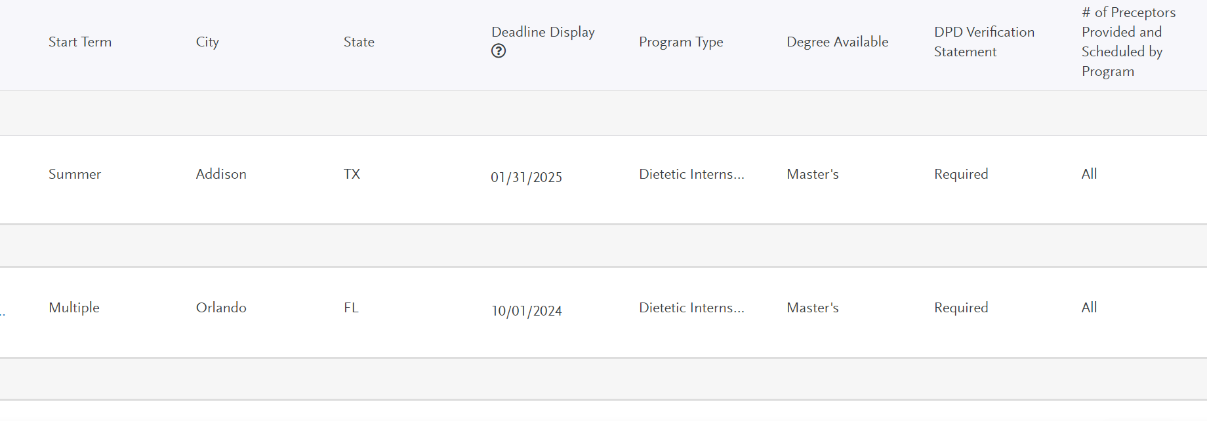

Slide 30
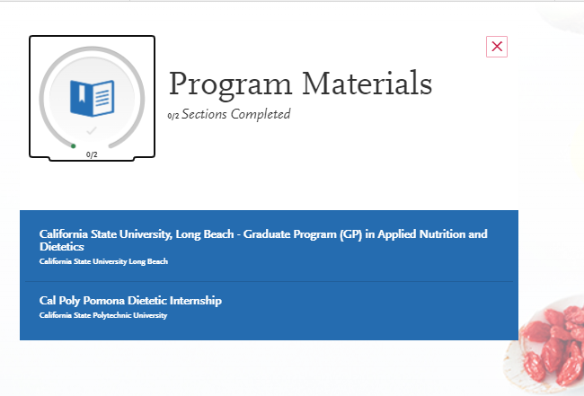
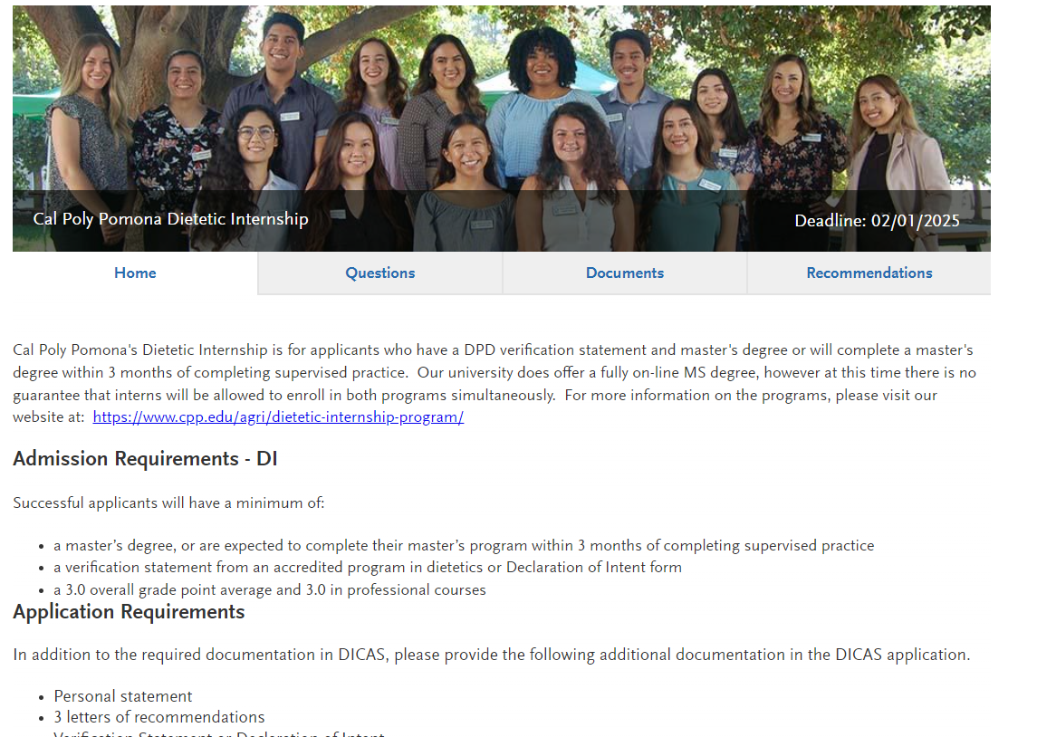
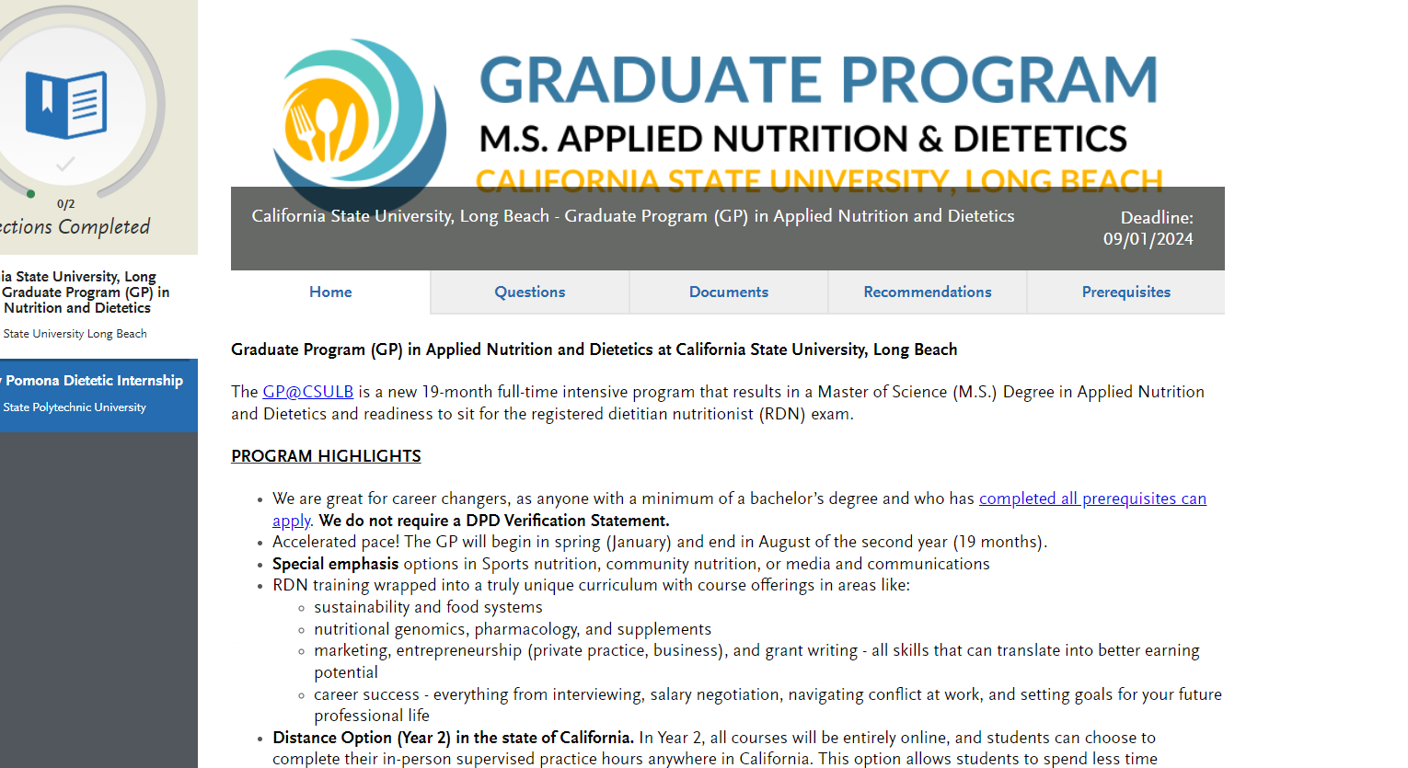

Slide 31
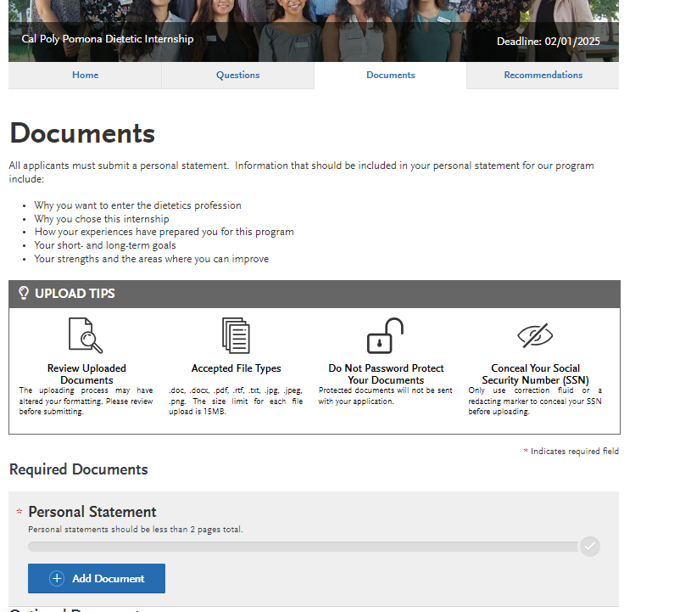
Your personal statement goes here:

Slide 32
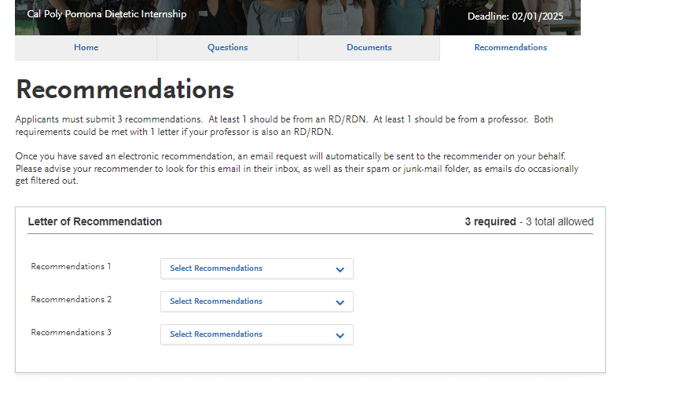
References: look at what each program wants in a reference. Teachers, work, etc. you can designate which reference is for which program(s) Ask for references EARLY. Please give your contacts at least 3-4 weeks to complete these letters.

Slide 33
Who do you ask?
Check the requirements of the program. Could be RD’s/employers, instructors, DPD Director, friends (rare)
Request your letters EARLY:
give 3-4 weeks, request before the end of Fall semester if possible
Ask – when they say YES provide:
Resume
unofficial transcripts
List short and long-term goals
List of programs to which you’re applying
& DICAS only or also letters for a Master’s program
Maybe – your personal statement *to help them write a good letter

Slide 34
$50 for 1 + $25 for each additional program Apply to 4 programs = $125

Slide 35
Tips from past applicants
During Application:
Have your transcripts ready by your side when entering your classes
Be Aware of Fees:
DICAS fee
Graduate program application fee
Program-specific Fees
After Acceptance:
Fees – be prepared to pay for fees to get the following:
Attend orientation (another city/state)
LiveScan/Background check, Vaccinations
Textbooks
Tuition (know the due date vs. when you’ll get your financial aid/support

Slide 36
Take the NDTR Exam! Make yourself more competitive!
The steps for the DTR exam process are as follows:
please order and have a set of sealed Official Transcripts mailed directly to me from the Cal Poly Registrar's Office to my address listed below. OR email an official copy to dpd@cpp.edu Note: The date that your BS degree was conferred must appear at the top of the first page of the Official Transcripts.
Emily Kiresich, PhD, RD
Director, Didactic Program in Dietetics
Department of Nutrition and Food Science
Don B. Huntley College of Agriculture
California State Polytechnic University, Pomona
3801 West Temple Avenue
Pomona, CA 91768
Pay the $25 non-refundable DTR exam processing fee via E-Market https://commerce.cashnet.com/Nutrition_Food
Upon received the transcript and the payment, I will email you to schedule an appointment to complete the additional required paperwork via Zoom

Slide 37
Improving Your Application
Experience
If you plan to take any time between graduation and DICAS - working as diet aide or taking the DTR exam
Work or volunteer:
Hospitals
School Food Service
Corporate Wellness Programs
Healthy City Programs
Nutrition Entrepreneurs
Student Health Centers
Farmer’s Markets
Other Options:
Consider the Certified Dietary Manager (CDM) Certification
Work for Women, Infants, and Children (WIC) as a nutritionist
Explore Fitness Specializations:
Certified Personal Trainer (CPT)
Group Fitness Instructor Certifications
With a fitness specialization, you may work in hospital or rehab clinics, fitness centers, or grade school athletics.
Health Promotion:
Health educators can work for health departments, schools, and community or non-profit organizations.
Consider a Graduate Degree:
Master of Science, Master of Public Health, or Master of Business Administration

Slide 38
Improve your Application
Honors & Awards (highlight these)
Still time to apply for awards and scholarships
Apply for Scholarships
Certifications
ServSafe
CPR

Slide 39
Improve your Application
Have a GREAT Personal Statement
https://www.allaccessdietetics.com/dietetic-internship-personal-statement-checklist/
https://www.nutritionjobs.com/how-to-write-a-winning-dietetic-internship-personal-statement

Slide 40
Improve your Application
Demonstrate Leadership
Volunteer Opportunities
On and off campus orgs
FN Forum
PhiU
ED Club
Others?! (STEM, Cultural or personal interest)
CA Academy Local Districts
Inland District
LA Region
Orange County District

Slide 41
Thank you
Questions:
dpd@cpp.edu

