Slide 1
Cal Poly Pomona & The Cal Poly Pomona Alumni Association
MODULE I
A Brief History and Strategic Plans for:

Slide 2
Welcome to Module I
This is the first of 3 modules which will hopefully tell you a little more about the Cal Poly Pomona Alumni Association, who we are, and what we do.
Module I will focus on:
History
Strategic Plans
Missions and Visions
How the Alumni Association fits into Cal Poly Pomona

Slide 3
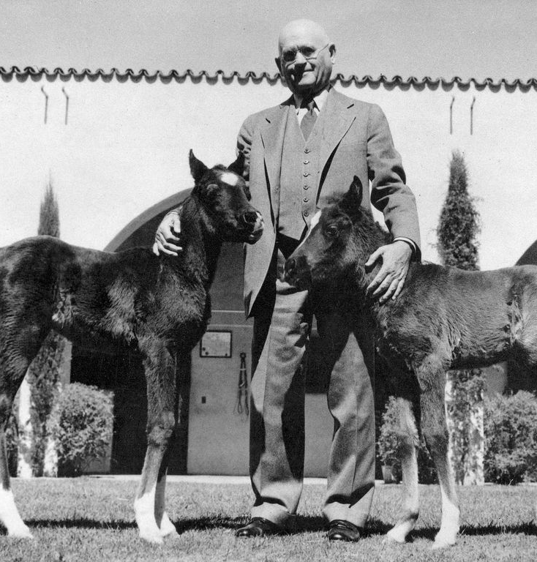
A Brief History of Cal Poly Pomona…
Cal Poly Pomona opened on Sept. 15, 1938, with an all-male enrollment of 110 students as the Voorhis Unit of California State Polytechnic College in San Luis Obispo. It was located on the 150-acre San Dimas site of the former Voorhis School for Boys.

Slide 4
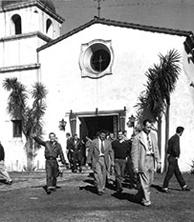
Today, the university is part of the 23-campus California State University system. Cal Poly Pomona has about 24,000 students and 2,600 faculty and staff on 1,438 acres.
To learn more about
Cal Poly Pomona’s history
CLICK HERE

Slide 5
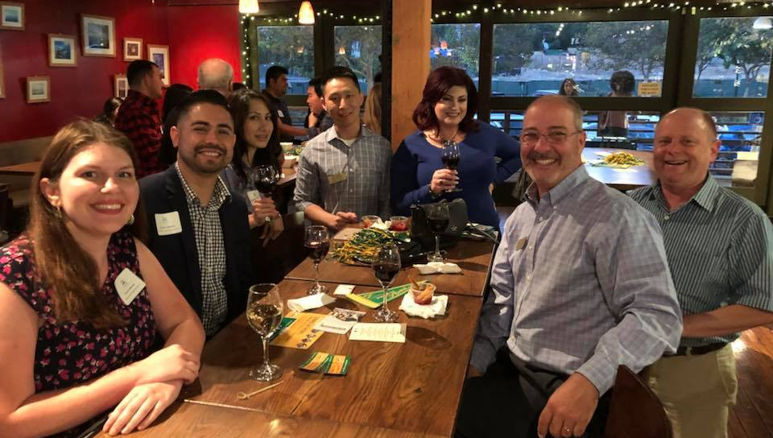
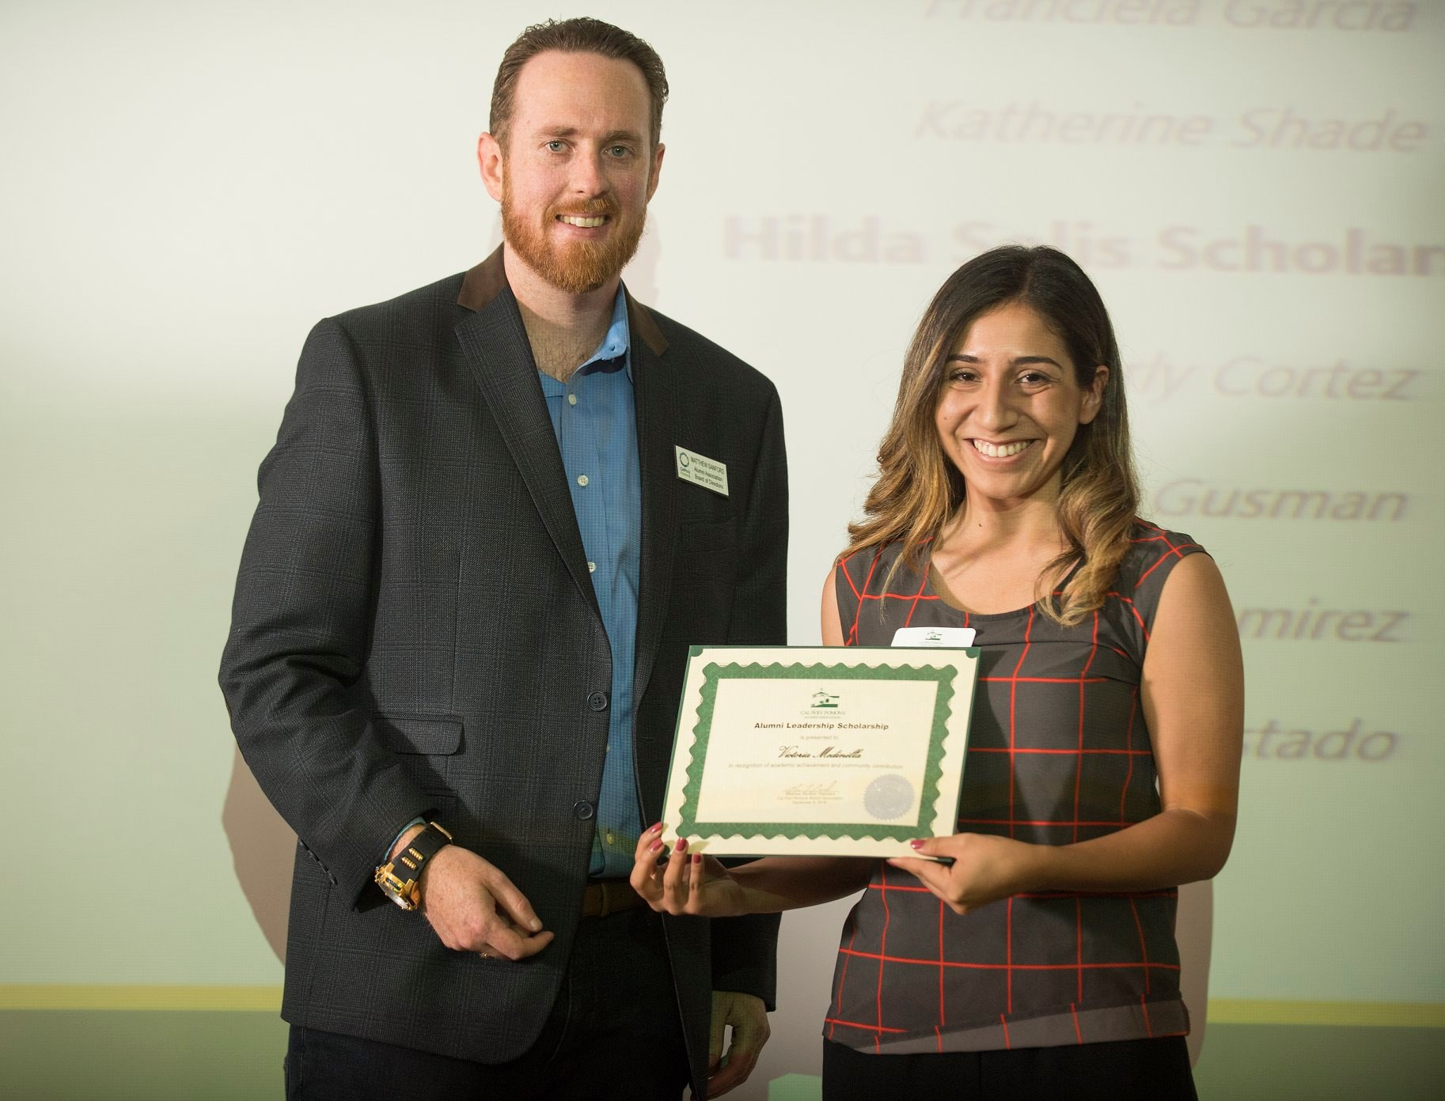
A Brief History of the Cal Poly Pomona Alumni Association
Founded in 1972, The Cal Poly Pomona Alumni Association (CPPAA) is an independent 501 (c) 3
To learn more about Cal Poly Pomona’s Alumni Association CLICK HERE

Slide 6
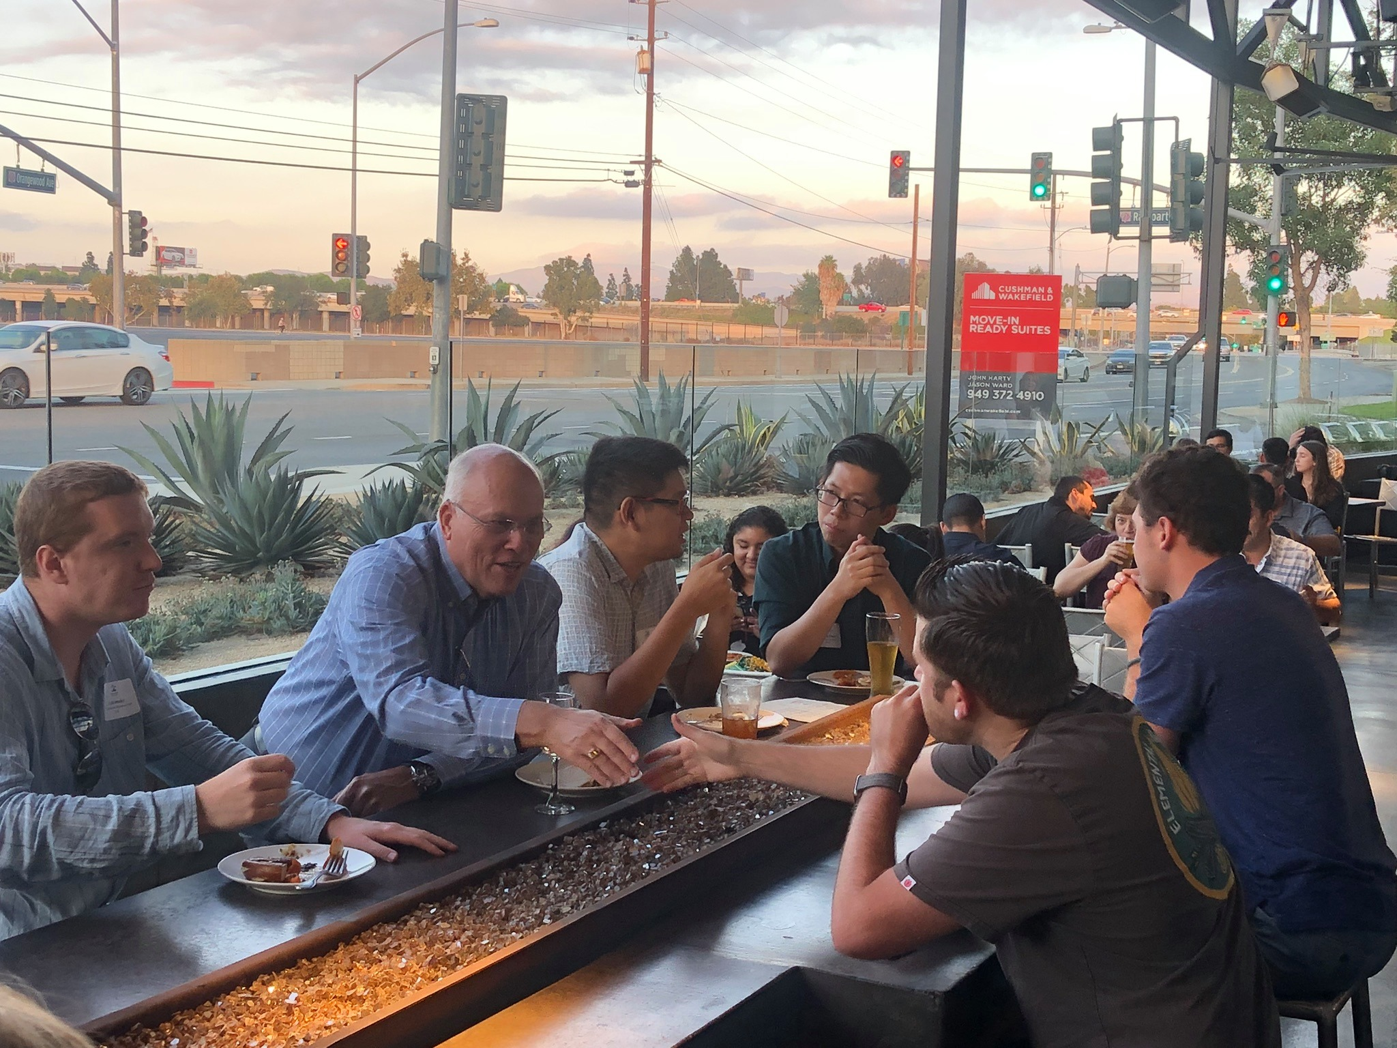
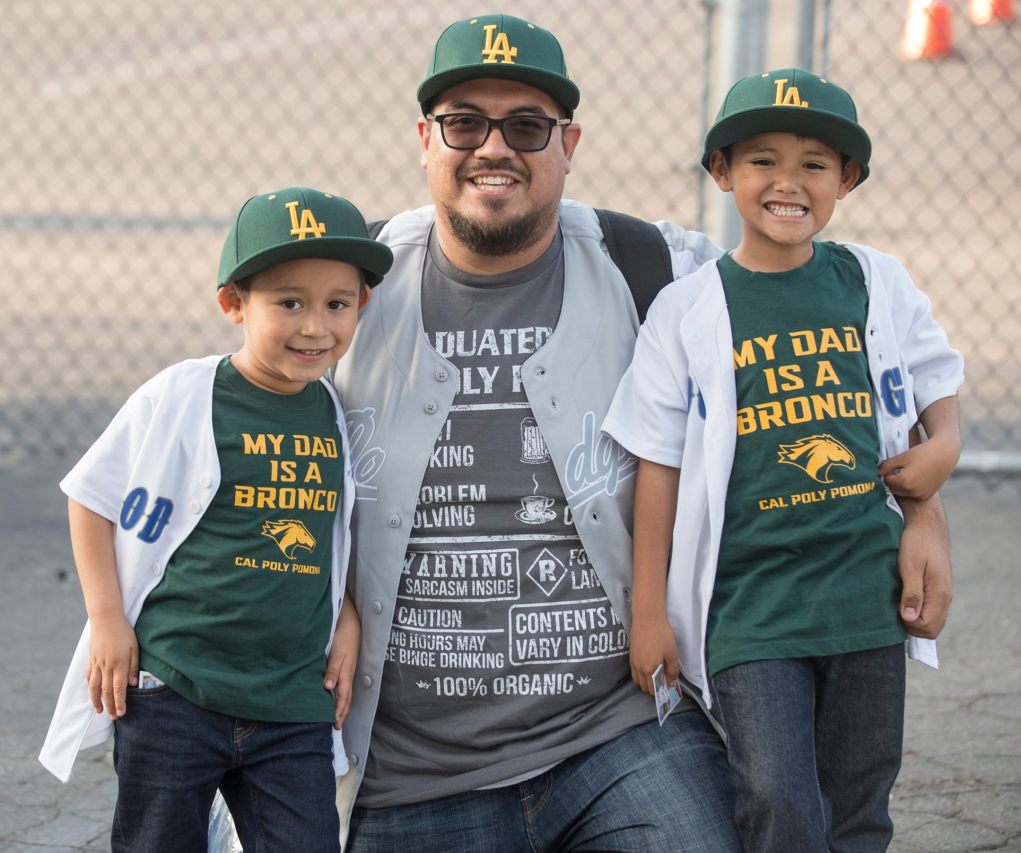
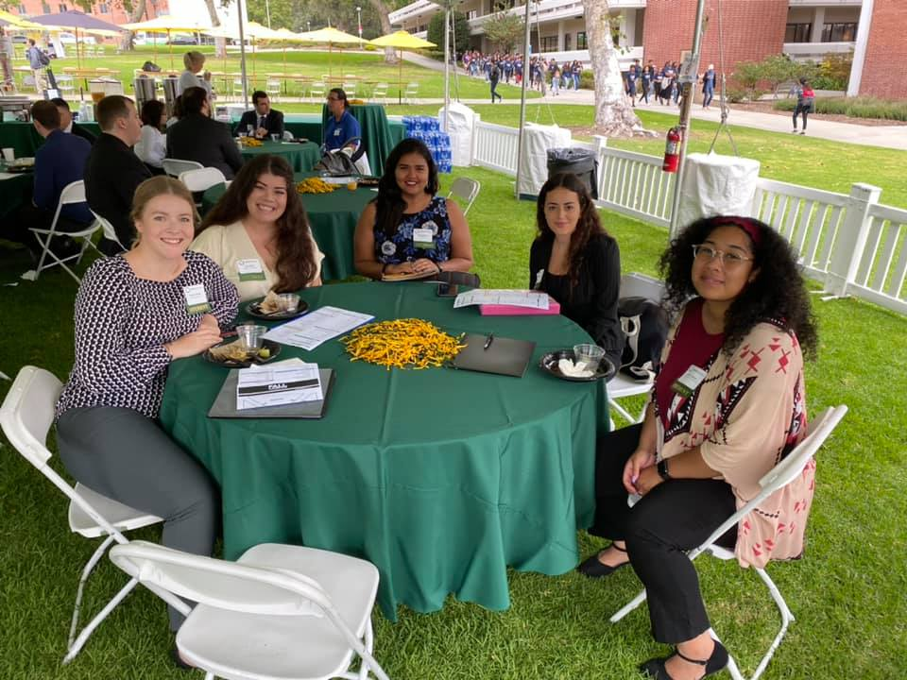
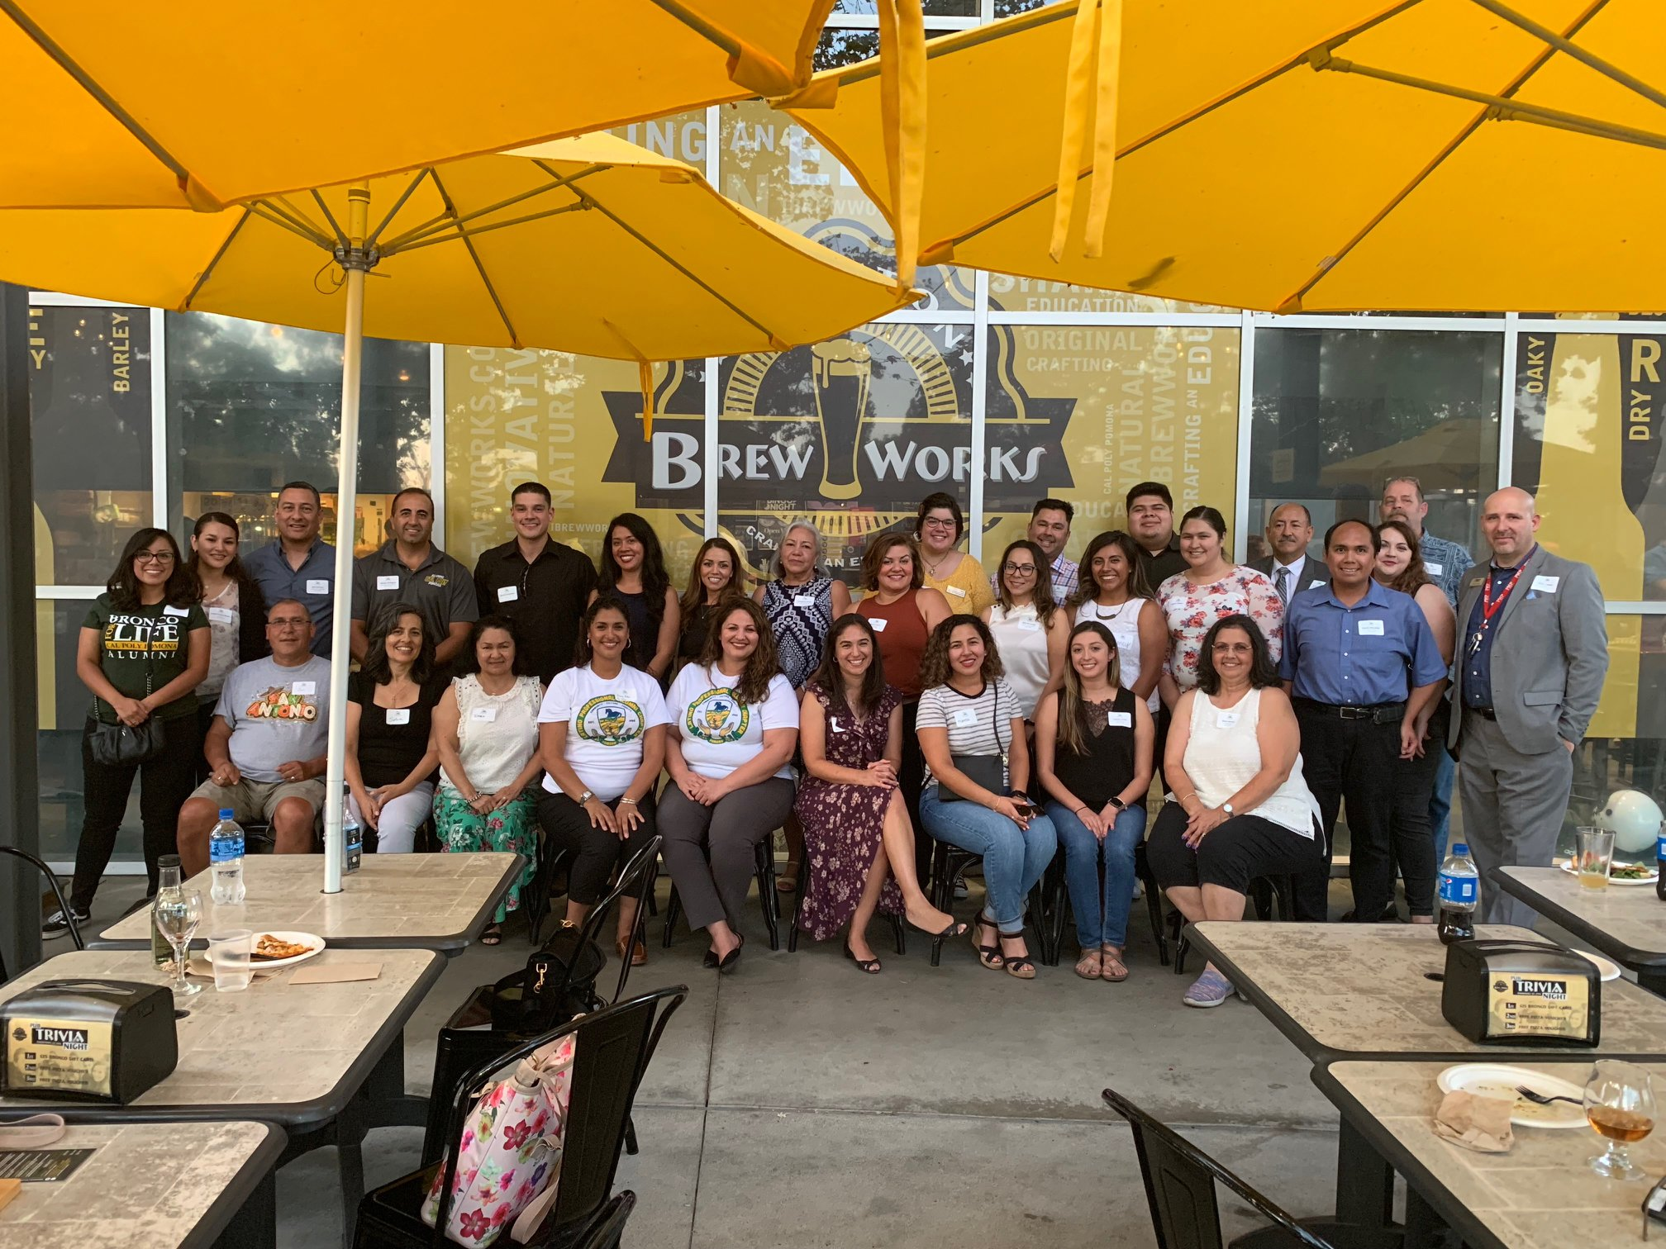
Approximately 85% of Cal Poly Pomona’s 170,000 alumni live or work within a 50-mile radius to the campus. This enables the Office of Alumni & External Relations and Cal Poly Pomona Alumni Association to engage alumni in many facets of campus life.

Slide 7
Strategic Plans and How The Alumni Association Fits
Values
Outcomes
Initiatives
Vision
Goals
Mission

Slide 8
Cal Poly Pomona’s Mission
We cultivate success through a diverse culture of experiential learning, discovery and innovation.

Slide 9
Cal Poly Pomona’s Vision
Cal Poly Pomona will be the model for an inclusive polytechnic university that inspires creativity and innovation, embraces local and global challenges and transforms lives.

Slide 10
Cal Poly Pomona’s Five Initiatives
Over the course of 80 years, California State Polytechnic University, Pomona has sustained a profound commitment to creativity, discovery and innovation. This legacy serves as the inspiration for the bold institutional vision found in our Strategic Plan 2017-2025.

Slide 11
5 Campus Initiatives
#1 Deliver Quality Programs that Promote Integrative Learning, Discovery and Creativity
#2 Enhance Student Learning, Development and Success
#3 Prepare Our Students for the Future of Work, Human & Civic Engagement
#4 Strengthen Our Economic Vitality and Impact
#5 Advance Organizational Development and Employee Excellence
To learn more about Cal Poly Pomona’s strategic plan and strategic initiatives CLICK HERE
To learn more about Cal Poly Pomona’s public good CLICK HERE

Slide 12
Where the Alumni Association Fits In
CPP
University Advancement
Alumni and External Relations
To learn more about University Advancement CLICK HERE

Slide 13
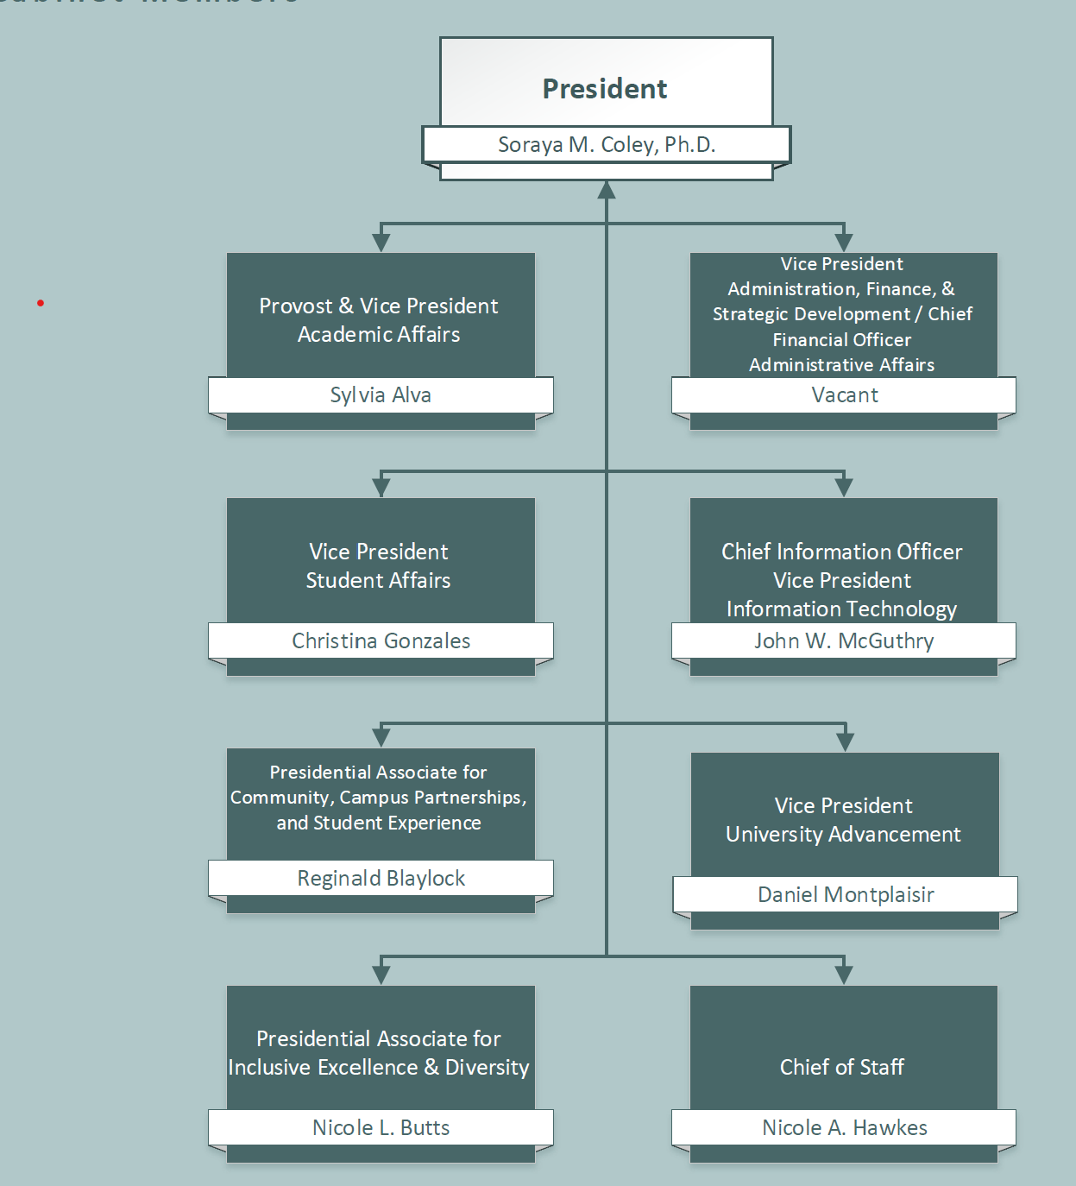
How the Alumni Association Fits in to the Campus
University Advancement
Is One of 5 Divisions at
Cal Poly Pomona
University Advancement
5 Departments
2 Boards
Philanthropic Foundation
Alumni Association

Slide 14
Dan Montplaisir
Vice President University Advancement
Doug Nelson
Associate VP of Development
Philanthropic Foundation
Melissa Watkins
Executive Director of Major Gifts
Gina Johnson
Executive Director Central Development
Natalie Graff
Executive Director Advancement Services
Melissa Riordan
Executive Director
Alumni & Ext. Relations
Alumni Association

Slide 15
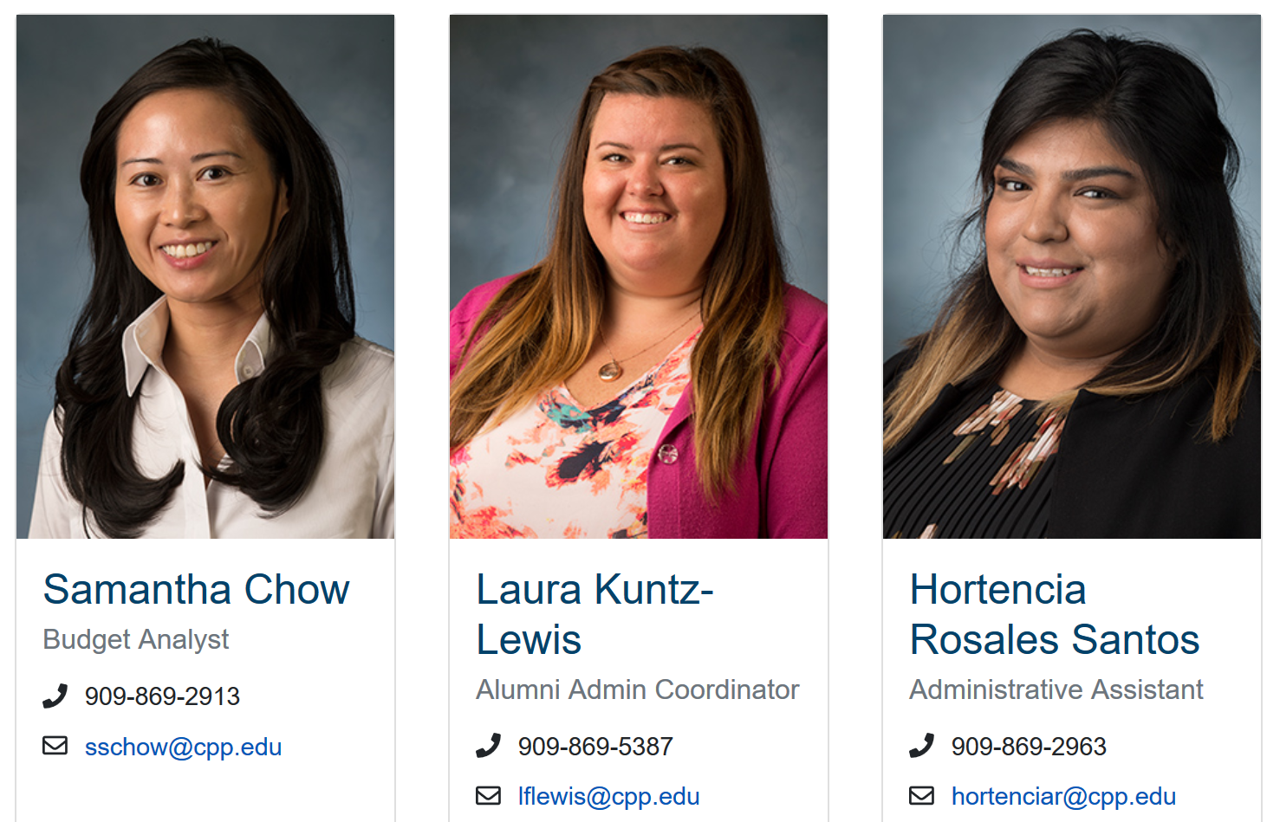
Meet the Alumni and External Relations Team

Slide 16
Alumni Association’s Vision Statement
Cultivating, building, and fostering a culture of partnership and investment

Slide 17
Cal Poly Pomona Office of Alumni & External Relations Vision Statement
Implementing programs, events and opportunities that connect current and future alumni to Cal Poly Pomona through engagement, involvement and philanthropy.

Slide 18
Conclusion… Outreach and Engagement
The Office of Alumni & External Relations and The Cal Poly Pomona Alumni Association (CPPAA) are committed to providing engagement opportunities to the campus community. There are five areas of focus and most events and programs fall under the purview of at least one of these areas.
Student Outreach
Student/Alumni Connections
Alumni Networking Opportunities
Alumni & Faculty Recognition
Electronic Communication and Social Media

