Slide 1
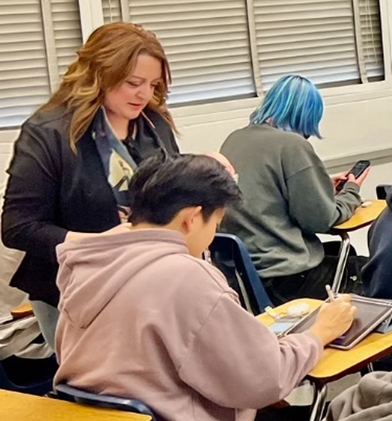
Supporting All STEM Students Via Faculty Professional Development Focused on Student Motivation
Paul Beardsley, Cal Poly Pomona
Sanaa Saykali, Cal Poly Pomona
Laurie Starkey, Cal Poly Pomona
Dustin Thoman, San Diego State University
Allison Vaughn, San Diego State University
Teresa Hulleman, Motivate Lab
Zach Himmelberger, Motivate Lab
Chris Hulleman, Motivate Lab

Slide 2
Partnerships and Resources are KEY
CSU CREATE (Creating Responsive, Equitable, Active Teaching and Engagement) Awards Program (Dr. Thoman, SDSU PI)
CPP Special Projects for Improving the Classroom Experience
Polytechnic for All: STEM Success via an Inclusive institutiON; NSF HSI Grant
#1832405
Notes:
a team of educators and researchers dedicated to translating the science of motivation into educational practices that support equitable system change.

Slide 3
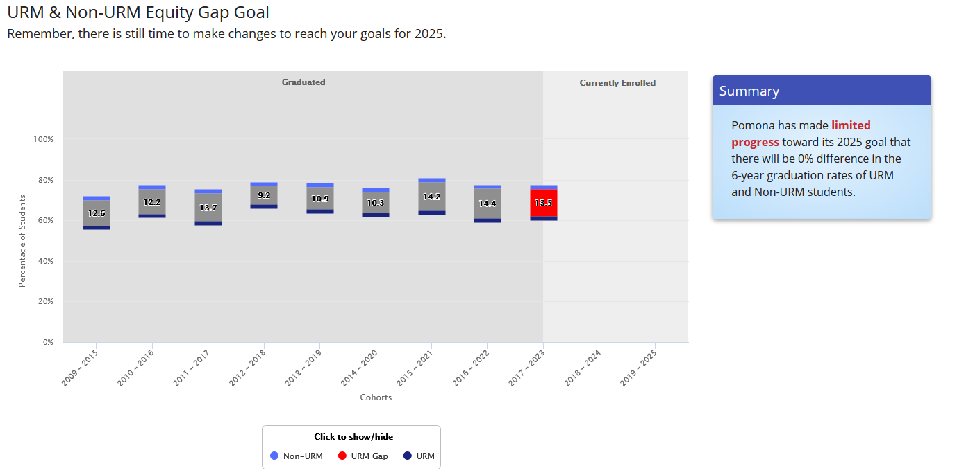
CPP still has important gaps in graduation rates
13.5%
Notes:
12:08

Slide 4
Attending to students’ motivation may help us make progress…
Faculty actions within the classroom have a large effect on student success
Undergraduate students’ motivation plays an important role in their STEM success
Motivation research experts at the Motivate lab from psychology and education, along with a curriculum designer, created the Motivating Learning Course (MLC).
Hypothesis: The students of faculty who learn to implement motivation-informed strategies will experience improved learning outcomes

Slide 5
Motivating Learners Course
An online & asynchronous learning experience
This course equips faculty with motivationally-supportive tools and language to create a classroom environment that supports students to develop adaptive beliefs about learning and school.

Slide 6
The Motivation Revolution at CPP is well underway!
At the end of this semester over 130 STEM instructors will have completed the course!

Slide 7
Course Outcomes
Learn 3 key learning mindsets (Mindset GPS)
Identify both supportive and unsupportive learning mindset messages
Customize and implement learning mindset supportive activities and messages
Identify equity and opportunity gaps for key student groups and adopt learning mindset interventions to counteract them

Slide 8
Mindset GPS!
Growth Mindset:
Intelligence and skills can be developed
Can I do this?
Do I want to do this?
Do I belong here?
Purpose and Relevance:
Belief that schoolwork is valuable
Sense of Belonging:
Students are connected, supported and respected

Slide 9
G.P.S. via Weekly “Friday Five” Reflection
1) Describe how you spent your time working on Organic Chemistry this past week.
2) Describe your plan for working on Organic Chemistry this coming week.
3) Varies each week …promotes Growth Mindset, Purpose & Relevance, Sense of Belonging
…and it’s a wonderful way to connect!

Slide 10
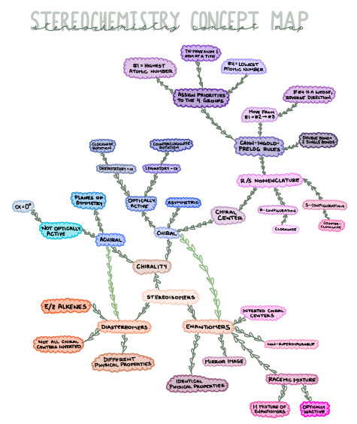
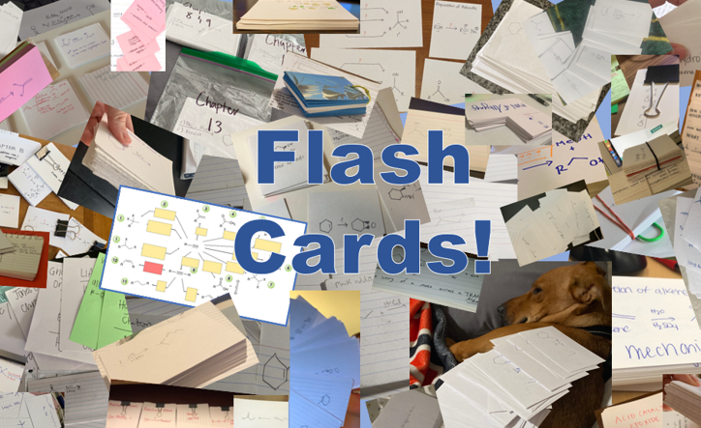
Friday5 Prompts (Gradescope)
Create a Concept Map
Research/share Nanotech topic
Start-Stop-Continue (mid-semester feedback)
Mental Health check-in
Career planning (explore REU)
Upload a picture of your flash cards
Celebrate National Chemistry Week (explore webpage)
ACS celebrates Earth Day
Favorite volunteer activities? YouTuber? Autumn activities?

Slide 11
Friday5 Responses → Class “411” Announcements
11

Slide 12
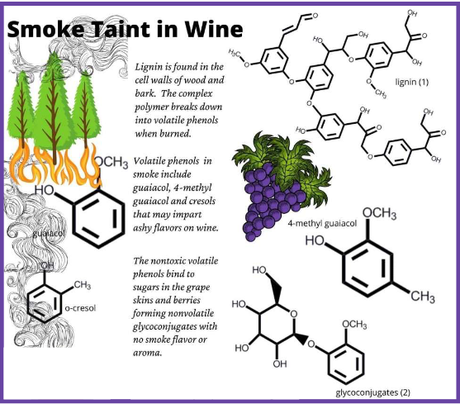
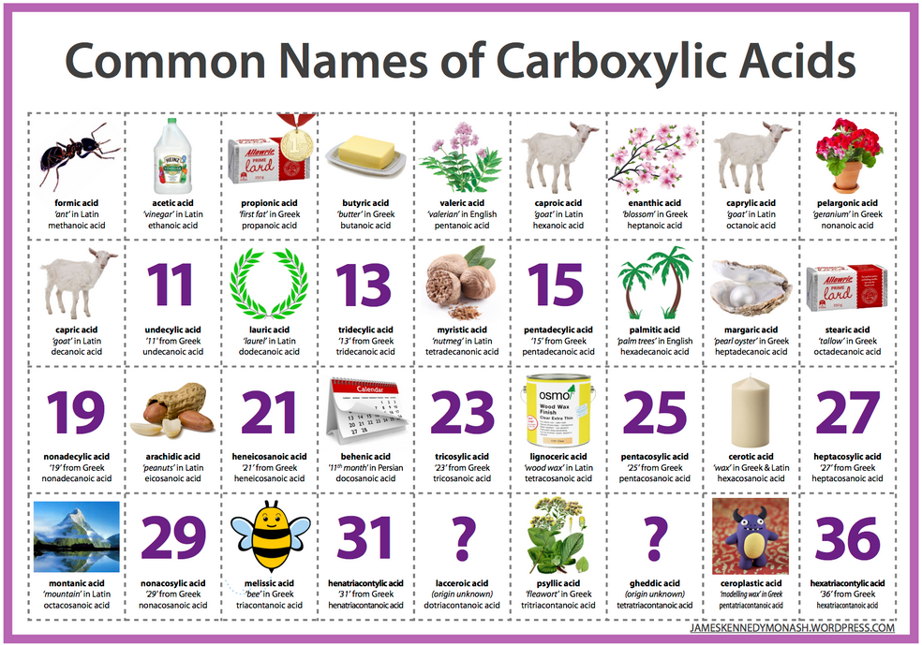
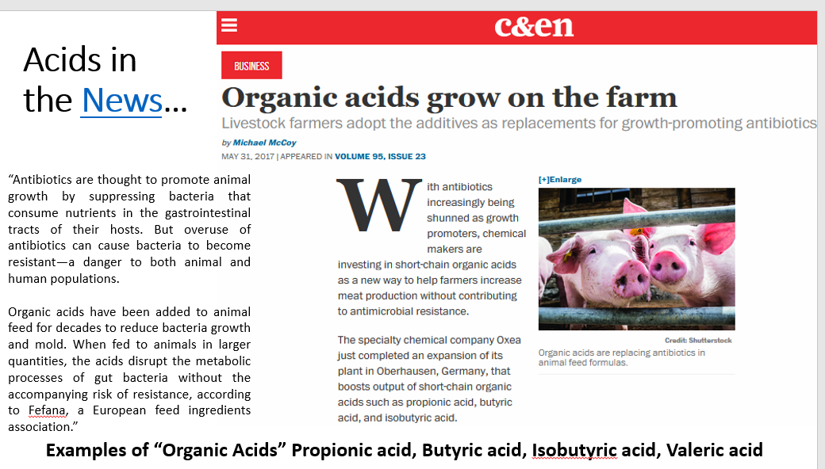
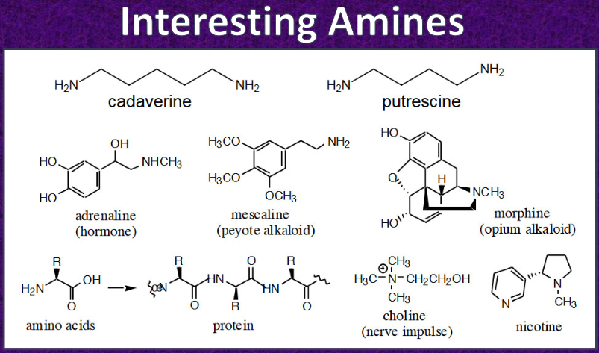
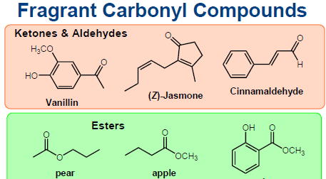
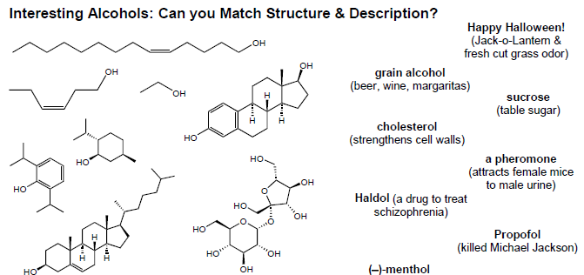
GPS: Focusing on Purpose and Relevance
Weekly reflection assignments
Find/share an interesting molecule
Tell me why this course matters to you
Share stories of former students
Provide “hooks” to grab attention

Slide 13
Support is Critical!
Course offered from the Motivate Lab, including technical support (the amazing Teresa Hulleman!)
Recruitment and context specific support offered by campus faculty fellows
Laurie Starkey, Professor, Chemistry and Biochemistry
Sanaa Saykali, Senior Lecturer faculty, Math
Arlo Caine, Professor and Assc Chair for Instruction, Math
Paul Beardsley, Professor, Director CEMaST, Biology

Slide 14
Faculty Fellows

Slide 15
Impact
Dr. Thoman at SDSU and team evaluated the effectiveness of MLC for a subset of 25 math faculty
Instructor reactions to the MLC.
“I found this course to be valuable” – 100% of responding instructors reported that they Agree or Strongly agree.

Slide 16
Impact
Evaluation of student outcomes- Grades and Passing Rates
3,118 students of 25 instructors who participated in the MLC vs. 35 control instructors teaching similar courses in the same department who did not
Overall MLC results
Students taught by MLC instructors earned significantly higher grades (M = 2.33) than those whose instructors did not (M = 2.19).
Students with MLC instructors had a higher pass rate (68.9%) than those whose instructors did not (64.9%).

Slide 17
Impact
Students from underrepresented minority (URM) backgrounds and students who are Pell grant recipients tended to benefit the most.
23% DECREASE in URM achievement gap in passing rates compared to no MLC
56% decrease in Pell recipient gap in passing rates
Notes:
12.15

Slide 18
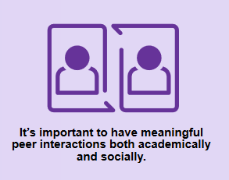
Keeping the Revolution in Motion!
Sense of Belonging:
Students are connected, supported and respected
and our community of instructors!

Slide 19
Keeping the Revolution in Motion!
Informal “share-a-thon” gatherings 3x per semester.
Hyflex format, food, “lightning” talks
Motivation-buddy program
Participants / alums paired in groups of 2-3.
Meet 5 times throughout the year (on their own, for an hour or so each time) to share ideas, try new approaches, or discuss collected data.

