Slide 1
FOSTERING STUDENT SUCCESS THROUGH STUDENT LEADERS
EOP LEARNING CENTER
Tatiana Pedroza, M.A.
Coordinator, EOP Learning Center, Educational Opportunity Program
Mayra Chacón, M.S.
EOP Specialist/Academic Advisor, Educational Opportunity Program
Alex Gonzalez
Learning Strategist, EOP Learning Center, Educational Opportunity Program
Department of Student Success and Equity Programs

Slide 2
LEARNING OUTCOMES
One of the main contributions to student success in our center is credited to our student leaders, the EOP Learning Strategists.
We will share our student leader structure including hiring, training, and overall experience which directly impacts student success in the EOP Learning Center.

Slide 3
SSEP DEPARTMENTS
& UNIT AREAS
Student Support & Equity Programs
Undocumented Students Services
Renaissance Scholars
Educational
Opportunity
Program
Supports the holistic success (academic, personal, professional) of undocumented students and students from mixed status family at CPP.
Launched in 2002, RS is a comprehensive program dedicated to supporting the success of current and former foster youth attending CPP to complete a bachelor’s degree.
Established in 1969, EOP serves
low-income and first-generation, students.
EOP currently has over 2,000 active students.
Comprehensive advising approach
EOP Peer Mentoring
Summer Bridge/Transfer Bridge
EOP Events
EOP Admission services
Outreach efforts
Tutoring with Learning Strategists
EOP Multimedia

Slide 4
WHO WE ARE
OUR MISSION
The EOP Learning Center (EOPLC) provides an inclusive learning community.
We specialize in supporting students through learning, empowerment, and belonging.
STAFF
LEARNING STRATEGISTS
MULTIMEDIA ASSISTANTS
Tatiana Pedroza
Coordinator
Mayra Chacon
EOP Specialist/
Academic Advisor
Alex
STEM
Antonio
STEM
Arely
Writing & Presentations
Brissa
Writing & Presentations
Diego
STEM
Crystal
Hector
Pamela
Evelyn
Writing & Presentations
Gladys
STEM/
Writing & Presentations
Hector
STEM
Isabella
STEM/
Writing & Presentations
Manshaa
STEM
Learning. Empowerment. Belonging.
Notes:
LS: 5 EOP
MA: 3 EOP
This year consisted of 2 weeks of training with our student staff. CRLA for LS and Multimedia Training

Slide 5
WHAT WE DO
STUDY AT THE EOPLC
DROP-IN HOURS
1-1 APPOINTMENTS
WHAT IS A LEARNING STRATEGIST?
An EOP Learning Strategist is the official name of EOP tutors.
Learning Strategists provide guidance by using metacognition, student self-efficacy, and tools for academic success.
Our focus is not just on grades but on sharing the skills and knowledge needed to learn meaningfully and independently.
Notes:
LS: 5 EOP
MA: 3 EOP
This year consisted of 2 weeks of training with our student staff. CRLA for LS and Multimedia Training

Slide 6
LEARNING STRATEGIST TRAINING
Learning Community
EOP
History
CRLA Certification Training
First-Gen Identity
Intent vs. Impact
LS vs. Tutor

Slide 7
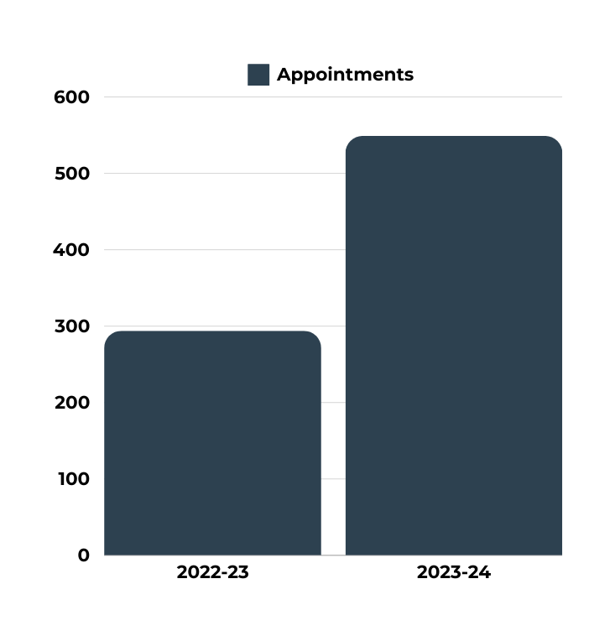
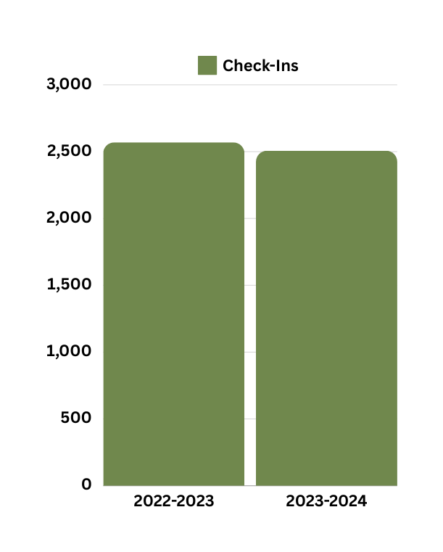
EOPLC DATA
57
294
549
2,570
2,507
294
With data up until April 2024 alone, appointments for 2023-2024 academic year have increased
by 55% from 2022-23, while check-ins and usage have been consistent for the EOP Learning Center.
12,440

Slide 8
TESTIMONIALS FROM EOP STUDENTS
FALL 2023
My overall experience was great from walking in and being greeted to leaving with what I needed whether that was with prints or tutoring.
I received some really good tips and advice from the learning strategist which was very helpful.
I feel seen and appreciated by the tight knit community at EOP.
It’s a very peaceful and welcoming learning space where help is offered even if you don’t need it, and you can just chill in there studying or hanging out a little.
I felt very welcomed and understood. The advice and help that was given to me was very useful and motivating.
They instilled me the confidence in my writing and provided helpful suggestions that improved my essay.
Learning. Empowerment. Belonging.

Slide 9
HEAR FROM AN EOP LEARNING STRATEGIST
ALEX GONZALEZ, STEM LEARNING STRATEGIST
EOP Student | B.S. Applied Mathematics/Statistics | Spring 2024
Teaching College Level Mathematics
What has been your experience as a Learning Strategist at the EOP Learning Center?
How do you think your role impacted student success?

Slide 10
QUESTIONS?
SCAN TO VIEW OUR WEBSITE
Contact Information:
Tatiana Pedroza
tapedroza@cpp.edu
Mayra Chacón, M.S.
mayrachacon@cpp.edu

