Slide 1
Lightning Talks
Group A, Auditorium
April 19, 2024

Slide 2
Fostering Inclusive Excellence and Belonging in Nurturing Educational Environments
Bharti Sharma, Ph.D, Department of Biological Sciences, Cal Poly Pomona​

Slide 3
Inclusive Excellence
What does belonging mean in educational environments, such as classrooms and campuses?
Why is fostering a sense of belonging crucial for students' academic and personal development?
How can educators and institutions cultivate a stronger sense of belonging among students?
What impact does a strong sense of belonging have on students' future success and community involvement?
Achieving “Inclusive Excellence” requires a comprehensive and intentional approach beyond superficial or surface-level diversity efforts. It involves creating a culture of belonging, valuing diverse perspectives, and actively working to dismantle systemic barriers.

Slide 4
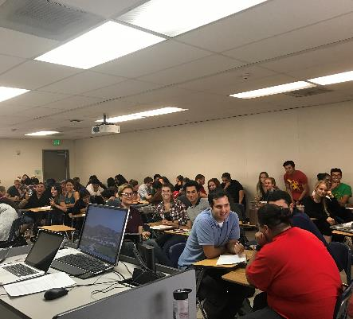
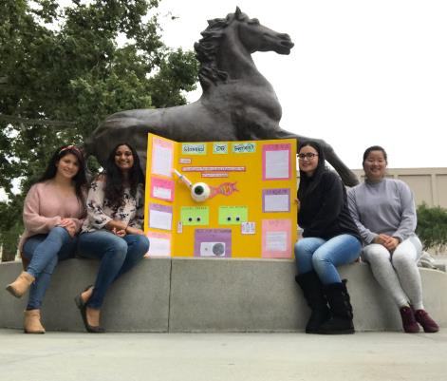
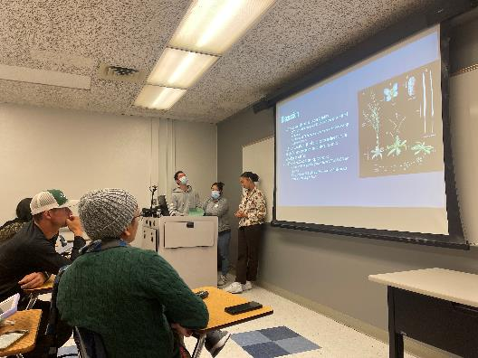
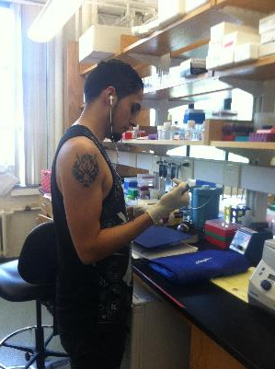
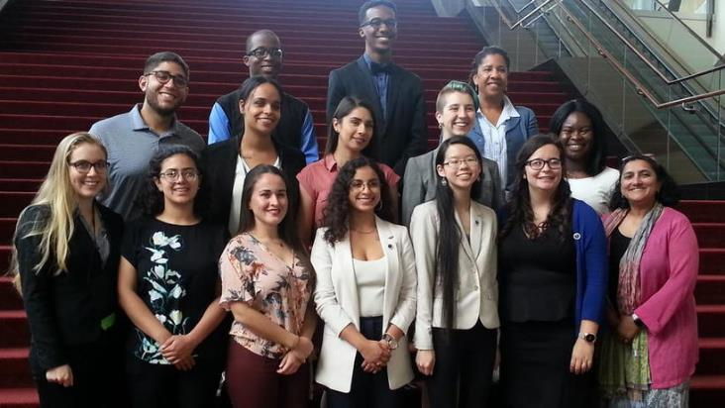
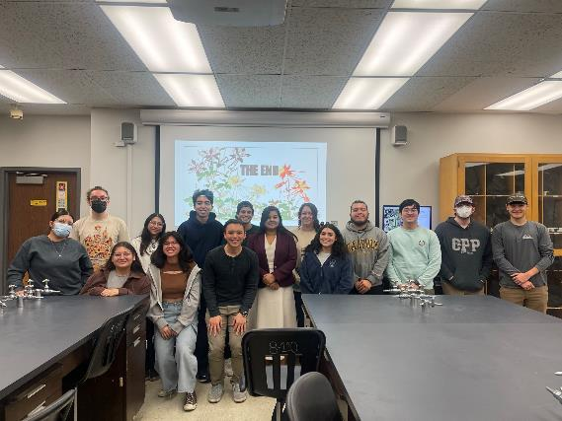
Thank you!
"Embedding a sense of belonging at the core of education isn't just effective—it's transformative, unlocking potential and driving unprecedented success."

Slide 5
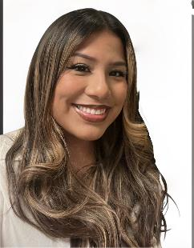
Teaching as transformative practice: A critical discussion about co-constructing knowledge in the classroom
Dr. Marisol Diaz PhD
Early Childhood Studies
CEIS
Fatima Ibanez
Student
early Childhood studies
Joselyn Renee Segundo
Student
Early Childhood Studies- Multilingual Teaching
CEIS

Slide 6
Co-construction of knowledge
Co-construction in education allows for students to work through a collaborative process of learning from one another.
Shared spaces such as inclusive and culturally rich classrooms, support students in fostering more meaningful and relevant learning opportunities.
Feeling a sense of belonging not only fundamentally supports the well-being and academic success in our students, but it also highlights a sense of respect, acceptance, and the importance they bring into our communities.
"We long to belong, and belonging and caring anchors our sense of place in the universe"
Patricia Churchland- Philosopher

Slide 7
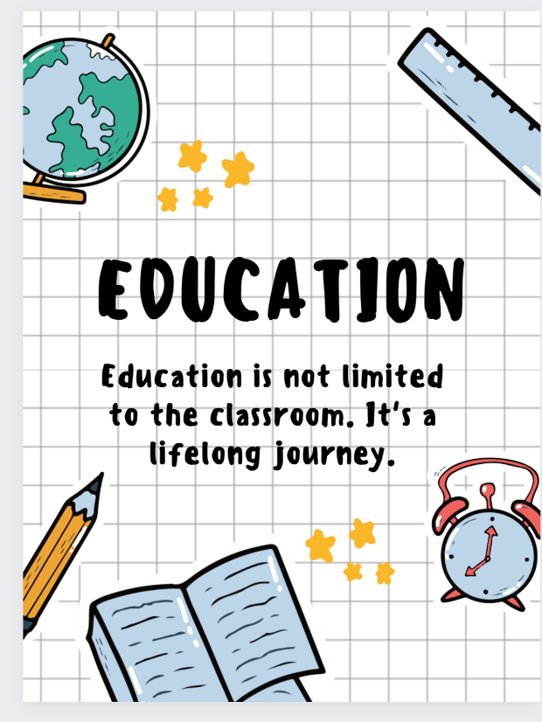
Transformative Thinking- Fatima
self reflection
The topics we did not address
reformation and moving forward

Slide 8
Communication DEPARTMENT PEER Mentoring Program Peers meNToring Peers

Slide 9
Peer Mentoring ProgRam OBJECTIVES
Improved attendance and class participation.
Improved classroom community-building skills.
Greater connection to CPP.
Enhanced academic performance.
Lower rate of DFWs.

Slide 10
CLOSING THE GAPS
Students have access to a diverse group of mentors with whom they can relate.
Mentors have successfully completed the course for which they are now providing mentoring. Mentors thus serve as role models for how to perform well in the course.
Mentors have flexible hours to accommodate student needs.
Mentors offer the sort of insight often afforded by friends and peers when you are a typical entry-level student.

Slide 11
Fostering Equity in Education Through Collaborative Learning: The Symphony of Teamwork
Christine Lee-Song, D.M.A, Department of Music, Cal Poly Pomona​

Slide 12
Small group vs Large group

Slide 13
Classroom setting
*Facilitator
*Resource Monitor
*Equity monitor
*Product monitor

Slide 14
Equitable Approaches to Homework Assignments
Pezhman Hassanpour, Ph.D., P.E., Department of Mechanical Engineering, Cal Poly Pomona​​

Slide 15
What is the best practice for setting an assignment submission policy?
Image generated with AI on April 15, 2024, using Copilot Designer.

Slide 16
Options Assessed
No late submission.
Due one week from the posting
No late submission is accepted.
Submit whenever you can.
Due one week from the posting
Late submissions were accepted up until the last day of classes with no penalty.
You can submit late.
Due one week from the posting
Late submissions are accepted up until one week from the due date with no penalty.

Slide 17
Outcome
 | No late | Until end of semester | A week from due date
On-time submission | 93.7% | 45.5 % | 56.2%
Late submission | N/A | 37.6 % | 35.7%
No submission | 6.3% | 16.9 % | 8.1%
Class Average Score | 58.5% | 76.9% | 81.5%

Slide 18
Thank you!
Image generated with AI on April 15, 2024, using Copilot Designer.

