Slide 1
Lightning Talks
Group B, Mountain Vista
April 19, 2024

Slide 2
Nurturing a Classroom Ecology to Improve Engagement, Support, and Success in Your Classroom
Eliud (Eddie) Partida, Ph.D, Department of Education, Cal Poly Pomona

Slide 3
Richard Powers Poem
There are no individuals in a forest, no separable events.
The bird and the branch it sits on are a joint thing. A third or more of the food a big tree makes may go to feed other organisms.
Even different kinds of trees form partnerships. Cut down a birch, and a nearby Douglas-fir may suffer…
Richard Powers, 2018
The Overstory

Slide 4
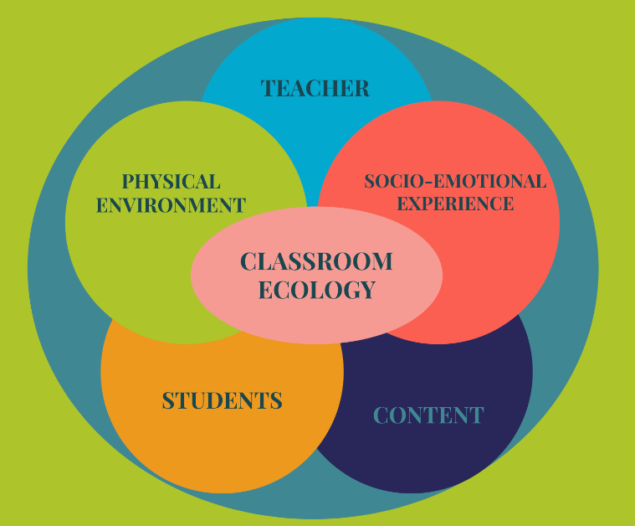
Classroom Ecology
All interactions and relationships between teachers, students, curriculum, and the classroom environment, which contribute to students’ learning experiences. (Hatkoff & Bermúdez, 2019).

Slide 5
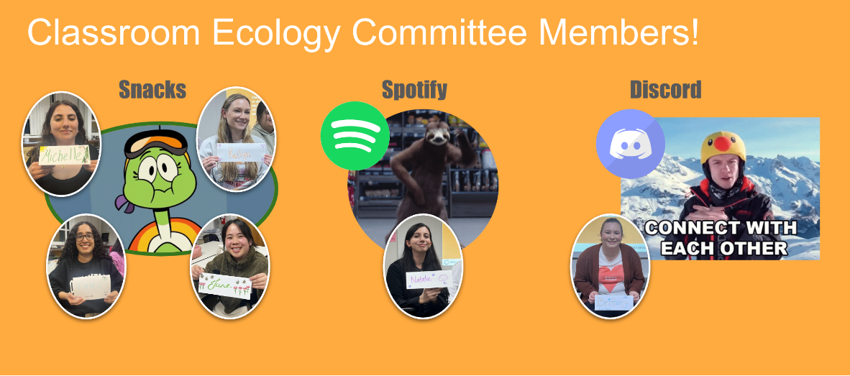
Classroom Ecology Committees
1

Slide 6
Circle
2

Slide 7
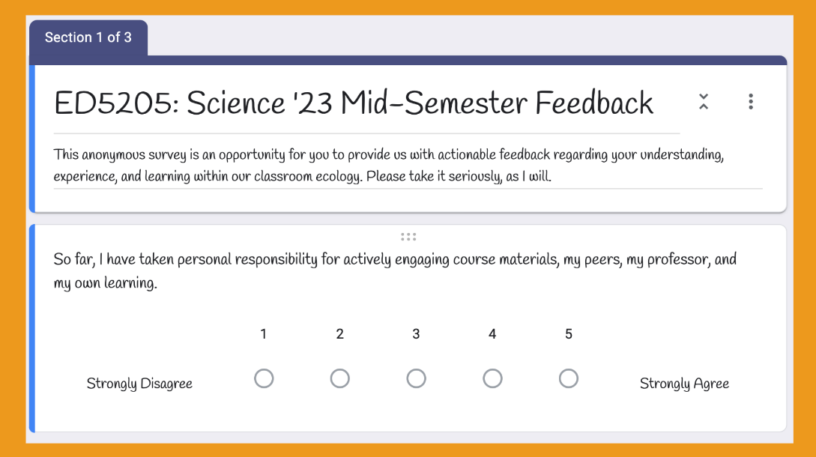
Mid-semester Feedback
3

Slide 8
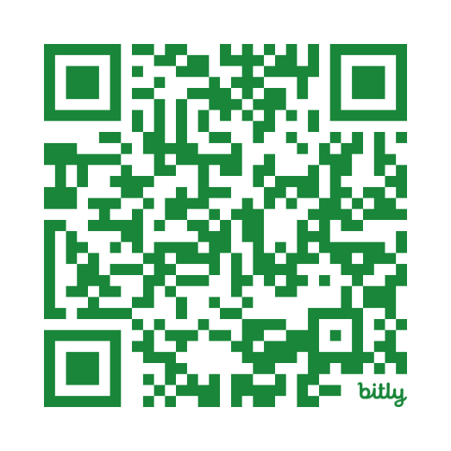
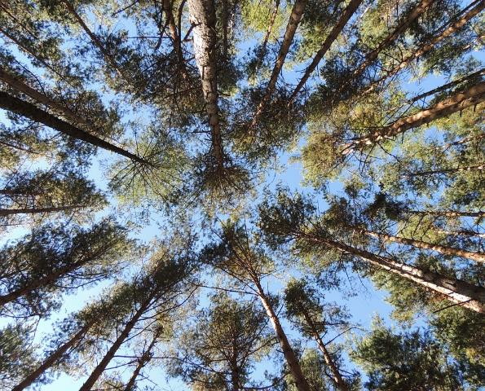
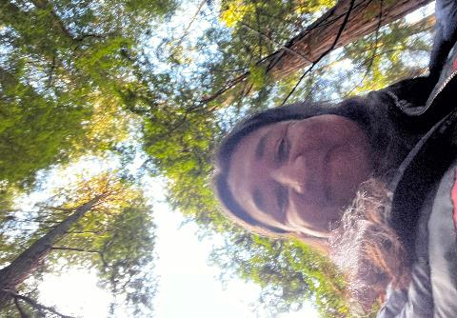
Thank you!
ADDITIONAL RESOURCES
https://bit.ly/EIP24-Partida

Slide 9
NSF HSI Implementation and Evaluation Project (IEP): Closing Under-Represented Minority Achievement Gaps in the Gatekeeper Courses of the Civil Engineering Program (CURE, Award #2318158)
Strategic Partnership between:
CPP: (PI) Sunai Kim, (co-PI) Giuseppe Lomiento, Felipe Perez, Yasser Salem, Jeyoung Woo
Mt. SAC: Eugene Mahmoud, Brandon Saller, Chrystin Green
2024-2028 (4-year Project), $1M Budget
Issues with Gatekeeper Courses
1. Gatekeeper Courses & Equity Gaps
High DFW Rates (passing grade is C-)
(2021-2022) Category |  | CE2041, Engineering Statics |  |  | CE2051, Mechanics of Materials
 |  | No. Students | Pass | Fail (DFW) | No. Students | Pass | Fail (DFW)
CPP | URM | 82 | 46 (56.1%) | 36 (43.9%) | 84 | 62 (73.8%) | 22 (26.2%)
 | Non-URM | 89 | 59 (66.3%) | 30 (33.7%) | 108 | 89 (82.4%) | 19 (17.6%)
 | Total | 171 | 105 (61.4%) | 66 (38.6%) | 192 | 151 (78.6%) | 41 (21.4%)
 | Equity Gap = 10.2% |  |  |  | Equity Gap = 8.6%
Mt. SAC | URM | 44 | 23 (52.3%) | 21 (47.7%) | 17 | 15 (88.2%) | 2 (11.8%)
 | Non-URM | 30 | 19 (63.3%) | 11 (36.7%) | 16 | 16 (100%) | 0 (0.0%)
 | Total | 74 | 42 (56.8%) | 32 (43.2%) | 33 | 31 (93.9%) | 2 (6.1%)
 | Equity Gap = 11.0% |  |  |  | Equity Gap = 11.8%
Disclaimer: Opinions or points of view expressed in this presentation represent the view of the presenter, and does not necessarily represent the official position or policies of NSF.

Slide 10
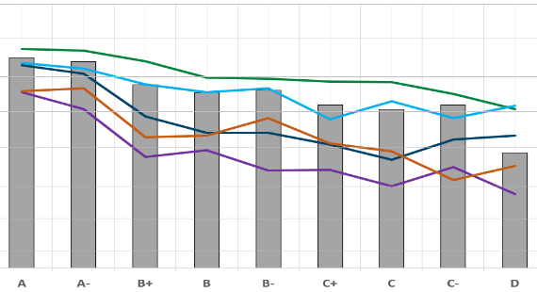
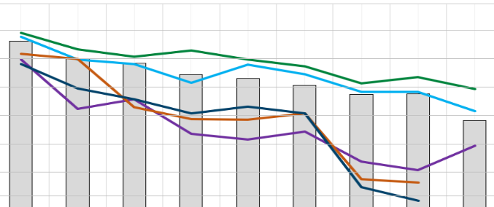
Cure Award cont'd
2. Low Performance in CE2041/2051 and Subsequent Courses
3. Variability in Teaching Practices
Between Institutions & Full-Time/Part-Time Faculty
Gatekeeper Courses: 33% taught by FT, 67% taught by PT Faculty
4.00 (A)
3.70 (A-)
3.40 (B+)
3.00 (B)
2.70 (B-)
2.30 (C+)
2.00 (C)
1.70 (C-)
4.00 (A)
3.70 (A-)
3.40 (B+)
3.00 (B)
2.70 (B-)
2.30 (C+)
2.00 (C)
1.70 (C-)
CE 2030: Civil Engineering Materials (2 units) CE2041: Engineering Statics (3 units) CE2051: Mechanics of Materials (3 units) CE2061: Fluid Mechanics (3 units) CE3501: Structural Analysis I (3 units) CE4510: Structural Design – Reinf. Concrete (3 units)
CE2041 Grade (‘18-’22)
CE2051 Grade (‘18-’22)
(Spring, 2023) Faculty Status | CE2041 No. Sections | CE2051 No. Sections | Total Sections
Full-Time | 3 (60%) | 1 (14.3%) | 4 (33.3%)
Part-Time | 2 (40%) | 6 (85.7%) | 8 (66.7%)
Total | 5 | 7 | 12
Disclaimer: Opinions or points of view expressed in this presentation represent the view of the presenter, and does not necessarily represent the official position or policies of NSF.

Slide 11
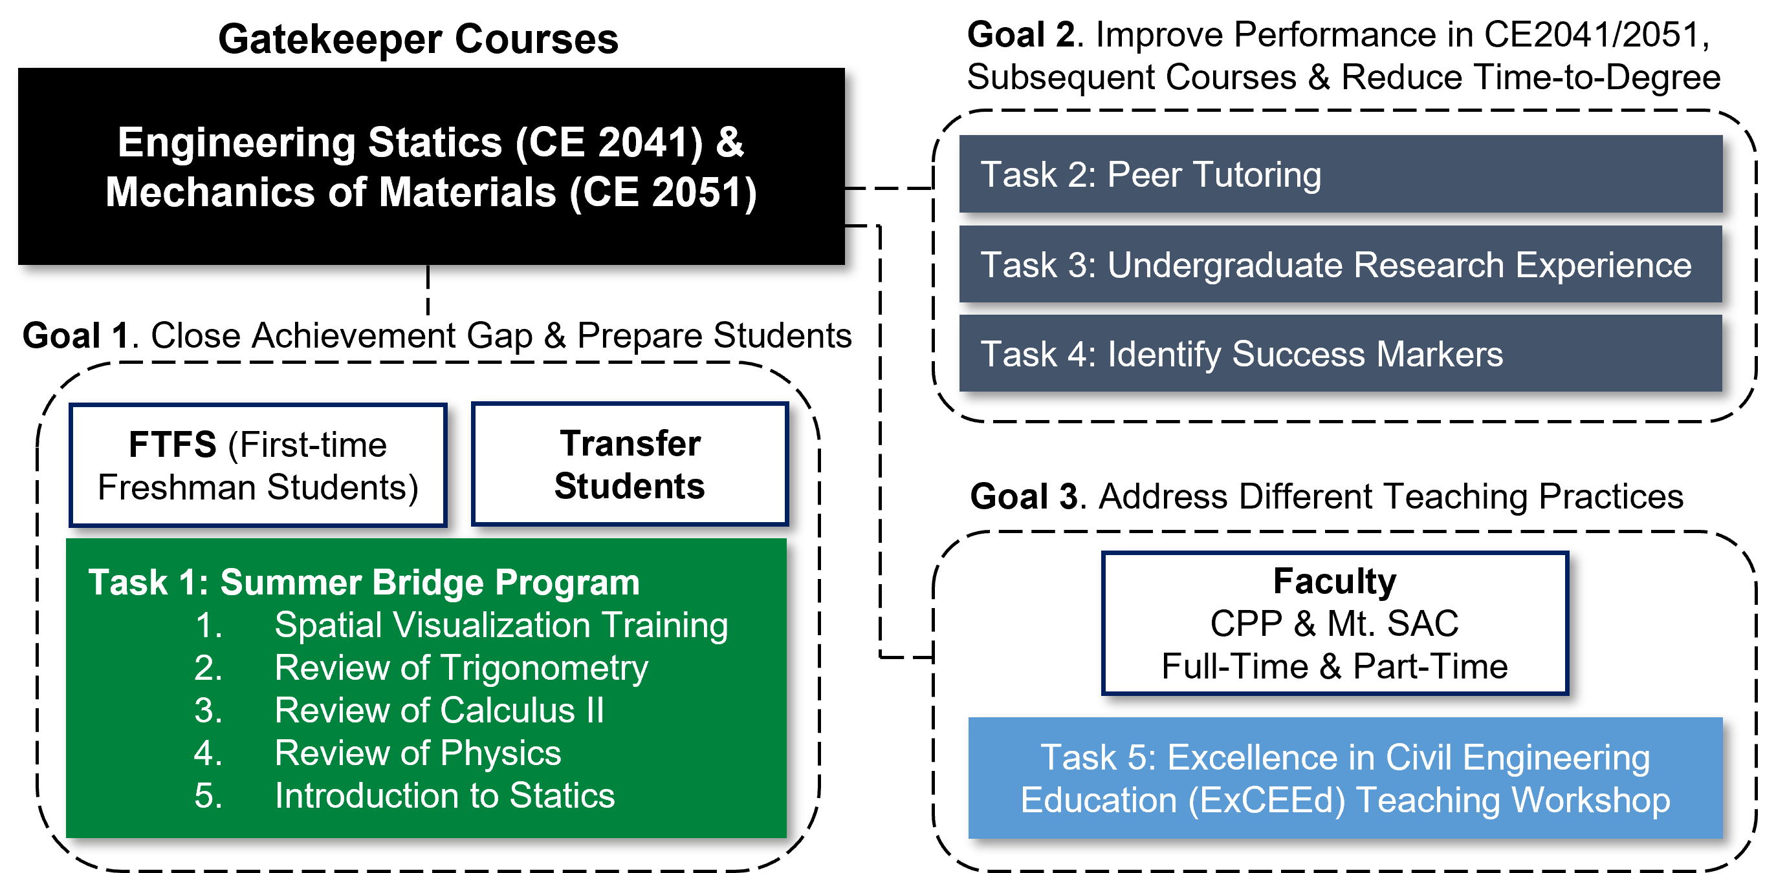
NSF CURE Project
Four-year project (Summer 2024 – Spring, 2028)
Disclaimer: Opinions or points of view expressed in this presentation represent the view of the presenter, and does not necessarily represent the official position or policies of NSF.
Notes:
Mixed Methods Rearch

Slide 12
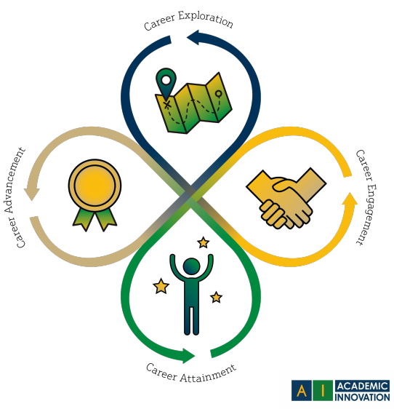
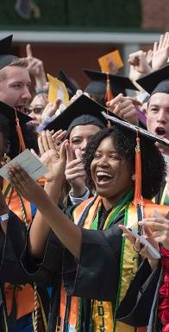
Critical Career Readiness
Preparing Students to Enter and Transform the Professional World through a Flipped Classroom
Dr. Dana Marshall, PhD.
Department of Communication

Slide 13
One Path Forward…
Choose Your Own Adventure
Practical Skills & The Hidden Curriculum
Bringing Change
First Generation
55%
Ethnic Minority
56%

Slide 14
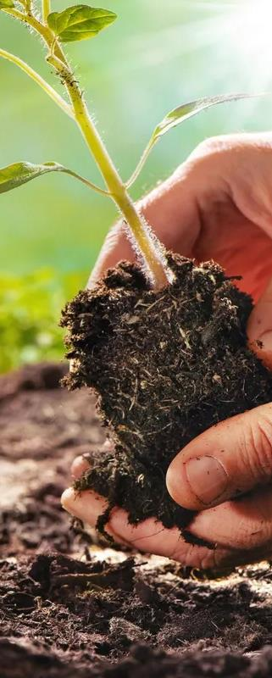
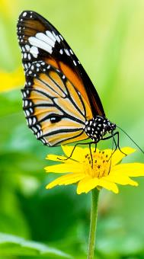
…one path forward
Bringing Change
Choose Your Own Adventure
Practical Skills & The Hidden Curriculum

Slide 15
Artificial Intelligence ACROSS CONTEXTS EXPANDING HOW WE THINK ABOUT AI IN THE CLASSROOM
Dr. Dana Marshall, PhD. | Department of Communication

Slide 16
Applied ai project
Task/Prompt
Purpose
Outcome/Assessment
Task/Prompt
Task/Prompt
Personal
Professional
Social
Purpose
Outcome/Assessment
Purpose
Outcome/Assessment

Slide 17
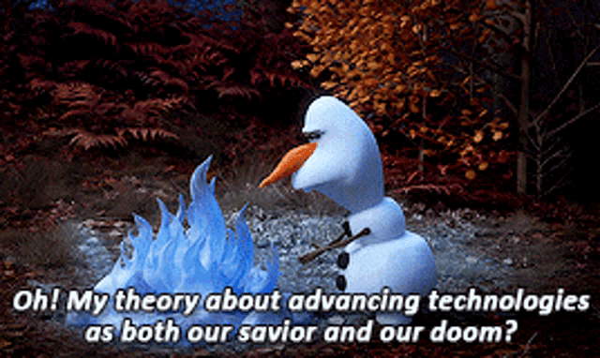
Transformative technology

Slide 18
Using Multi-Media Learning Objects for Learning Content
Jodye Selco, Ph.D, CEMaST and Chemistry, Cal Poly Pomona​ jiselco@cpp.edu

Slide 19
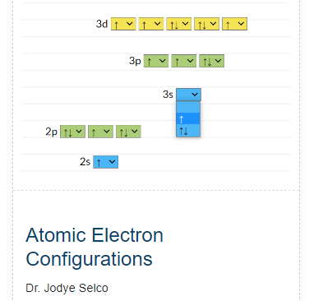
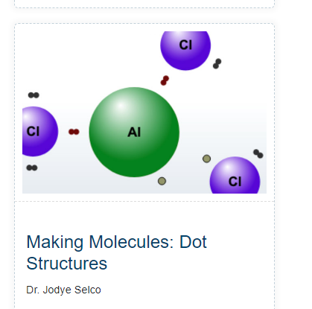
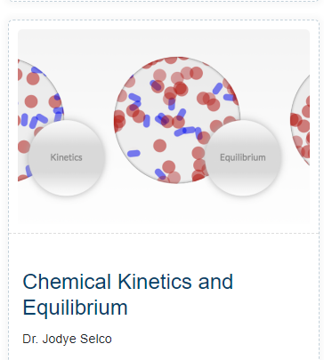
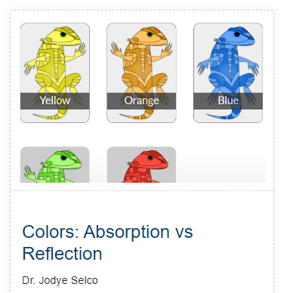
Multi-Media Learning Objects at CAFE
All Available at CAFÉ – Teaching and Learning – Multimedia Learning Objects
Developed in Collaboration with CAFÉ
Interactive – Built for Discovery Learning
Each used by students
Student learning has increased
Makes invisible chemical information visible
Each MMLO focuses on difficult topics to learn in beginning chemistry
After using the MMLO student grasp of “big picture” as well as details is enhanced
Focus on student responses to Atomic Electron Configuration today

Slide 20
Using the MMLO
Students are shown how to use the simulation
You add up to 2 electrons per orbital from lowest energy to highest energy until you run out of electrons
The “order” of orbital energies looks “crazy” until you see the patterns of the energy levels with this MMLO.

Slide 21
Student Responses-Spring 2024
“I haven’t seen this before but after using the simulation it makes sense. I am very confident that I can produce the linear electronic configuration by looking at a periodic table”
“After completing the assignment, I understand the filling order of electrons in orbitals…the visual aide…helps it make more sense since I can physically see the order”
“helped to strongly visualize how the (periodic table) separates the orbitals…to create the configuration.”
“Now it makes sense to me. The Periodic Table showing the numbering was helpful.”
“I am more confident than before. If I have the periodic table with me, I think I can do it.”

Slide 22
Similar results with each MMLO
Historically students have had difficulties with each of the topics
Students now have a better understanding of the topic
Some semesters there has been no difference in student performance (cumulative grades) regardless of subgroup (male, female, URM, SES…)
THANK YOU!!!!

