Slide 1
Course Structure For Equity: Your course may be biased against some groups
David J. Webb, Department of Physics and Astronomy, University of California - Davis​ Cassandra A. Paul, Department of Physics and Astronomy and Science Education Program, San Jose State University​

Slide 2
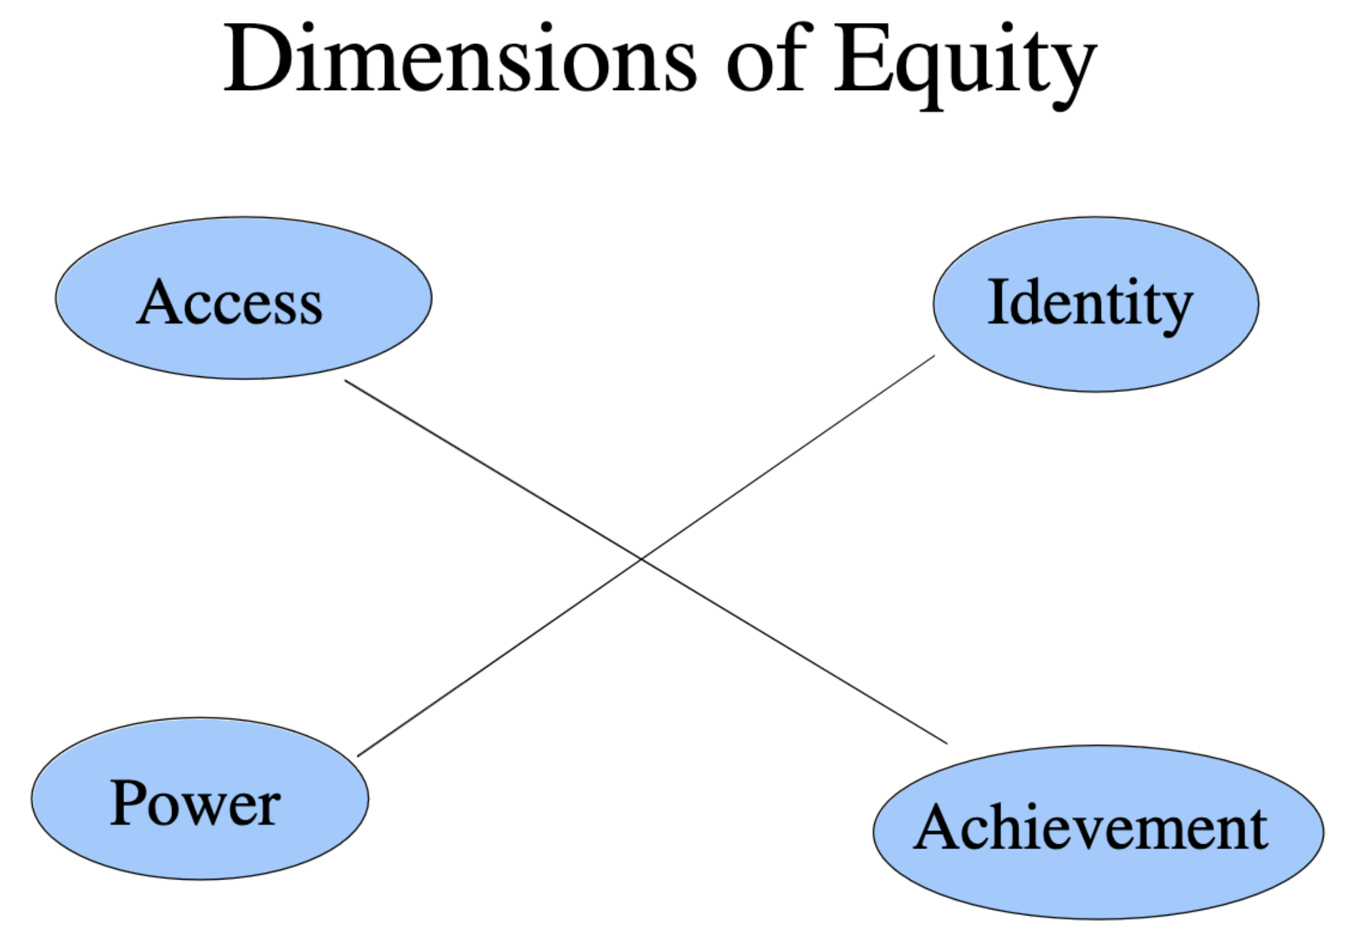
We’ll use the Achievement dimension of Equity
Measures of achievement (physics)
Grade on Final Exam
Course Grade
Graduation in STEM major
Examine the difference between:
Students from underrepresented minority (URM) groups (those with Hispanic, African, Indigenous, or Pacific Islander heritage)
Female students
and their peers.
Negative values will mean lower average measured achievement by URM or Female students
2
Gutiérrez, R. (2012). “Context matters: how should we conceptualize equity in mathematics education?” in Equity in Discourse For Mathematics Education (Dordrecht: Springer), 17–33.

Slide 3
Examine four ways to change the structure of a physics course (and uncover hidden biases)
Don’t use percent-scale grading
Offer retake exams
Teach concepts first (then practice calculations)
Use undergraduate Learning Assistants (LAs) in your course
All of these modified classes will also be active-learning classes
3

Slide 4
Using a 4-point-like grade scale lessens the effect of the most subjective grades and gives students a chance to recover from a bad exam
4-point Scale – At UCDavis each exam answer is given a grade between 0 and 4
Percent Scale – At UCDavis each exam answer is given a grade between 0 and 10
Paul, C. A., & Webb, D. J. (2022). Percent Grade Scale Amplifies Racial or Ethnic Inequities in Introductory Physics. Physical Review Physics Education Research, 18(2), 20103. https://doi.org/10.1103/PhysRevPhysEducRes.18.020103
Webb, D. J., Paul, C. A., & Chessey, M. K. (2020). Relative impacts of different grade-scales on student success in introductory physics. Physical Review Physics Education Research, 16(2), 20114. https://doi.org/10.1103/PhysRevPhysEducRes.16.020114
Percent-scale zeros and low F’s have no comparable grades under 4-point grading and so skew grades downward
4

Slide 5
Examine course gradebooks from 72 classes of UCDavis intro-physics for bioscience students (5131 percent-scale students and 8927 4-point scale students so 541,392 individual problem scores)
Roughly same number of A’s and B’s given under percent-scale grading but many more F’s
5

Slide 6
We used each student’s fraction of A-grades as a measure of their understanding of the material (their physics knowledge).
Percent-scale grading had large bias against URM students after controlling for physics knowledge

Slide 7
Percent-scale grading had large bias against URM students after controlling for physics knowledge
4-point scale grading had smaller grade bias
The percent scale amplifies grading biases

Slide 8
Allowing retake exams removed our course’s gender gap (focuses students on using exam to improve)
UCDavis intro-physics for biosci
Students take an exam every two weeks and get their grade within 5 days
The week after each exam they can take a different exam (a retake) that covers the same material
Webb, D. J., & Paul, C. A. (2023). Attributing equity gaps to course structure in introductory physics. Physical Review Physics Education Research, 19(2), 020126. https://doi.org/10.1103/PhysRevPhysEducRes.19.020126
8

Slide 9
NonRetake classes had large bias against Female students
(N = 12,884)
Retake classes had essentially no grade bias (N = 610)

Slide 10
NonRetake classes had large bias against Female students
(N = 12,884)
Retake classes had essentially no grade bias (N = 610)
Allowing retakes removed bias from the course

Slide 11
Teach Concepts First (build students’ understanding of ideas before they use them in complicated situations)
UCDavis intro-physics for engineers
60% of the term is spent on applying ideas, pictures, graphs, and single-step math to all of the course material
40% of the term is spent on more complicated (often multistep) calculations
4 introductory sections of Newtonian Mechanics take the same final exam at the same time and graded by the same graders
Webb, D. J., & Paul, C. A. (2023). Attributing equity gaps to course structure in introductory physics. Physical Review Physics Education Research, 19(2), 020126. https://doi.org/10.1103/PhysRevPhysEducRes.19.020126
Webb, D. J. (2017) Concepts first: A course with improved educational outcomes and parity for underrepresented minority groups. American Journal of Physics, 85(8), 628–632. https://doi.org/10.1119/1.4991371
11

Slide 12
Chap-by-Chap classes have large grade bias against URM students
(N = 481)

Slide 13
Chap-by-Chap classes have large grade bias against URM students
(N = 481)
Concepts First class does not (N = 152)
Changing the order of the material removed bias

Slide 14
81% of NonURM from ConceptsFirst classes graduated in STEM vs 69% of URM students
N = 334
71% of NonURM from Chap-by-Chap classes graduated in STEM vs 41% of URM students
N = 322

Slide 15
81% of NonURM from ConceptsFirst classes graduated in STEM vs 69% of URM students
N = 334
81% of NonURM from Concepts First classes graduated in STEM vs 69% of URM students
N = 334
71% of NonURM from Chap-by-Chap classes graduated in STEM vs 41% of URM students
N = 322

Slide 16
Undergraduate Learning Assistants in your active-learning course
LAs are undergraduates who have taken the course recently
LAs monitor and help out with the small-group work of your students either during ”lecture” or during ”discussion”
The first semester of intro-physics for bioscience majors at SJSU was changed from mostly lecture to active-learning and then LAs were added.
Compare grade equity in these three versions.
Paul, C. A., & Webb, D. J., (in preparation)
16

Slide 17
Non-ActiveLearning classes had large bias against URM students
(N = 1746)
Active Learning class with LAs has smaller grade bias (N = 846)

Slide 18
LAs can help remove bias from the course
Non-ActiveLearning classes had large bias against URM students
(N = 1746)
Active Learning class with LAs has smaller grade bias (N = 846)

Slide 19
81% of NonURM from ActiveLearning classes with LAs graduated in STEM vs 82% of URM students
N = 334
80% of NonURM from NonActiveLearning classes graduated in STEM vs 68% of URM students
N = 1746

Slide 20
81% of NonURM from ActiveLearning classes with LAs graduated in STEM vs 82% of URM students
N = 334
81% of NonURM from ActiveLearning classes with LAs graduated in STEM vs 82% of URM students
N = 334
80% of NonURM from NonActiveLearning classes graduated in STEM vs 68% of URM students
N = 1746

Slide 21
Models we could use to explain mismatch between course and student 1) Student-deficit Model 2) Course-deficit Model (really, Course Empowerment Model! )
The Student-Deficit Model is most commonly used but, as we show in our paper, does not explain our data.
The Course Empowerment Model does explain our data.
Each of the modifications discussed today produced equal or higher achievement for all demographics groups we could identify.
21
Cotner, S., & Ballen, C. J. (2017). Can mixed assessment methods make biology classes more equitable? PLoS ONE, 12(12), 1–11. https://doi.org/10.1371/journal.pone.0189610

Slide 22
Thank you!
Collaborator on all this:
Prof. Cassandra A. Paul
Physics and Astronomy, Science Education Program
San Jose State University
Work at SJSU partially supported by:
NSF #2234071: "Agents of Change: Investigating How Partnerships between Faculty and Learning Assistants Enable Pathways for Sustainable Institutional and Classroom Transformation"
NSF #1953760: "Transforming Undergraduate Teaching and Learning Through Culturally Sustaining, Active, and Asset-Based Approaches to Introductory Science Courses"

Slide 23
Minimum Grading produces a “4-point-like” grade scale
Percent Scale | Letter Grades | Minimum grading | GPA scale/ 4.0 scale
90-100 | A | 90-100 | 4.0
80-89 | B | 80-89 | 3.0
70-79 | C | 70-79 | 2.0
60-69 | D/F | 60-69 | 1.0
50-59 | F | 50-59 | 0
40-49 | F
30-39 | F
20-29 | F
10-19 | F
0-9 | F
81% of NonURM from ActiveLearning classes with LAs graduated in STEM vs 82% of URM students
N = 334

Slide 24
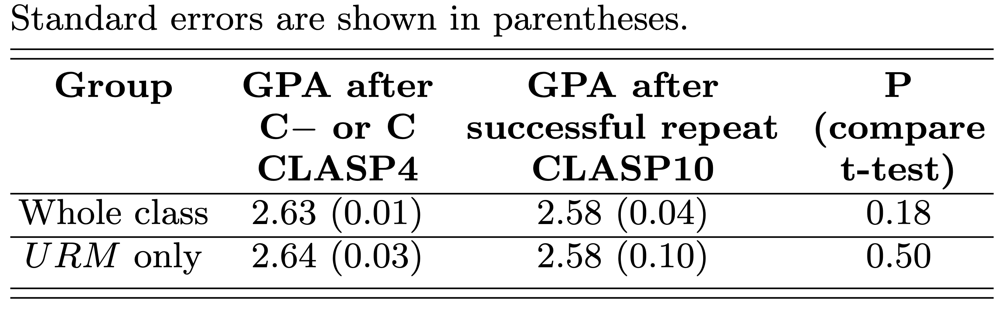
GPAs of Student Work After Completing Physics Series
4-Point Scale
Percent Scale
Statistically insignificant differences

Slide 25
81% of NonURM from ActiveLearning classes with LAs graduated in STEM vs 82% of URM students
N = 334
The actual grade distributions
Changing from percent grading to 4-point grading need not produce grade inflation.

Slide 26
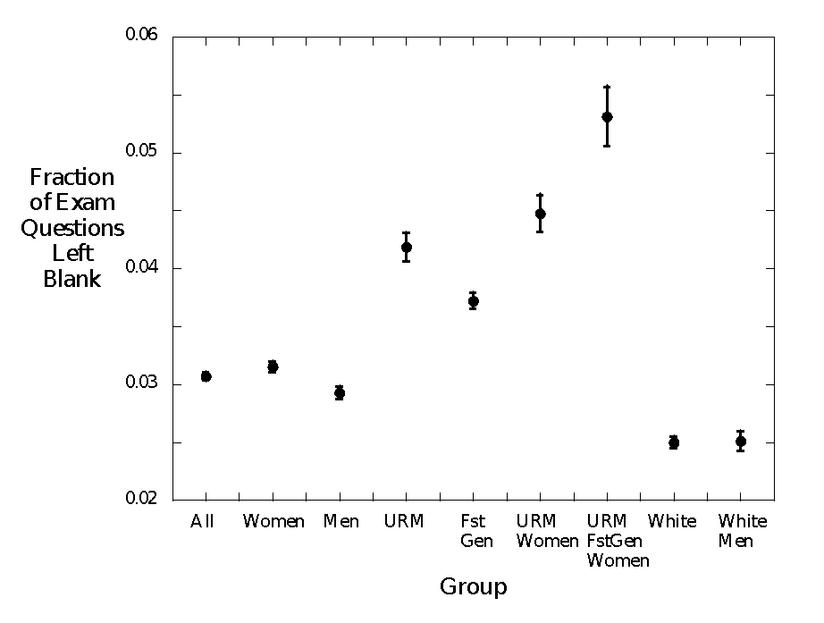
81% of NonURM from ActiveLearning classes with LAs graduated in STEM vs 82% of URM students
N = 334
Answer left blank is missing data
Leaving answers blank has a demographic-dependent probability the produces inequity under harshest grading.
Paul, C., Webb, D. J., Chessey, M. K., & Lucas, J. (2018). Pondering zeros: Uncovering hidden inequities within a decade of grades. In A. Traxler, Y. Cao, & S. Wolf (Eds.), 2018 PERC Proceedings. https://doi.org/10.1119/perc.2018.pr.Paul

Slide 27
81% of NonURM from ActiveLearning classes with LAs graduated in STEM vs 82% of URM students
N = 334
Controlling for GPA doesn’t affect our conclusion that the non-retake courses contain a hidden bias.

Slide 28
Some ways to think about “Concepts First” course
Students should learn to think with ideas, pictures, graphs, and equations so that they can do this thinking before doing calculations.
Students should be exposed to all of the ideas applied in different ways before they use combinations of those ideas in very complicated situations
Students will do better on exams if they have a chance to learn all of the material in the first part of the term and then get more chances to learn those ideas (deepen their understanding) later in the term
81% of NonURM from ActiveLearning classes with LAs graduated in STEM vs 82% of URM students
N = 334

Slide 29
81% of NonURM from ActiveLearning classes with LAs graduated in STEM vs 82% of URM students
N = 334
All three chap-by-chap sections had a hidden bias against URM students (same instructor taught I and II)

Slide 30
81% of NonURM from ActiveLearning classes with LAs graduated in STEM vs 82% of URM students
N = 334
Controlling for math and physics preparation doesn’t affect our conclusion that the chap-by-chap courses contain a hidden bias.

Slide 31
81% of NonURM from ActiveLearning classes with LAs graduated in STEM vs 82% of URM students
N = 334
Half the final exam had problems that some students had seen previously.
The Concepts-First class had higher average score on the problems that were new to all students

Slide 32
81% of NonURM from ActiveLearning classes with LAs graduated in STEM vs 82% of URM students
N = 334
Another look at equity
Having LAs in classes decreases everyone’s D/F probability but the change for URM students is much larger so, again, a bias is (mostly) removed

