Slide 1
Hello! We will start at 4 pm.

Slide 2
Variation of activities in remote courses
Victoria Bhavsar,
Cal Poly Pomona Faculty Center

Slide 3
Nobody “falls in wonder” through a keyboard

Slide 4
A few ideas to start
Expand your thinking about, and clarify, topic/module/lesson level learning outcomes
Brainstorm – challenge yourself to think of an unreasonable number of things
Set a time limit on searching for ideas!
Work with others teaching the same or similar courses. Recruit student ideas!
Hit a sweet spot – there needs to be consistency and rhythm as well

Slide 5
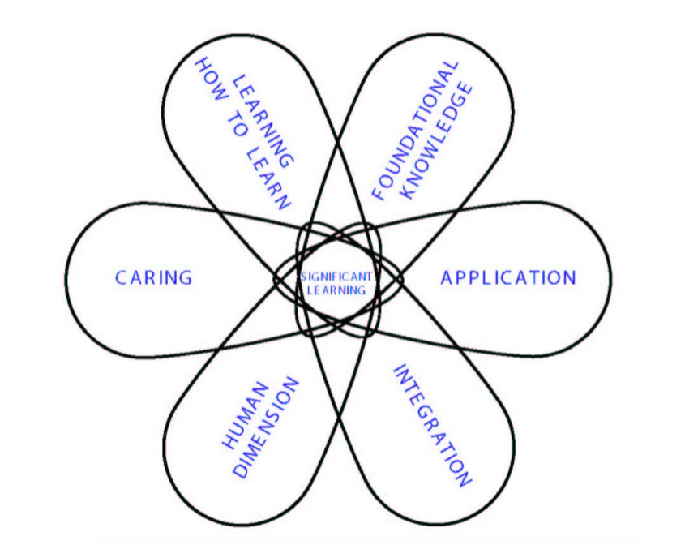
Types of learning outcomes

Slide 6
Holistic view of active learning

Slide 7
Activities that promote active learning
 | Getting Information and Ideas | Experiencing |  | Reflecting (on what one is learning and how one is learning)
 |  | Doing | Observing
Direct | Original data Original sources | Real doing, in authentic settings | Direct observation of phenomena | Classroom discussions Term papers In-depth reflective dialogue and writing on the learning process
Indirect, Vicarious | Secondary data and sources Lectures, textbooks | Case studies Simulations Role-play | Stories (can be accessed via film, literature, oral history)
Distance Learning (online courses, interactive video, correspondence courses) | Course web site Internet Video lectures Printed materials | Teacher can asign students to "directly experience"... Students can engage in indirect kinds of experience, at distant sites or online. |  | Students can record their reflections, and then, if they choose, share their reflections with others in writing, via TV, or online.

Slide 8
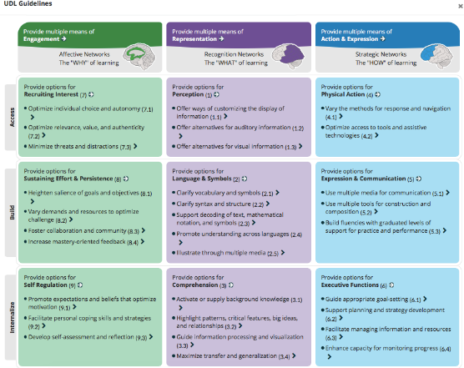
Two frameworks to consider activities
Quality Matters: Interaction of students with…
Their faculty
Each other
The content
The real world
Universal Design for Learning

Slide 9
Wall of COOL: Stephanie Rothman

Slide 10
Breakout rooms: Come up with 10 ideas….
Interacting with faculty
Interacting with content
Interacting with each other
Interacting with the real world

Slide 11
Some of my favorites
Learning engagement log
Critical incidents questionnaires
Interviews of family & friends
Critique other people’s (experts) videos
Testing claims with evidence
Asking questions – “Fifty Questions”
Compare and contrast phenomena
Experience a phenomenon

