Slide 1
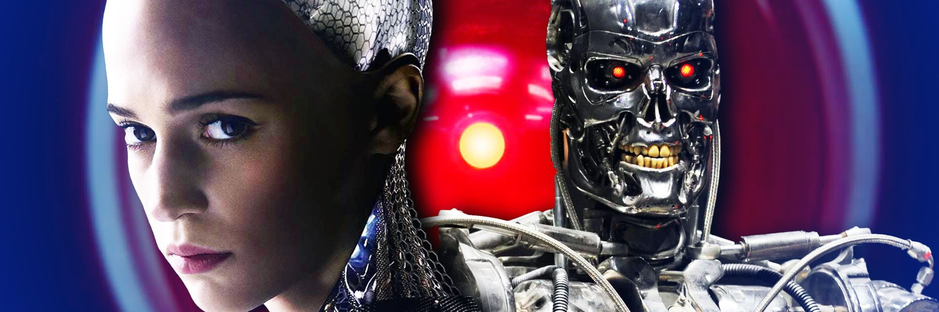
AI in the classroom: It’s here
Communication department | Dr. Dana Marshall

Slide 2
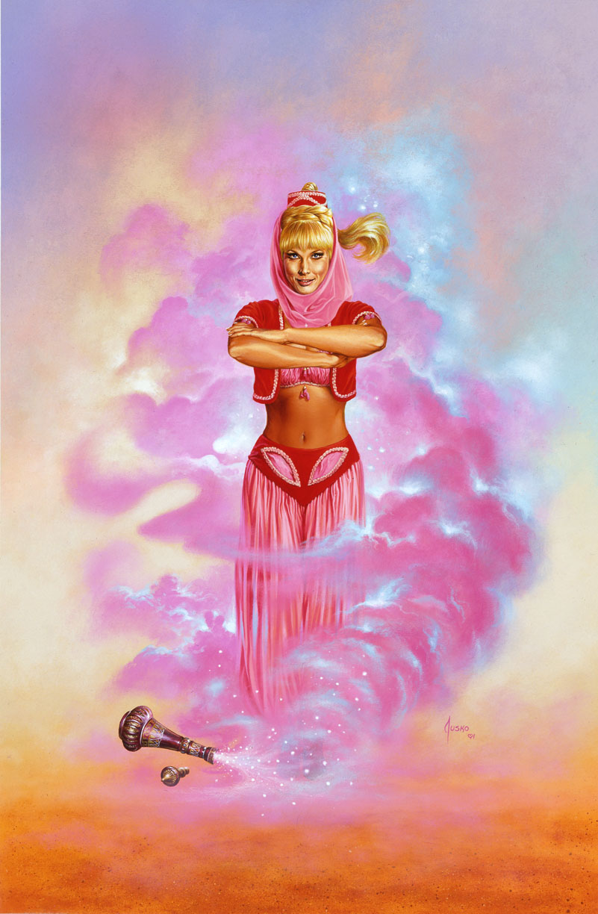
How should we approach generative ai?
The genie is already out of the bottle
Lesson & Assessment Preparation
Modeling Appropriate Use & Citation
Scenarios, Examples
Awareness of Uses and Capabilities
Exploring & Using AI

Slide 3
Algorithms & Ai: The Basics
Rule-based
Direct and unambiguous
Constructed by humans
Machine-learning
Give the machine the goal, data and feedback
Artificial Intelligence

Slide 4
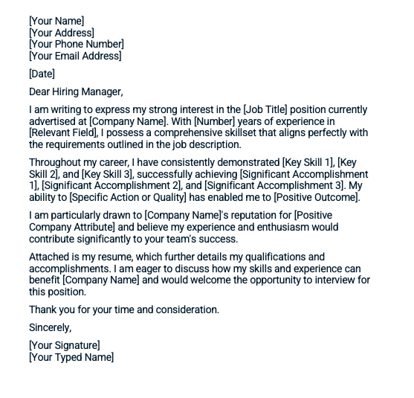
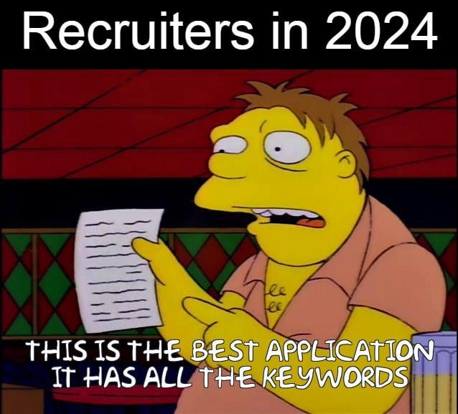
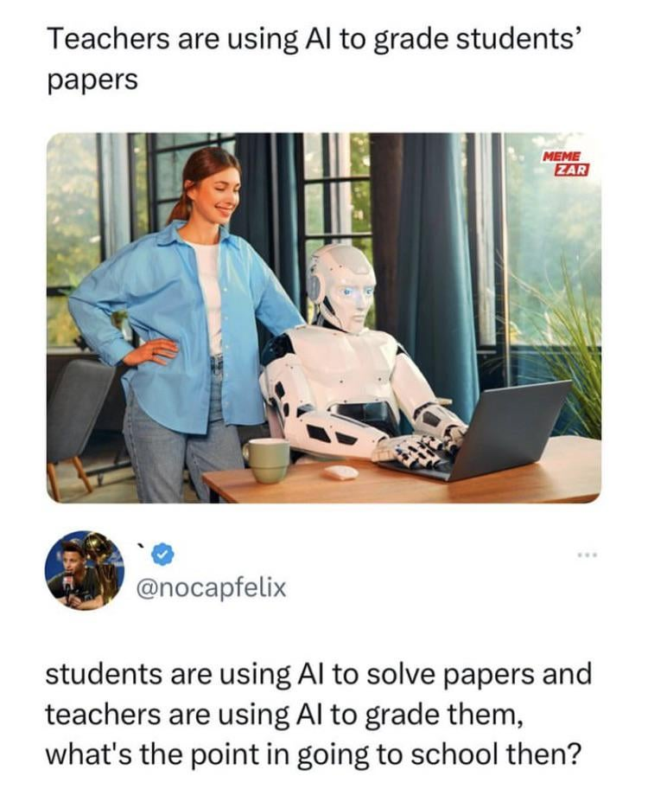
How is AI being used in your field…and your classroom?

Slide 5
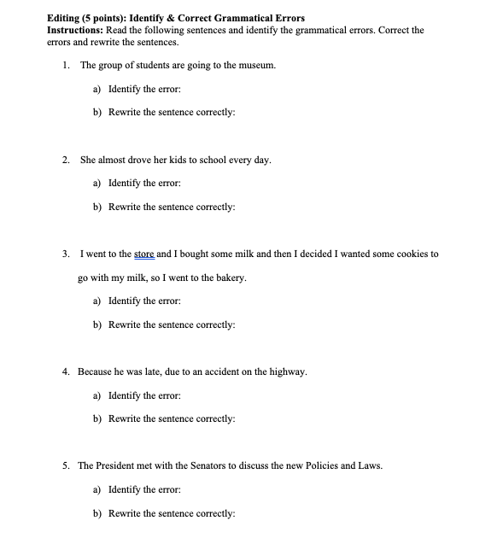
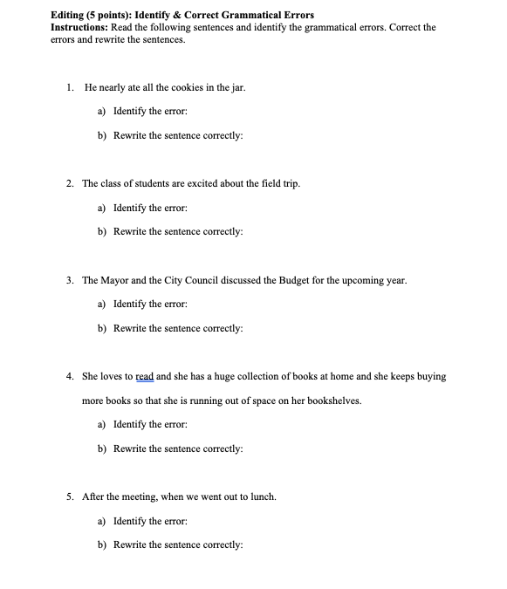
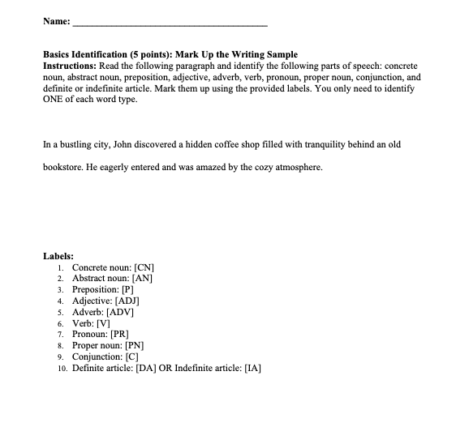
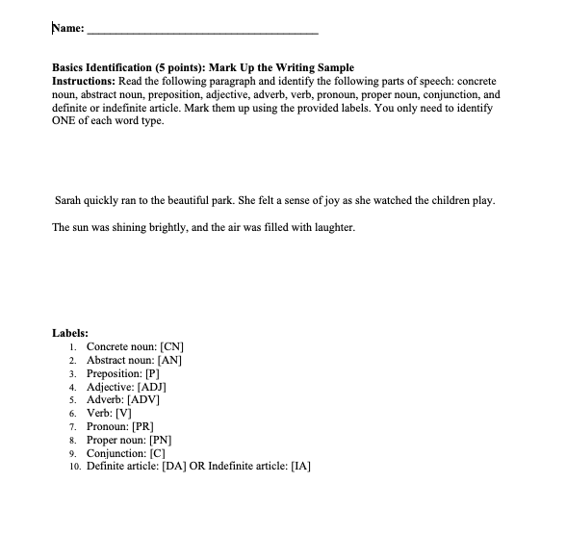
A tool for you
Updating dates/schedules for syllabi
Creating different versions of existing quizzes/exams
Activities and Examples
Developing rubrics based on assignment descriptions
Behind the scenes assistant to do the busy work

Slide 6
For students: Exploring and using ai
Desired Learning Outcome
Driving Thought or Replacing it?
An opportunity to engage critical thinking, ethical considerations of ai use

Slide 7
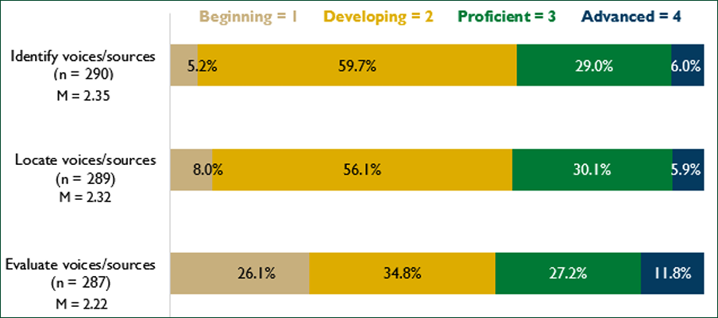
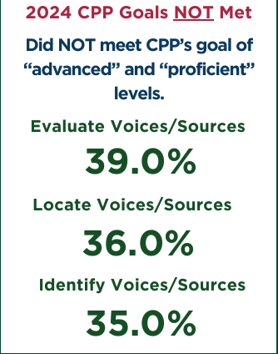
Information literacy→ AI Literacy

Slide 8
Applied ai project
Task/Prompt
Purpose
Outcome/Assessment
Task/Prompt
Task/Prompt
Personal
Professional
Societal
Purpose
Outcome/Assessment
Purpose
Outcome/Assessment

Slide 9
Prompt Generation
Iterate
Be specific
Give context
Give format guidelines
Set boundaries
"Do" and "Don't"
Build and refine on responses
Correct mistakes
Give feedback
THINK CRITICALLY
Know what you are looking for

Slide 10
Transparency in your ai use
Cite AI Generated Text
Clear Policies
Structure Assignments for Accountability
"Catching" AI

Slide 11
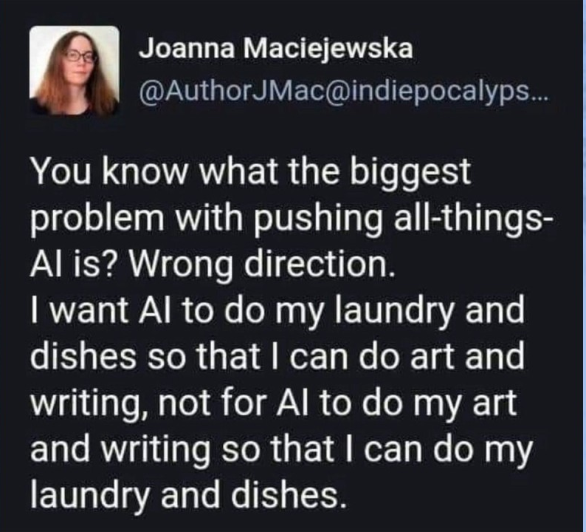
How should we be using generative ai in the classroom?

