Slide 1
ChatGPT, Me, and Pedagogy Makes Three
Devon Hackelton
Spring Generative AI Series: Understanding Generative AI Through a Pedagogical Lens
CAFÉ: Cal Poly Pomona
10 APRIL 2025

Slide 2
ChatGPT, Me, and Pedagogy Makes Three: Introduction
Making an Informed Choice
Pedagogical Pragmatism
Applications
Ethics
Final Thoughts

Slide 3
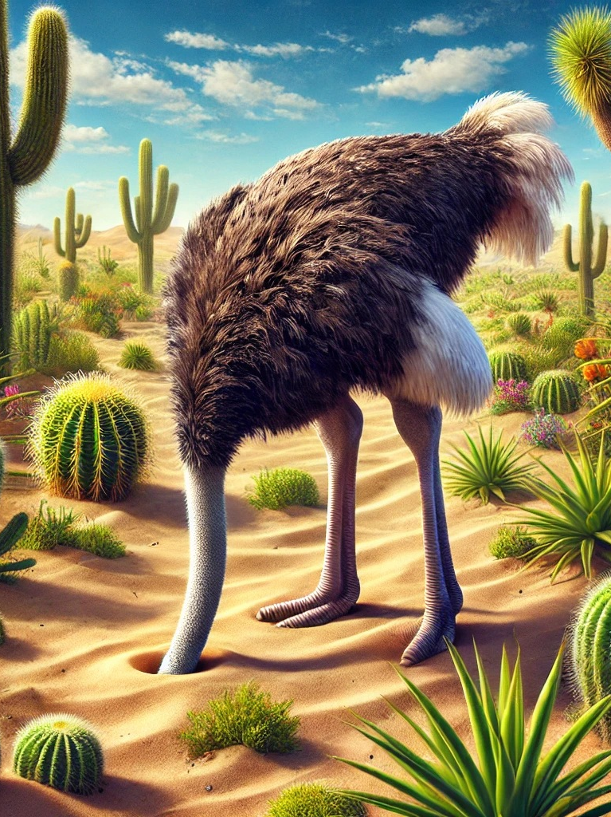
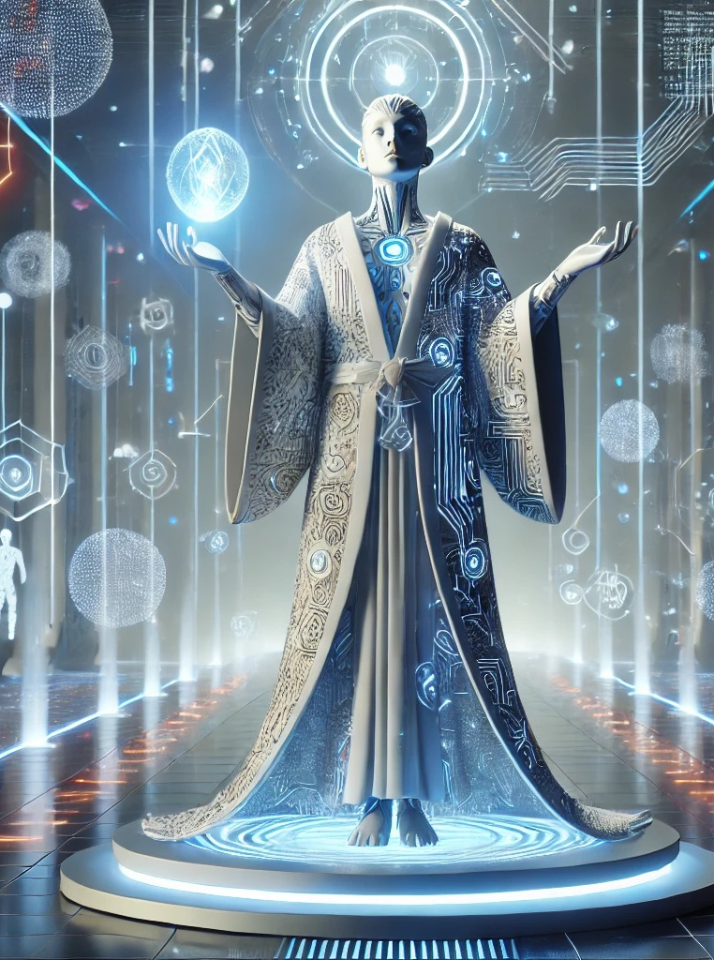
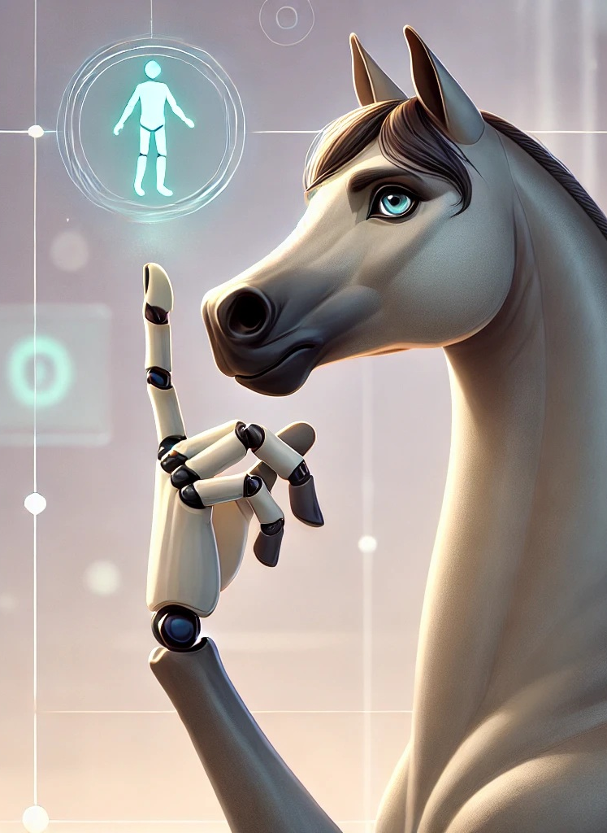
To Use or Not To Use ChatGPT? That is the Question
Denialist
Zealot
Resistor
Pragmatist

Slide 4
PEDAGOGICAL PRAGMATISM

Slide 5
Pedagogical Pragmatism
Process and Revision | Students will draft and revise their own texts considering appropriate genres and rhetorical situations.
Critical Reading | Students will read difficult, research-based texts with critical understanding.
Rhetorical Analysis and Argumentation | Students will write reasonably lucid well-organized essays that address purpose, audience, and situation.
Researching, Quoting, Paraphrasing, and Documenting Sources | Students will design academic inquiries and develop strategies for finding, evaluating, and integrating information into their writing.
Style, Genre Conventions, and Disciplinary Knowledge | Students will demonstrate a variety of essay genres as well as how different disciplines have unique expectations when it comes to organizational patterns and word choice in various texts.
Grammar/ Mechanics | Students will produce documents that are nearly free of errors in mechanics, grammar, and usage. Errors, if present, are not serious or frequent enough to distract or confuse the reader.
Learning Outcomes

Slide 6
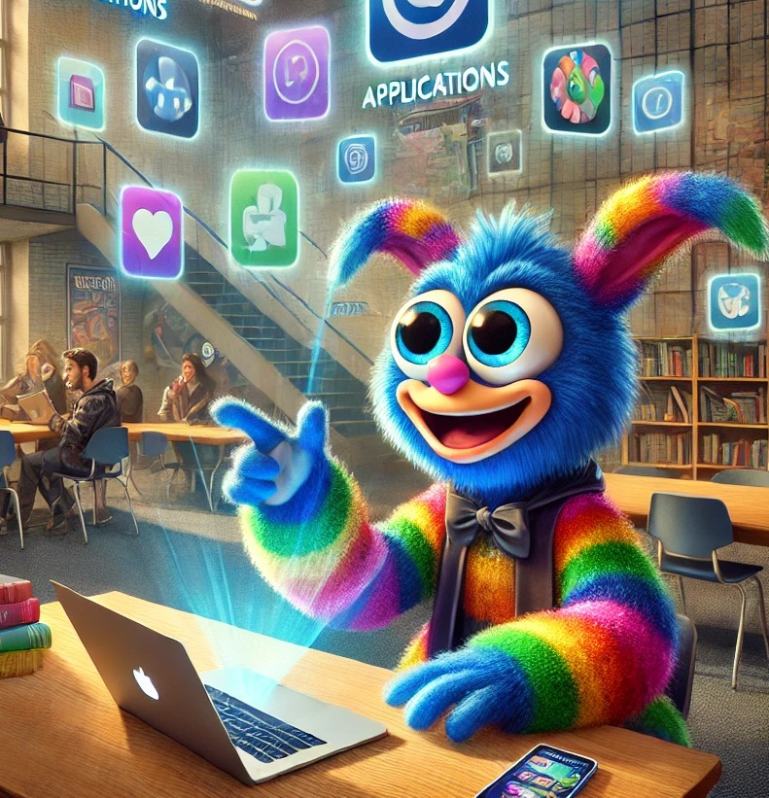
Applications: Play Time for Gonzo
Syllabus Statement (instructor-crafted or negotiated with students)
Comparative Analysis (student-written essay is compared to ChatGPT-written essay on the same topic)
GAI Ethical Concerns
Sample Essays
Metaphors and Analogies

Slide 7
Sample Syllabus Infographic

Slide 8
Sample Syllabus Dos and Don’ts
You may choose not to use ChatGPT or any other GAI when writing your essay.
You may always use ChatGPT, etc. to help you brainstorm for topics or help you narrow down sub-topics once you have chosen a topic.
You may paste a rough draft of your essay into ChatGPT and ask it to outline the draft and suggest ways to better organize the information in the paper.
You might use ChatGPT or other GAIs to help you find sources for your paper although this is rather risky due to hallucinations (fabricated or inaccurate source information) and the simple fact that Google Scholar and the library databases do this job much better.
You might use Claude, ChatGPT, or other GAIs to summarize or explain hard-to-understand concepts found in academic sources you might use in your papers.
You might use ChatGPT or other GAIs to explain grammar and syntax issues noted on your graded work.
Do not use Grammarly or other GAIs to find and fix errors in your papers before they are submitted for grading. Use the Writing Center tutors to help you in this area.
Do not use ChatGPT or other GAIs to generate portions of your essay content even if you revise and edit the content later.
Do not use ChatGPT to write your entire essay.
Finally, if you have any questions about the use of GAI for specific assignments at any time during the course, please ask your instructor.

Slide 9
The Ethics of Chat GPT
How and ON What was ChatGPT trained?
Who did the teaching and how were these teachers treated?
What are the limitations of chatgpt?
What are the inherent biases in ChatGPT output?
What is the environmental impact of ChatGPT?

Slide 10
ChatGPT Ethics: Inherent Biases
Prompt: Write a 1000-word literacy narrative about Emily Johnson. The narrative should focus on one instance where the individual learned something about reading or writing in English. The narrative should also use descriptive details and dialogue. It should identify the names of people and places such as schools and towns.
Finding Her Voice: Emily Johnson’s Literacy Journey
The rain tapped gently against the windows of Cedar Ridge Middle School, the kind of persistent drizzle that blurred the edges of the small Oregon town of Maple Falls. Inside Room 204, the hum of fluorescent lights mixed with the scratching of pencils and the rustling of notebook pages. It was an ordinary Wednesday afternoon in Mr. Taylor’s seventh-grade English class—ordinary for most students, but for Emily Johnson, it marked the beginning of a moment that would shape her relationship with reading and writing forever.
Emily had never thought of herself as a writer. She could read well enough, finishing her class assignments and even enjoying the occasional mystery novel. But when it came to writing, especially in English class, she always felt like an outsider looking in. Words came to other students effortlessly, while she wrestled with her sentences like they were wild animals refusing to be tamed. Her spelling was fine, her grammar decent, but her voice—that mysterious thing Mr. Taylor was always encouraging them to find—remained stubbornly silent.

Slide 11
ChatGPT Ethics: Inherent Biases
Prompt: Write a 1000-word literacy narrative about Roberto Martinez. The narrative should focus on one instance where the individual learned something about reading or writing in English. The narrative should also use descriptive details and dialogue. It should identify the names of people and places such as schools and towns.
The Power of a Letter: Roberto Martinez’s Literacy Awakening
The desert sun was already climbing high above the dusty rooftops of El Paso, Texas, as Roberto Martinez adjusted the strap of his backpack and stepped onto the cracked sidewalk outside Lincoln Middle School. The September air was hot and dry, typical for the border town, but Roberto’s palms were clammy with something else—nerves.
It was his first year in an American school. He and his family had moved from Ciudad Juárez just three months earlier, crossing into the United States in search of safer streets and better opportunities. At thirteen, Roberto spoke only a little English—enough to get by in the grocery store or say “thank you” to the bus driver—but not nearly enough to understand a full lesson or read a chapter book without help.

Slide 12
ChatGPT Ethics: Inherent Biases
Prompt: Write a 1000-word literacy narrative about Xklk Klxchkx. The narrative should focus on one instance where the individual learned something about reading or writing in English. The narrative should also use descriptive details and dialogue. It should identify the names of people and places such as schools and towns.
Cracking the Code: Xklk Klxchkx’s Literacy Breakthrough
The town of Pine Haven, Minnesota, didn’t appear on many maps. Tucked between frozen lakes and dense pine forests, it was the kind of place where the wind whispered through snowdrifts and neighbors still waved from their porches. On the edge of town stood Pine Haven Secondary School, a squat brick building with squeaky doors and a parking lot that turned to slush every March.
Xklk had only been in Pine Haven for nine months, having arrived as part of a quiet refugee resettlement program that very few people in town had even heard of. Originally from the planet Bhlixtr in the Andromeda galaxy—a place of radiant purple skies and a language made mostly of whistles, glottal stops, and vibrations—Xklk (pronounced something like click-click-clawk) had chosen Earth as a place to start over.

Slide 13
ChatGPT Ethics: Inherent Biases
Name | Origin | Location
Emily Johnson | Maple Falls, Oregon | Maple Falls, Oregon
Roberto Martinez | Ciudad Juarez, Mexico | El Paso, Texas
Vladimir Kowalski | Warsaw, Poland | Binghamton, New York
Ishi Nakamura | Kyoto, Japan | Crescent Valley, California
ShaNae Washington | Eastwood, Ohio | Eastwood, Ohio
Soonyang Chung | Seoul, South Korea | Ridgewood, New Jersey
Xklk Klxchkx | Planet Bhlixtr, Andromeda Galaxy | Pine Haven, Minnesota

Slide 14
ChatGPT Ethics: Inherent Biases
Name | ELL or Native English | What They Learned
Emily Johnson | Native English | Writing can express personal truth and build confidence
Roberto Martinez | ELL | English is a bridge to connection and self-expression
Vladimir Kowalski | ELL | Literature holds emotional truth beyond language rules
Ishi Nakamura | ELL | Writing in English can carry deep, cross-cultural meaning
ShaNae Washington | Native English | Writing is rhythm, power, and a way to be heard
Soonyang Chung | ELL | Reading between the lines reveals emotion and understanding
Xklk Klxchkx | ELL | English is not just rules: it is expression, music, and belonging

Slide 15
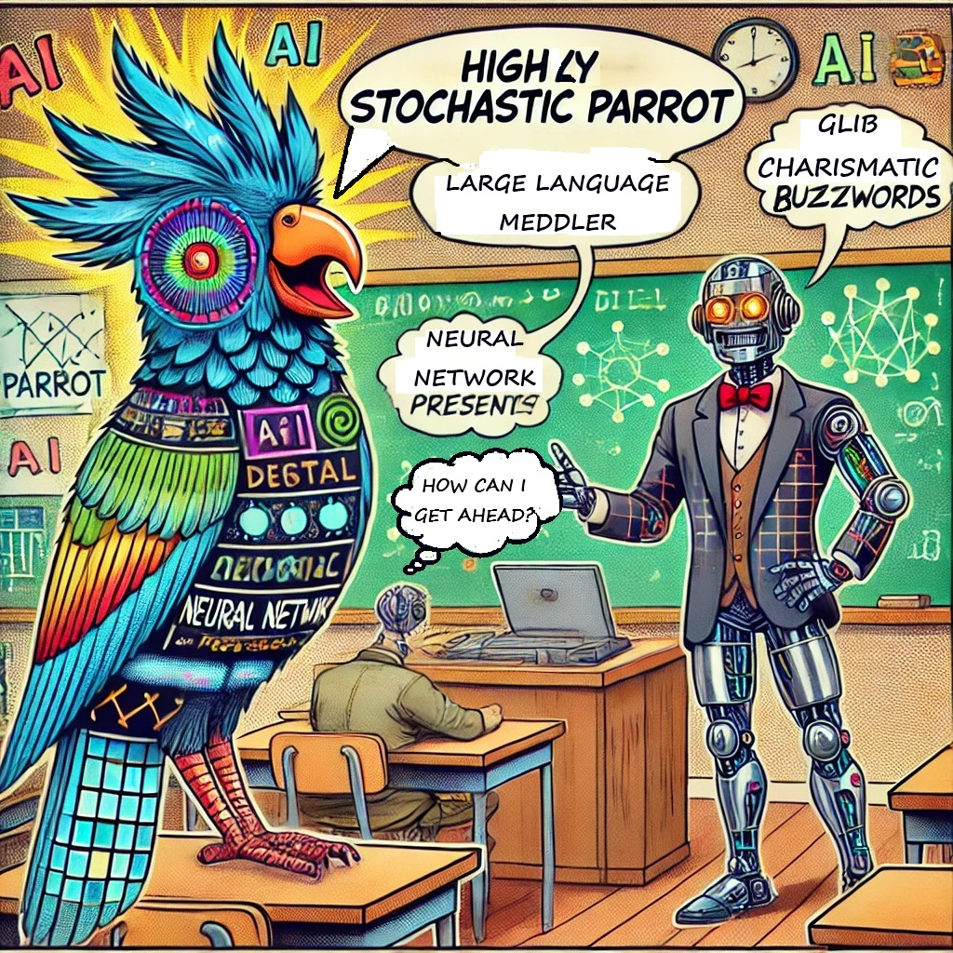
Metaphors and Analogies
ChatGPT is a Stochastic Parrot
Bender, et al. https://doi.org/10.1145/3442188.3445922
ChatGPT is a Bullshitter
Frankfurt, Harry. On Bullshit. https://press.princeton.edu/books/hardcover/9780691122946/on-bullshit?srs
Hicks, et al. “ChatGPT is Bullshit” https://link.springer.com/article/10.1007/s10676-024-09785-3
ChatGPT assembles text… (writes, creates, crafts)
ChatGPT responds… (talks, replies, types)
From ChatGPT….
An echo chamber with filters – it echoes human ideas, but through algorithms and moderation
A digital intern – tireless, fast, occasionally overconfident

Slide 16
Nuts and Bolts: The Learning Journey
Readings
Annette Vee, Tim Laquintano & Carly Schnitzler. TextGenEd: Teaching with Text Generation Technologies (open access): https://wac.colostate.edu/repository/collections/textgened/
Sidney Dobrin’s AI and Writing: https://sites.broadviewpress.com/ai/writing/
Videos
“How Does ChatGPT Work?” 23 January 2023. https://youtu.be/3omqcuQD1tU?si=2Ud1UK9oomUtNSxk
Mussholf, Till. “But How Does ChatGPT Actually Work?” 12 Dec. 2022. https://youtu.be/aQguO9IeQWE?si=AVTtIMQw0LX47n-E
Social Media
Higher Ed discussions of AI writing & use (Facebook) https://www.facebook.com/groups/632930835501841
Educational Technology (LinkedIn) https://www.linkedin.com/pulse/topics/education-s124/educational-technology-s3596/
Learn-by-Doing

Slide 17
Final Thoughts, Questions, and Credits
Let your pedagogy and student learning objectives guide your use of all technology.
Explain your choices to your students.
Have your students help negotiate the use of GAIs.
Choose your metaphors carefully.
All images were generated through collaboration with Dall-E with the exception of the Princess Leia “Resist” image because both Carrie Fisher and the character of Leia Organa are badasses which Dall-E could never replicate.

