Slide 1
AI & Pedagogy
Dr. Rachel Tamar Van History Department & Digital Humanities Consortium

Slide 2
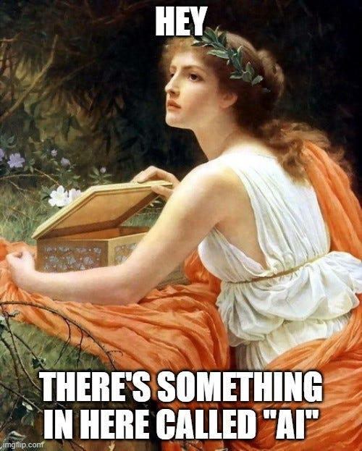
Learning Together

Slide 3
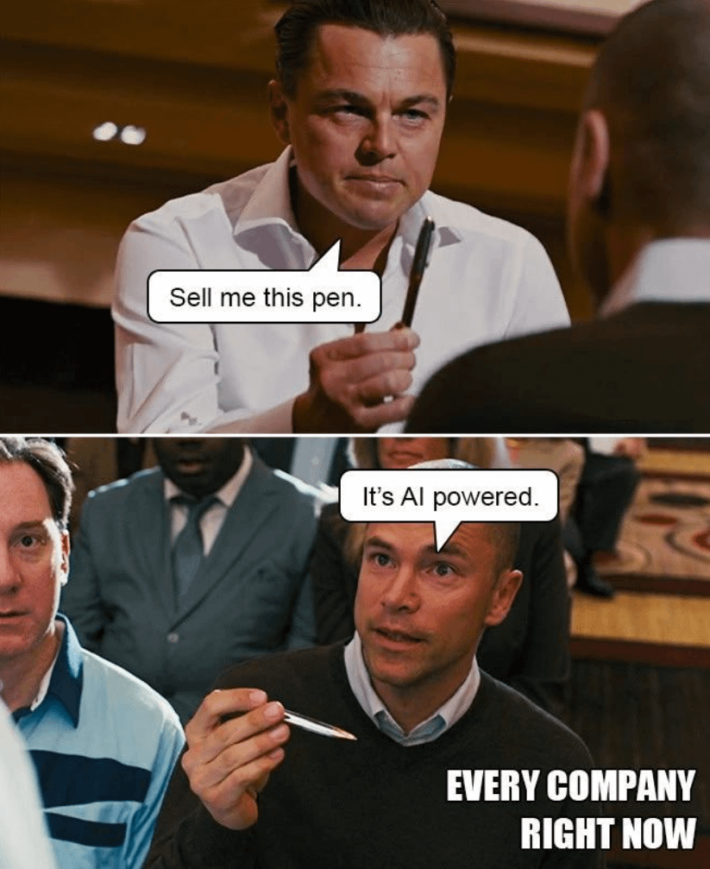
From “Opt-in” to “opt-out”

Slide 4
Deepfakes

Slide 5
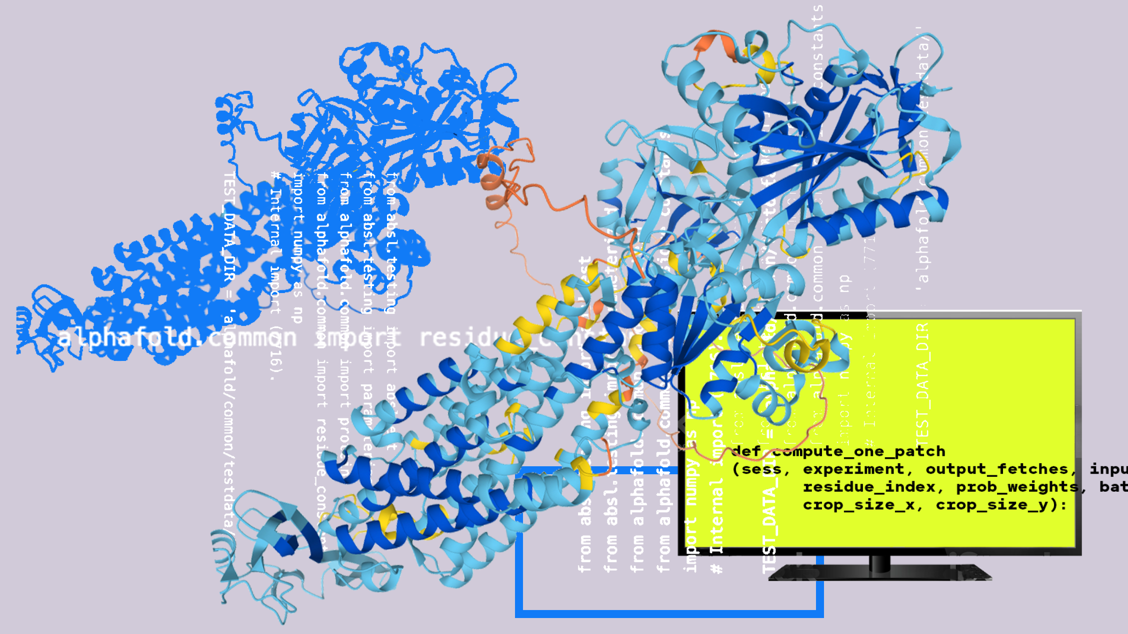
Generative Ai – the Good

Slide 6
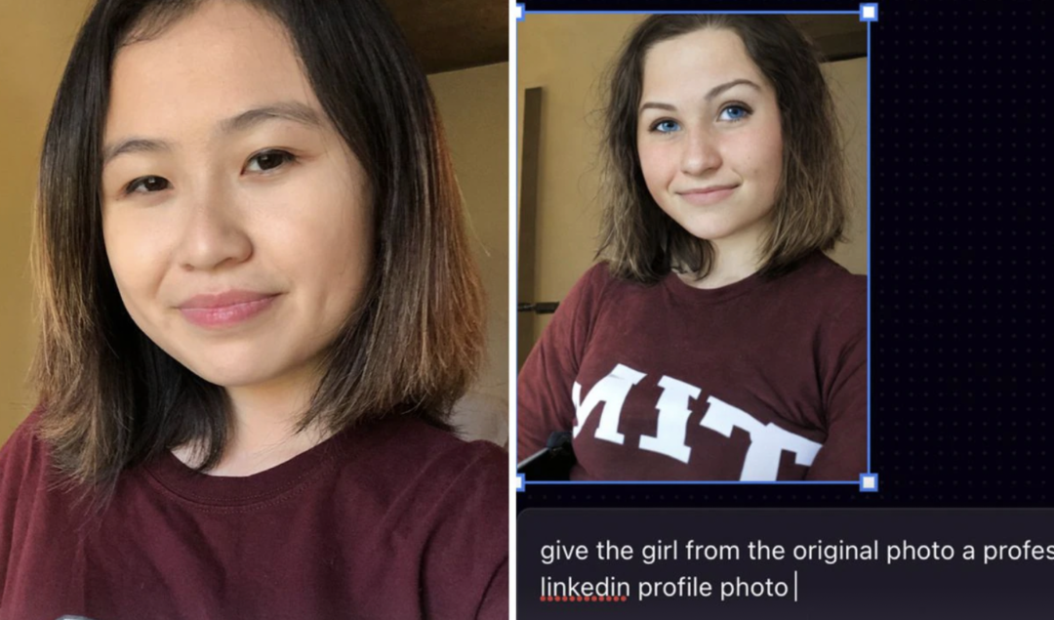
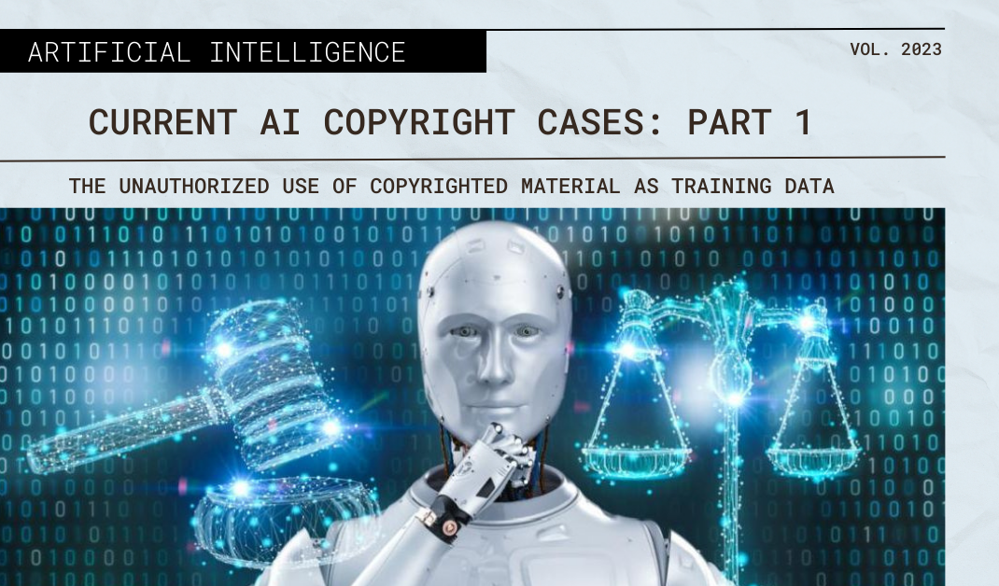
… the Bad & the UGLY
Notes:
But also, discussing issues like algorithmic bias, outright theft of copyrighted and owned material, and environmental costs.

Slide 7
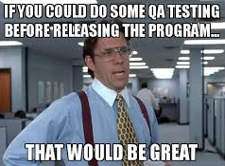
Assignment & Experimentation

Slide 8
Assignment – The “Meta” Essay
VERSION 2023: Put the essay prompt into the Chat and include the responding essay in your assignment. Then, using our course materials, analyze the response. Is it persuasive? Is it well argued? Is it accurate & effectively substantiated?
Historian's Op Ed: Is capitalism viable or doomed, in your lifetime? Reflect on what we have discussed in class to answer. Especially: what trend(s) do you think is/are the MOST important for understanding the directions of modern American capitalism? [3 pages double spaced – so short!)]
This is asking your take, so there is no wrong answer - but you must reflect on the history. The paper will be evaluated based on your historical specificity - those historical trends that you think are especially important - as well as your analysis of the overarching question.
Tip: Consider the longer history: has capitalism substantively changed during the 20th -21st century versus the 17th -19th c.? Or is it composed of the same economic drivers, just with new technologies?
CITE at least 4 class-based sources. This may include your source from your Future of Capitalism memo.

Slide 9
Assignment – The “Meta” Essay
VERSION 2023: Put the essay prompt into the Chat and include the responding essay in your assignment. Then, using our course materials, analyze the response. Is it persuasive? Is it well argued? Is it accurate & effectively substantiated?
VERSION 2024: Use the essay prompt to come up with your own prompt on the essay topic. Include the AI tool used, final prompt, and the responding essay in your assignment. Then, using our course materials, be the expert: analyze the response & experience. Is it persuasive, well argued? Missing or counter-points? Verify details, sources – any hallucinations?

Slide 10
Teaching students to be THEIR own educational advocate In the age of AI.
AI as Parasite, if you let it – “The folly of producing expertise without experts.” [Tressie McMillan Cottom NYT 3/29/2025]

Slide 11
Being THEIR own educational advocate
AI as Parasite, if you let it
Forklifting v. Weightlifting – What is the goal? [Ted Chiang, 2024; Hard Fork 3/28/2025]

Slide 12
Being THEIR own educational advocate
AI as Parasite, if you let it
Forklifting v. Weightlifting
Human-in-the-Loop – On the unbearable weight of fact-checking & ethics-checking in the age of AI.

Slide 13
Being THEIR own educational advocate
AI as Parasite, if you let it
Forklifting v. Weightlifting
Human-in-the-Loop
Iterative Process – making the process visible in new ways?

Slide 14
AI Tools YouTube: Jeff Su Tina Huang
Slide from class:
“Human-in-the-Loop”: chatbot responses are not research (but they *can* help) – needs to be your work
Hallucinations
Algorithmic & LLM biases
Predictive jargon v. thoughtful connections
Asking for sources v. “De-Authoring”
Means, not end: what is this information?
“Chain of thought” → “Explain your thought process.” Microsoft study – outsourcing critical thinking
How to CITE: N: Cite AI text only in footnotes. Include the name of the tool, the prompt, the tool publisher, date the text was generated, and the tool URL. Chat GPT, response to “insert prompt here,” OpenAI, March 19, 2025.

Slide 15
Assignment – The “Meta” Essay
VERSION 2025, maybe: from OUTPUT to PROCESS focused. From the essay question, brainstorm on the topic. (1) Paste the prompts & responses in your assignment. (2) Using our course materials and these brainstormed resources, write a 3-page essay answering the class essay question. Address the tool’s utility in your essay—helpfulness, hurdles?—and the implications, you think, for the topic. Options -
Iterative – 1-2-3: refine questions as you go
Comparative – compare 2 ideas: ask to highlight strengths &
Feedback Loop – input a starter essay, prompt for feedback, loop

Slide 16
Being THEIR own educational advocate
AI as Parasite, if you let it
Forklifting v. Weightlifting
Human-in-the-Loop
Iterative Process
Creativity, Confidence, & Learning [Lee, et. al., “The Impact of Generative AI on Critical Thinking,” CHI (2025).]

Slide 17
Learning Together
Notes:
Moving target. Need to have these conversations, repeatedly, b/c this learning and thinking environment is moving fast. But not all of our students are in the same place.

