Slide 1
Designing Assignments & Feedback with AI
Spring Generative AI Workshop Series
May 8, 2025

Slide 2
Agenda
Beginning with Relationships (15 min)
Victoria Bhavsar, CAFE
Creating Assignments & Giving Feedback(45 min)
Yingjie Liu, Director of Digital Learning Strategies, San Jose State
Closing remarks and Q&A (15 min)
Everyone

Slide 3
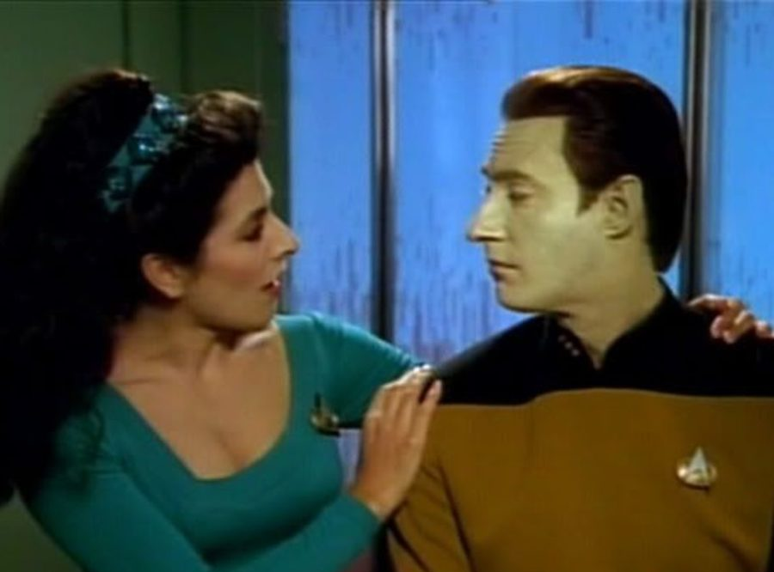
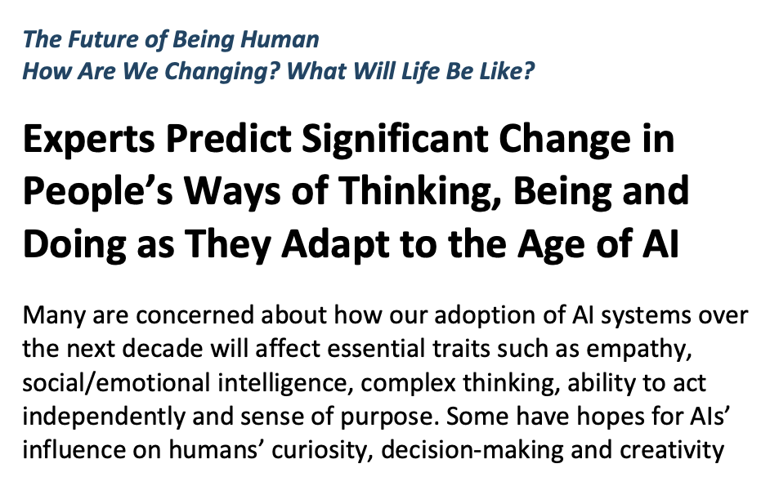
I-Thou
I-It

Slide 4
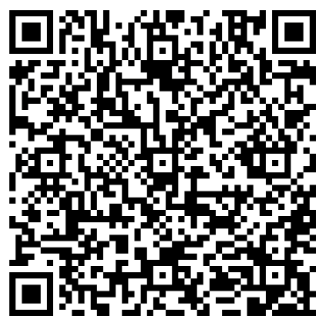
Beginning with relationships
Academic Affairs Guidelines for Emerging Technologies:
https://www.cpp.edu/academic-programs/emerging-tech/emerging-technologies-guidelines.shtml
Academic Affairs will work to ensure that gAI is used to support and enhance human instruction, not to replace the essential relationships between students and faculty.

Slide 5
Relationships are critical for assignments to be successful
Trust in our expertise as faculty
Trust in our commitment to students’ well-being
Intrinsic motivation
Learning beyond the grade
Learning beyond response to positional power
Willingness to do the work!
Willingness to seek help

Slide 6
Relationships are critical for assignments to be successful
Trust in our expertise as faculty
Trust in our commitment to students’ well-being
Intrinsic motivation
Learning beyond the grade
Learning beyond response to positional power
Willingness to do the work!
Willingness to seek help
Use “immediacy” behaviors
Reduce non-essential content – add relational and physical world activities
Establish affective (caring and human dimension) learning outcomes

Slide 7
Q&A

Slide 8
THANK YOU

