Slide 1
Discipline-Specific AI Tools for Enhanced Learning
Spring Generative AI Workshop Series
April 15, 2025

Slide 2
Spring Generative AI Series
Crafting Prompts as Teaching Tools
DATE: Apr 24, 12:00pm-1:15pm FORMAT: Online via ZOOM PRESENTERS: Jennie Watson, PhD, EML Erick Zelaya, CAFE
Enhancing Course Alignment With gAI: Bloom’s Taxonomy for gAI
DATE: May 1, 12:00pm-1:15pm FORMAT: Online via ZOOM PRESENTER: Brandy M. Jenner, PhD, Teaching & Learning Manager, Anderson IDLX
Designing Assignments and Feedback with gAI
DATE: May 8, 12:00pm-1:15pm FORMAT: Online via ZOOM PRESENTER: Yingjie Liu, PhD, Director of Digital Learning Strategies, San Jose State University

Slide 3
Poll

Slide 4
Agenda
Welcome & AI Intro
Yajaira Garcia, CAFE
A.I. For Design - Responsibilities and Opportunities
Kevin Finch, Lecturer, Landscape Architecture
AI in the Classroom: It’s Here
Dana H. Marshall, Assistant Professor, Communication
Q&A

Slide 5
Presenters
Dana H. Marshall
Kevin M. Finch
Communication College of Letters, Arts, & Social Sciences
Landscape Architecture College of Environmental Design
Yajaira Garcia
Instructional Designer Center for the Advancement of Faculty Excellence

Slide 6
AI is EVERYWHERE
Digital Assistants
Search Engines
Social Media
Personalized Recommendations
Robots
Navigation
Gaming
Healthcare

Slide 7
Seriously, it’s everywhere
Humanities/Social Sciences: Natural Language Processing (NLP) Tools, AI for Historical Research
Natural Sciences: AI for Drug Discovery & Development, Image Analysis, Climate Modeling & Prediction
Art & Design: GenAI for Image Creation and Music Creation
Business: Market analysis & Trend Forecasting tools, Customer Relationship Management (CRM) with AI.
Computer Science/Engineering: Code generation & Debugging Assistants

Slide 8
AI in Higher Ed-The New Normal
Course design
Lesson/activities/assignments
Assessments
Note-taking
Writing & Grammar
Summarizing material

Slide 9
If an AI tool could help your students build one key skill, what would it be?

Slide 10
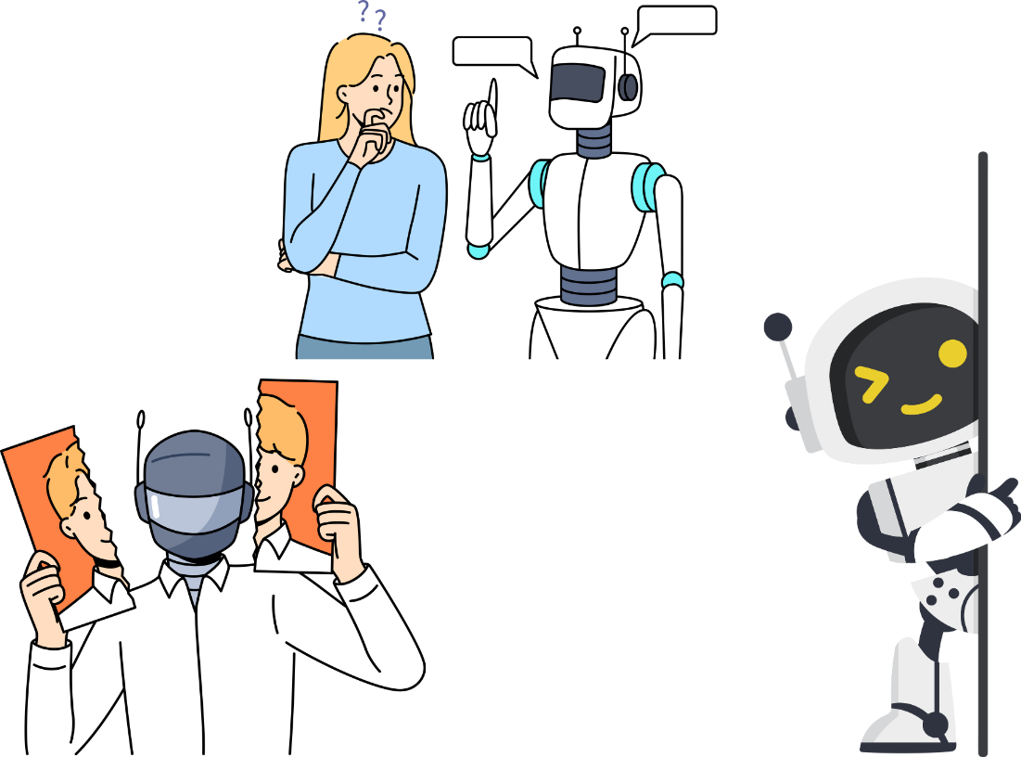
AI Concerns
Cheating
Over-reliance
AI Bias
AI Hallucinations
Copyright issues

Slide 11
To minimize these concerns…
Promote academic integrity through honor codes and policies
Educate students on responsible AI use
Enhance classroom engagement to foster a learning environment where students actively participate
Pepperdine Syllabus Statement Crafting Tool
Classroom Policies for AI Generative Tools Google Doc
CPP AI Faculty Samples
CPP Guidelines for Generative Artificial Intelligence

Slide 12
Cal Poly Pomona Licensed Tools
Microsoft Copilot
Copilot is more of an assistant
ChatGPT is more of a general-purpose AI tool.
Additional AI Tools-CAFÉ’s Website
CSU Resources – AI Commons
Open AI’s ChatGPT

Slide 13
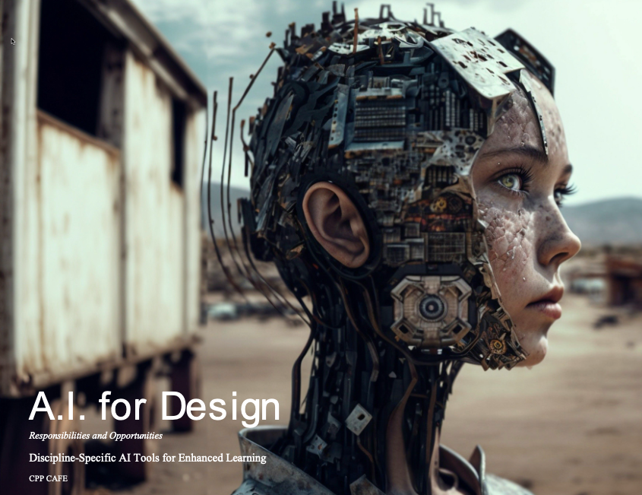

Slide 14
AI in the classroom: It’s here
Communication department | Dr. Dana Marshall

Slide 15
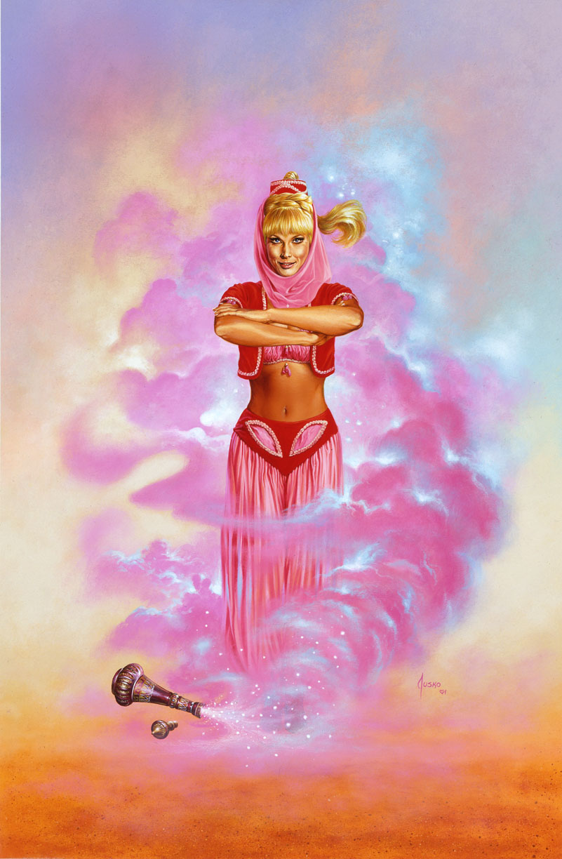
How should we approach generative ai?
The genie is already out of the bottle
Lesson & Assessment Preparation
Modeling Appropriate Use & Citation
Scenarios, Examples
Awareness of Uses and Capabilities
Exploring & Using AI

Slide 16
Algorithms & Ai: The Basics
Rule-based
Direct and unambiguous
Constructed by humans
Machine-learning
Give the machine the goal, data and feedback
Artificial Intelligence

Slide 17
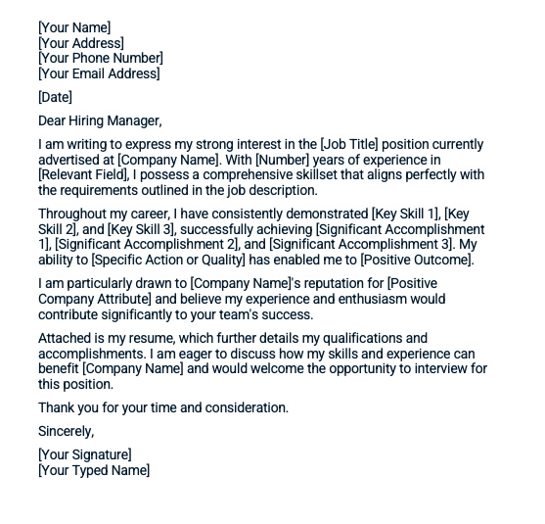
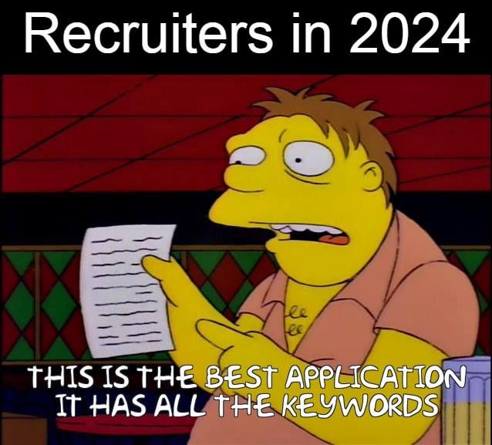
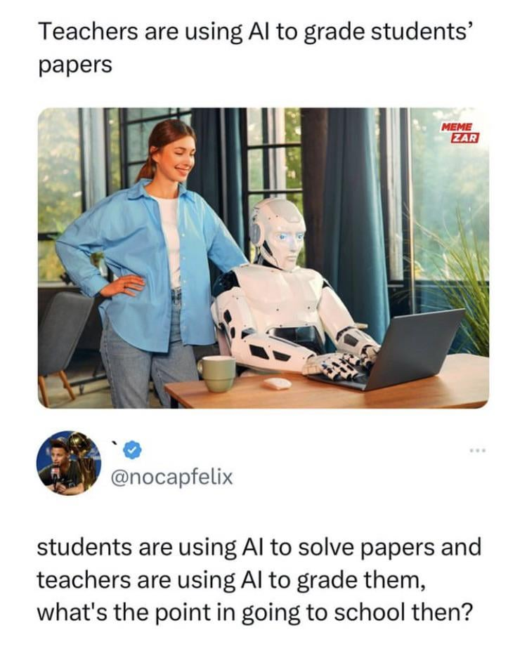
How is AI being used in your field…and your classroom?

Slide 18
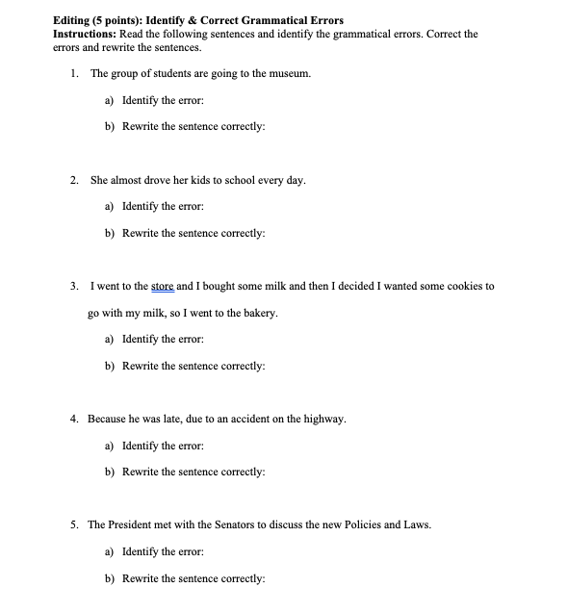
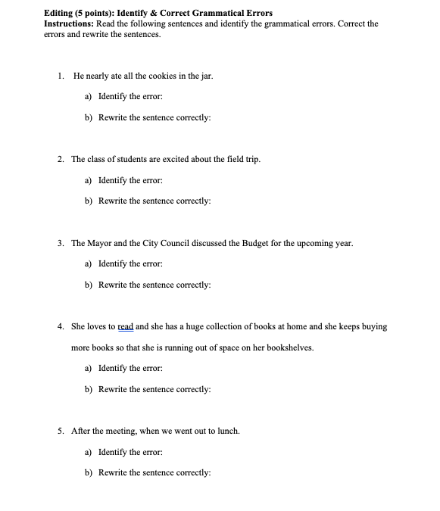
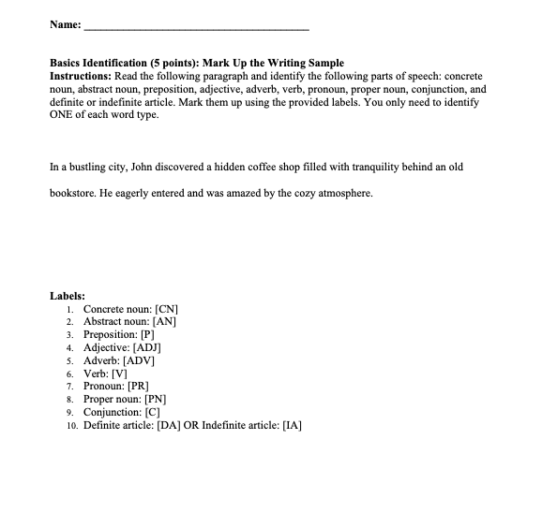
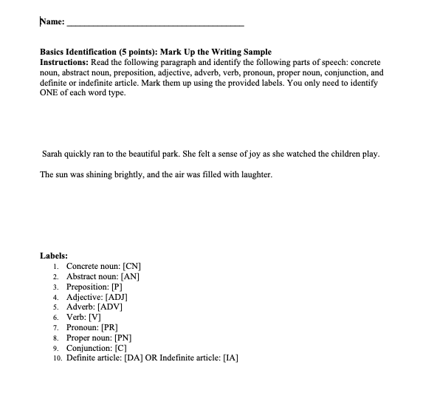
A tool for you
Updating dates/schedules for syllabi
Creating different versions of existing quizzes/exams
Activities and Examples
Developing rubrics based on assignment descriptions
Behind the scenes assistant to do the busy work

Slide 19
For students: Exploring and using ai
Desired Learning Outcome
Driving Thought or Replacing it?
An opportunity to engage critical thinking, ethical considerations of ai use

Slide 20
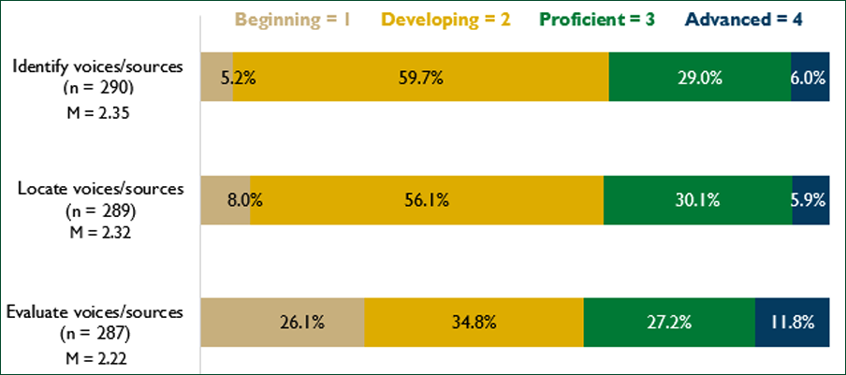
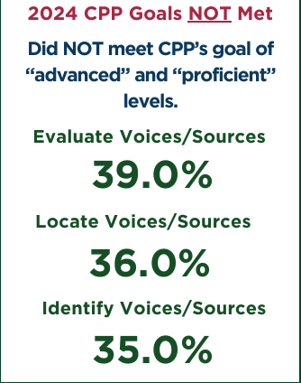
Information literacy→ AI Literacy

Slide 21
Applied ai project
Task/Prompt
Purpose
Outcome/Assessment
Task/Prompt
Task/Prompt
Personal
Professional
Societal
Purpose
Outcome/Assessment
Purpose
Outcome/Assessment

Slide 22
Prompt Generation
Iterate
Be specific
Give context
Give format guidelines
Set boundaries
"Do" and "Don't"
Build and refine on responses
Correct mistakes
Give feedback
THINK CRITICALLY
Know what you are looking for

Slide 23
Transparency in your ai use
Cite AI Generated Text
Clear Policies
Structure Assignments for Accountability
"Catching" AI

Slide 24
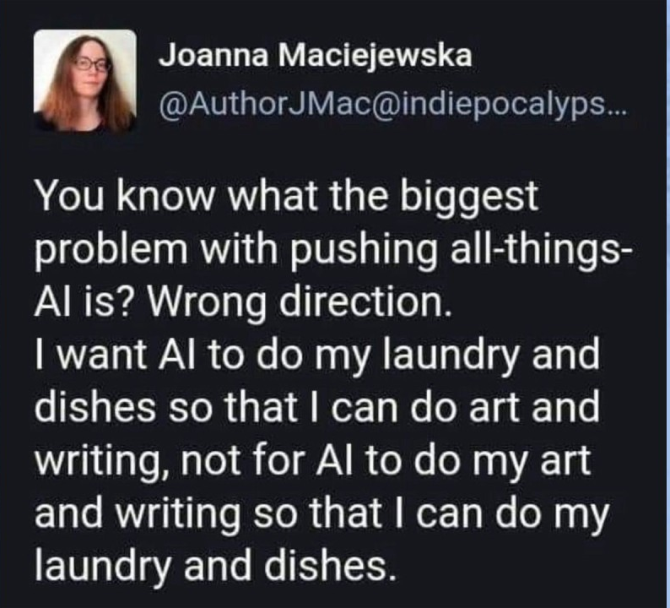
How should we be using generative ai in the classroom?

Slide 25
Q&A

Slide 26
Thank you!

Slide 27
Spring Generative AI Series
Crafting Prompts as Teaching Tools
DATE: Apr 24, 12:00pm-1:15pm FORMAT: Online via ZOOM PRESENTERS: Jennie Watson, PhD, EML Erick Zelaya, CAFE
Enhancing Course Alignment With gAI: Bloom’s Taxonomy for gAI
DATE: May 1, 12:00pm-1:15pm FORMAT: Online via ZOOM PRESENTER: Brandy M. Jenner, PhD, Teaching & Learning Manager, Anderson IDLX
Designing Assignments and Feedback with gAI
DATE: May 8, 12:00pm-1:15pm FORMAT: Online via ZOOM PRESENTER: Yingjie Liu, PhD, Director of Digital Learning Strategies, San Jose State University

