Slide 1
The IRB Application Process
Maya Monges-Hernandez, IRB Administrator
California State Polytechnic University, Pomona
Institutional Review Board

Slide 2
Introduction
Our IRB goal is to make the application process as easy for you as possible.
We will:
Review the procedure, provide guidelines and guiding resources
Provide hints, help, and examples
You will:
Complete CITI Training
Request authentication
Navigate Cayuse IRB Website
Learn about protocol writing*
  *includes resources, consent/assent forms FAQs and other forms
Notes:
How presentation will benefit audience: Adult learners are more interested in a subject if they know how or why it is important to them.
Presenter’s level of expertise in the subject: Briefly state your credentials in this area, or explain why participants should listen to you.
Coordinates IRB services with other departments, Evaluates, develops and modifies forms/documents to aid both committee members and researchers in the review and submission process, Reports serious/continuing noncompliance with regulations and suspension/termination of IRB approval to institutional officials, federal government and others, as required

Slide 3
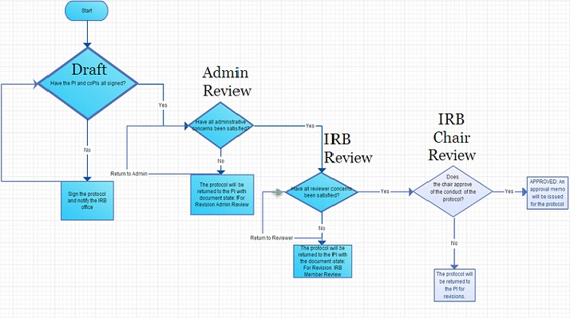
Over-view of the process
Notes:
Shared values in scientific research that includes:
HONESTY convey information truthfully and honoring commitments
ACCURACY report findings precisely and take care to avoid errors
EFFICIENCY use resources wisely and avoid waste
OBJECTIVITY let the facts speak for themselves and avoid improper bias
Admin review- look for deviations pertaining subject protection, structure, clarity for the reviewer.

Slide 4
Hints, Help and Examples
Here is the link: https://www.cpp.edu/~research/irb/hints-help-and-examples.shtml
Notes:
https://www.cpp.edu/~research/irb/hints-help-and-examples.shtml

Slide 5
CITI Certification
You can also take the NIH Certification
The link is available on-line at https://www.citiprogram.org
  modules addressing topics in both social science and bio-medical research followed by quizzes
  How do I get my certificate?
    CITI will have an option in your account
Notes:
You can also take the NIH Certification (but it is much more complicated)
How do I get my certificates: CITI will have an option in your account

Slide 6
Cayuse Training
Learn how to navigate in Cayuse IRB by going to the training environment.
  Practice in the Cayuse IRB training site, use https://cpp-t.cayuse424.com/.
  Use this guideline to get in and around the training site: Cayuse training website
Then review the Cayuse tutorial “Submitting a New Protocol” to learn how to navigate, complete, and submit an actual IRB protocol.
4. To actually submit an IRB protocol, enter the Cayuse IRB site using your Bronco Credentials (from authentication process above) and start a "new study".
For the Cayuse IRB site to start or continue with an existing protocol, use https://cpp.cayuse424.com/
Notes:
Don’t be afraid: certify means e-signature, legacy is the history ( the old system called atune), approve is confirm.

Slide 7
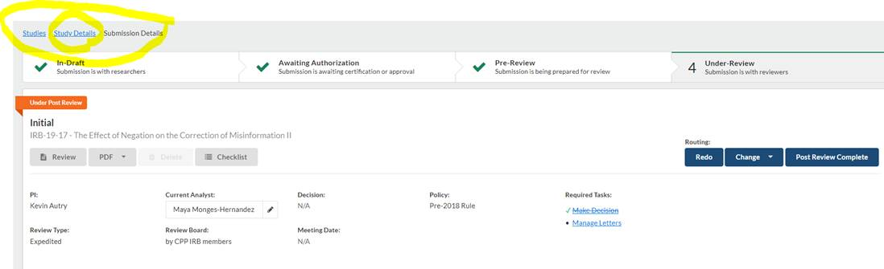
To find your: Study

Slide 8
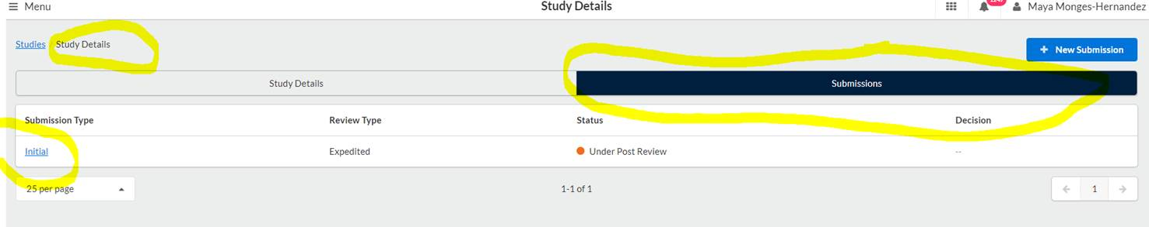
Study details

Slide 9
Cayuse (Continued)
Other reasons that you need to go into Cayuse…
Revise: Returned to the PIs with comments.
  Learn how to navigate through revisions here. (Step by step help with screenshots)
Amend (modification): After IRB approval, when the PI(s) would like to change things to the approved protocol, they must submit an Amendment Submission.
  Our website has step by step help with screenshots
Adverse Event (Incident):
Researchers may encounter "adverse events" and unanticipated problems.
  Cayuse will also provide guidance for reporting
Notes:
Sometimes things in research just don't go as planned.
Renew: When the protocol is close to the expiration date, the PIs will receive notifications. If they wish to renew the approval period for an additional year (the usual amount of time), a Renewal Submission must be submitted before the expiration date (earlier is better!).
Learn how to renew here! (Step by step help with screenshots)

Slide 10
More about Cayuse
Research teams can work together in Cayuse
  For example, a professor can look at all of her students who have IRB protocols in the Cayuse IRB system.
The IRB Review
  Reviews from the IRB member(s) - The member(s) will post both 1) comments, which are required to be addressed because they are IRB regulatory concerns and 2) suggestions
  The approval email - When the protocol review has been completed, an approval email letter to conduct the research study will be issued. A copy is kept within the "Letters" tab of a protocol.
If you need more time…you need a renewal - The Cayuse system will send reminder notices at 45, 30 and 15 days before a protocol expires, so that the PI(s) have adequate time and opportunity to renew it. It is the PI’s, not the IRB’s, responsibility to renew their protocol before it expires.
  For an explanation on how to renew your previously approved IRB protocol in Cayuse
Notes:
Did you know that research teams can work together in Cayuse?
Research teams can work together on drafting protocols and reading IRB member reviews.

Slide 11
Protocol Writing
This is the most difficult part of doing the study.
  I use the word doc template and then copy and past into Cayuse.
  The Cayuse IRB software does not accept Word applications.
  Samples: https://www.cpp.edu/~research/irb/writing-your-protocol.shtml
Consent forms samples
  https://www.cpp.edu/~research/irb/consent-forms.shtml
Anonymous versus confidential
  A study cannot be both—it is one or the other

