Slide 1
Machine Learning
February 7th, 2022
Dr. Carsten Lange
Professor of Economics
California State University, Pomona
clange@cpp.edu

Slide 2
Common Misconceptions About AI
AI discriminates
AI is a Black Box procedure
AI and “intelligence”

Slide 3
AI Discriminates
AI banking and insurance algorithms do discriminate, if not very carefully designed
We need explainable AI models (e.g., SHAP values)
Discrimination is not a new problem in quantitative procedures such as OLS regression or ANOVA
  This is neither fair nor legal, but it did not come up with AI
  Explainable AI algorithms that can detect discrimination and thus allow to implement measures to prevent discrimination.
  Explainable AI algorithms are one of the hottest topics in AI currently (again: SHAP values)

Slide 4
AI is a Black Box
Not anymore!!!
SHAP values

Slide 5
Is Artificial Intelligence Really “Intelligent”?
Let us discuss some statements of Gary Smith, author of “The AI Delusion”.
Professor Smith writes in an article titled :
"CHATBOTS: STILL DUMB AFTER ALL THESE YEARS”
  In 1970, Marvin Minsky, recipient of the Turing Award (“the Nobel Prize of Computing”), predicted that within “three to eight years we will have a machine with the general intelligence of an average human being.”
  Answer: Progress stopped in the 70 but came back in the late 80!!!
“I don’t have access to LaMDA, but OpenAI has made its competing GPT-3 model available for testing. (...). For example, I posed this commonsense question:
Is it safe to walk downstairs backwards if I close my eyes?”
  Answer: OpenAI might not be very powerful but LaMDA certainly is!

Slide 6
Definition of Artificial Intelligence vs. Machine Learning
Turing Test (developed by Alan Turing in 1950): “If the evaluator cannot reliably tell the machine from the human, the machine is said to have passed the test. ”
Google Demo
In what follows I use the term
Machine Learning
in its broadest definition.

Slide 7
What will I show you
Learn a little about tidymodels, a very powerful and easy to use machine learning tool in R
Recognize handwritten numbers with k-Nearest Neighbors
Estimate housing prices with Random Forest
Using SHAP values to interpret machine learning models
Your questions!

Slide 8
Types of Machine Learning
Regression (supervised learning)
Estimate a number.
e.g., estimate the price of a house or estimate a firm’s profit.
Classification (supervised learning)
Estimate a category.
e.g., estimate if a credit card transaction is fraudulent (=1) or not fraudulent (=0), identify handwritten notes as 1,2,3, ...
Clustering (unsupervised learning)
Create a predefined number of groups with similar properties.
e.g., using 1 Mio. balance sheets to determine 6 groups of similar balance sheets. After groups have been determined find what these groups have in common, e.g., industry, size, region, etc.

Slide 9
Classification with Nearest Neighbors
Recognize images from handwritten numbers

Slide 10
The MNIST Datase
`MNIST` is a classic dataset in machine learning, consisting of 28x28 gray-scale images of handwritten digits. The original training set contains 60,000 examples and the test set contains 10,000 examples. Here we will be working with a subset of this data: a training set of 8,500 examples and a test set of 1,500 examples.

Slide 11
Training Data, Test Data, and
Cross Validation
Training Data
Test Data
Are used to optimize/train the ML procedure
The input data are known for each record (here: the 784 element lists for the 7,800 images).
The targets are known for each record (here: the correct labels (0, 1, 2, 3 … 9) for each of the 7800 images)
The ML procedure is trained to best predict the known target data
Test data are never used for training. They are only used to test the performance of the trained ML procedure.
The input data of the test data set are fed into the trained ML procedure (here: the 784 element lists for the 1,000 images)..
The ML procedure predicts a label (here: 0,1,2, … or 9).
The prediction is compared to the true label.
The average error is calculated.

Slide 12
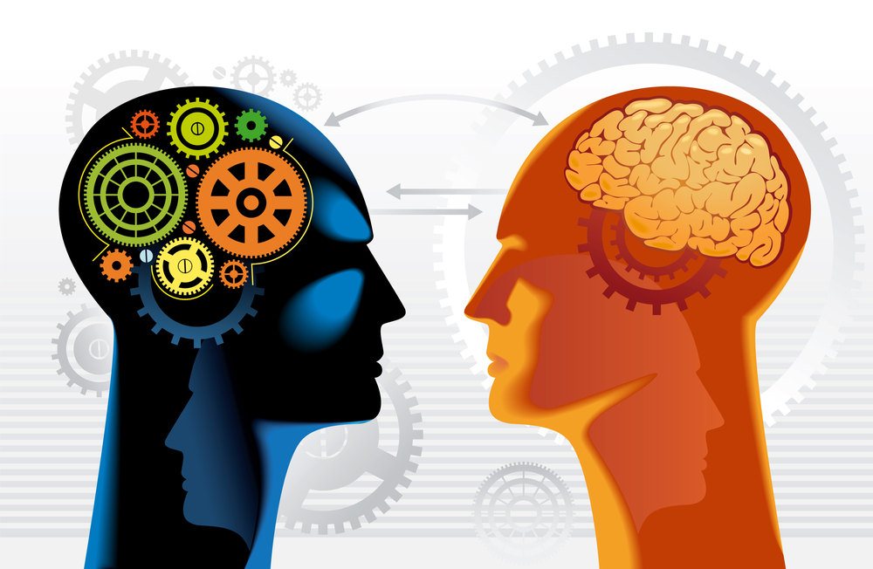
Machine Learning vs. Domain Knowledge
Domain Expert
Understands Problem
Provides Strategies
Provides and Prepares Data
Advises with Data Encoding
Machine Learning Expert
Data Encoding
Standardizes Data
Chooses Algorithms
Optimizes Learning
Tests Results
Implements Learning Results

Slide 13
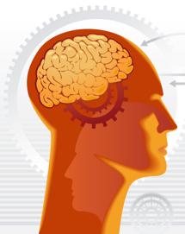
Domain Knowledge:
Raster Images
How are handwritten numbers stored in images?
How can raster imagines be encoded?

Slide 14

Grey scale 28x28 Raster Image (number 9)

Slide 15
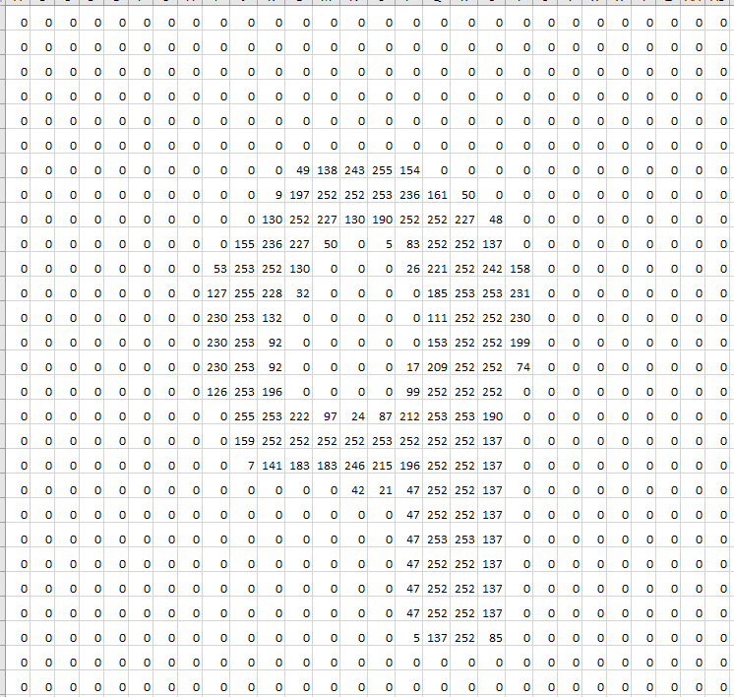
784 list/vector
28x28 array
. . .
Problem: Most ML Algorithms require lists of numbers rather than arrays.

Slide 16
How Does Nearest Neighbor Works
Create a model from the 8,500 records from training dataset
Take the first record from the 1,500 record test data.
Compare the 784 element list/vector of this record with each of the 8500 training records (images) from the training set.
Find the most similar record.
Predict the label from that record.
Compare the predicted label with the true label from the test record and record a possible error.
Go to 1) and repeat steps 1) – 6) for all test records.

Slide 17


How to Measure Similarity Between two Images
- Similarity between their 784 elements lists/vectors -
Similar Images |  |  |  |  | Not-Similar Images
Element i | Image x | Image y | (xi - yi)² |  | Element i | Image x | Image y | (xi - yi)²
1: | 0 | 0 | 0 |  | 1: | 0 | 0 | 0
2: | 0 | 0 | 0 |  | 2: | 0 | 12 | 144
3: | 198 | 244 | 2116 |  | 3: | 198 | 11 | 34969
4: | 200 | 196 | 16 |  | 4: | 200 | 23 | 31329
5: | 12 | 30 | 324 |  | 5: | 12 | 0 | 144
6: | 0 | 0 | 0 |  | 6: | 0 | 0 | 0
7: | 0 | 0 | 0 |  | 7: | 0 | 0 | 0
 |  | Sum: | 2456 |  |  |  | Sum: | 66586

