Slide 1
Virtual Advising & Fall 2021 Registration
Psychology Department
College of Letters, Arts, and Social Sciences
Summer 2021
Notes:
Hello and welcome to Psychology. My name is Erika DeJonghe and I am the chair of our department.

Slide 2
Agenda
Part 1: Getting to Know Us
Psychology Department Overview
Psychology Club (Psi Chi)
Part 2: Getting to Know Your Degree
Curriculum Sheets
Credit Requirements
General Education Requirements
Major Requirements
Part 3: Getting Help
Part 4: Getting Classes (registration!)
Notes:
Here is a brief overview of what we will discuss today. We will begin with this video presentation to cover some crucial advising information. The video will describe basic department information, degree requirements, how to get advising help, and how to approach registration. After the video, we will move info small groups to register for fall classes.

Slide 3
Zoom Etiquette
Make sure your first and last name is visible as your screen name
You should also include your preferred pronouns
Mute yourself when you aren’t talking
Make sure your video is on
Don’t use the Chat for unrelated discussion
You should be the only one logged on to protect both your and others' privacy
Notes:
As we get started, I just wanted to share a few basic tips to make our meeting run as smoothly as possible.
First, please be sure that your full first and last name appears as your screenname. This will allow is to verify that you are present for the session today. In addition, please include your preferred pronouns, if possible.
If you are not speaking, please mute yourself to minimize background noise.
Please make sure your video is on if at all possible. This makes communication much easier. Please use the chat to post questions as needed, but please don’t use the chat for separate discussions.
Finally, to protect your privacy as well as the privacy of others in the session, please make sure that you are the only person logged in to our session today.

Slide 4
2-Step Authentication (DUO) Reminder
Signing up for 2-step authentication to protect your Bronco account is a university-wide requirement
Sign up by July 12 – don’t get locked out of your Bronco account (MyCPP, BroncoDirect, Canvas, etc.)!
Find more information and how-tos at www.cpp.edu/duo
Notes:
I also want to remind everyone that you need to sign up for “DUO” before July 12 or you wont be able to access your classes or your CPP online accounts.

Slide 5
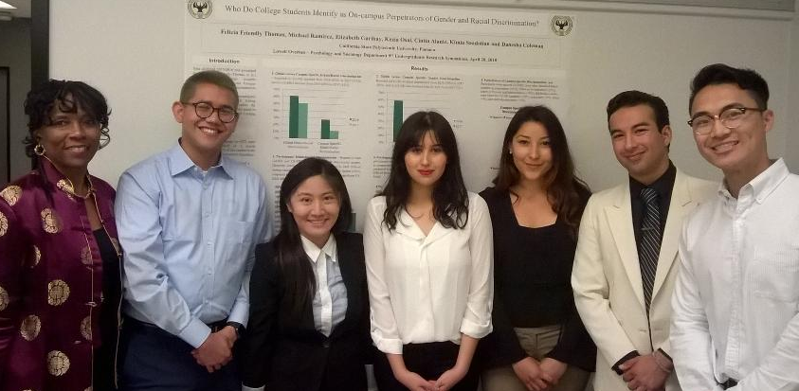
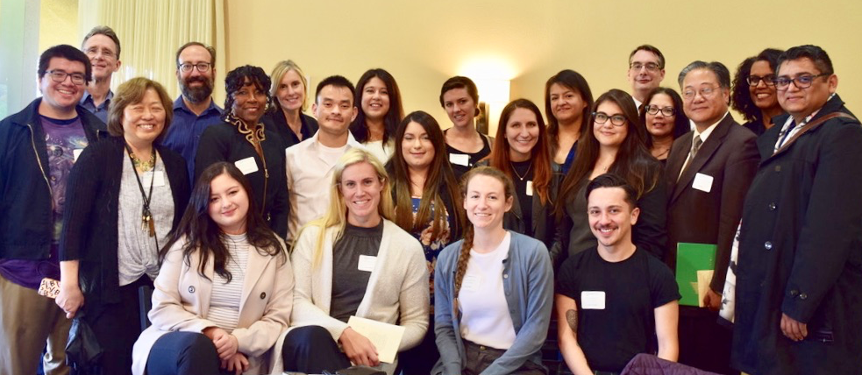
Part 1: Getting to Know Us
Welcome to Psychology!
https://www.cpp.edu/class/psychology/index.shtml
Notes:
Welcome to you new psychology family.
The link to the department web page is provided here. We are revising the website this summer and I hope that you will find it to be a useful resource going forward.

Slide 6
Psychology Faculty and Staff
Clinical/Counseling Psychology: Lori Barker, Erika DeJonghe, Alejandro Morales, James Sturges, & Felicia Friendly Thomas
Cognitive Psychology: Kevin Autry & Nicholas Von Glahn
Developmental Psychology: Juliana Fuqua & Susan Siaw
Educational Psychology: Michael Giang
Industrial/Organizational Psychology: Jill Nemiro & Sara Langford
Neuropsychology: Robert Blumenfeld
School Psychology: Tatiana Pumaccahua
Social/Environmental Psychology: Viviane Seyranian
Department Office: Antionette Abernathy
Notes:
As you might know, psychology has lots of sub-disciplines. This is a list of all of our permanent faculty by sub-discipline.

Slide 7
Psychology Faculty Advising
Each of you will be assigned a Psychology Faculty Advisor during your first term.
Once assigned, you may locate you advisor’s name in your Degree Progress Report (DPR).
Advisor names, email addresses and office hours can be found at the Psychology Department website, as well as on the department website.
You can see any faculty member for advising during their office hours.
Notes:
A great way to get involved with the major is to get to know the faculty. Everyone is assigned a faculty advisor, but you can choose to meet with any faculty in the department. After getting to know the major better, you will probably tend to want to meet with a faculty area in the subdiscipline you want to pursue.

Slide 8
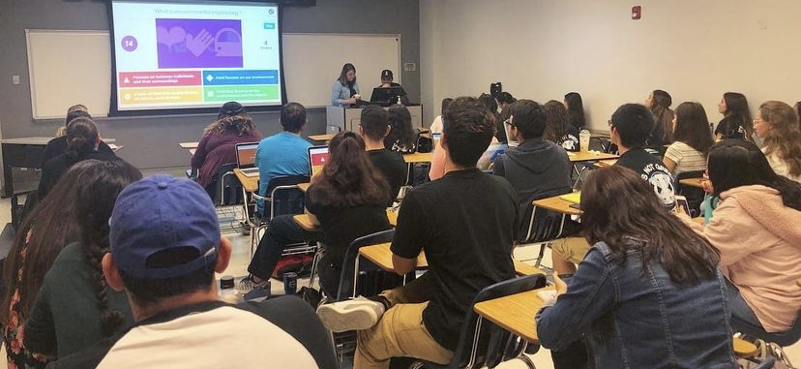
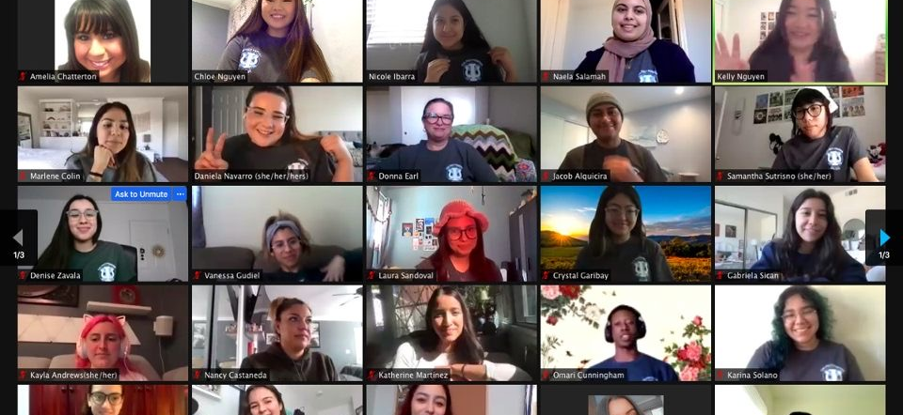
Psi Chi (https://bio.fm/calpoly)
Our Psychology club!!!
Instagram, Facebook, and Twitter: @psichicpp
Notes:
Another great way to get involved with the major is to join our student club. Psi Chi is the psychology club and they are pretty much the nicest group of folks you will meet. They usually mee t in person every Tuesday form 12-1, but they kept meeting at that time by zoom right through the pandemic. Even if you are not sure you want to join the club yet, you should follow them on social media for sure. They send out lots of great info about the major and it is a really easy way to stay on top any Psychology-related events.

Slide 9
Part 2: Getting to Know Your Degree
…or “how to graduate on time!”
Notes:
Next, I’m going to walk you through the main degree requirements to help you understand how to graduate on time. There are three major resources you will want for this section of the presentation and for registration. The first is the college CANVAS site. The second is the curriculum sheet, which you will find on the CANVAS site. The third is your CPP Connect Planner (which I will talk about in a few minutes).

Slide 10
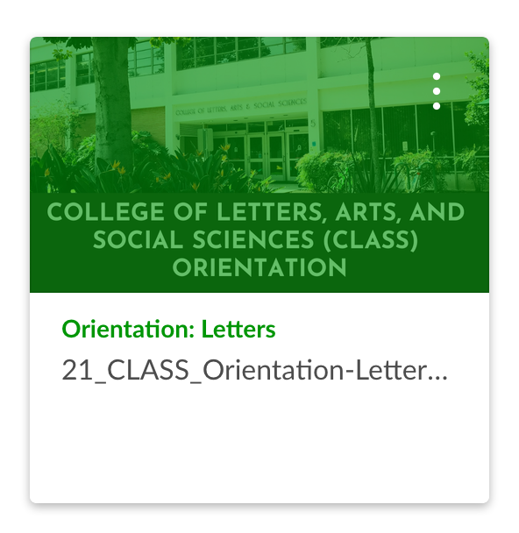
Our College Canvas Site
Links to Curriculum Sheets
Information about CPP Connect Planner
General Education Information
Instruction Modes Overview
Advising Contact Information
College-Specific Information
Link to New Student Registration Guide
Make sure you have it pulled up to reference today – find Canvas in your MyCPP portal

Slide 11
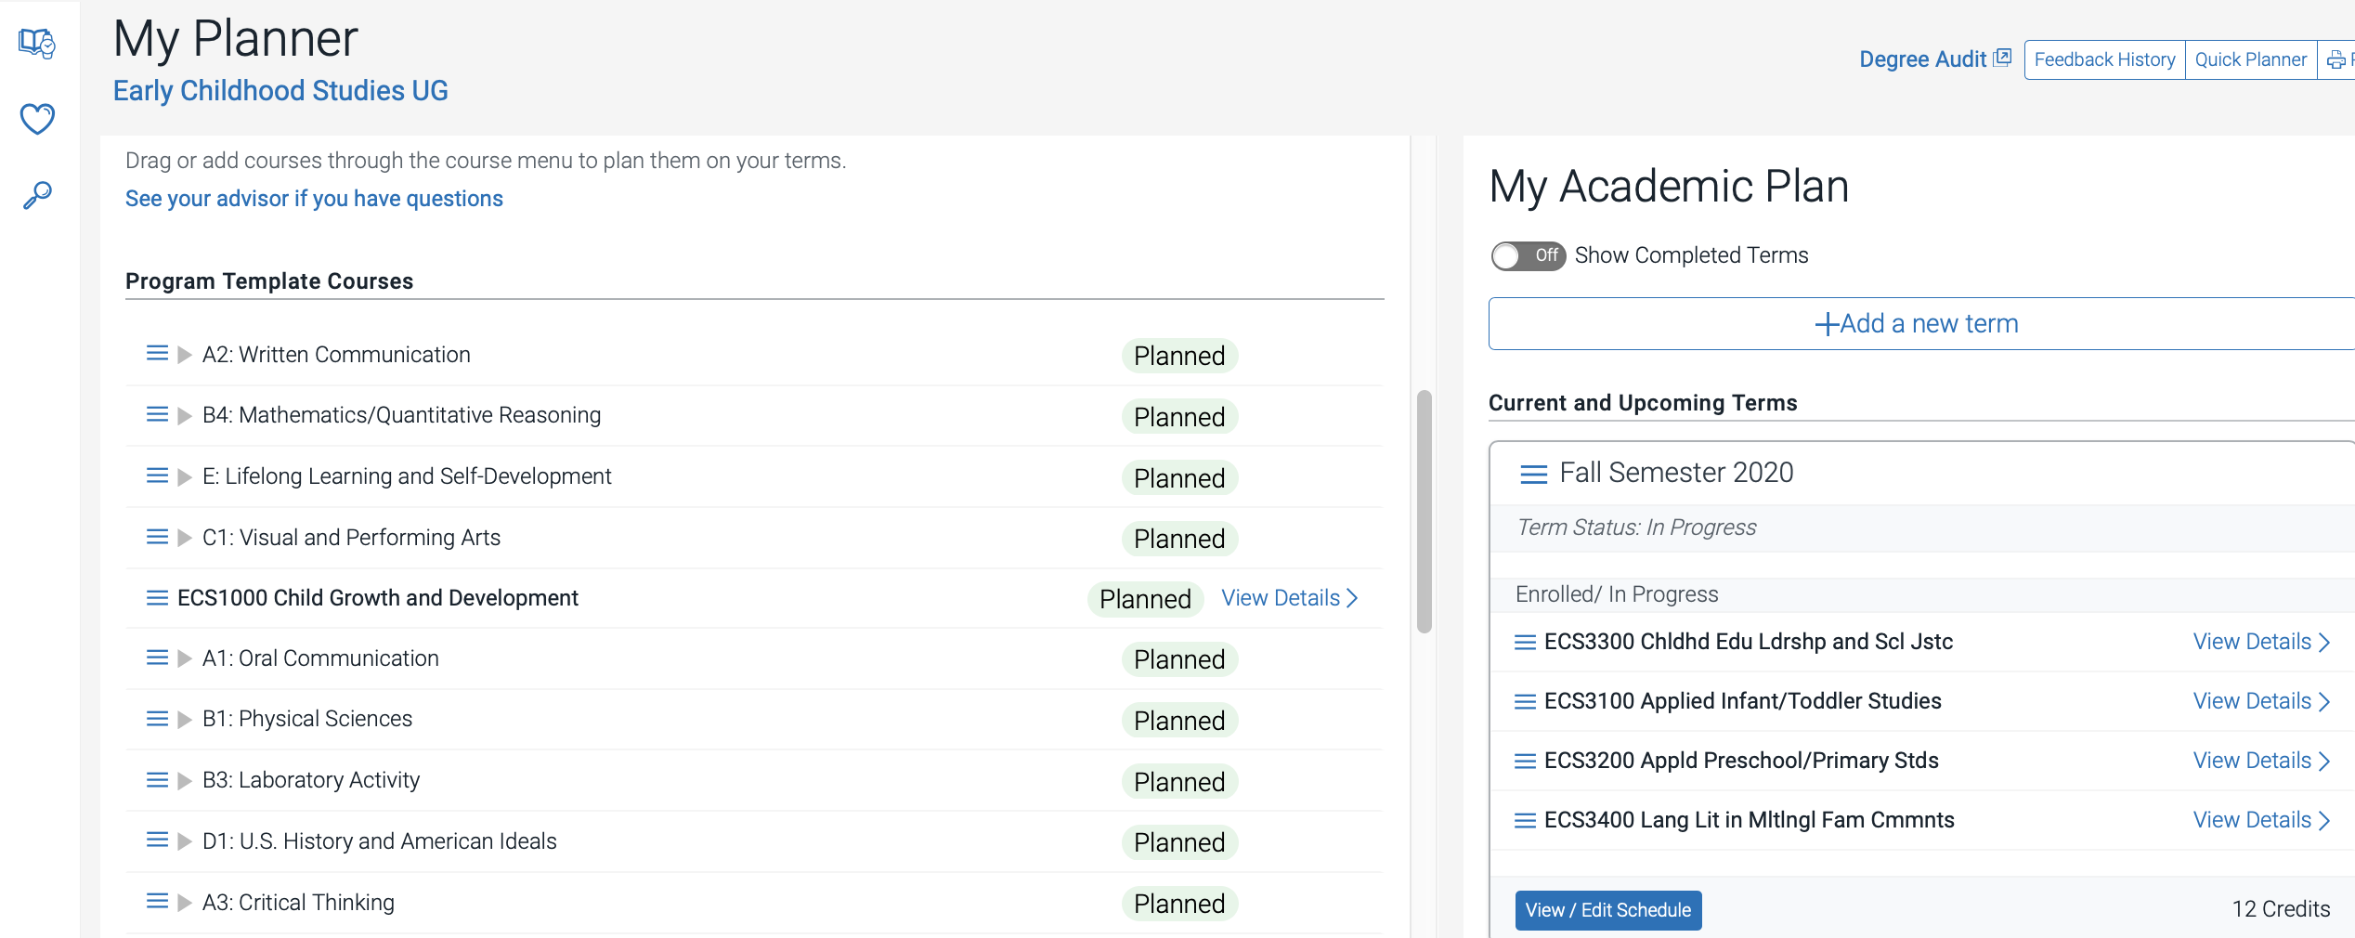
CPP Connect’s Planner
Map out your term-by-term plan with courses from your other academic planning tools
Use it with your other academic planning tools
Have it open and ready to review during our session
Notes:
Another important tool that will help you plan for graduation is your CPP Connect Planner. Alongside your other academic planning tools, you can map out your term-by-term plan with courses from your curriculum. Your advisor can access it too and make suggestions or approve your plan. If everyone fills out their Planner, it helps CPP plan for course demand.
You should access and work on filling it out with your 2- or 4-year plan before your Orientation program. You’ll get an email when it’s available to you. Be sure to pay attention to the upcoming Online Orientation slide about Planner so you can learn more about it.

Slide 12
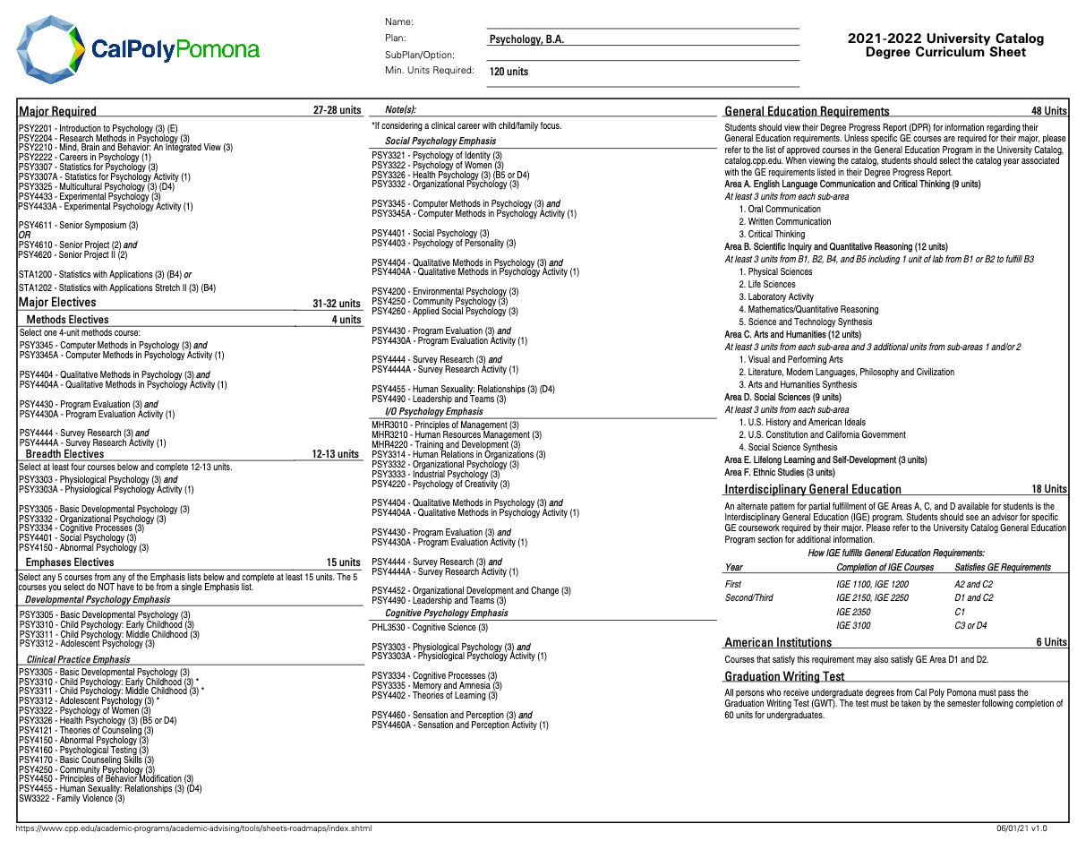
Your Curriculum Sheet
University Requirements
Total Units
Upper Division Units
General Education​
Major Required Core​
Major Electives
Unrestricted Electives​
Linked on our College Canvas Site
Notes:
Your curriculum sheet ilists most of the basic requirements for your degree. I’ll walk you through these now.

Slide 13
Your Curriculum Sheet
University Requirements
Total Units =120
Upper Division Units = 60
General Education​
Major Required Core​
Major Electives
Unrestricted Electives​
Linked on our College Canvas Site
Notes:
Frist, let’s discuss the overall university degree requirements.
There are 120 units needed to complete your undergraduate degree and 60 of these must be upper division courses.

Slide 14
Take 30 to Graduate on Time
Fall
12 units
Spring
12 units
Year
30 units
Summer
6 units
Fall
15 units
Spring
12 units
Year
30 units
Summer
3 units
Fall
15 units
Spring
15 units
Year
30 units
0 units
Summer
Notes:
One important thing to keep in mind when you are planning for classes is to consider taking 30 units each year. Your degree at Cal Poly Pomona are 120 semester units. Taking 30 units per year puts students who are on these degree programs on track to graduate in two (for transfer students) or four years (for first-time freshmen).
Here are a few options of what you can do in future terms:
- If you take 12 units in the fall, you can take 12 units in the Spring and then take 6 units in the summer to complete your 30 units in one year.
- If you take 15 units in the fall, you can take 12 units in the Spring and then take 3 units in the summer to complete your 30 units in one year.
Or you can take 15 units in the fall, take 15 units in the Spring, and complete your 30 units for the year. You’d be able to take use summer to get ahead for next year.
Engineering and architecture degrees have more units and are considered five-year programs. Visit your academic advisor to do your longterm academic planning and determine your unit load.

Slide 15
Your Curriculum Sheet
University Requirements
Total Units
Upper Division Units
General Education​
Major Required Core​
Major Electives
Unrestricted Electives​
Linked on our College Canvas Site
Notes:
Everyone must also complete the university’s general education requirements (commonly called GEs).

Slide 16
Your General Education Curriculum
GE Area A
English Language Communication and Critical Thinking (9 units)
Oral Communication
Written Communication
Critical Thinking
GE Area B
Scientific Inquiry and Quantitative Reasoning (12 units)
Physical Sciences
Life Sciences
Lab Activity
Mathematics /Quantitative Reasoning
Science and Technology Synthesis (upper division)
GE Area C
Arts and Humanities (12 units)
Visual and Performing Arts
Literature, Modern Languages, Philosophy and Civilization
PLUS 1 more course in C1 or C2
GE Area D
Social Sciences (9 units)
U.S. History American Ideals
U.S. Constitution and California Government
Social Science Synthesis (upper division)
GE Area E
Lifelong Learning and Self-Development (3 units)
GE Area F
Ethnic Studies (3 units)
3. Arts and Humanities Synthesis (upper division)
Notes:
The general education curriculum has 6 overall areas and within each, there are specific courses you can take to fill each sub-area.

Slide 17
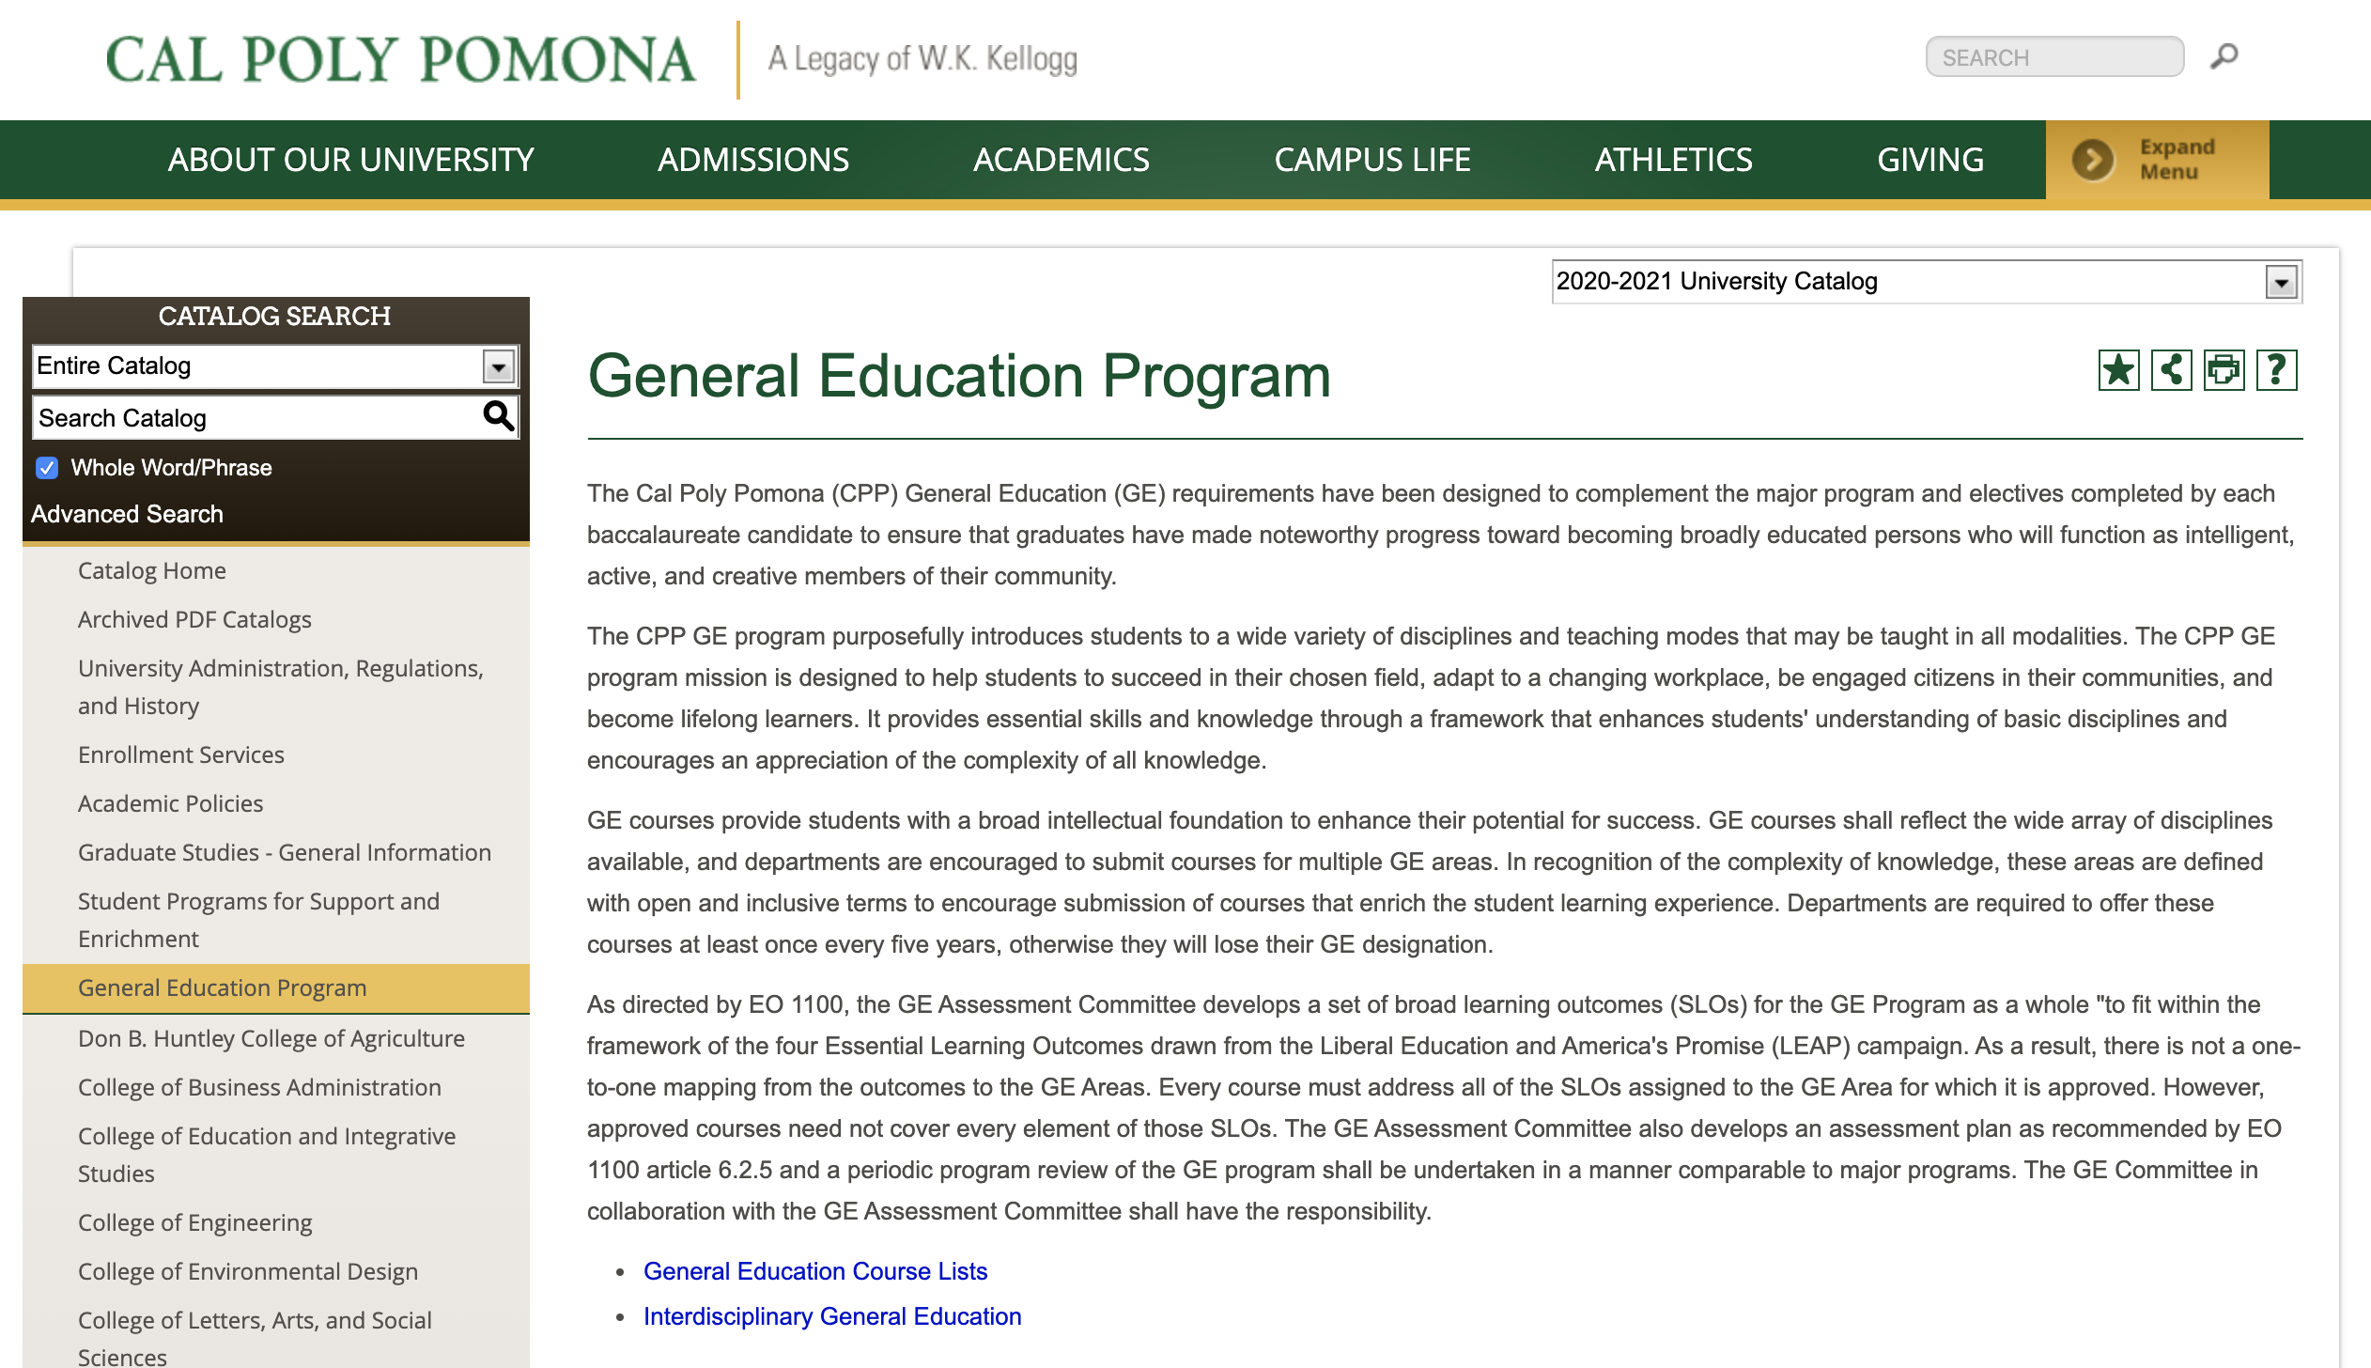
Finding GE Courses
University Catalog GE Course Listings
Make sure you are using the 2021-22 catalog
Shows you all the courses within the GE areas
Note: Not all GE courses are scheduled every term
catalog.cpp.edu
Notes:
To find the GE course lists, visit the University Catalog at catalog.cpp.edu. Make sure that you are using the 2021-22 version.
Click on General Education Program in the lefthand menu, and then click on the link for the General Education Course Lists. It’ll show you all the potential classes to take within each GE area. You can learn more about the IGE curriculum there too.
Note that not all GE courses are scheduled every term, so you may need to pick a few options.

Slide 18
Your Curriculum Sheet
University Requirements
Total Units
Upper Division Units
General Education​
Major Required Core​
Major Electives
Unrestricted Electives​
Linked on our College Canvas Site
Notes:
General organization of the pink sheet
Major Required (must take)
Major Electives: Methods (1 course); Breadth (5 courses); Emphases (5 courses); Unrestricted (12-26 units)
General Education
General Education-SOME COURSES DOUBLE COUNT!!
Choices with no flexibility vs. choices with flexibility
Units can double count in the major and in GE
(e.g., PSY 2201 satisfies Area E, STA 1200 satisfies B4, . . . etc.)
Still need to meet 120 overall units; units only count once
Always check for course pre-requisites https://www.cpp.edu/~class/psychology/student-resources/student-forms.shtml
PSY 2201, ENG comp, STA 1200 / PSY 2204 / PSY 3307 / PSY 4433

Slide 19
Your Curriculum Sheet
University Requirements
Total Units
Upper Division Units
General Education​
Major Required Core​
Major Electives
Unrestricted Electives​ (enough to get to 120 units)
Linked on our College Canvas Site
Notes:
General organization of the pink sheet
Major Required (must take)
Major Electives: Methods (1 course); Breadth (5 courses); Emphases (5 courses); Unrestricted (12-26 units)
Choices with no flexibility vs. choices with flexibility
Units can double count in the major and in GE
(e.g., PSY 2201 satisfies Area E, STA 1200 satisfies B4, . . . etc.)
Still need to meet 120 overall units; units only count once
Always check for course pre-requisites https://www.cpp.edu/~class/psychology/student-resources/student-forms.shtml
PSY 2201, ENG comp, STA 1200 / PSY 2204 / PSY 3307 / PSY 4433

Slide 20
Part 3: Getting Help
Making Use of Advising

Slide 21
How to be successful?
It is your responsibility to do what you need to do to graduate.
But we are here to help and guide you.
Notes:
Ultimately, it is always the student’s responsibility to make sure that you are meeting your graduation requirements. However, we want to provide you with lost of help along the way.

Slide 22
Types of Advisors Who should you go to?
CLASS
STUDENT SUCCESS CENTER
General Curriculum and GE-related advising
Transfer –related Advising
Graduation Requirements
Academic Petitions
DEPARTMENT
FACULTY ADVISORS
Major/Minor Related Advising
Graduate School and Career Related Advising
Advising related to student involvement in the department- undergraduate research, clubs, etc
Notes:
There are two main types of advisors our students use and you’ll probably want to be BOTH types pretty consistently. The first are our CLASS Student Success Center Advisors. These are professional advisors who are really great at helping you make sense of university policies and procedures. You might see them for checks on graduation requirements or to help you submit petitions if you need to. Faculty advisors are really experts in psychology. They are fantastic to talk to about your career, what you want to do after you graduate, and what you need to do during your years at CPP to prepare for your next steps after graduation.

Slide 23
Part 4: Getting Classes
Registration!!

Slide 24
What should you register for today?
12-15 units including:
GE Math
(STA 1200)
GE English
PSY 2201 and/or PSY 2210
other courses recommended on your Planner

Slide 25
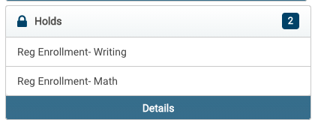
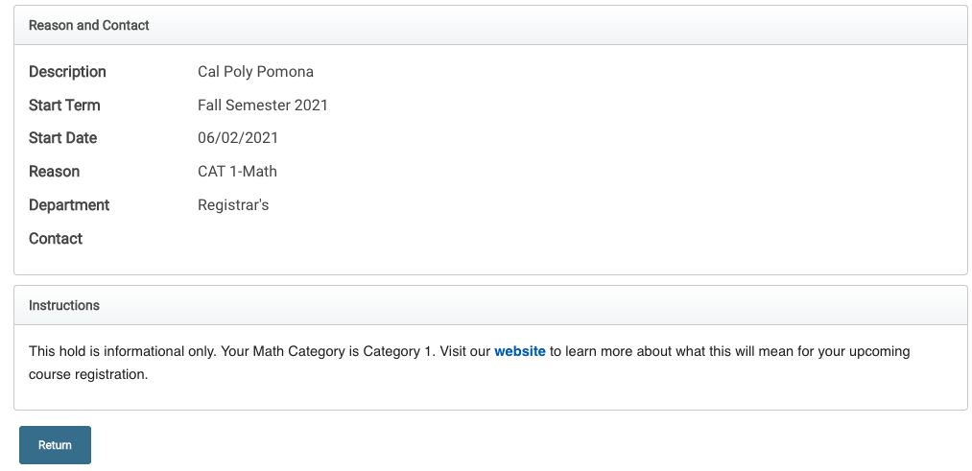
Check your Math and English Placement Categories:
Step 1: View your Category Placement in your BroncoDirect Student Center’s Holds box
Step 2: Review the website to learn what this will mean for you

Slide 26
GE Writing Course- If you see:
Category I
Your GE English requirement has been met
Category II
Use Directed Self Placement to pick your course
Category III
Use Directed Self Placement to pick your course. Required to enroll in course in fall.
Category IV
Use Directed Self Placement to pick your course. Required to enroll in course in fall.

Slide 27
GE Math Course- If you see:
Category I
Category II
STA 1200.
Category III
STA 1200 AND required co-requisite of STA 1200A, or STA 1201/A in Fall and STA 1202 in Spring.
Category IV
STA 1201/A in Fall, and STA 1202 in Spring.
GE Math requirement met but may need STA 1200 for major.

Slide 28
Registering for GE Areas A2 and B4
You may be automatically enrolled for the appropriate English and/or Math course for Fall 2021 when you register at Orientation – you can make adjustments with the help of an advisor
If you're not, you may have already completed the requirements, or you'll take them in Spring 2022 instead
If we receive AP scores or if you take the ALEKS calculus placement test (if applicable), you can make changes to your schedule during adjustment period (starts August 9)

Slide 29
Guided Registration for Area F and D2
You may be enrolled in other GE area courses to help keep you on track to completing GE requirements – you can make adjustments with the help of an advisor
When you register for Fall, BroncoDirect may also guide you to register for specific GEs before other classes – also to help keep you on track
If you have any questions about what you’re automatically enrolled in, ask your advisor during your Orientation program

Slide 30
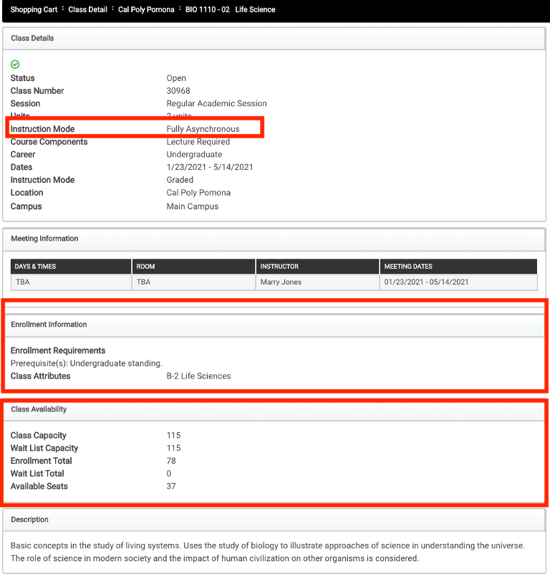
Course Details
Enrollment Requirements & Class Attributes
Prerequisites/Corequisites
GE Designation
Class Availability
Instruction Mode

Slide 31
Instruction Modes: At-a-Glance
MODE | HOW |  |  | WHEN
MODE | In-person | Online | Both | Any Time | Set Time | Both
Face-to-Face
Fully Asynchronous
Fully Synchronous
Hybrid-Asynchronous
Hybrid-Synchronous
HyFlex
Notes:
Face-to-Face
In-person instruction for all meetings
Online:
Instruction delivered online
Fully Asynchronous
Online instructional content accessed at any time
Fully Synchronous
Online instruction delivered at specific times
Hybrid:
Combination of in-person and online instruction modes
Hybrid-Asynchronous
In-person meetings and anytime content online
Hybrid-Synchronous
In-person meetings and online meetings at a specific time
HyFlex
Students may choose to attend each class meeting in-person with the instructor, synchronously online or asynchronously online

Slide 32
During Virtual Advising (Today)
E-Student Services: Registration Troubleshooting, AP Score, Transcript and Financial Aid Questions
Hours Today: 1:00 to 5:00 p.m.
Zoom Link: https://cpp.zoom.us/my/estudentservices
Notes:
So where do you go if you need help today?? We’ll put you in to smaller groups to register. You will be able to get some help in those breakout rooms.

Slide 33
After Today
Bronco Advising Center
Hours: Monday to Friday, 8 a.m. to 5 p.m.
Email: bac@cpp.edu
Phone: (909) 869-4600
Check website for updated hours: https://www.cpp.edu/bac
CLASS Student Success Center
Info and appointments at https://www.cpp.edu/class/student-success-center/index.shtml
Faculty Advising
FALL: List of faculty office hours and contact information at department office and department website
SUMMER: To schedule a meeting with the department chair, email Antionette Abernathy at arabernathy@cpp.edu
Keep tabs on CPP email and Billy Chat text messages
Notes:
If you would like to schedule a time to meet, please reach out to Antionette Abernathy (arabernathy@cpp.edu) department office to arrange an appointment.
you can seek advising with the CLASS Student Success Center at https://www.cpp.edu/class/student-success-center/index.shtml (scroll down on that page for info on how to make an appointment)

Slide 34
Before you leave us today:
Register for 12-15 units.
Review your CPP Connect Planner and ask questions.
Know how to find advising after today.

Slide 35
Fall 2021 Registration!!!!!
You will be assigned to breakout rooms for small group advising
Use the reaction buttons in zoom to raise your hand and ask for questions
For individual conversations, you may move to a separate breakout room.
Consult your CPP Connect Planner
Log into broncodirect and enroll!

