Slide 1
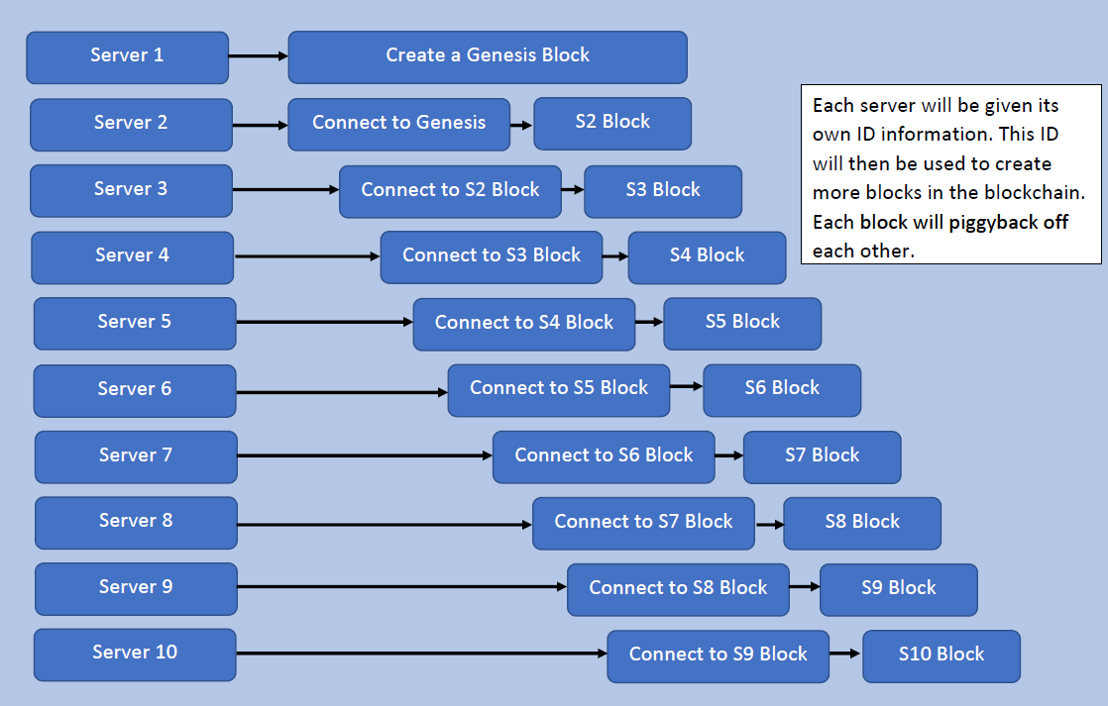
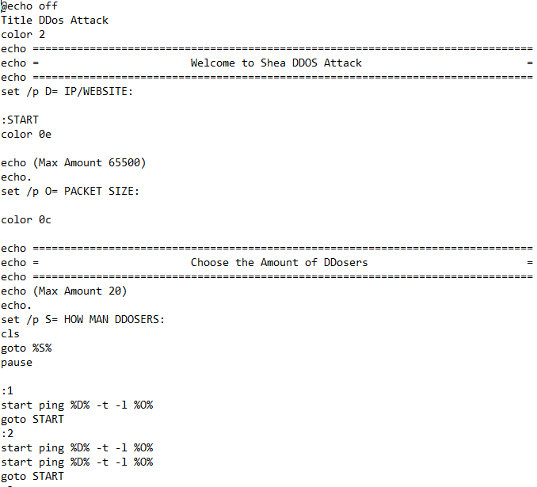
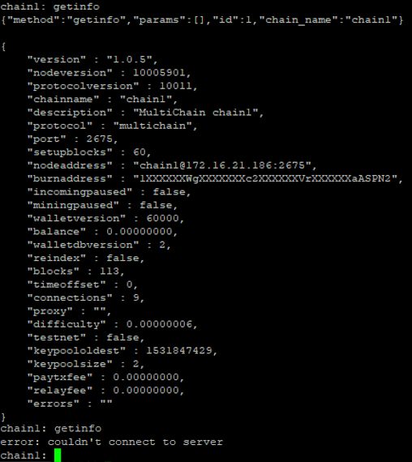
Title
Team: Name 1, Name 2
College Name, College Department
Cal Poly Pomona Cybersecurity and Awareness Fair 2021
Cybersecurity Awareness OR Problem-Solving Category
Problem
Analysis
Figure 3: Blockchain Architecture
Challenges
Recommendations
Figure 1: Dos Attack Bash Script
Figure 2: Dos Attack Execution
Sources

