Slide 1
How to: PEER NOTETAKING (Confirm Notetaking)
Peer Notetaking is a 2-step process. Step one is described in How-To: Request your Accommodations.
The second step of the Peer Notetaking process requires you to confirm your request.
From My Accommodations menu, select Notetaking Services
Click on Confirm Now under each class.
Confirmation – Done!

Slide 2
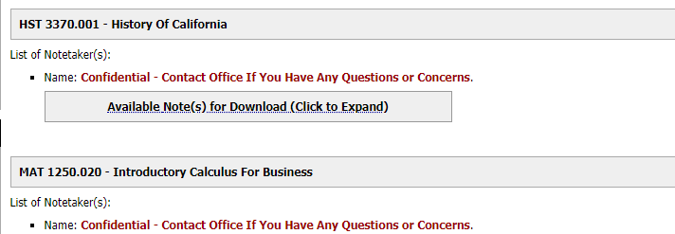
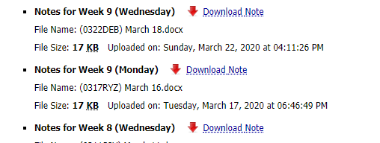
How to: DOWNLOAD NOTES
From My Accommodations menu, select Notetaking Services
Available notes from each class will be listed. Click on the Available Notes for Download to open the list of notes.
Click on Download Note to view the file.

Slide 3
If you have any questions, please contact our office.
We’re here to help!
Email: drcnotetaking@cpp.edu

