Slide 1


GHS Hazard Communication
Environmental Health & Safety

Slide 2
What is GHS?
GHS stands for the Globally Harmonized System of Classification and Labeling of Chemicals.
  It is the new standard for hazard communication that gives workers the “right to understand,” rather than the original 1983 standard that gave workers the “right to know.”

Slide 3
What are the benefits of GHS?
GHS provides a harmonized system for classifying and identifying hazardous chemicals according to their physical, health and environmental hazards.
  This newly defined system can be used and understood across international borders which improve the quality and consistency of hazardous information.
  It also helps reduce worker confusion and improves their understanding of the information being provided.

Slide 4
Major Changes in GHS
Labels will now include a signal word, pictogram, hazard statement, and precautionary statement for each hazard class and category.
Safety Data Sheets require a new format with sixteen different sections to ensure consistency and are formally known as a Material Safety Data Sheet (MSDS).

Slide 5
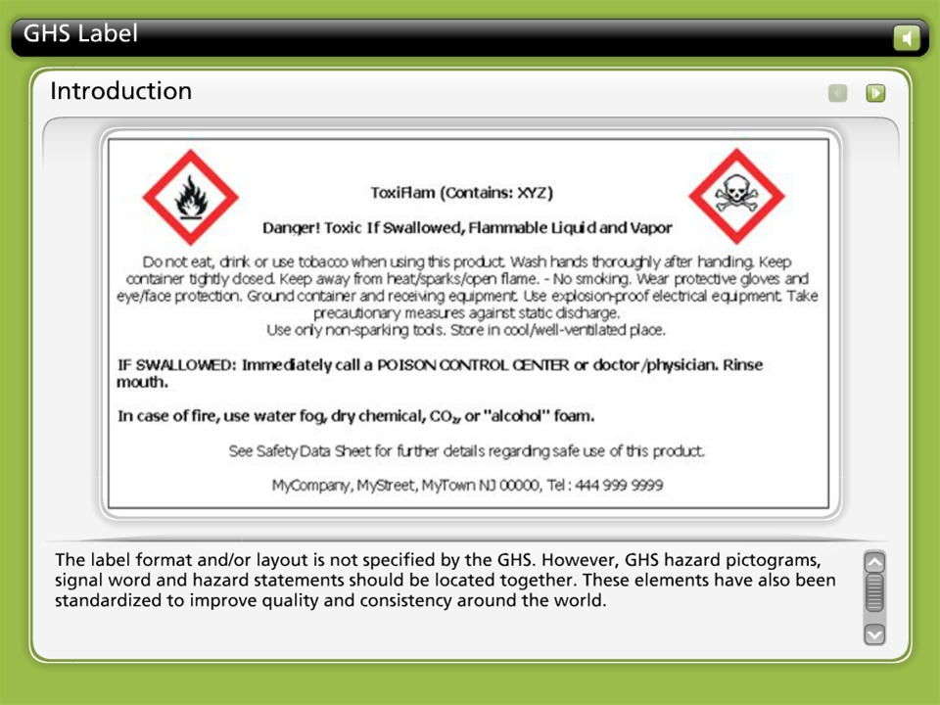



GHS Label

Slide 6
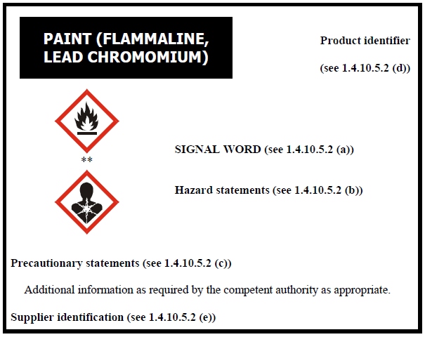
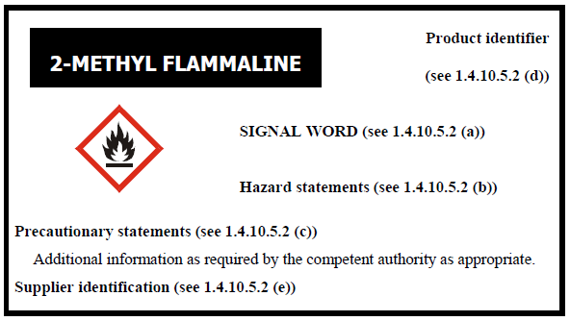
Examples of other GHS Labels
These two labels illustrate the other formats that one can see when using hazardous chemicals.
Even though the layout is different than one previously displayed the content still stays the same.

Slide 7



GHS Symbols & Hazard Classes
Oxidizers
Flammables
Self Reactives
Pyrophorics
Self-Heating
Emits Flammable Gas
Organic Peroxides
Explosives
Self Reactives
Organic Peroxides

Slide 8



GHS Symbols & Hazard Classes
Acute Toxicity (severe)
Corrosives
Gases Under Pressure

Slide 9



GHS Symbols & Hazard Classes
Carcinogen
Respiratory Sensitizer
Reproductive Toxicity
Target Organ Toxicity
Mutagenicity
Aspiration Toxicity
Environmental Toxicity
Irritant
Dermal Sensitizer
Acute Toxicity (harmful)
Narcotic Effects
Respiratory Tract Irritation

Slide 10
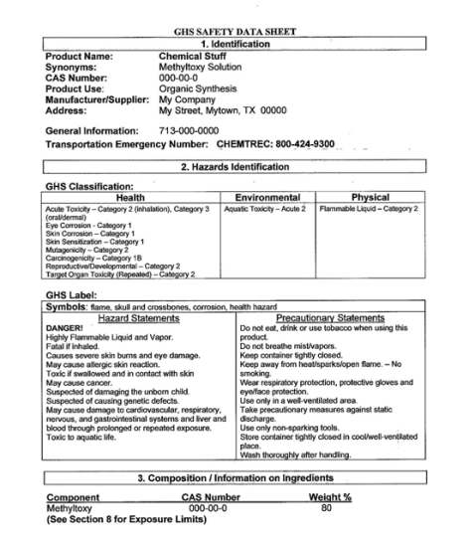
GHS Safety Data Sheet
The GHS Safety Data Sheet (SDS) provides comprehensive information on hazards in the workplace and offers advice on safety precautions.
It has a format of sixteen defined sections to ensure consistency and understanding.
A Safety Data Sheet is also formally known as a Material Safety Data Sheet or MSDS.

Slide 11
Sections 1-2 of a GHS SDS
Section 1: Identification of the substance or mixture and of the supplier.
  Section 1 should consist of a product identifier (the same one used on the GHS label), supplier or manufacture details, recommendations and restrictions of use, and an emergency telephone number.
Section 2: Hazards identification
  Consists of the GHS classification of the substance and/or mixture, as well as any national or local information.
  GHS label elements, such as symbols (can be provided with the written name of the symbol or pictogram), precautionary statements and other hazards which are not covered by the GHS can also be provided in this section.

Slide 12
Sections 3-4 of a GHS SDS
Section 3: Composition/Information on ingredients
  Section 3 contains the chemical identity, common name and synonyms of the given substance and/or mixture. The chemical identity and concentration of all hazardous ingredients will be provided for all hazardous mixtures.
  CAS numbers, EC numbers, impurities and stabilizing additives should also be provided in this section as well.
Section 4: First aid measures
  Consists of descriptions for necessary measures that are subdivided according to the most important symptoms/effects from different routes of exposure, such as, inhalation, skin and eye contact and ingestion.

Slide 13
Sections 5-8 of a GHS SDS
Section 5: Firefighting measures
  Consists of suitable extinguishing media and special protective equipment and precautions for firefighters, as well as any specific hazards arising from the chemical.
Section 6: Accidental release measures
  Includes personal precautions, protective equipment and emergency procedures. Environmental precautions, methods and materials for containment and cleaning up are available in this section as well.
Section 7: Handling and storage
  Section 7 contains precautions for safe handling and conditions for safe storage, including any incompatibilities with other chemicals.

Slide 14
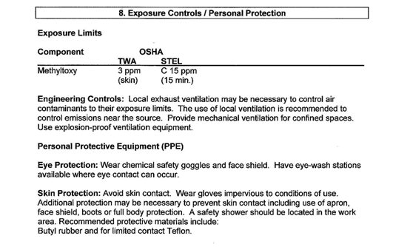
Section 8 of a GHS SDS
Section 8: Exposure controls/personal protection
  Includes control parameters, such as, occupational exposure limits or biological limits. Appropriate engineering controls and individual protection measures, such as protective equipment is provided in this section as well.

Slide 15
Sections 9-12 of a GHS SDS
Section 9: Physical and chemical properties
  This section contains the physical and chemical properties, such as, appearance, odor, pH. level, melting point/freezing point and flash point
Section 10: Stability and reactivity
  Contains information on the chemical stability and possible hazardous reactions.
Section 11: Toxicological information
  Consist of a full and clear description of various health effects and the information one needs to know in order to identify the side effects.
Section 12: Ecological information
  Includes any adverse effects on the environment such as ecotoxicity and degradability.

Slide 16
Sections 13-16 of a GHS SDS
Section 13: Disposal considerations
  Include a description of waste remains and information on safe disposal.
Section 14: Transport information
  Contains information such as the UN number, shipping name and the transport hazard class or classes.
Section 15: Regulatory information
  Consists of any specific regulations for the identified product.
Section 16: Other information
  Contains any other information, such as preparation and revision of the SDS.

Slide 17
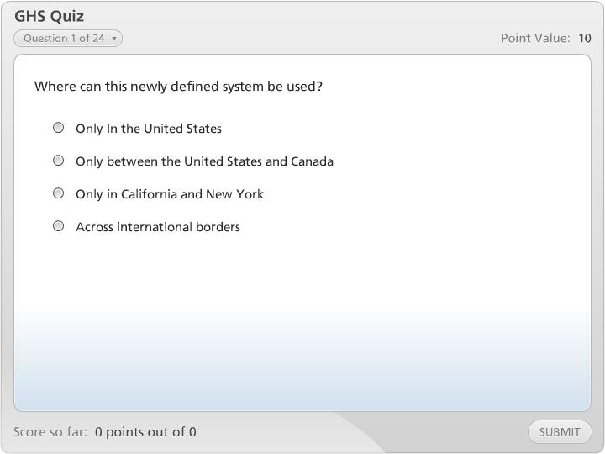

GHS Quiz

