Slide 1
CHRS Webinar Demo​
Introducing the Personal Profile & Benefits Modules​
February 9, 2026 I 10 – 11:30 AM

Slide 2
Agenda
CHRS Refresher
Today’s Modules
  Personal Profile
  Benefits
Demo Walkthrough
Q&A
Additional Resources & Information
Notes:
Any questions can be typed into chat.

Slide 3
What Is CHRS?
CHRS = Common Human Resources System​
Upgraded version of PeopleSoft​
A unified CSU-wide system​
Modern, intuitive, and mobile-friendly​
Designed to simplify HR tasks for all employees

Slide 4
What’s Changing for You?​
Cleaner, easier-to-use screens​
Clearer workflows (e.g., updating personal information, viewing benefits)​
Better consistency across all campus roles​
Improved self-service

Slide 5
Personal Profile Module

Slide 6
Personal Profile Overview​
What you can do in CHRS Personal Profile:​
  Add or Update Emergency Contacts​
  Disability Status​
  Final Paycheck Designee​
  Personal Address​
  Preferred Name​
  Veteran Status​
  Update Your Ethnicity

Slide 7
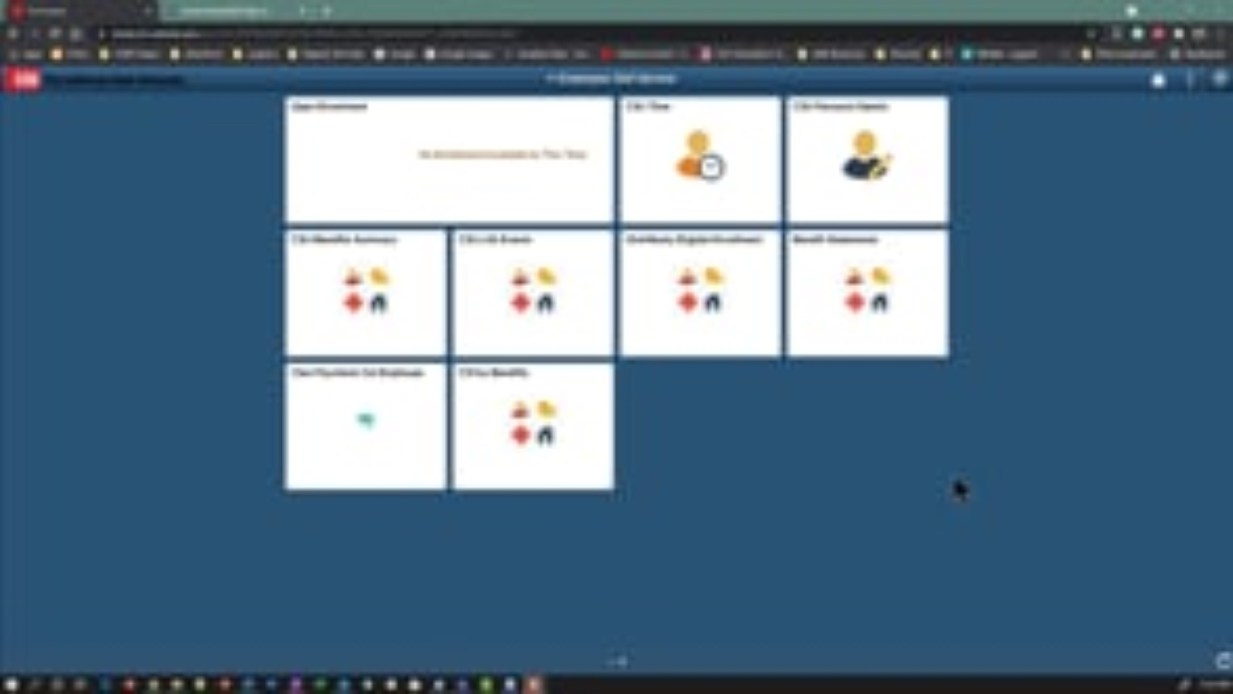
Contact Details

Slide 8

Knowledge Check
What should you do to set a phone number or email address as your preferred contact?​
Delete all other contacts​
Rename the contact​
Select the "Preferred" checkbox for the desired contact​
Contact the HR department
Notes:
Cue Yesenia to launch poll.

Slide 9

Update Address

Slide 10
Knowledge Check
What options do you have if find your mailing address is not current or incorrect?
A. Ignore it
B. Use CHRS employee self-service to change your mailing address to your current home address.
C. Contact your Human Resources department to request that your mailing address be made inactive
D. Both B and C

Slide 11
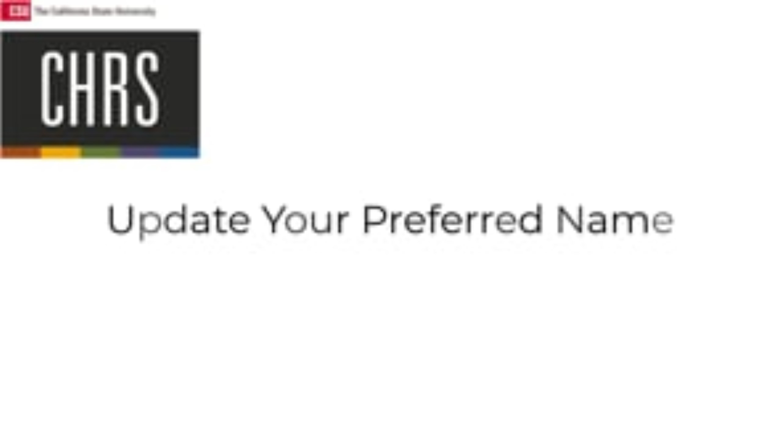
Update Preferred Name

Slide 12
Knowledge Check
How can you verify that your preferred name has been updated successfully?
Check your email for a confirmation
Refresh the page to see the updated name in the top left corner
Contact HR to confirm
Log out and log back in

Slide 13
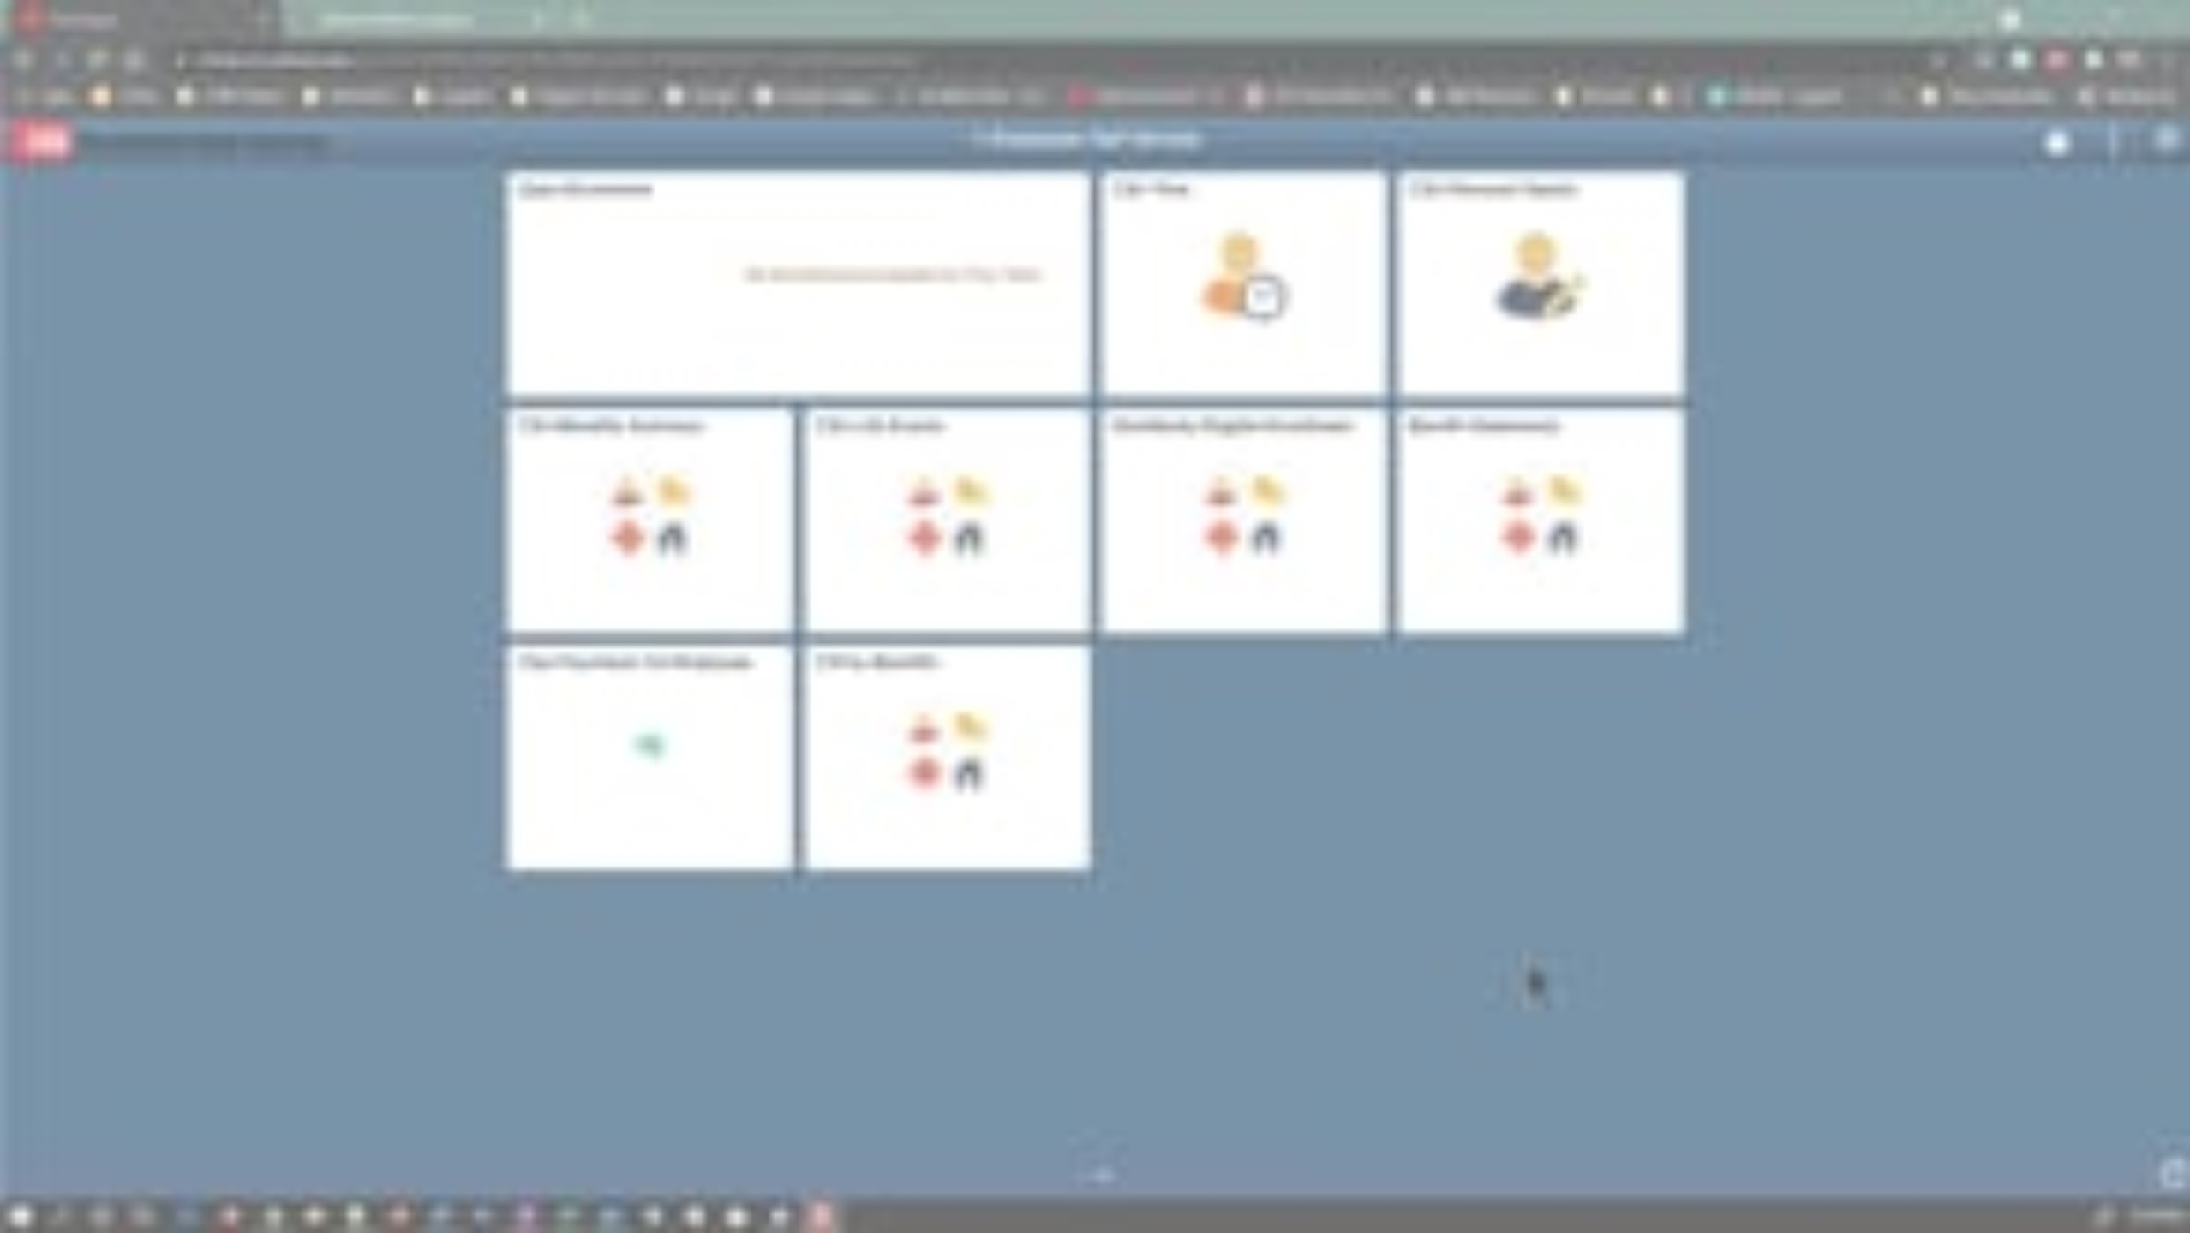
Add or Update Emergency Contacts

Slide 14
Knowledge Check
What information do you enter for your emergency contact?
Name and phone number only
Name, relationship, preferred contact, address and phone number
Name, relationship and phone number
Name, Relationship Preferred and address

Slide 15
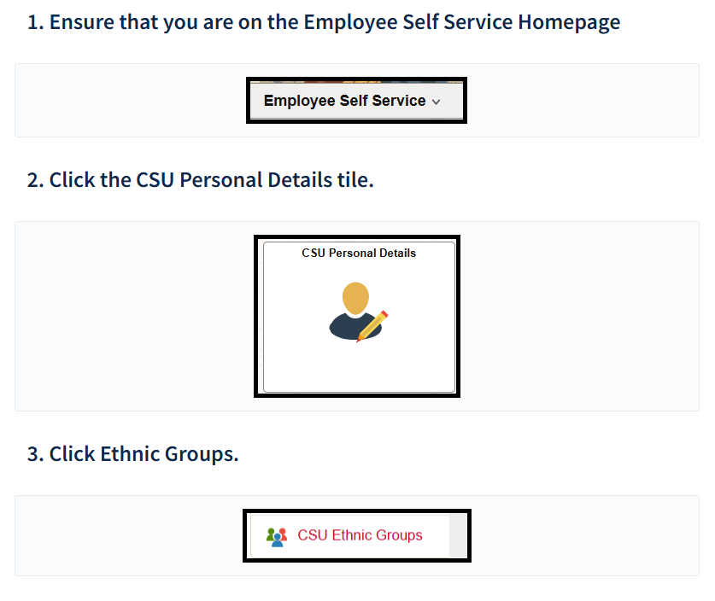
Update Your Ethnicity
Update Your Ethnicity | Employee Self-Service | CHRS Knowledge Base

Slide 16
Knowledge Check
According to the “Update Your Ethnicity” job aid, what is the last step an employee must take after selecting their ethnic group in the Employee Self-Service system?
Log out of the system
Click the Save button
Contact HR for approval
Restart the browser

Slide 17
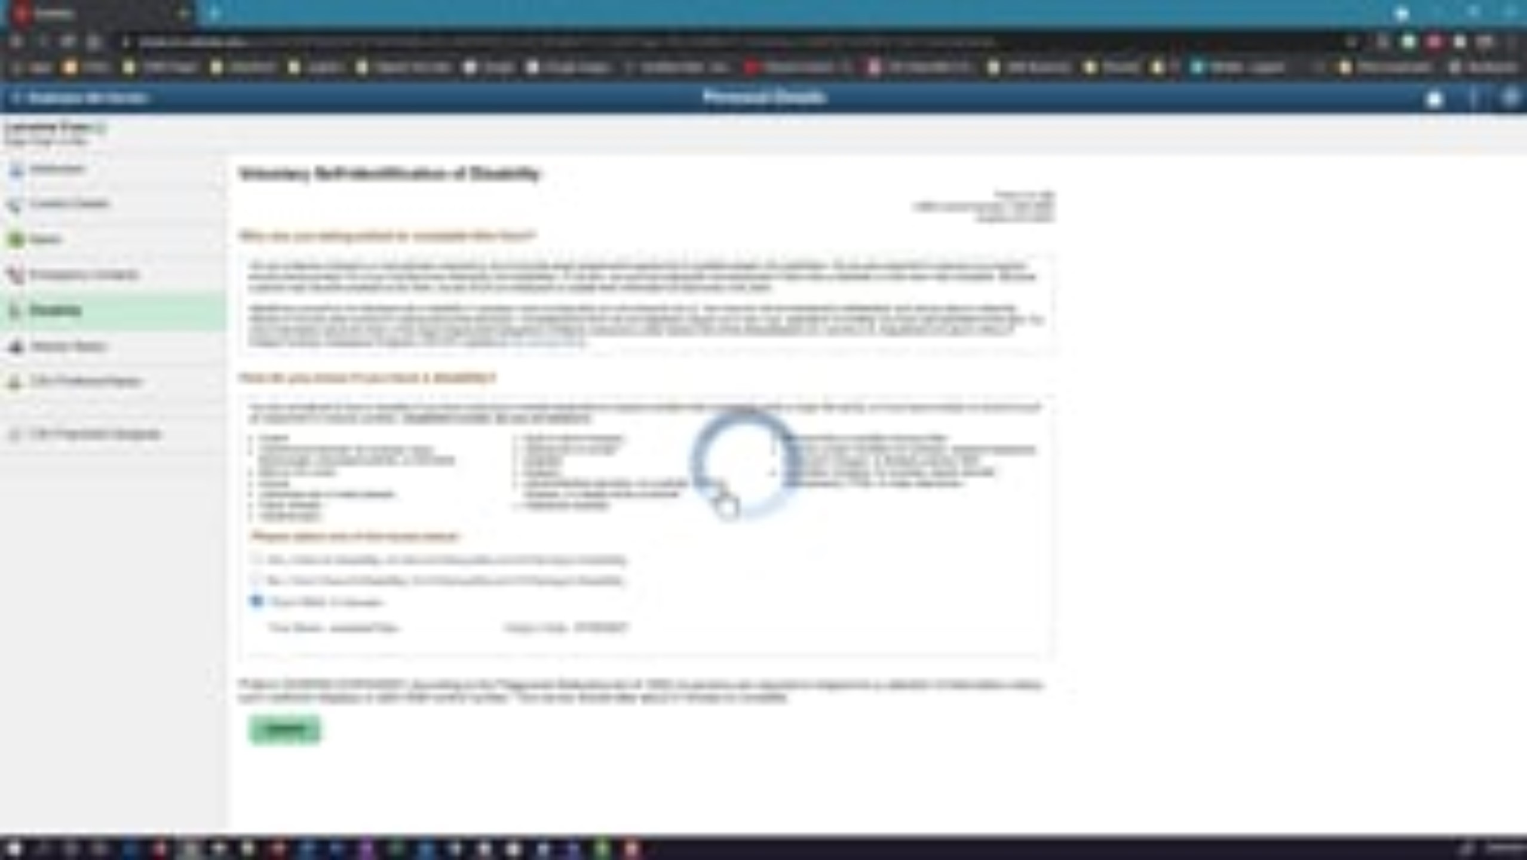
Disability Status

Slide 18
Knowledge Check
If you believe you have a disability and need an accommodation, whom should you contact?
Your immediate supervisor
The campus ADA Coordinator
Human Resources
IT Support

Slide 19
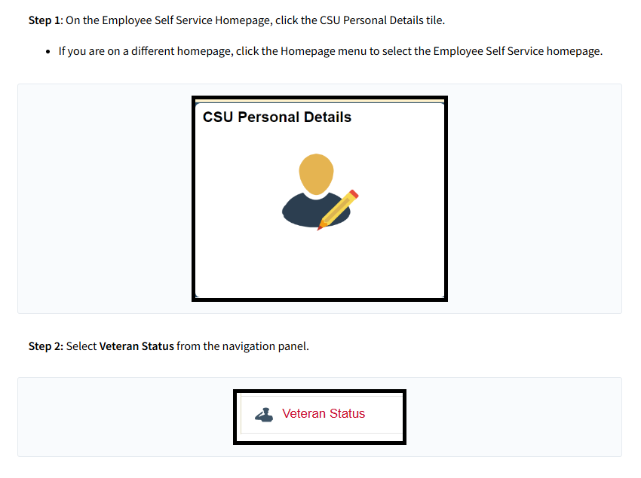
Veteran Status
Veteran Status (employee) | Employee Self-Service | CHRS Knowledge Base

Slide 20
Knowledge Check
If you select "Recently Separated Veteran," what additional information must you provide?
Branch of service
Rank at discharge
Service location
Military discharge date

Slide 21

Final Paycheck Designee

Slide 22
Knowledge Check
What information is required when adding a final paycheck designee?
Required information for final paycheck designee is name, relationship, address, phone number and country.
Declining paycheck designation
Selection of up to three contingent designees.
All of the above

Slide 23
Action Item
Before your data transfers into CHRS, please make sure the following information in PeopleSoft is correct.
  Contact Details (Phone Numbers & Email Addresses)
  Home and Mailing Address
  Preferred Name
  Emergency Contacts
  Ethnicity
  Disability Status
  Veteran Status
This ensures your information is accurate once CHRS launches.

Slide 24
Benefits Module

Slide 25
Benefits Overview
What you can do in CHRS Benefits:
  View Benefits Summary
  Benefits Life Event Workflow (Full Employee Self-Service)
  Choosing a Life Event
  Employee Life Event Self-Service
  Employee Print Benefits Confirmation Statements
  Print Dependent Verification Forms – Employee

Slide 26

View Benefits Summary

Slide 27
Knowledge Check
What feature allows you to view your benefit enrollments as of a different date?
The "Edit" button
The date selector and "Refresh" button
The "View All" option
The "History" tab

Slide 28
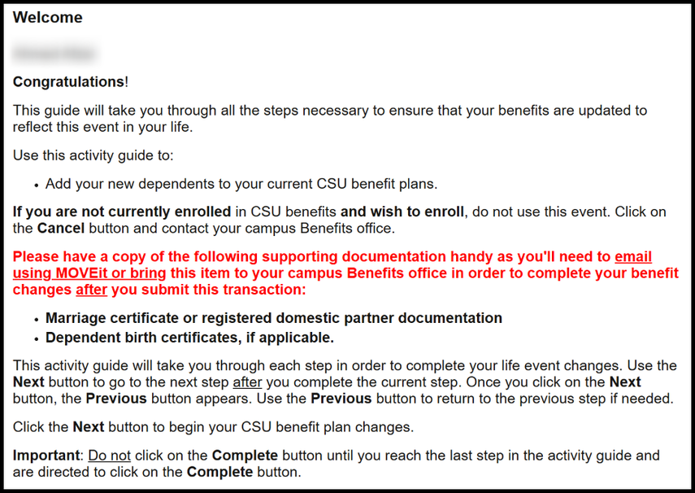
Employee Self Service Life Event Workflow
https://csuchrs.screenstepslive.com/a/1891345-ess-life-event-workflow

Slide 29
Knowledge Check
In the ESS Life Event Workflow job aid, what is the first action an employee must take to begin processing a life event in Employee Self-Service?
Click Start My Enrollment
Open the CSU Life Events tile
Review the Benefits Summary
Add or update dependents

Slide 30
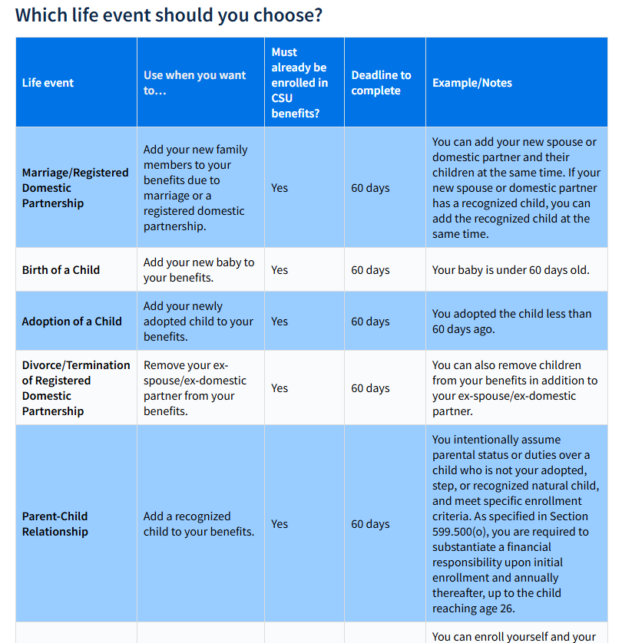
Choosing a Life Event
https://csuchrs.screenstepslive.com/a/1779548-choosing-a-life-event

Slide 31
Knowledge Check
What is the waiting period for benefits to take effect if you enroll during the Late Enrollment life event?
30 days
60 days
90 days
No waiting period

Slide 32
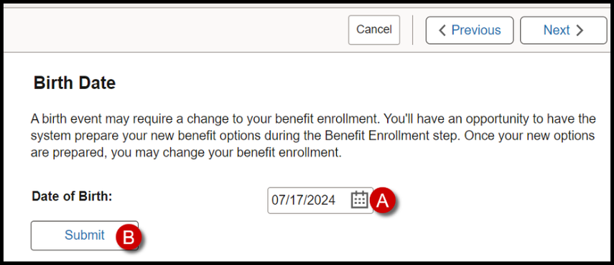
Employee Life Event Self-Service
https://csuchrs.screenstepslive.com/a/1794429-employee-life-event-self-service

Slide 33
Knowledge Check
What must you do if you realize you've entered the wrong "As Of Date" when starting a life event?
Proceed with the incorrect date In the Report Manager by reviewing the log file
Contact the IT department
Cancel the current life event and start a new one with the correct date
Ignore the date; it doesn't affect the process

Slide 34

Print Benefits Confirmation Statements

Slide 35
Knowledge Check
What should you do if you don't see a statement row after selecting the Confirmation Statement type?
Wait for 24 hours and check again
Contact the IT support team
Restart your computer and try again
Go to the CSU Benefits Summary tile and enter the applicable effective date

Slide 36

Print Dependent Verification Forms
Notes:
Our campus is Full eBenefits

Slide 37
Knowledge Check
When can you print the Affidavit of Parent-Child Relationship (APCR) and Domestic Partner Dependent Certification (DPDC) forms?
Anytime from the Employee Self Service portal
Only after completing an eBenefits Employee Self Service event
During the annual benefits enrollment period
After contacting the campus benefits office

Slide 38
Additional Resources & Information

Slide 39
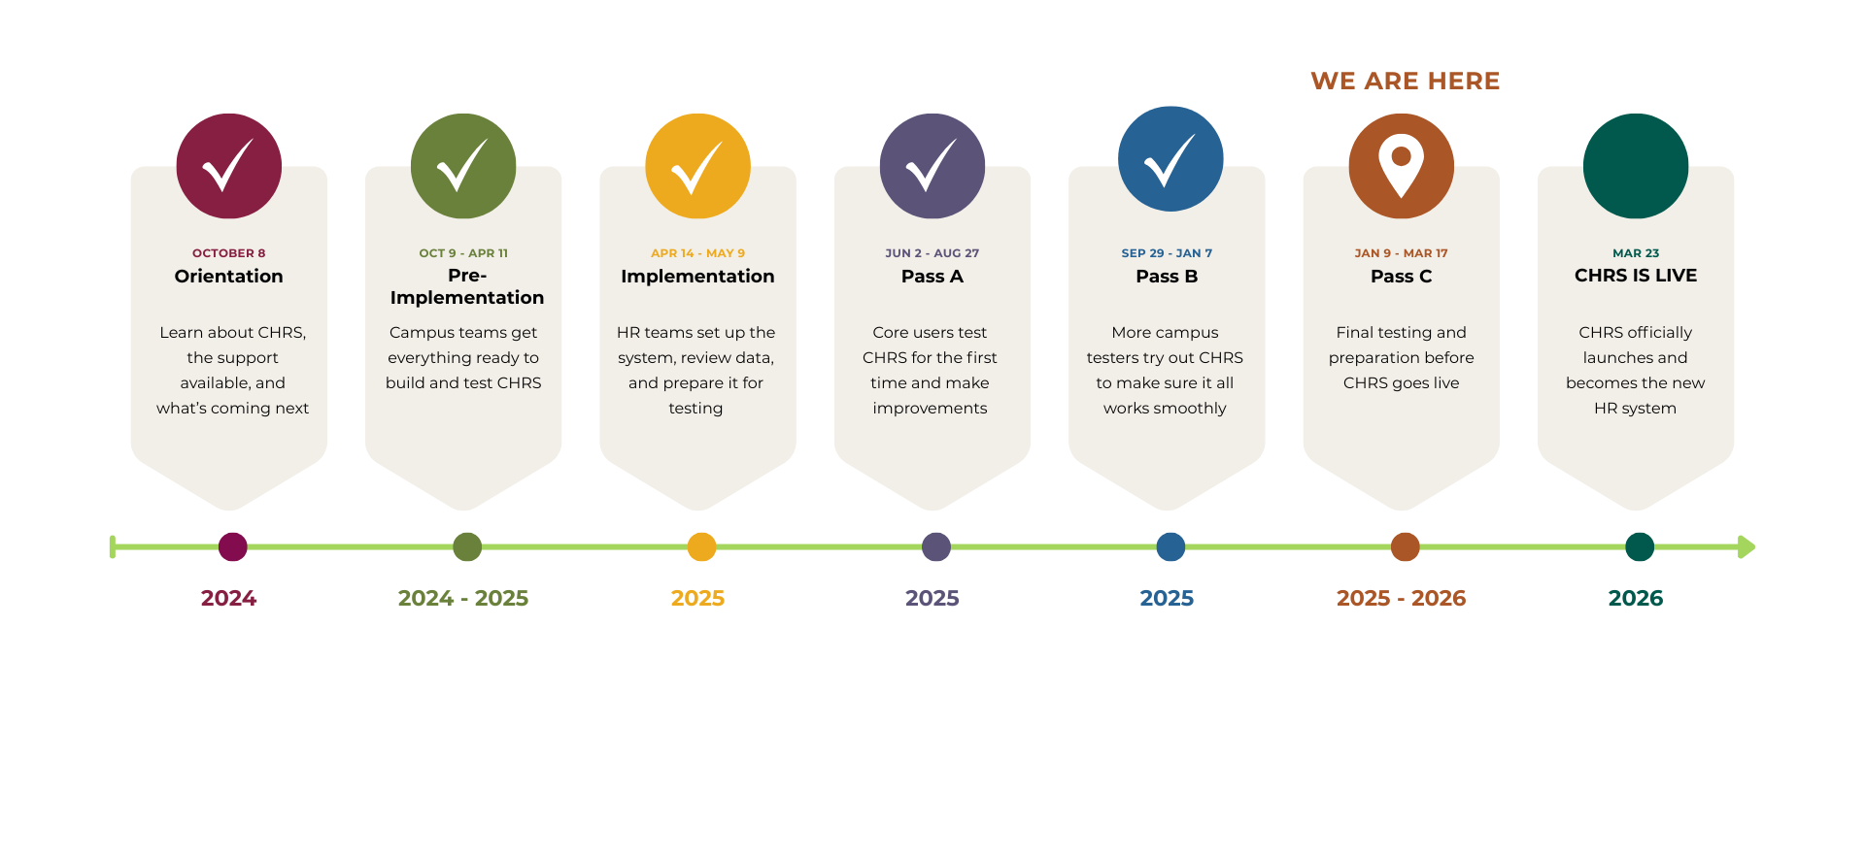
CHRS Roadmap

Slide 40

Upcoming Webinar
Next CHRS Webinar Demo is on February 16​
Topic: Time & Labor Module

Slide 41


Stay Connected
CHRS Website
https://www.cpp.edu/eoda-hr/chrs/index.shtml
CHRS Inquiry Form
https://app.smartsheet.com/b/form/b9171be6827a43ba80d926ad471059be

Slide 42
Q&A

Slide 43
Thank You

