Slide 1
CHRS Webinar Demo​
Introducing the Personal Profile Module (View Appointment Notification)​
February 17, 2026 I 10 – 11:30 AM

Slide 2
Agenda
CHRS Refresher
Today’s Modules
  Personal Profile (View Appointment Notification)
Demo Walkthrough
Q&A
Additional Resources & Information

Slide 3
What Is CHRS?
CHRS = Common Human Resources System​
Upgraded version of PeopleSoft​
A unified CSU-wide system​
Modern, intuitive, and mobile-friendly​
Designed to simplify HR tasks for all employees

Slide 4
What’s Changing for You?​
Cleaner, easier-to-use screens​
Clearer workflows (e.g., updating personal information, viewing benefits)​
Better consistency across all campus roles​
Improved self-service

Slide 5
View Appointment Notification

Slide 6
View Your Appointment Notification Overview
What you can do in CHRS:​
  Review and Acknowledge your Appointment Notification
  Multiple Jobs
  Reprint Old Notices
  View Your Course Assignments

Slide 7
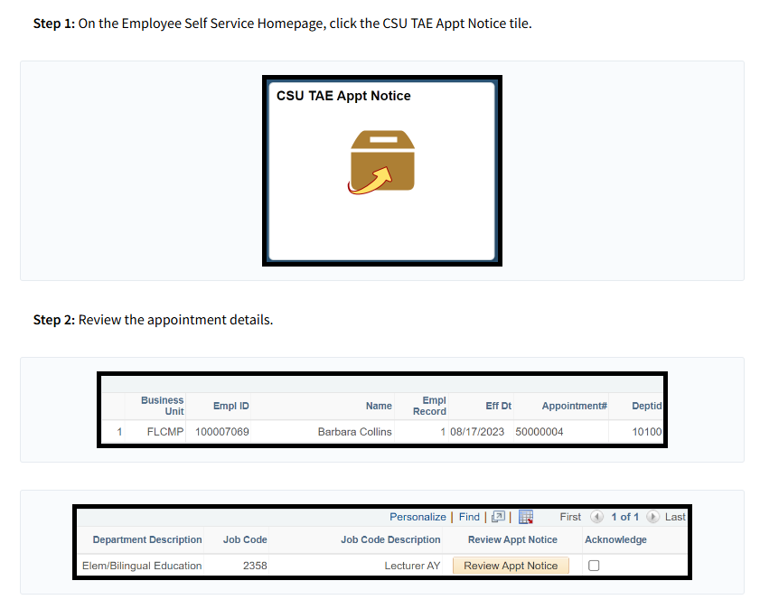
Review and Acknowledge Your Appointment Notification
View your Appointment Notification | Employee Self-Service | CHRS Knowledge Base

Slide 8
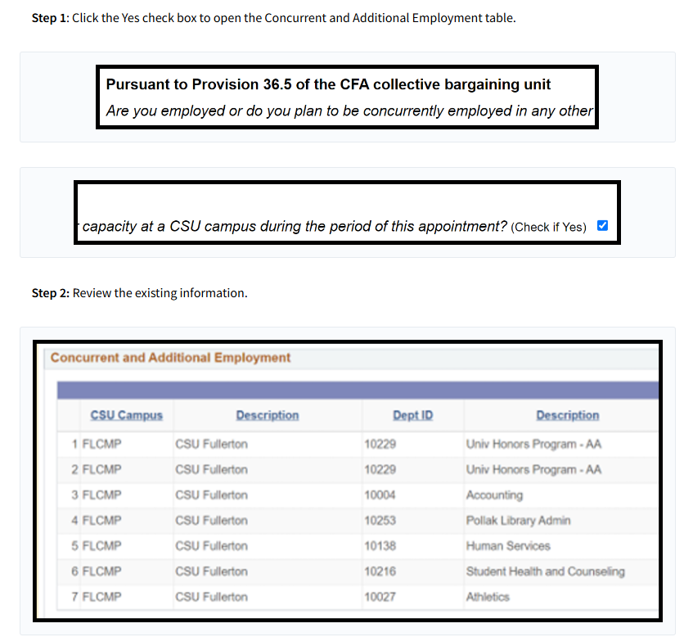
Multiple Jobs
View your Appointment Notification | Employee Self-Service | CHRS Knowledge Base

Slide 9
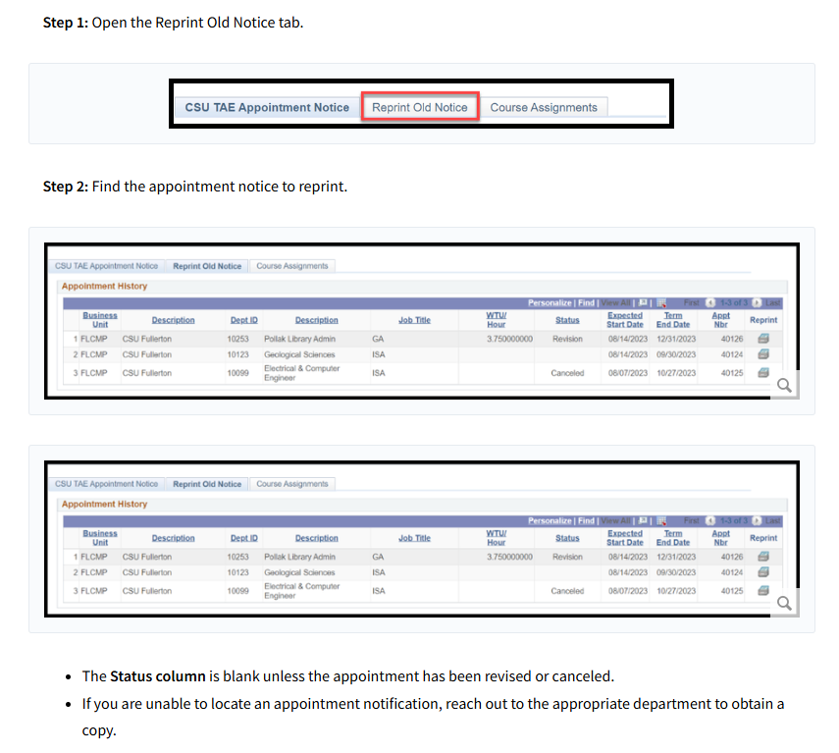
Reprint Old Notices
View your Appointment Notification | Employee Self-Service | CHRS Knowledge Base

Slide 10
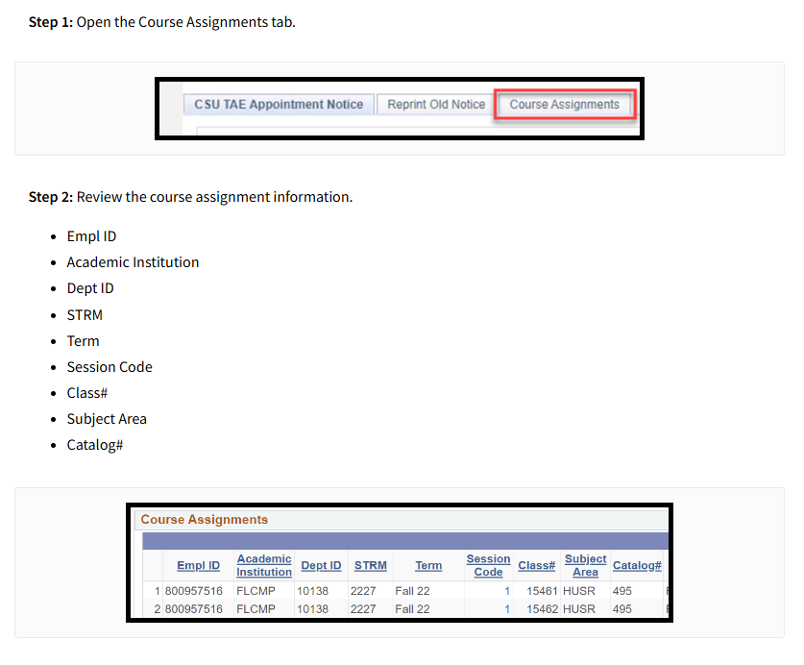
View Your Course Assignments
View your Appointment Notification | Employee Self-Service | CHRS Knowledge Base

Slide 11

Knowledge Check
What must you do before you can acknowledge your appointment notification in the CSU TAE Appointment Notice tile?
Close the browser tab where the notification opened.
Review the appointment notice by clicking Review Appt Notice.
Log out and log back in to the portal first.
Enter your course assignments manually.
Notes:
Cue Yesenia to launch poll.

Slide 12
Knowledge Check 2
If you are employed or plan to be employed in another capacity at a CSU campus while you have a current appointment notification, what should you do in the “Multiple jobs” section before acknowledging your notice?
Leave the Yes checkbox blank and proceed to acknowledge the appointment immediately.
Email HR to ask if you can ignore the section.
Click Yes to open the Concurrent and Additional Employment table and complete the details.
Enter only the campus name and skip all other fields
Notes:
Cue Yesenia to launch poll.

Slide 13
Knowledge Check 3
An employee has already acknowledged their appointment notification, and it no longer appears under the CSU TAE Appointment Notice tab. They need a copy for their records. What is the correct way to retrieve it?
Navigate to the Reprint Old Notice tab to locate and open the previously acknowledged notice.
Submit a request to HR because acknowledged notices cannot be accessed again.
Click “Review Appt Notice” from the main tile again to regenerate the document.
Wait for a new notification to generate automatically in the next pay cycle.
Notes:
Cue Yesenia to launch poll.

Slide 14
Knowledge Check 4
After selecting View Your Course Assignments, what information can you review on that page?
Only your total pay for the term.
The detailed courses associated with your appointment, including class information.
Your benefits eligibility and deductions.
A history of all prior campuses where you’ve worked.
Notes:
Cue Yesenia to launch poll.

Slide 15
Additional Resources & Information

Slide 16
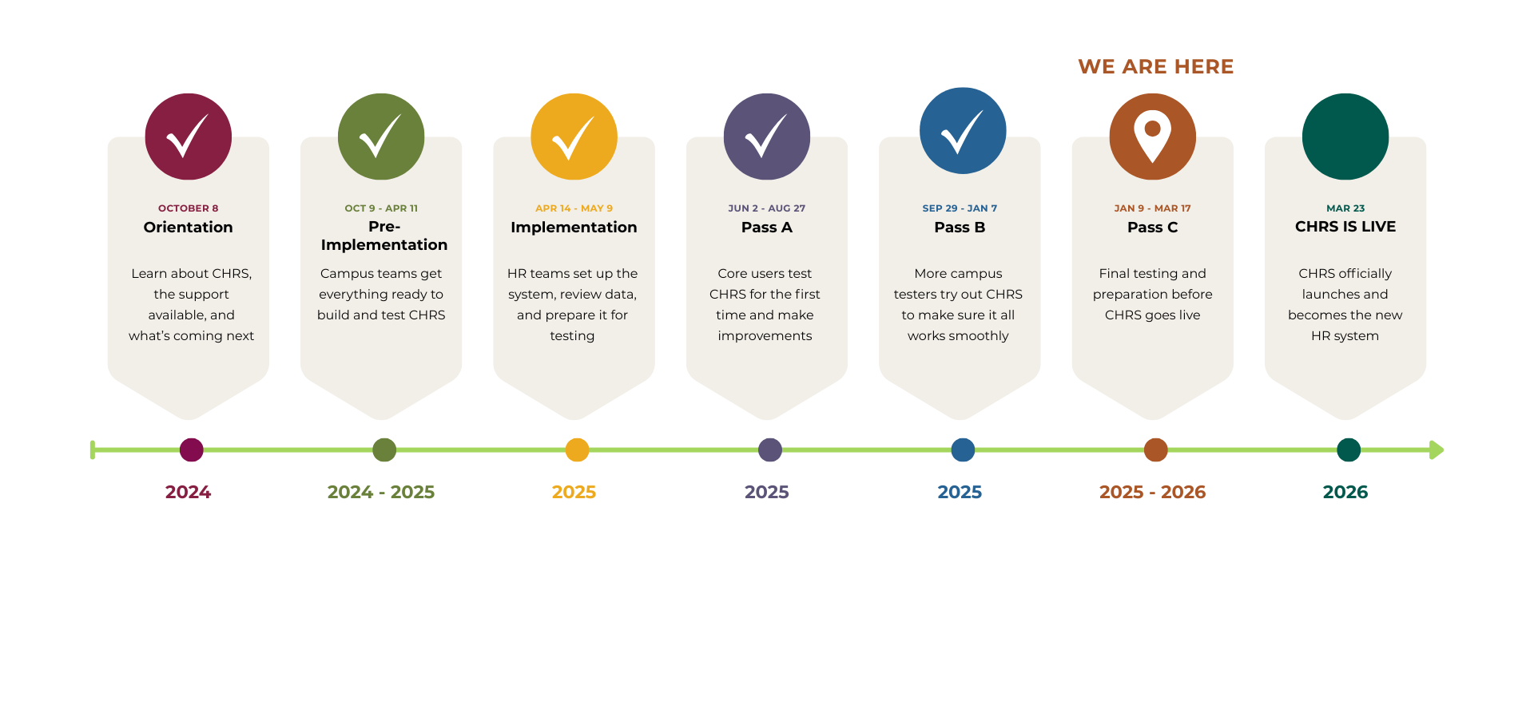
CHRS Roadmap

Slide 17

Upcoming Webinar
Next CHRS Webinar Demo is on February 23​
Topic: Absence Management

Slide 18


Stay Connected
CHRS Website
https://www.cpp.edu/eoda-hr/chrs/index.shtml
CHRS Inquiry Form
https://app.smartsheet.com/b/form/b9171be6827a43ba80d926ad471059be

Slide 19

34 Days Until Launch
34 Days Until Launch

Slide 20
Q&A

Slide 21
Thank You

