Slide 1
CHRS Webinar Demo​
Introducing the Absence Management Module
February 23, 2026 I 10 – 11:30 AM

Slide 2
Agenda
CHRS Refresher
Today’s Module
Absence Management
Demo Walkthrough
Important Deadlines
Additional Resources & Information
Q&A

Slide 3
What Is CHRS?
CHRS = Common Human Resources System​
Upgraded version of PeopleSoft​
A unified CSU-wide system​
Modern, intuitive, and mobile-friendly​
Designed to simplify HR tasks for all employees

Slide 4
What’s Changing for You?​
Cleaner, easier-to-use screens​
Clearer workflows (e.g., updating personal information, viewing benefits)​
Better consistency across all campus roles​
Improved self-service

Slide 5
Absence Management Module

Slide 6
Absence Management Overview​
What you can do in CHRS Absence Management:​
How to Request and Enter Absences
How to Request Partial Days Off
How to View Your Absence Balances
How to View your Absence Requests
How to Cancel Your Absence Request
How to Resubmit a Canceled Absence

Slide 7
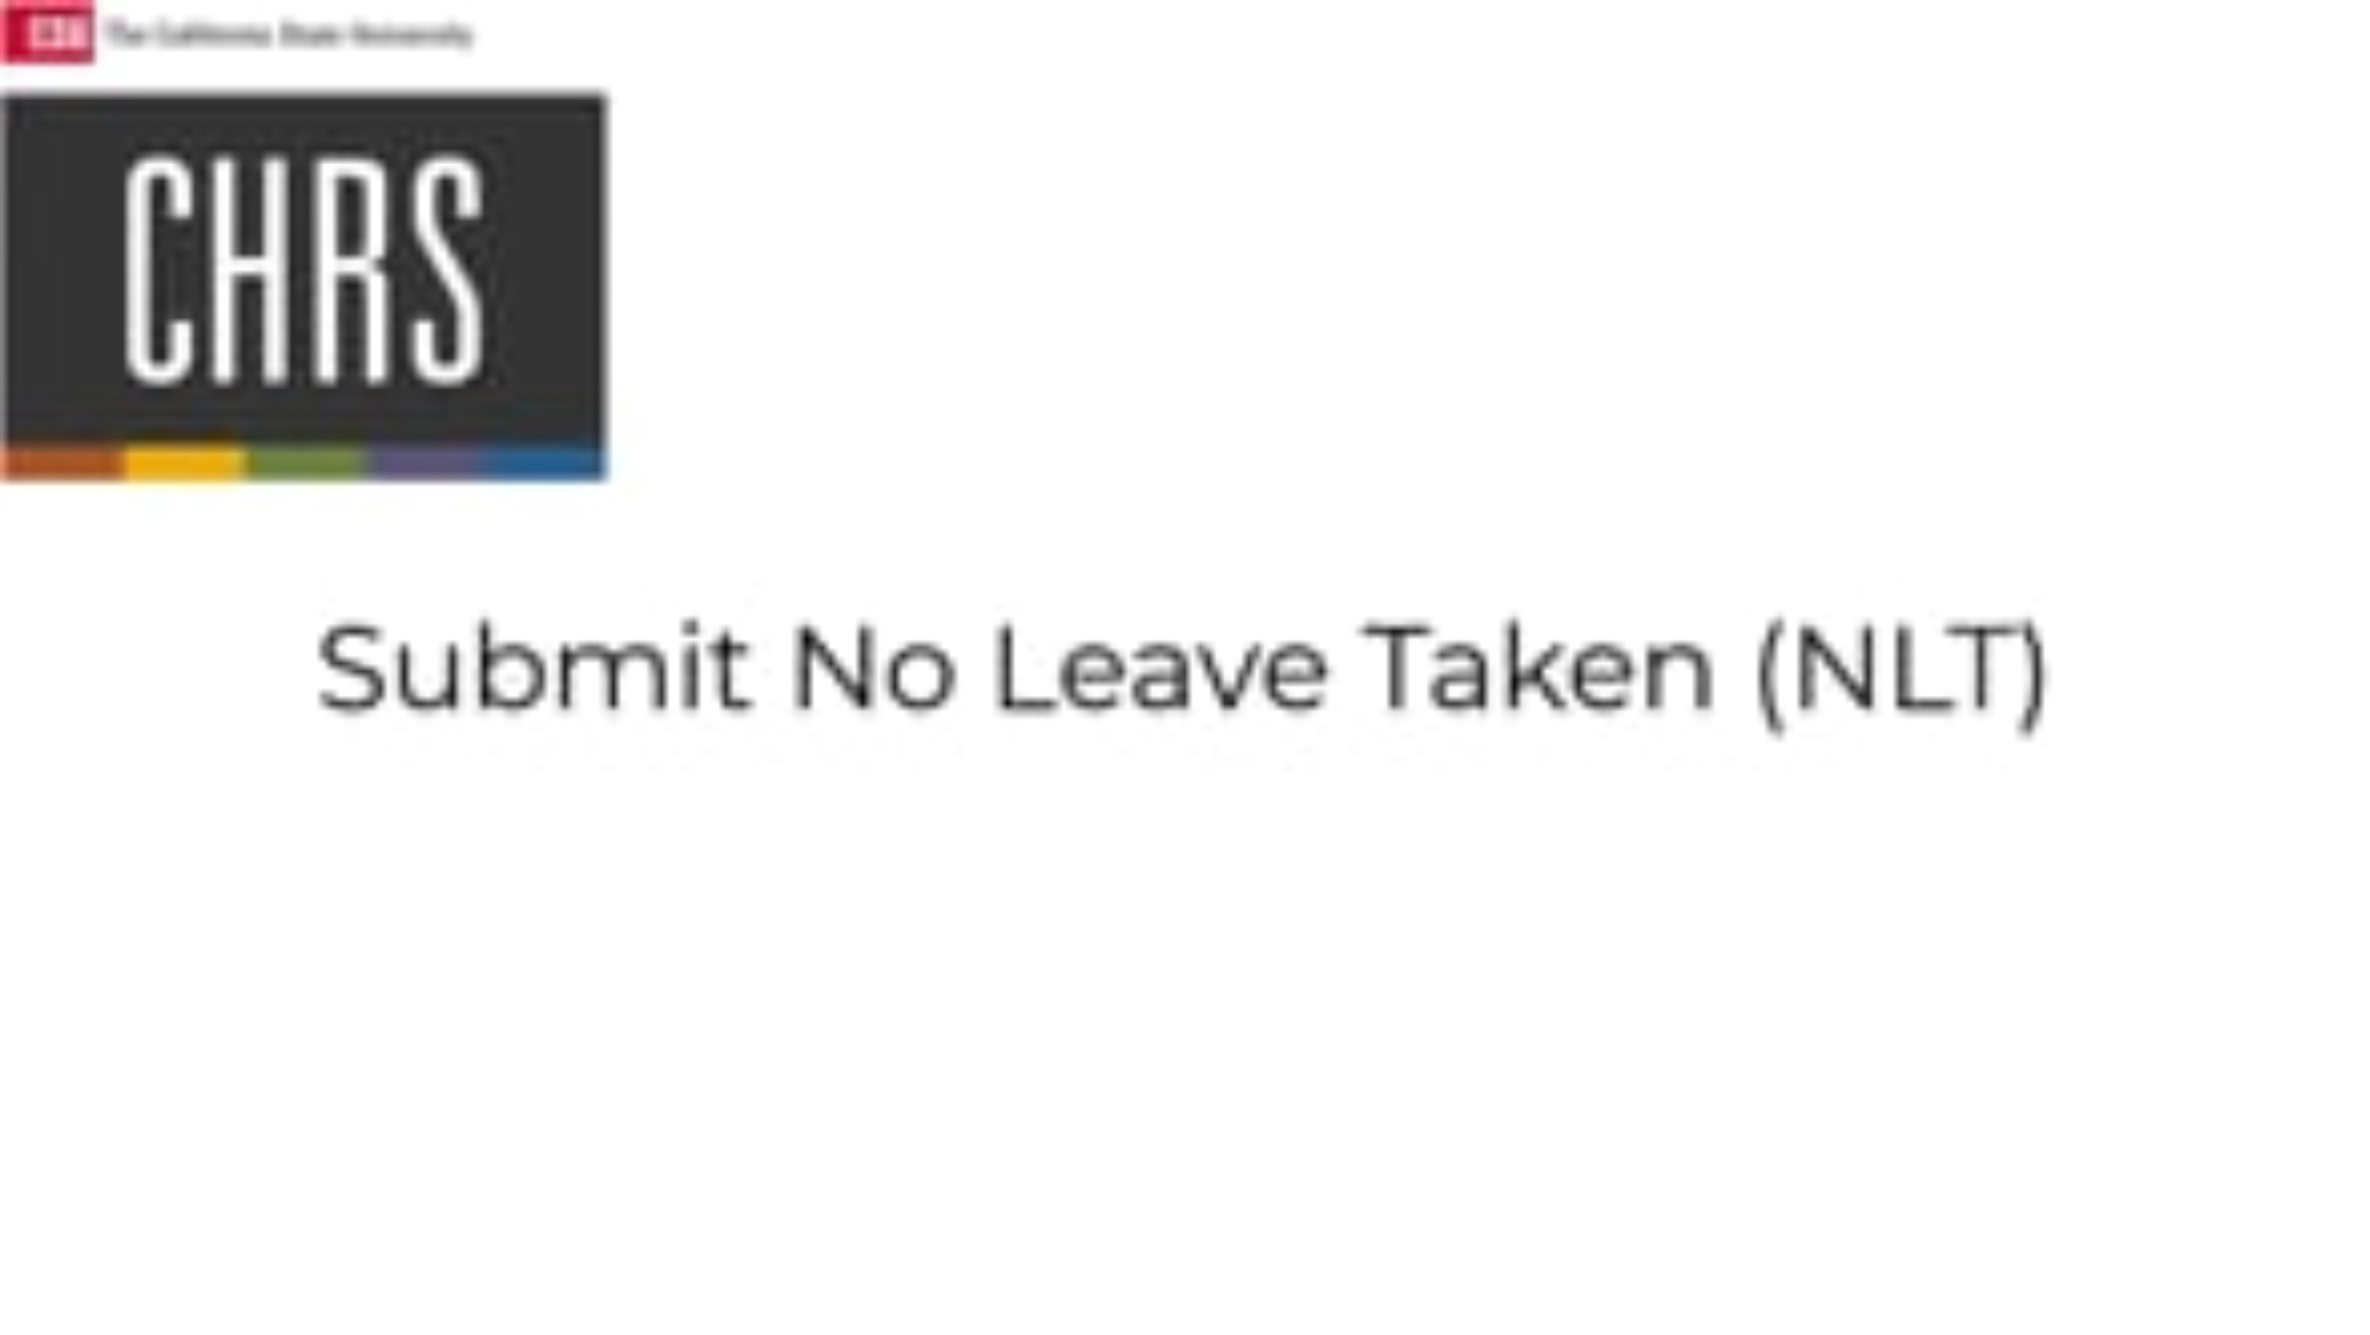
Report No Leave Taken

Slide 8
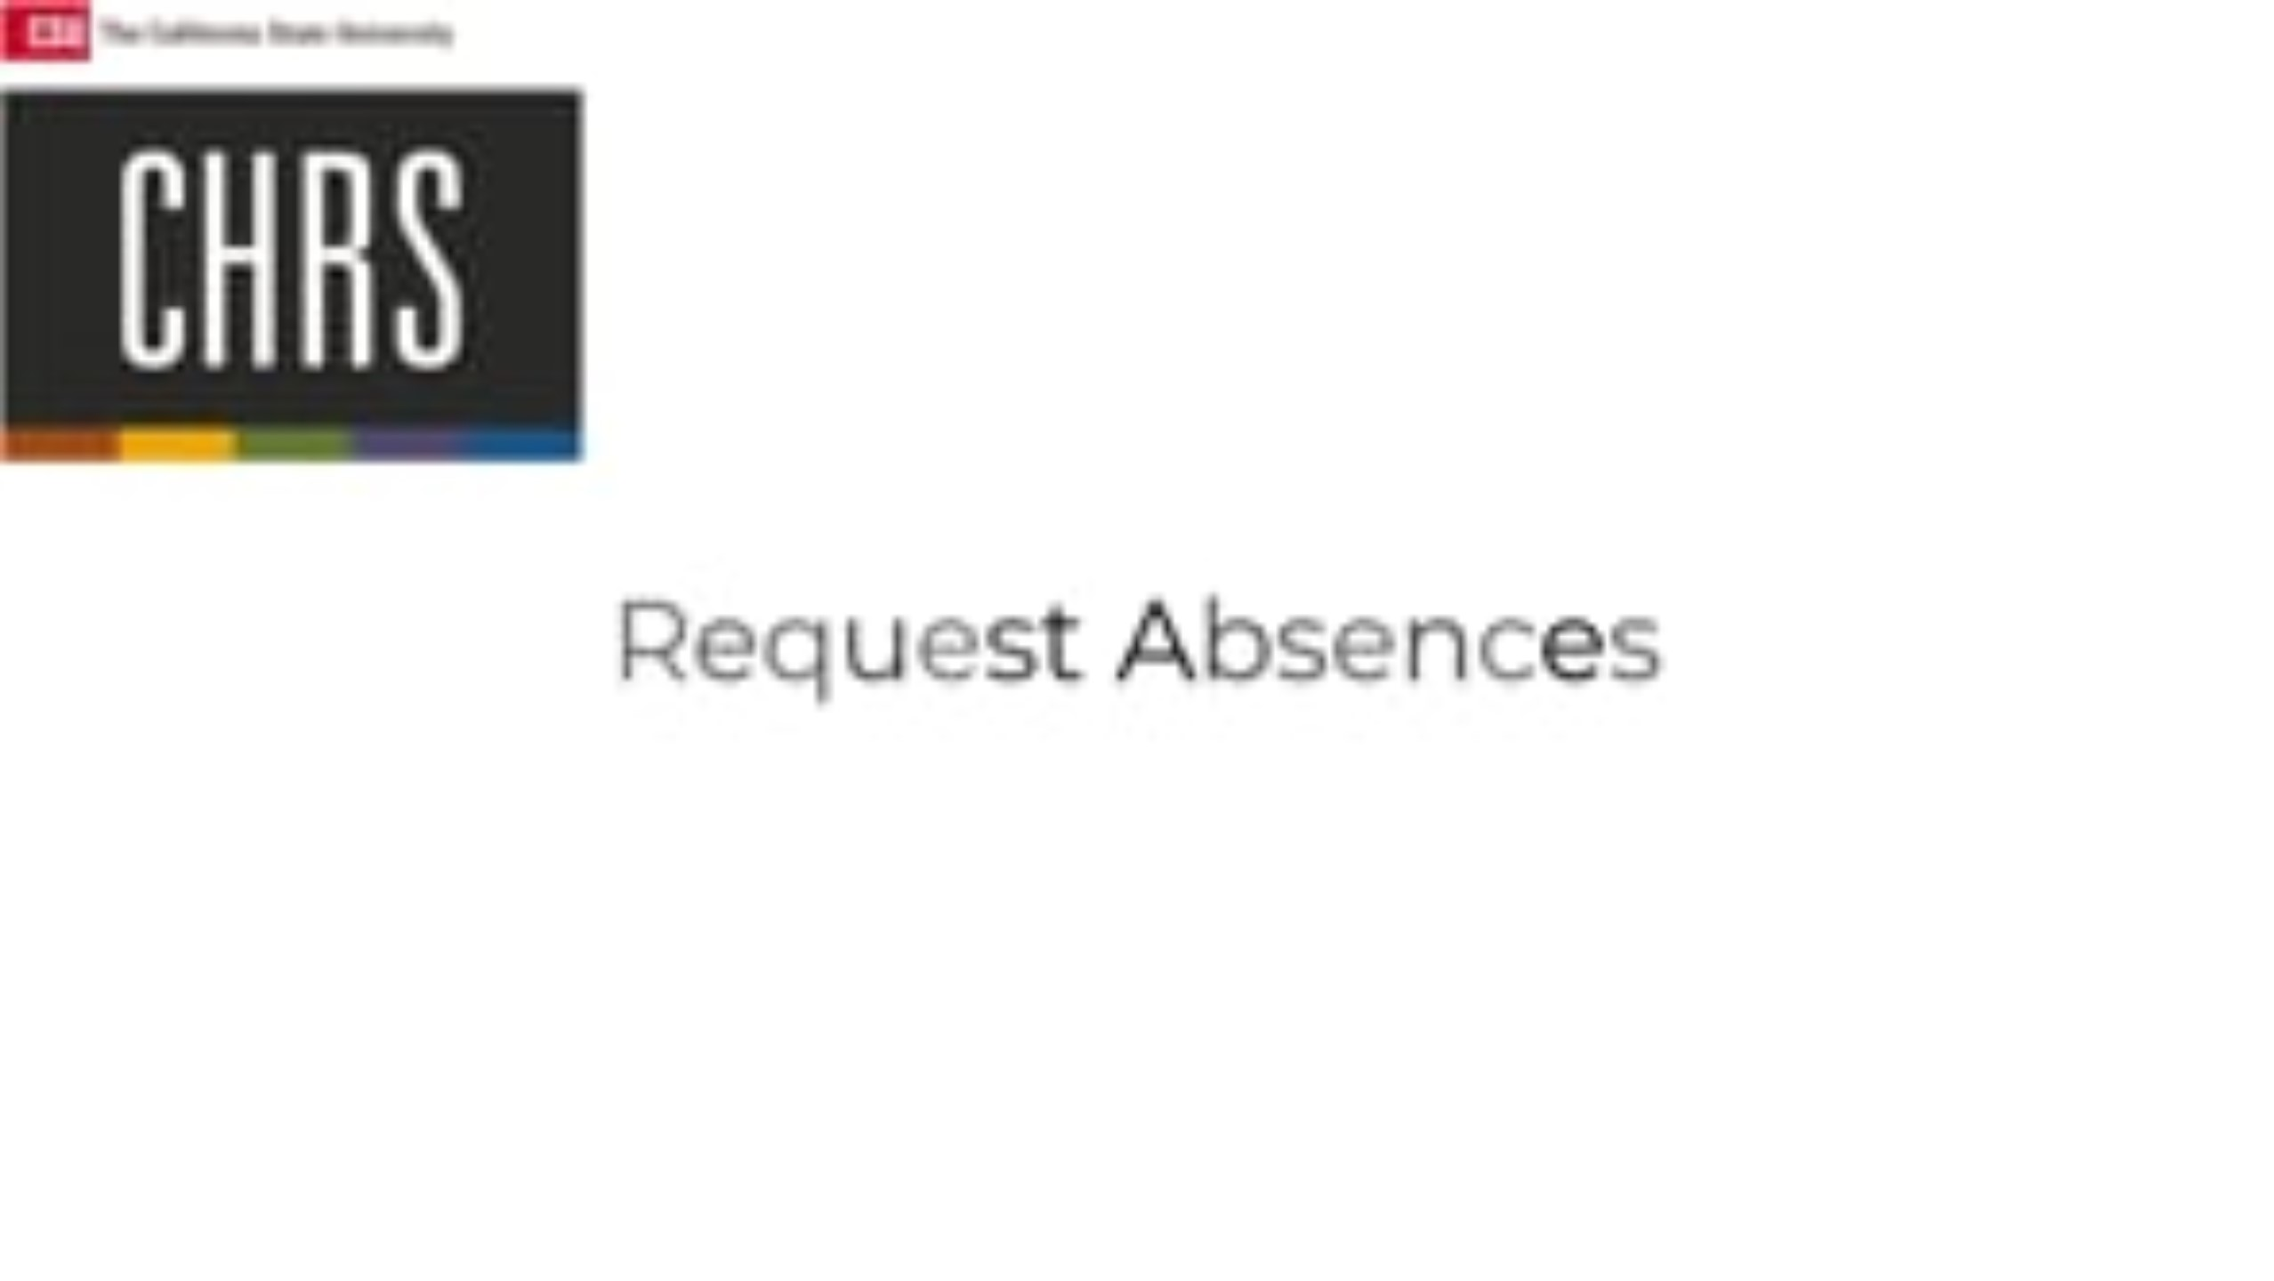
Request Absence

Slide 9
Important: Relationship Required for Certain Absence Entries
When entering the following absence types, employees must include the eligible family relationship in the Comments field:
Sick Leave - Family Care
Sick Leave - Bereavement
Bereavement - Other
⚠ The relationship must be eligible per the employee’s Collective Bargaining Agreement (CBA).
Failure to include the eligible relationship may result in delays, corrections, or denial of the leave request.

Slide 10
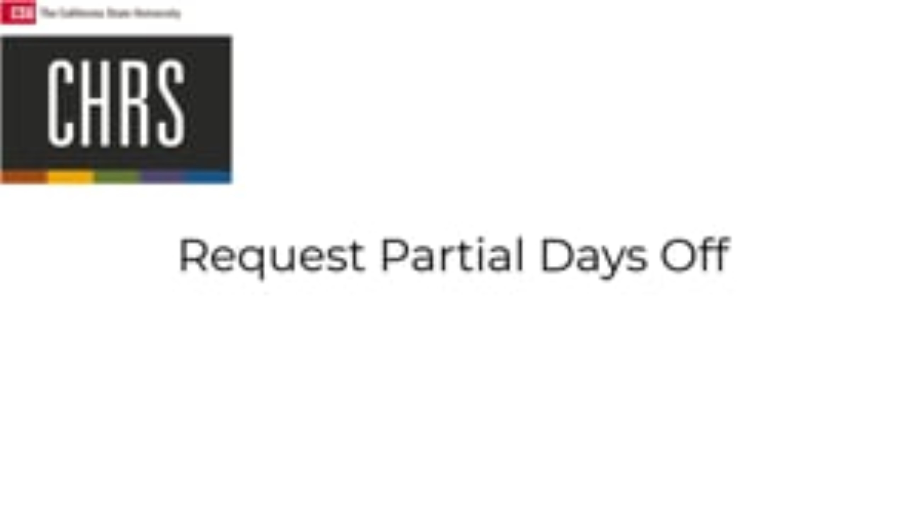
Request Partial Days Off

Slide 11

Knowledge Check
What does the "Forecast" button do when requesting an absence in CHRS?
It checks whether you have sufficient leave credits to cover the absence.
It submits your absence request for approval.
It automatically approves your absence request.
It allows you to bypass leave balance requirements.

Slide 12
Knowledge Check
What must employees do when requesting sick leave in CHRS?
Submit a doctor's note with every sick leave request.
Only enter the dates without providing a reason.
Select a reason for the absence, such as Sick - Personal, Family Care, or Bereavement.
Wait for manager approval before submitting the request.

Slide 13
Knowledge Check
When entering a partial-day absence in CHRS, which options are available for selection? (Select all that apply, more than one answer)
All Days
Half-Day Morning Only
Start and End Days
End Day Only

Slide 14

View Absence Balances

Slide 15
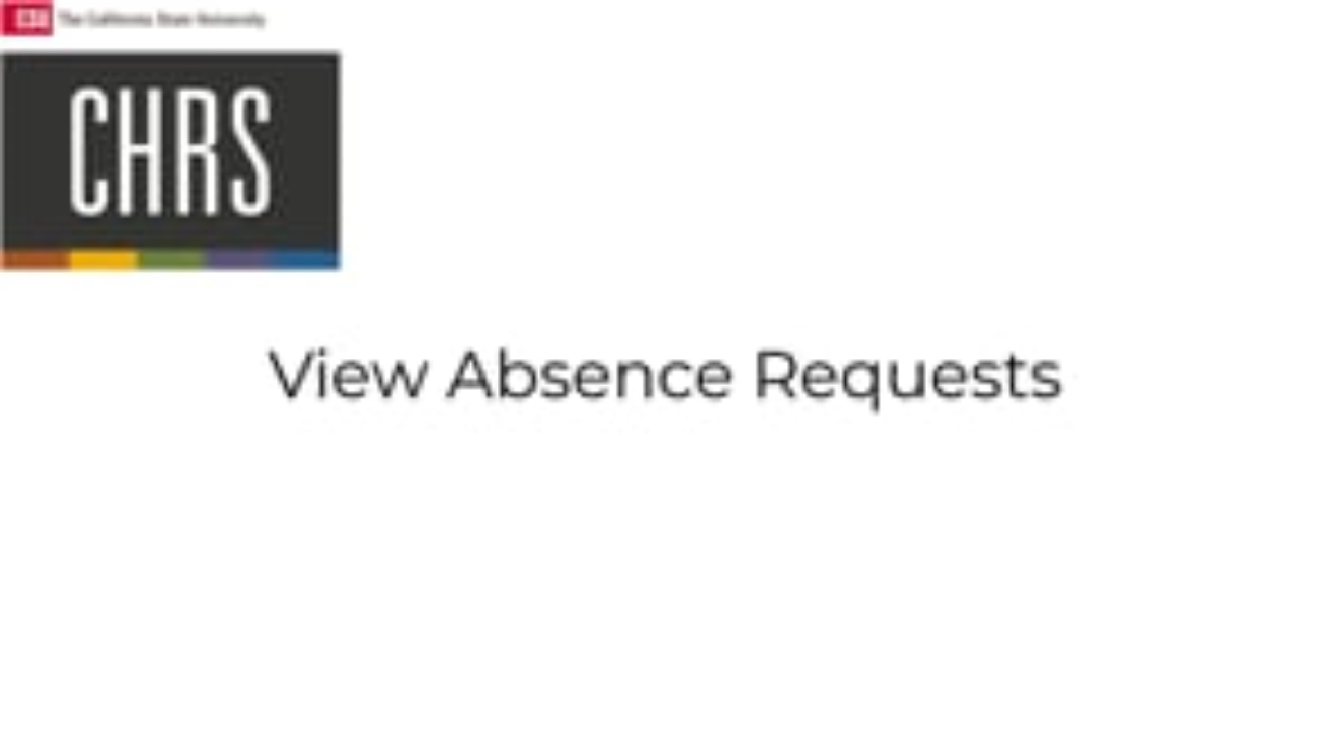
How to View Your Absence Requests

Slide 16

How to Cancel Your Absence Request

Slide 17
Knowledge Check
What types of leave balances can employees view using the CSU Employee Balance Inquiry?
Only Vacation and Sick Leave
Vacation, Sick, Personal Holiday, Vacation SS, and Excess Leave Details
Overtime Hours and Bonus Pay
Retirement Contributions and Payroll Deductions

Slide 18
Knowledge Check
True or False: You can view the date your absence request was submitted by clicking on the Details tab.
True
False

Slide 19
Knowledge Check
What happens when you cancel an absence request in CHRS?
The absence request is deleted from the system.
The absence request remains in the system but is marked as "Cancelled."
You cannot resubmit a cancelled absence request.
To request a new absence for the same time period, you must find the cancelled request and resubmit it for approval.

Slide 20
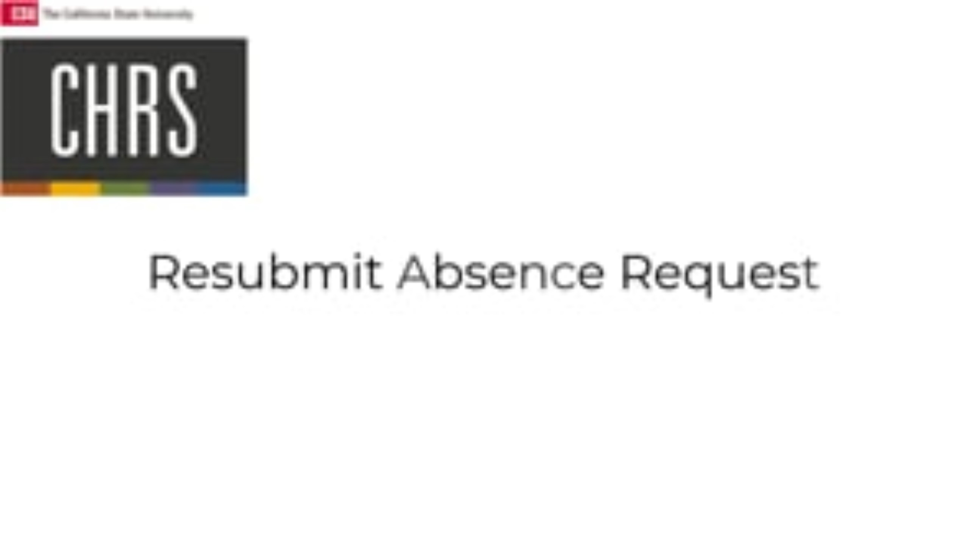
How to Resubmit a Canceled Absence

Slide 21

Employee Enter Additional Days (ADO/ADOT)

Slide 22

Employee Enter Compensatory Time

Slide 23
Knowledge Check
How can you request a new absence for the same time period as a canceled request in CHRS?
You must delete the canceled request before submitting a new one.
You must contact HR to reinstate a canceled absence request.
Once an absence is canceled, you cannot request time off for the same period.
You can update and resubmit the canceled absence request for approval.

Slide 24
Knowledge Check
If you need to record both regular hours worked and an Additional Day Off Taken (ADOT) on the same day, what should you do?
Enter both on the same row
Add a new row for ADOT
Replace regular hours with ADOT
Only enter ADOT

Slide 25
Knowledge Check
Which Time Reporting Code (TRC) should you select to record Compensatory Time Earned at a rate of 1.5?
CTST
CTPR
CTO
REG

Slide 26
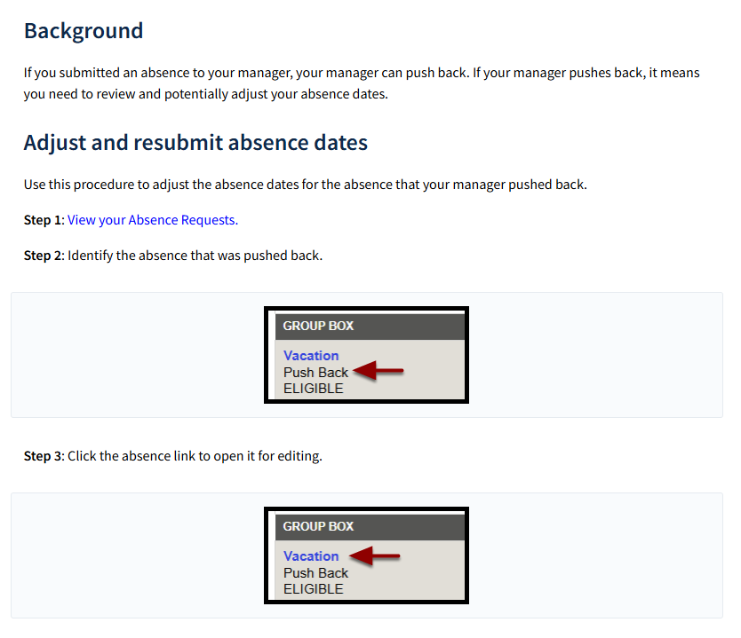
Respond to Pushback Absence Request
https://csuchrs.screenstepslive.com/a/1961547-respond-to-pushback-absence-request

Slide 27
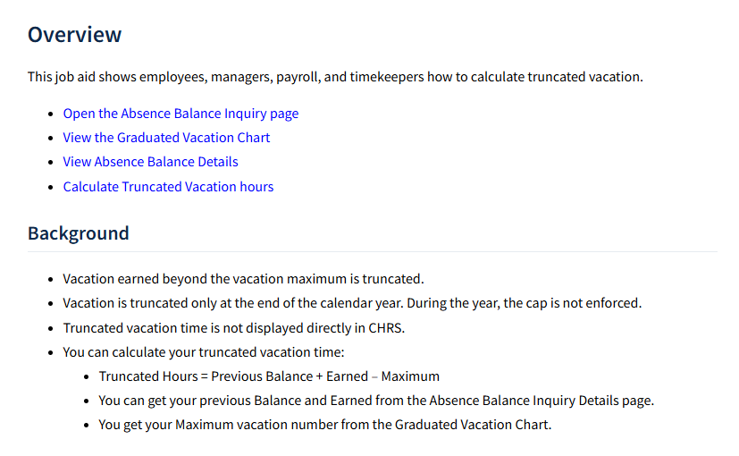
Calculate Vacation Maximum
https://csuchrs.screenstepslive.com/a/1866304-calculate-vacation-maximum-truncated-vacation

Slide 28
Important Deadlines

Slide 29
March Pay Period Deadlines (Go-Live Month)
Absence Management
Time and Labor
Deadline to Enter AND Approve March Absences
Deadline to Enter AND Approve March Payable Time
April 1
April 5
*The deadlines for this month are different due to the go-live calendar disruption

Slide 30
ALL FUTURE Pay Period Deadlines
Absence Management
Time and Labor
Deadline to Enter AND Approve Absences
Deadline to Enter Payable Time
Last Day of Pay Period
Last Day of Pay Period
*For example, the deadlines for the April Pay Period will be April 30

Slide 31
Additional Resources & Information

Slide 32
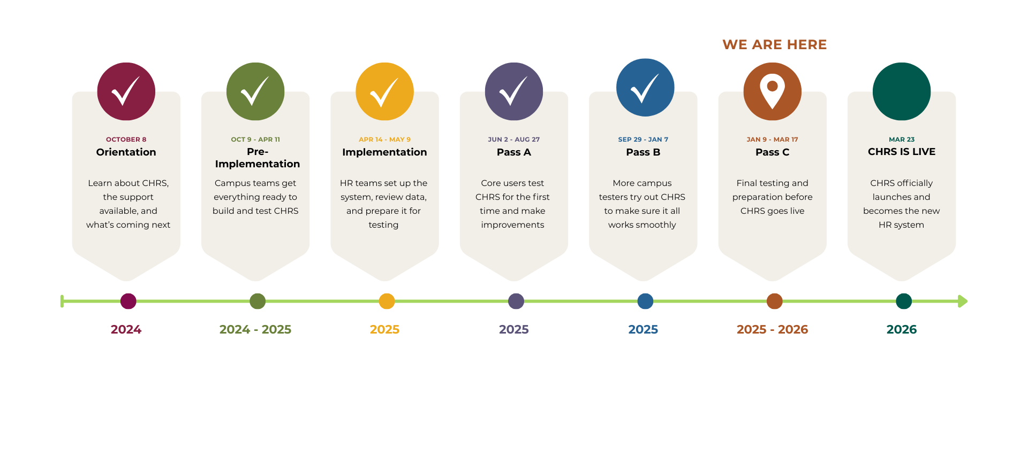
CHRS Roadmap

Slide 33


Stay Connected
CHRS Website
https://www.cpp.edu/eoda-hr/chrs/index.shtml
CHRS Inquiry Form
https://app.smartsheet.com/b/form/b9171be6827a43ba80d926ad471059be

Slide 34

28 Days Until Launch

Slide 35
Q&A

Slide 36
Thank You

