Slide 1
CHRS Webinar Demo​
Introducing the Time, Labor & Absence Modules for Managers and Timekeepers
February 25, 2026 I 10 – 11:30 AM

Slide 2
Agenda
CHRS Refresher
Today’s Module
Time, Labor & Absence Modules for Managers and Timekeepers
Demo Walkthrough
Important Change for Managers
Transaction and System Pauses/Outages
Important Payroll Deadline Changes
Action Required Before 3/17
Additional Resources & Information
Q&A

Slide 3
What Is CHRS?
CHRS = Common Human Resources System​
Upgraded version of PeopleSoft​
A unified CSU-wide system​
Modern, intuitive, and mobile-friendly​
Designed to simplify HR tasks for all employees

Slide 4
What’s Changing for You?​
Cleaner, easier-to-use screens​
Clearer workflows (e.g., updating personal information, viewing benefits)​
Better consistency across all campus roles​
Improved self-service

Slide 5
Time, Labor & Absence Modules for Managers and Timekeepers

Slide 6
Time, Labor & Absence Overview​
What you can do in CHRS Time, Labor & Absence:​
Enter Time for Employee
Approve Time (Manager)
Request Absence for Employees
Approve No Leave Taken NLT (Manager)
Enter No Leave Taken on Behalf of Employee
Cancel Employee Absence (Manager)
Absence Balance Inquiry (Manager/Timekeeper)
Maintain Absences (Manager/Timekeeper)
Timekeeper Absence Review
Timekeeper and Payroll Enter Time
Approve Absences (Manager)
View Team Absence Balances (Manager)

Slide 7

Enter Time for Your Employees

Slide 8
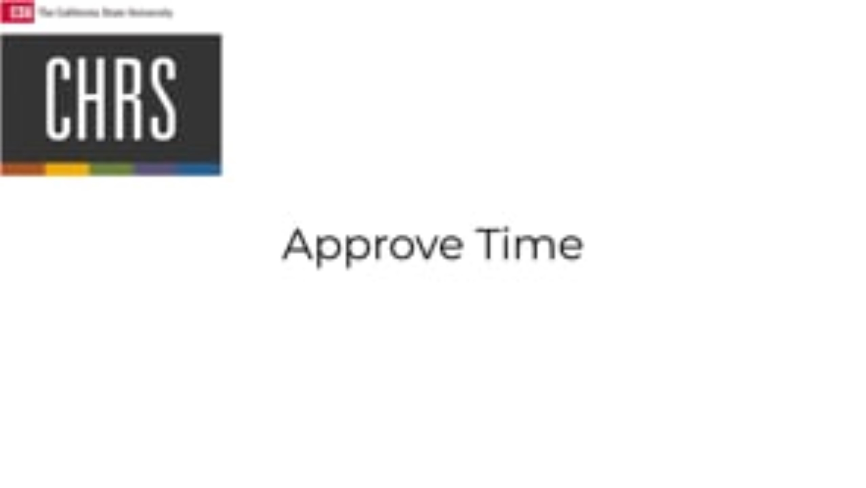
Approve Time (Manager)

Slide 9

Knowledge Check
Where does the manager or Timekeeper navigate to find the timesheet page for employees in CHRS?
Manager dashboard
Time entry portal
Manager self-service menu
Employee services

Slide 10
Knowledge Check
What must be selected for the hours entered?
Employee's job code
Pay grade level
Time reporting code
Shift type

Slide 11
Knowledge Check
What information can be found on the approval details page?
Employee's personal details
Company policies
Payroll submission status
Detailed time entries

Slide 12
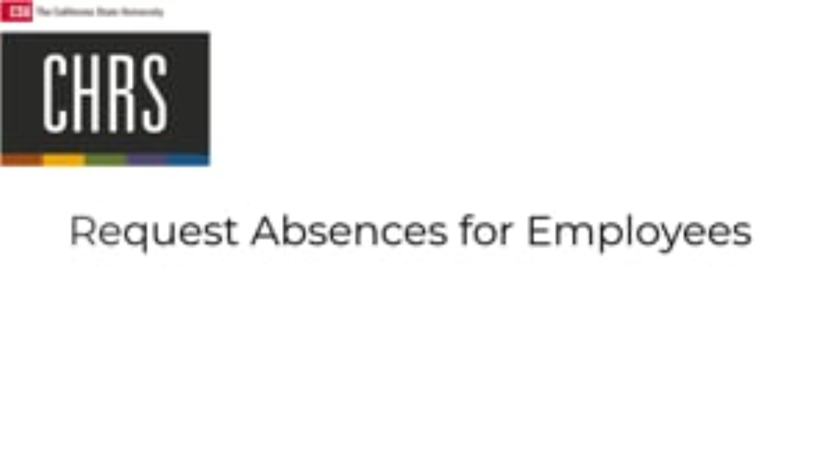
Request Absences for Employees

Slide 13
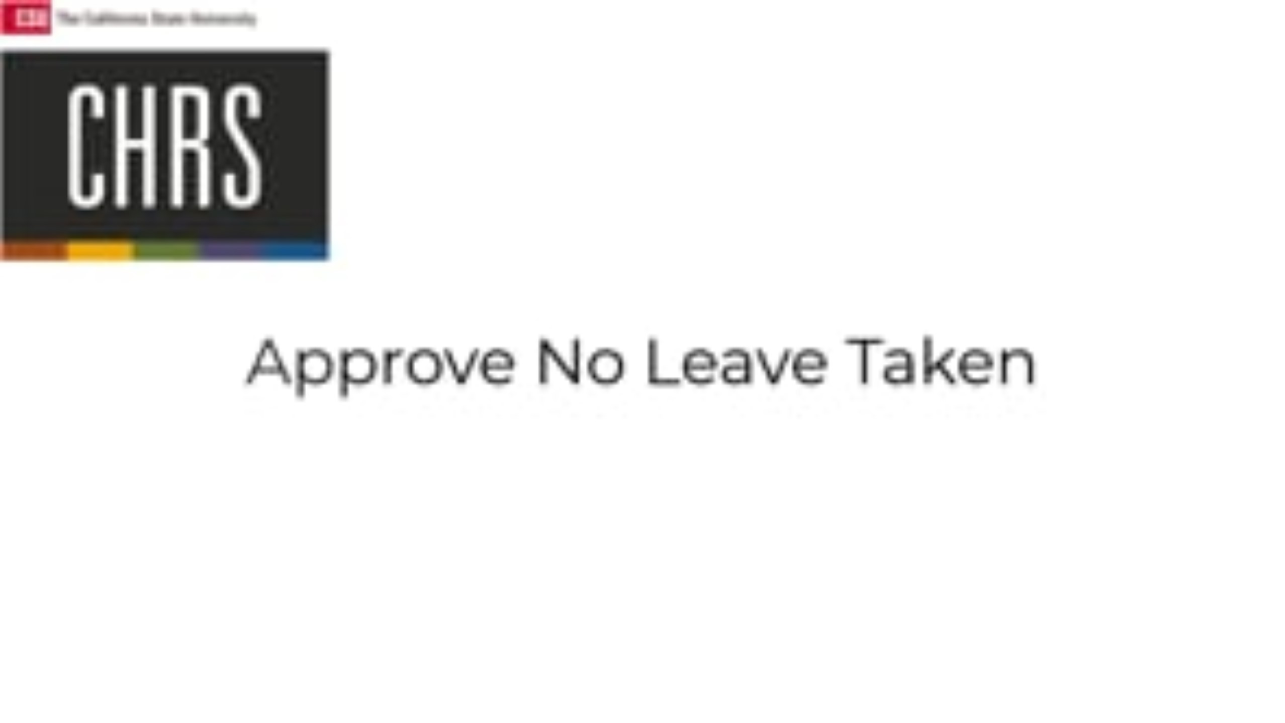
Approve No Leave Taken

Slide 14
Knowledge Check
What is the purpose of the "forecast" button in the absence request process?
To calculate the future absence balance
To schedule the absence into the team calendar
To check if the employee is available

Slide 15
Knowledge Check
Why is it important for a manager to verify an employee’s vacation balance before approving time off?
To apply a penalty if insufficient
To ensure the employee has enough balance
To inform the payroll department

Slide 16
Knowledge Check
What must you do if you deny an employee's no leave taken request?
Approve automatically
Archive the request
Contact the employee to submit any absences
Forward for higher approval

Slide 17
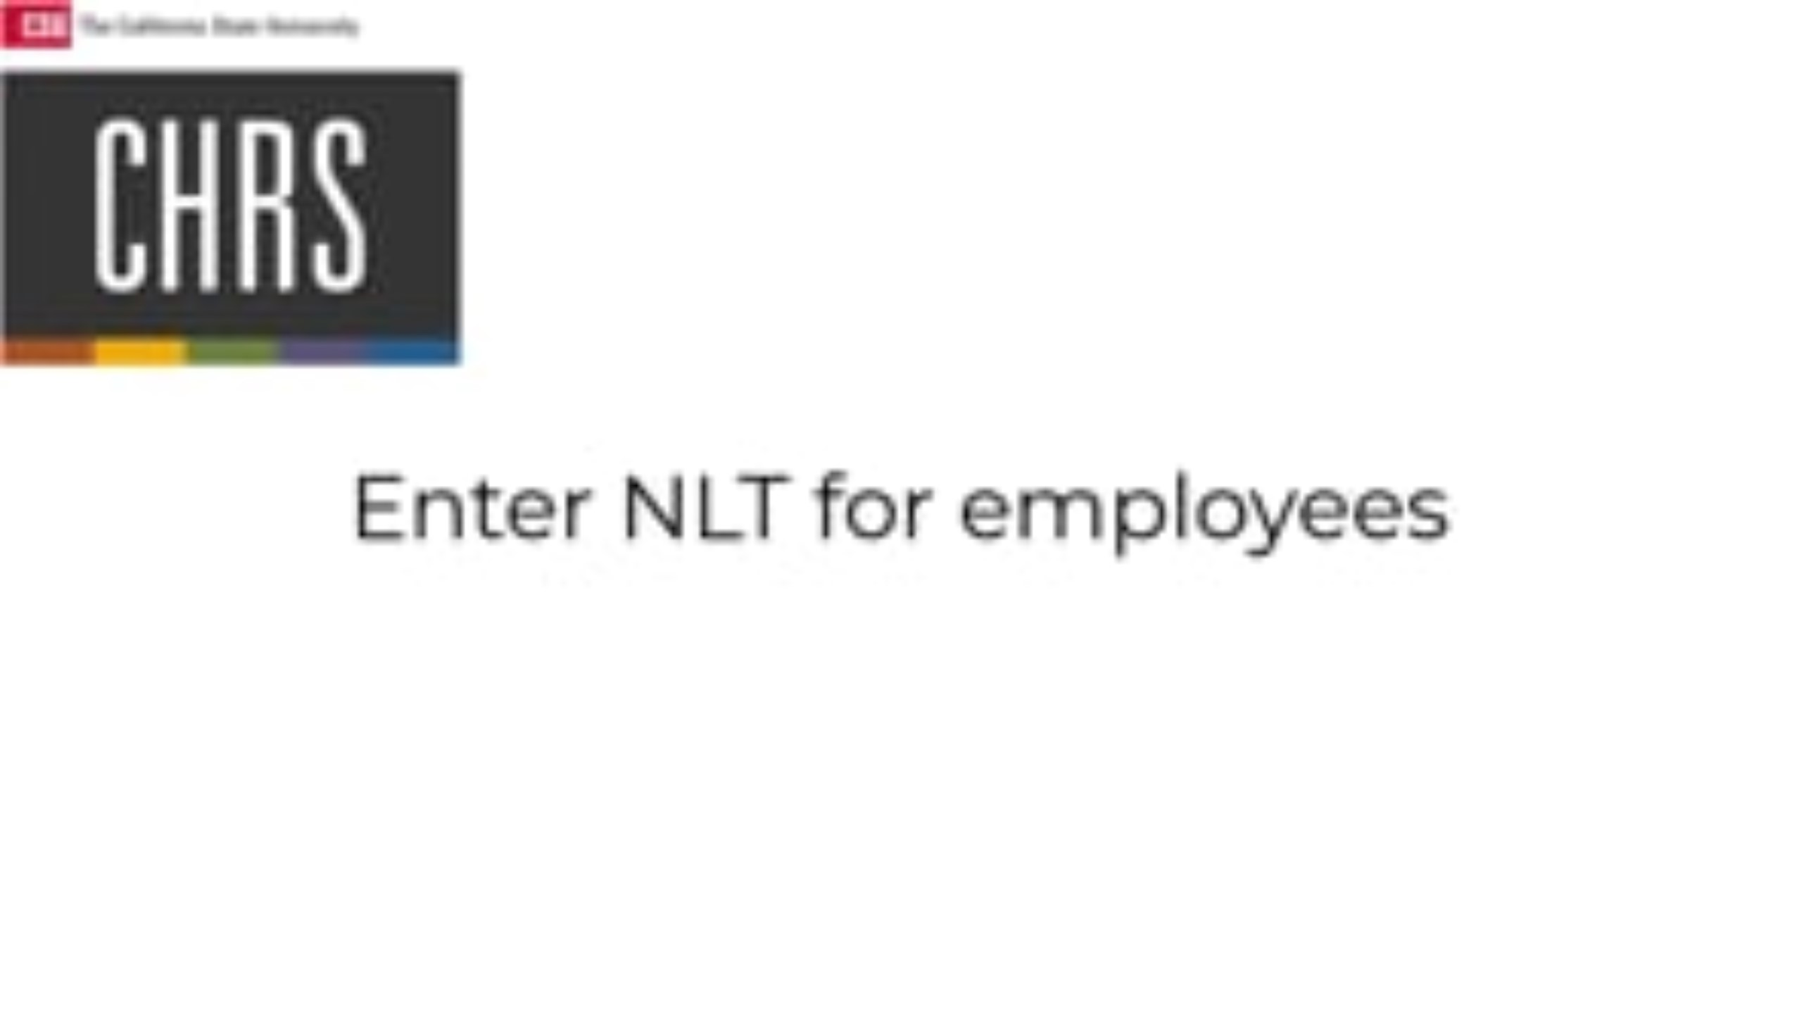
Enter No Leave Taken on Behalf of Employee

Slide 18
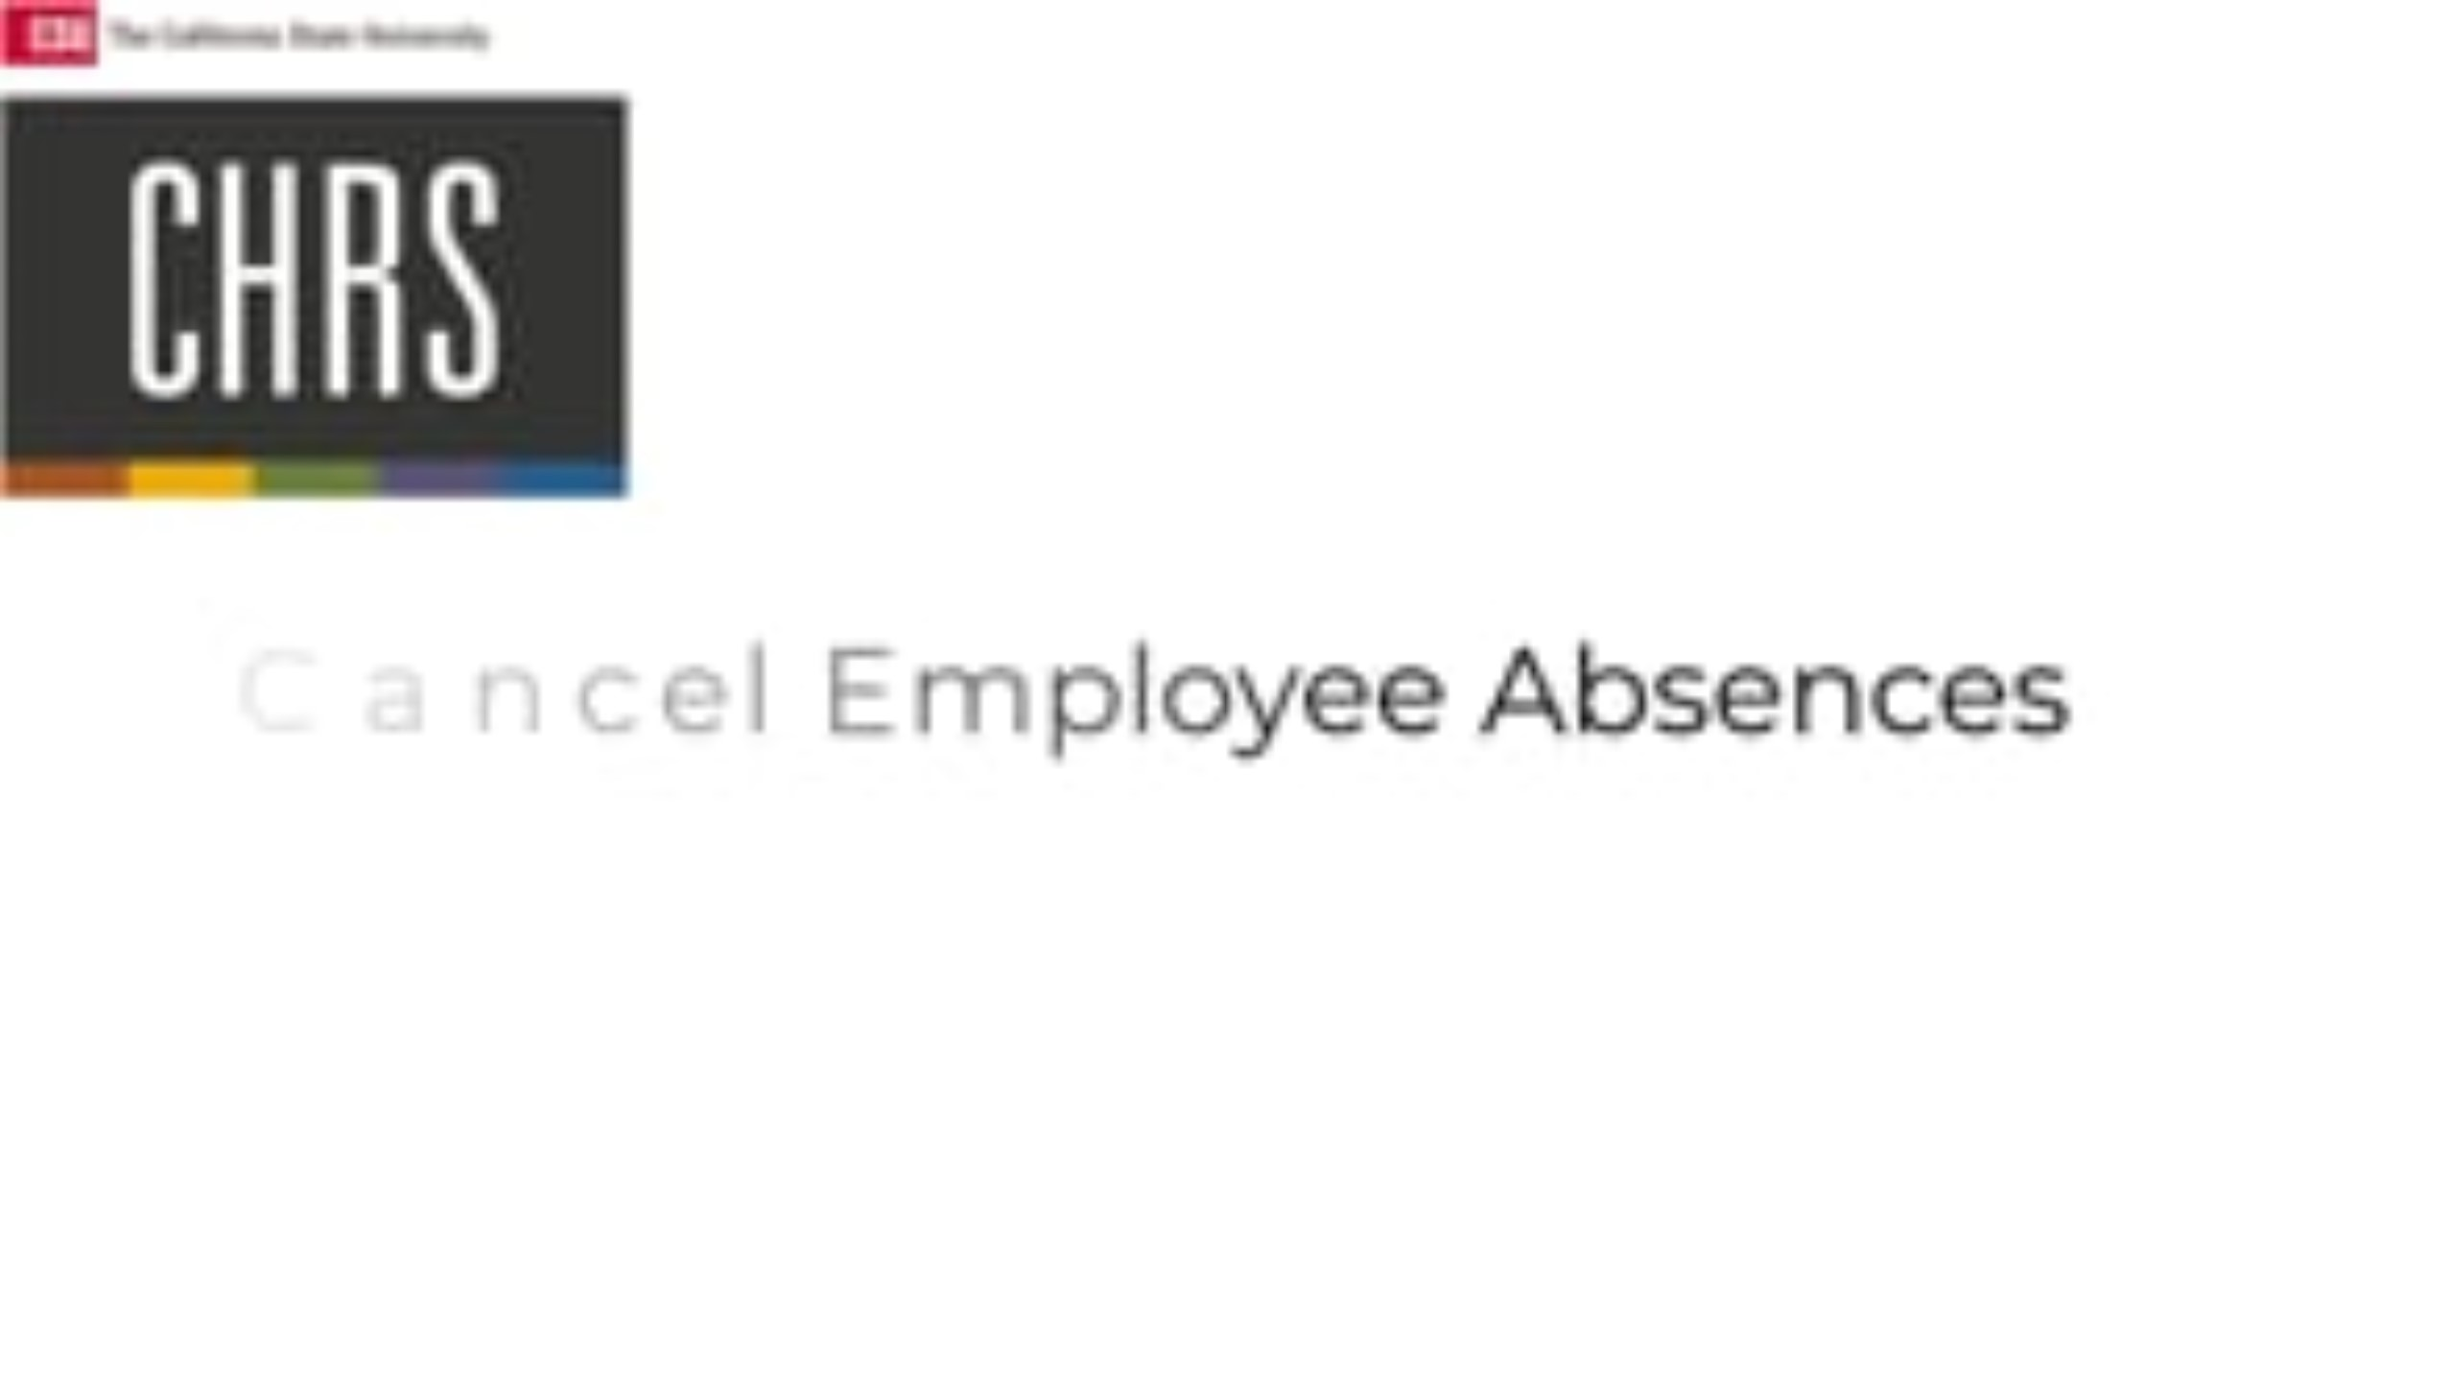
Cancel Employee Absence (Manager)

Slide 19
Knowledge Check
What happens when a manager submits an NLT entry for their own employees?
The status is "Submitted for Approval
The status is "Pending Review"
The status is "Automatically Approved"
The status is "Rejected"

Slide 20
Knowledge Check
After selecting an employee and clicking Continue, what is the next step to complete the absence cancellation?
Approve the absence
Archive the request
Select the absence you want to cancel
Edit absence details

Slide 21

Absence Balance Inquiry (Manager / Timekeeper)

Slide 22

Maintain Absences (Manager / Timekeeper)

Slide 23
Knowledge Check
What information is not displayed in the Absence Balance Inquiry?
Sick leave balance
Vacation balance
Personal holiday balance
Overtime pay

Slide 24
Knowledge Check
What must you select before viewing absence balances?
An employee’s tax information
The "As Of Date"
The manager's approval status
The time period of work hours

Slide 25
Knowledge Check
What should be done if the forecast indicates the employee is not eligible for the absence?
Contact HR for clarification
Archive the request
Save the request for later
Select and delete the request

Slide 26
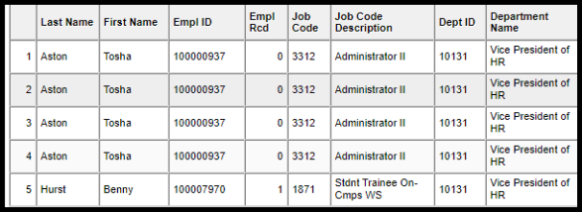
Timekeeper Absence Review
https://csuchrs.screenstepslive.com/a/1815288-timekeeper-absence-review

Slide 27

Timekeeper and Payroll Enter Time

Slide 28
Knowledge Check
What happens to the Review Status field if the employee or approver changes the status after the timekeeper has marked it as reviewed?
The field resets to blank.
The field remains marked as "Reviewed."
The field is locked and cannot be changed.
The field automatically updates to "Needs Corr."

Slide 29
Knowledge Check
What can you do if multiple time reporting codes are needed within a timesheet?
Submit separate timesheets
Use a single code for all
Discard the entry
Enter multiple time codes on separate rows

Slide 30
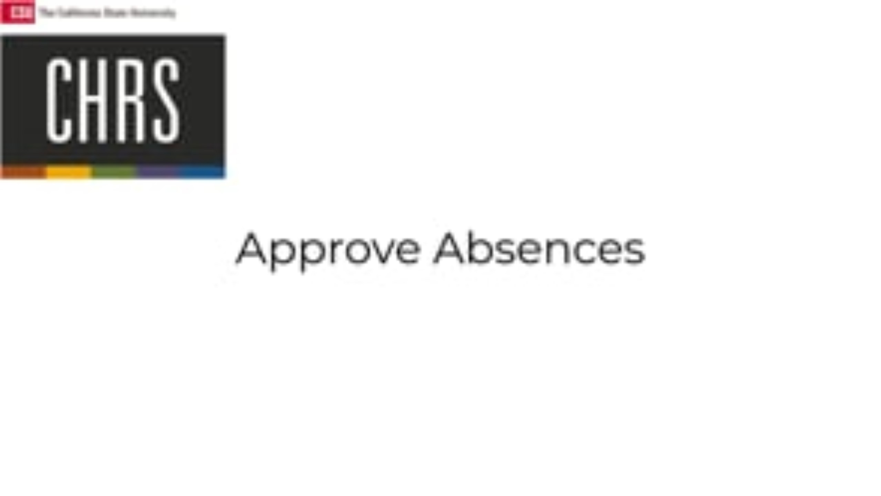
Approve Absences (Manager)

Slide 31
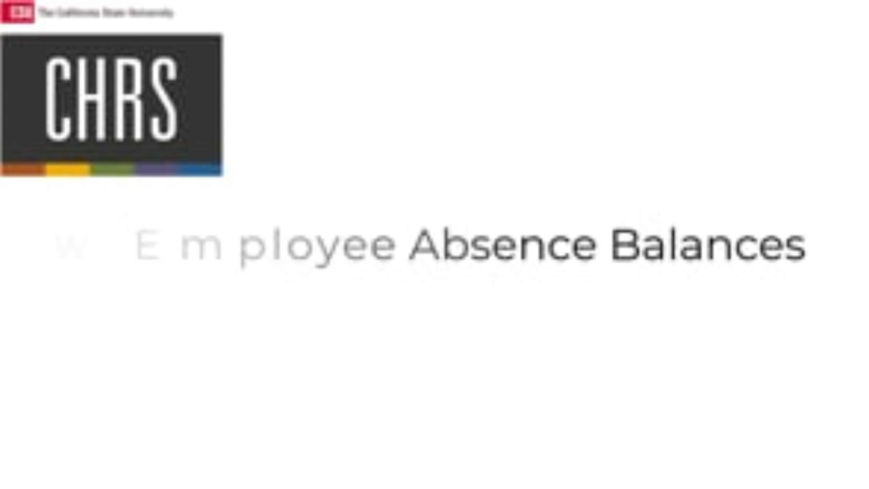
View Team Absence Balances (Manager)

Slide 32
Knowledge Check
How can you communicate any additional notes or context to the employee requesting the absence?
Through email
By adding comments in the absence request
By calling the employee
In a separate meeting

Slide 33
Knowledge Check
What information is available when you click 'details' for a specific employee?
Only vacation balance
Only sick time hours
Sick, Vacation, and Personal Holiday balances.
Detailed payroll information

Slide 34

View Work Study Balance

Slide 35
Important Change for Managers

Slide 36
What's Changing?
In the Current PeopleSoft 9.0 System:
Departments could assign a different approver by:
Creating dynamic groups
Granting specific security roles
For example, even though John Smith was the Reports To Manager, Jane Doe was able to be granted access to approve absences for John's employees
That workaround will no longer apply in CHRS
In CHRS:
Absence Management approvals are routed to the employee’s “Reports To” position in the system.

Slide 37
Delegation is Limited & Temporary
All managers with a Reports To relationship will be assigned:
Absence Management (AM) Approver role
Time & Labor (TL) Approver role (TL approvals are based on dynamic groups)
Managers are expected to directly approve requests.
When is delegation appropriate?
Delegation (proxy assignment) should only be used in specific, temporary situations, such as:
Manager is on Leave of Absence (LOA)
Extended absence
Delegation is not intended to permanently return to previous approval workflows.

Slide 38
If a proxy is required:
A ticket must be submitted that includes:
Begin date of delegation
End date of delegation
The proxy must:
Be an MPP
Already have the Approver role assigned in CHRS
Why this matters
Ensures proper routing and accountability
Maintains compliance with approval structure
Prevents inappropriate or open-ended delegation

Slide 39
Transaction and System Pauses/Outages

Slide 40
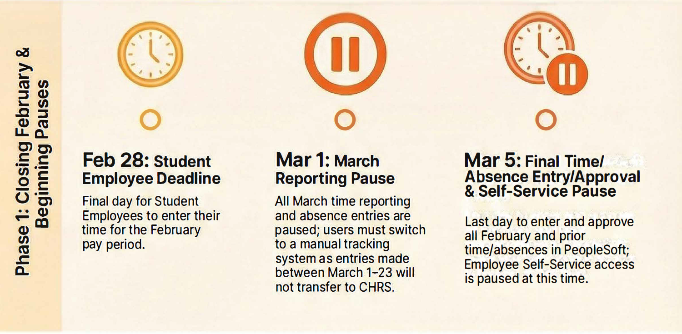
Phase 1: Closing February & Beginning Pauses

Slide 41
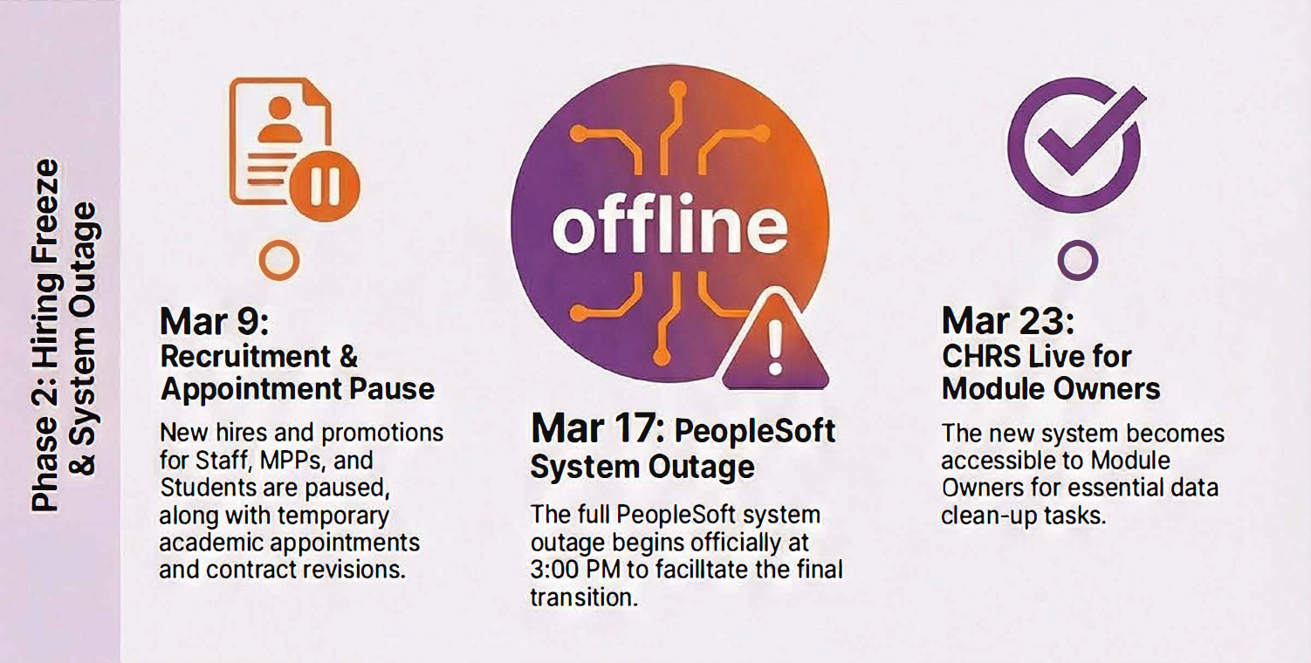
Phase 2: Hiring Freeze & System Outage

Slide 42
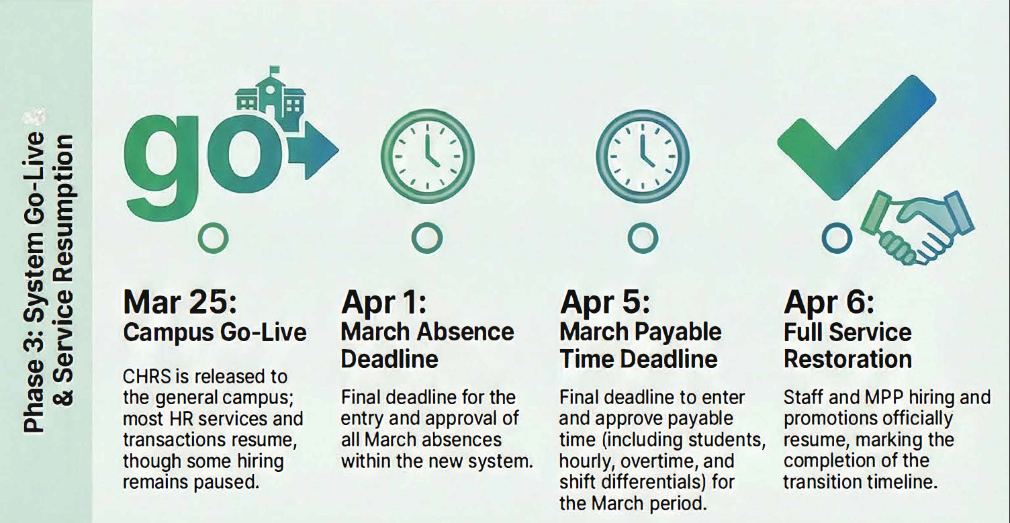
Phase 3: System Go-Live & Service Resumption

Slide 43
Important Payroll Deadline Changes for Timekeepers & Approvers

Slide 44
March Pay Period Deadlines (Go-Live Month)
Absence Management
Time and Labor
Deadline to Enter AND Approve March Absences
Deadline to Enter AND Approve March Payable Time
April 1
April 5
*The deadlines for this month are different due to the go-live calendar disruption

Slide 45
ALL FUTURE Pay Period Deadlines
Absence Management
Time and Labor
Time and Labor
Deadline to Enter/Edit/Approve Payable Time for Employees
Deadline to Enter AND Approve Absences
Deadline to Enter Payable Time
Last Day of Pay Period
Last Day of Pay Period
Fifth Calendar Day of the Next Pay Period

Slide 46
Let's look at an example:
This is the last day that Jane's absences can be entered, reviewed, and approved before the calendar closes.
April 30
Jane Doe is an hourly employee at CPP.
It is Friday April 24, and some important Payroll Deadlines are coming up to close out the April Pay Period.
Let's make sure Jane, her Timekeeper and her Approver meet those deadlines so she gets her paycheck on time!
This is the last day that Jane's time worked can be entered before the calendar closes.
April 30
This is the last day that Jane's Timekeeper and Approver can enter/edit/approve time worked for Jane before the calendar closes.
May 5

Slide 47
Action Required Before System Goes Offline (3/17)

Slide 48
Action Required Before System Goes Offline (3/17)
Timekeepers & Approvers Must:
Run and download Payroll Certification Reports
Run and download Leave Accrual Balance (LAB) Reports
Why This Is Important
Reports will not be accessible while the system is offline (3/17 - 3/22)
Payroll Certification reports support review and reconciliation
LAB reports are needed to view each employee’s current leave balances
Required for accurate manual tracking of time off during the offline period

Slide 49
Additional Resources & Information

Slide 50
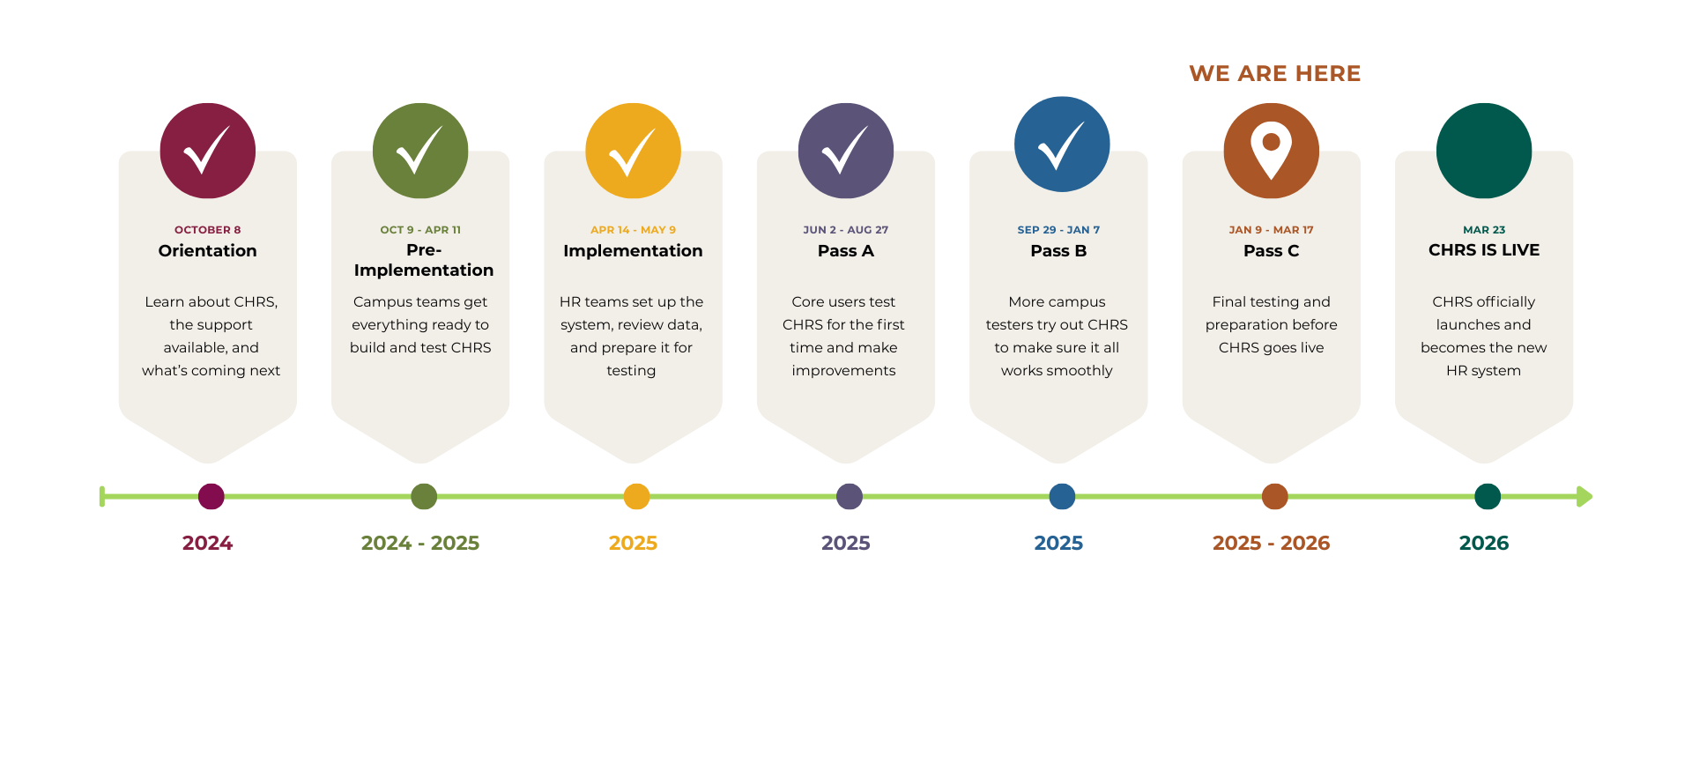
CHRS Roadmap

Slide 51


Stay Connected
CHRS Website
https://www.cpp.edu/eoda-hr/chrs/index.shtml
CHRS Inquiry Form
https://app.smartsheet.com/b/form/b9171be6827a43ba80d926ad471059be

Slide 52

26 Days Until Launch

Slide 53
Q&A

Slide 54
Thank You

