Slide 1
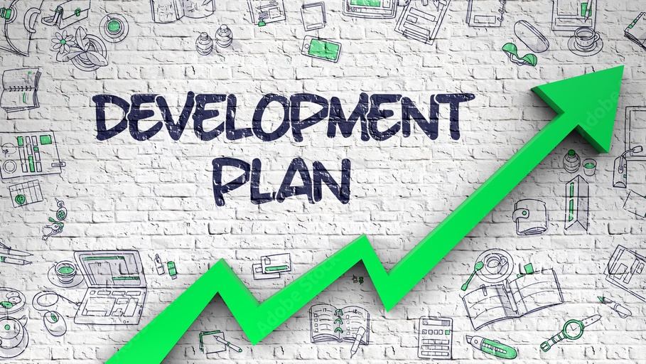

Development Plans
Coach the Coach

Slide 2
What’s the P.O.In.T.?
P – Purpose​: Get a better understanding of development plans
O – Outline: What they are, your role, how to leverage Cornerstone
In – Employee Input​: Questions or Concerns
T - Transition: Open Form & Feedback

Slide 3
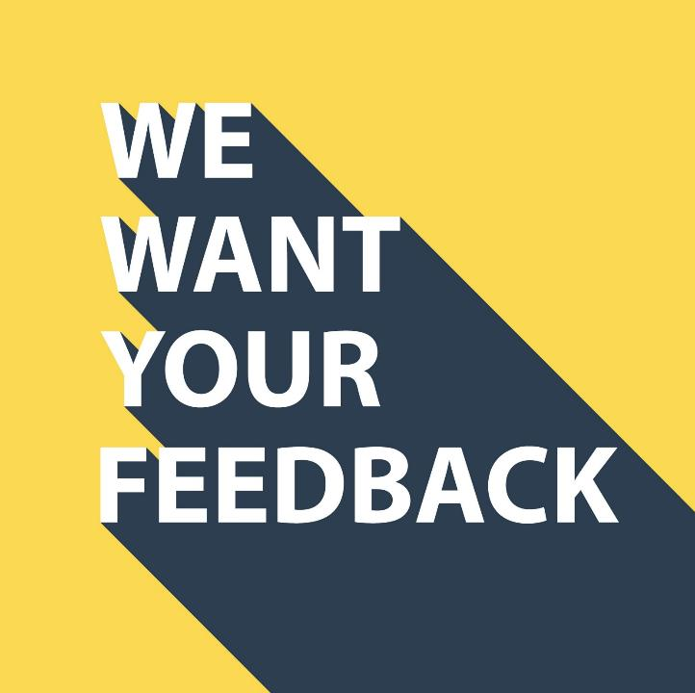

Open Forum & Feedback

Slide 4
Learning Outcomes
Understand how development plans fit in the performance review process
Utilize available resources to build a development plan and enter a development plan in the Cornerstone System
If applicable, understand your role to support and encourage staff to create individual development plans

Slide 5




Performance Management Cycle
CHECK-INS
(One-on-Ones)
GOALS
PERFORMANCE
REVIEWS
DEVELOPMENT
PLANS

Slide 6
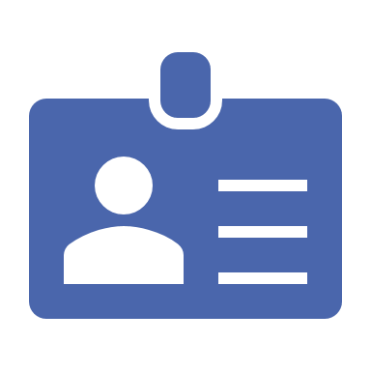
What is a Development Plan?
An individual development plan (IDP) is a tool to assist employees in career and personal development. Its primary purpose is to help employees reach short and long-term career goals, as well as improve current job performance.

Slide 7

Development Plans
“Investing in yourself is the best investment you will ever make. It will not only improve your life. It will improve the lives of all those around you.”
Robin Sharma

Slide 8

Development Plan

Slide 9
Development Plan Benefits
YOU
Gives you a voice
Improves your sense of purpose
Opportunity to grow in new and different ways
Increases satisfaction and engagement
They will also get all the same benefits as YOU
Feel supported by their leader
Sets clear expectations
STAFF

Slide 10
Understanding your Personal Investment when it comes to Development Plans

Slide 11

How Do I Choose My Development Plan Topic?
CSU Competencies
Goals
Professional
Personal

Slide 12

Development Plan Example
Plan Title: Mindfulness
Plan Description: I would like to focus on incorporating mindfulness techniques into my workday.
1. Objective Title: To be fully present in my activities
a. Development Action: Attend Dr. Alane’s Mind and Heart Lab meditation on Thursdays while at campus.
i. Activity Type: Learn by doing
2. Objective Title: Research Mindfulness Practices
a. Development Action: Take LinkedIn Learning Course: Becoming Mindful at work
i. Activity Type: LinkedIn Learning

Slide 13

Cornerstone Demo

Slide 14
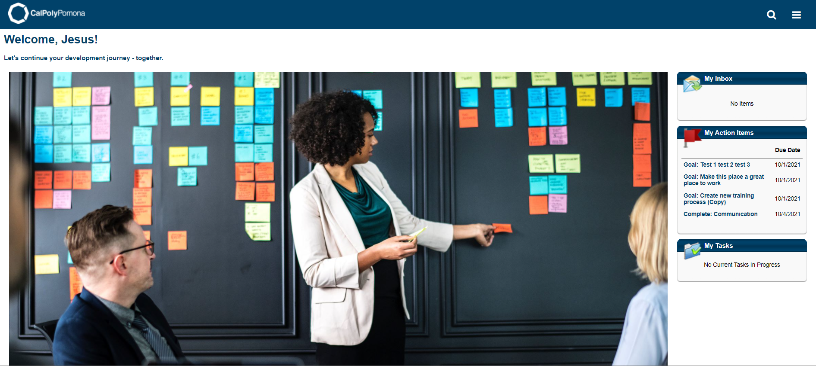

How To Access Development plans

Slide 15
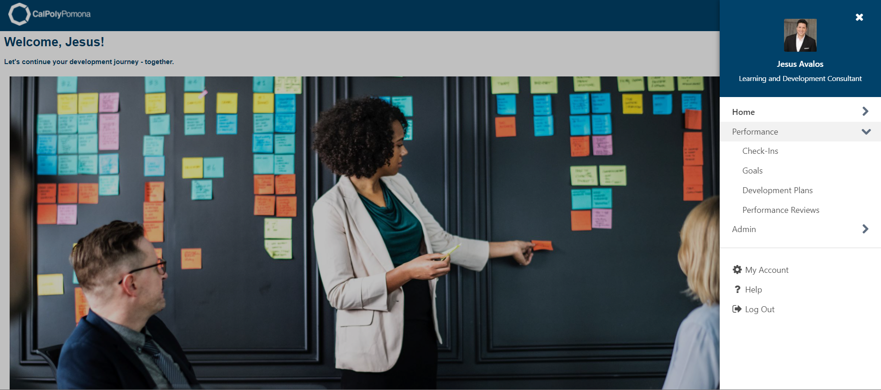
Development plans navigation

Slide 16
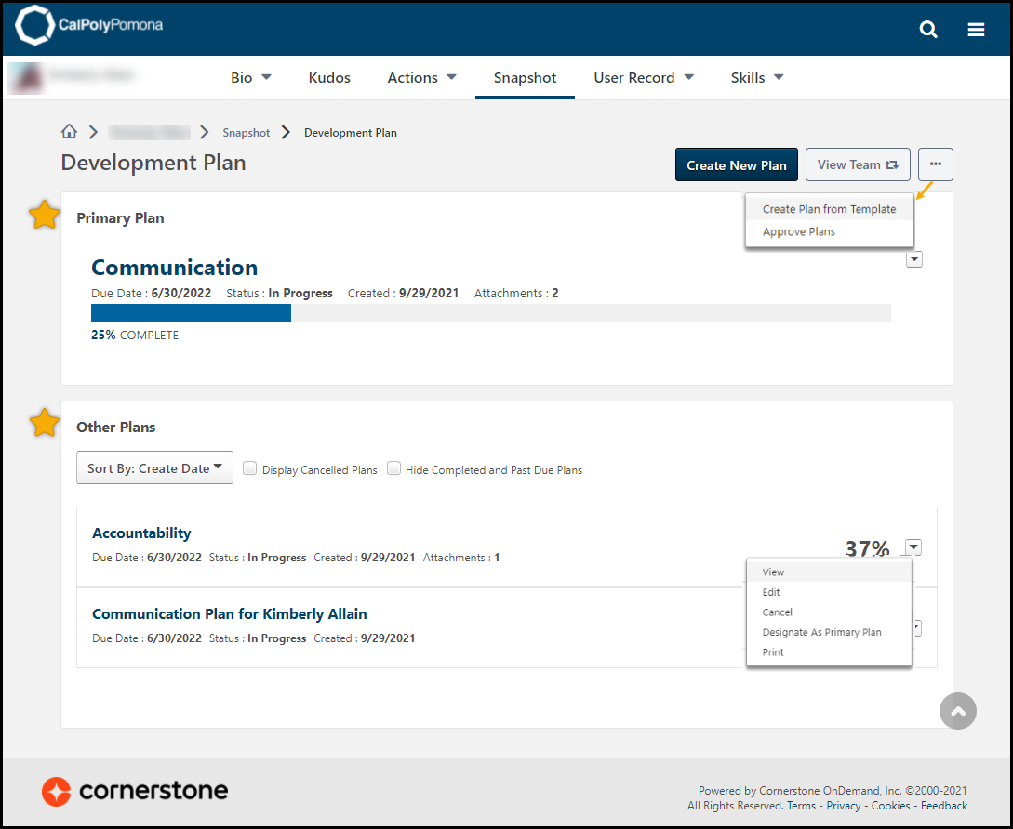
DEVELOPMENT PLANS SNAPSHOT

Slide 17
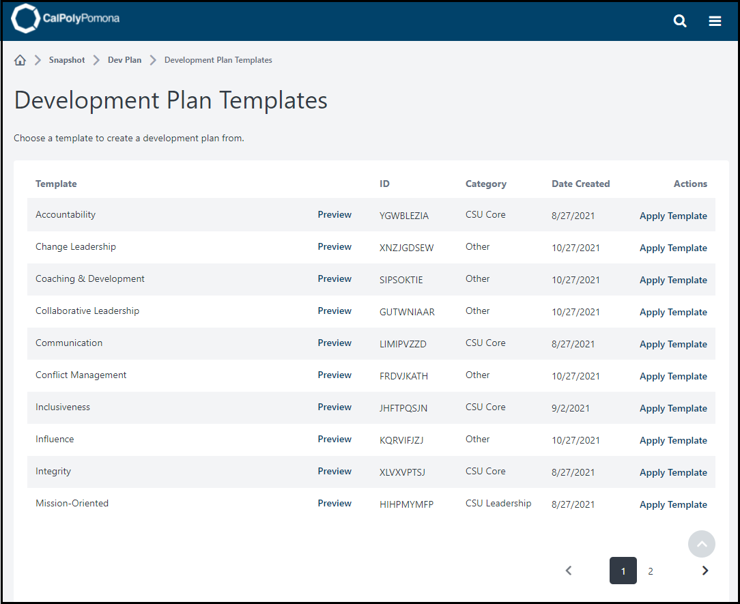
DEVELOPMENT PLAN TEMPLATES

Slide 18
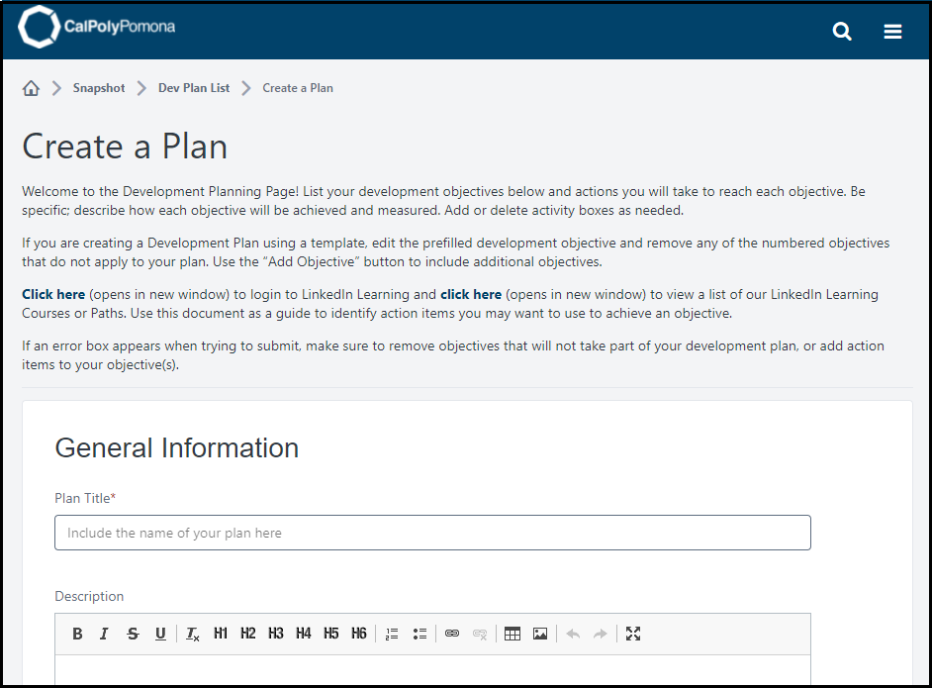
Creating Development plans

Slide 19
Activity
Where do you see yourself in the next five years?
What is something you need to do to get there?
Create a development plan

Slide 20
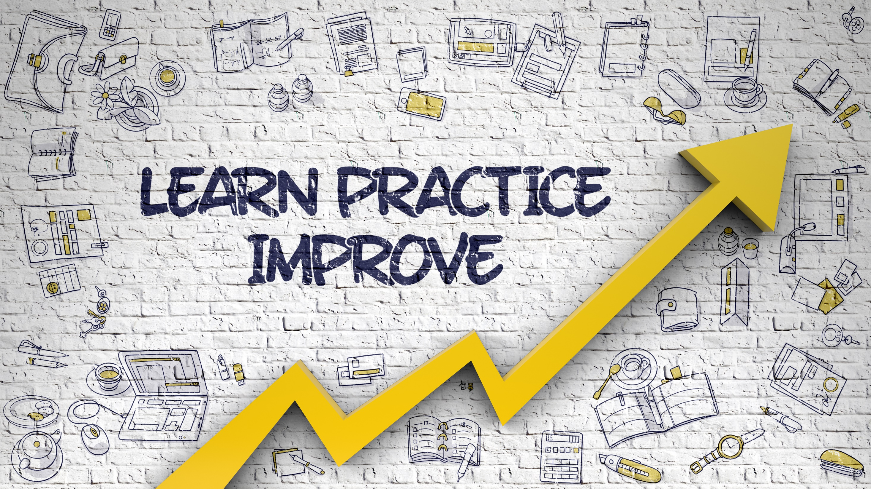

Development Plan Exercise

Slide 21
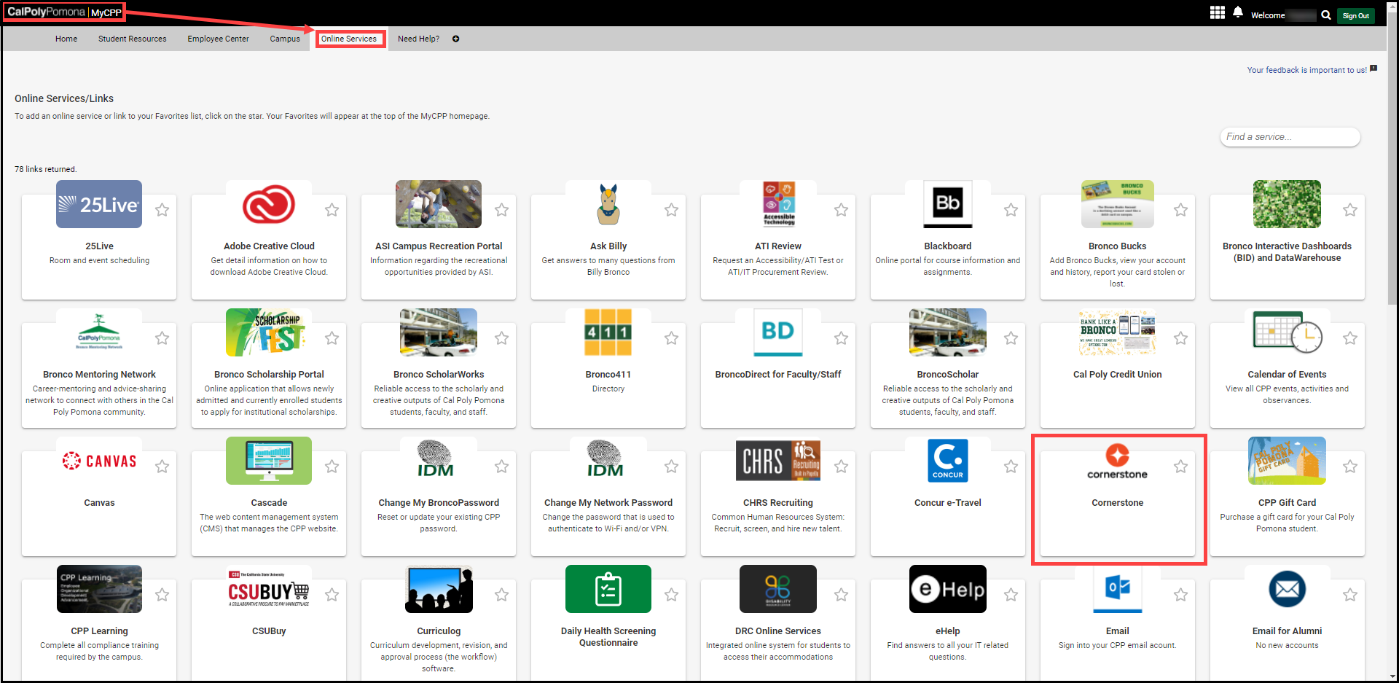
Logging into Cornerstone
MyCPP > Online Services

Slide 22


Performance Evaluation Transition Period
Evaluations for the 2021-2022 fiscal year will be completed using the current paper form.
This includes MPP’s hired on or before 6/30/22
Evaluation for the 2022-2023 fiscal year will be completed using Cornerstone
This includes MPP’s hired on or after 7/1/22
All MPP’s have access to the system and can begin using the system features now.
It is expected that by September 2022 all MPP’s will have a goal in the system for the next evaluation period.

Slide 23

Questions?

Slide 24

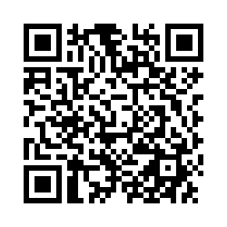
Next Steps
Survey: https://cpp.az1.qualtrics.com/jfe/form/SV_eVv9LQ4faIwFSxo
Implement the concepts we shared by practicing in Cornerstone.
Attend the next Coach the Coach Session!
Resources and Open forum – June 20, 2022, at 1:00 p.m. – 3:00 p.m.
Reviews – July 21, 2022, at 10:00 a.m. – 12:00 p.m.
Check-ins – August 23, 2022, at 10:00 a.m. – 12:00 p.m.

