Slide 1

Recognition and Feedback
Coach the Coach

Slide 2
Benefits of Recognizing Staff
Employee recognition helps to:
Retain top talent
Increase employee engagement
Encourage high performance

Slide 3
Statistics
In a Gallup workplace survey from 2016, employees were asked to recall who gave them their most meaningful and memorable recognition.
28% came from an employee's manager
24% came from a high-level leader or CEO
12% came from the manager's manager
10% came from a customer
9% came from a peer
17% cited as other

Slide 4
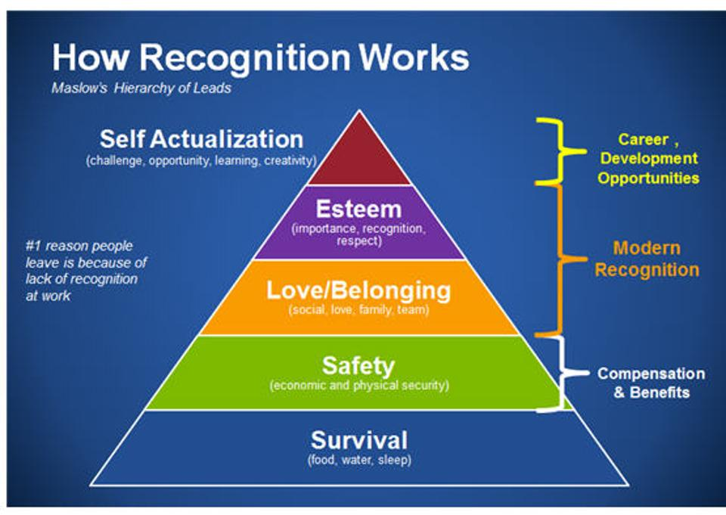
Overview
Maslow's Hierarchy of needs helps to explain in the workplace how people are “motivated by many needs other than economic security” (Marquis & Huston, 2015, p.418).
Psychological needs such as feeling appreciated, and belonging are among the most essential needs.

Slide 5

Recognizing your staff

Slide 6

Components of Effective Recognition – S.I.T.
Specific
Interactive
Timely

Slide 7
Recognition Using P.O.In.T.
P – Purpose​: What are you trying to accomplish in your time together?
O – Outline: What are you going to cover?
In – Employee Input​: What would they like to discuss?
T - Transition: What comes next?

Slide 8

Cornerstone Demo

Slide 9

How to Recognize Staff in Cornerstone
What tools do you currently use to recognize staff?
Cornerstone Platform has two options for providing feedback
  Kudos aligned to badges
  Kudos for general feedback

Slide 10

Additional Questions
What about perceived favoritism when recognizing one employee and not another?
What if an employee receives a needs improvement on their performance evaluation but disputes because of recognition they have received?
What if employees do not like public recognition? How will managers know what their preference is?

Slide 11

Feedback
Feedback is a free education to excellence. Seek it with sincerity and receive it with grace.
Ann Marie Houghtailing

Slide 12
Feedback Discussion

Slide 13
Components of Effective Feedback – S.I.T.
Specific
Interactive
Timely

Slide 14
Feedback Using P.O.In.T.
P – Purpose​: What are you trying to accomplish in your time together?
O – Outline: What are you going to cover?
In – Employee Input​: What would they like to discuss?
T - Transition: What comes next?

Slide 15

Receiving Feedback
Receiving feedback is a gift
Perception Vs. Reality
What paradigms (views) do you currently hold when it comes to feedback?
Why is receiving feedback difficult?

Slide 16
Where do you document feedback in Cornerstone?

Slide 17

Performance Evaluation Transition Period
MPP’s hired on or before 6/30/22 – employee will use current paper form.
  This includes evaluations for the 2021-2022 fiscal year
All MPPs, including MPP’s hired on or after 7/1/22 = employee will use Cornerstone.
All MPP’s have access to the system and can begin using the system features now.
It is expected that by September 2022 all MPP’s will have a goal in the system for the next evaluation period.

Slide 18

Next Steps
Practice some of the concepts we shared by providing kudos to someone in the system (HEERA managers only)
If delivering the kudos or providing feedback to one of your employees who is not in the system, use the P.O.In.T framework to deliver it in person.
Attend the next Coach the Coach Session! 5/19/22 10-12

Slide 19

Questions?

