Slide 1


ZOOM
Advanced Session
Notes:
The purpose of this meeting is to learn how to use and implement Zoom to support communication with our students, faculty, and staff.
1. Introduction of Host and Moderator
2. Moderator, please discuss your role in the meeting: To make certain all questions are answered in the chat box and/or responded to.
Host, please place links in the chat box for reference:
Employee and Organizational Development and Advancement (EODA) Virtual instruction and Remote work resources: https://www.cpp.edu/eoda/index.shtml This is the EODA site where you can find a pre-recorded zoom training session, detailed guides, and the FAQ’s from all of the previous Zoom sessions
You can access Zoom using your Bronco Username and Password at: https://cpp.zoom.us/ You can also download the app to access additional resources.

Slide 2

AGENDA
Questions from Zoom Basic
Settings
Breakout Rooms
Whiteboard
Polling
Recording Your Session and Kaltura
Notes:
Agenda
Questions about Zoom Basic
Breakout Rooms
Whiteboard
Multiple Screen Share
Polling
Record your session and Kaltura
Reports
Remote Control Feature
As we go through the presentation today, if you are comfortable, please log into the Zoom site so you can follow along while we are going over the details.

Slide 3

Questions from Zoom Basic
Notes:
Okay, before we go into our session, lets recall some of the features we learned in our Zoom basics training.
Click on the microphone icon to mute and unmute your mic and say hi to the group?
Can I have everyone turn one their video and then turn off their video? If you have a red line through your video, that means that it is not on.
In the chat box, please tell me your favorite movie or book is in the chat box!

Slide 4
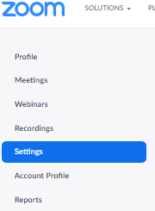
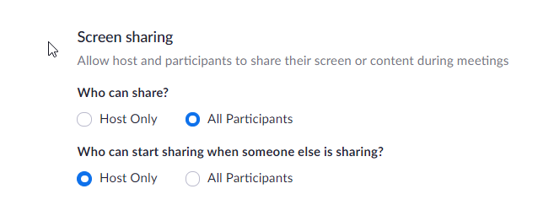
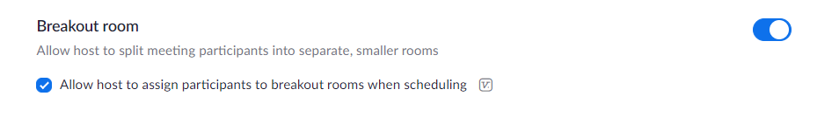
Update Your Settings
Require a password when scheduling new meetings
Co-host
Polling
Screen Sharing
Annotation
Whiteboard
Breakout Rooms
Notes:
For security, IT has disabled some features to prevent zoom bombing. You may need to go into settings and update this feature if you would like that capability to share with your teams or students. Also, Let’s chat about two options that may add a level of security to your meetings.
Share Screen: Go to settings, and you can turn the feature on for your meetings to require a password. When creating a new meeting, you can also click the box to require registration for the meeting.

Slide 5
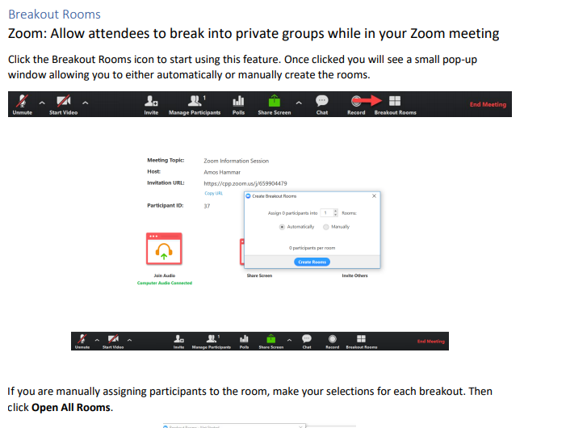
Breakout Rooms
Notes:
Breakout rooms allow you to split up your class or meeting into groups! This is great for collaboration and engagement efforts. The best part about the breakout rooms is that as facilitator, you can peak in to each room to see how the conversation is going.
Keep in mind, you are participating as an attendee, so you are seeing it the way your students or staff will be viewing it, which is very helpful. As facilitator, you will be able to assign breakout rooms before the meeting, or during! First, let’s go back to settings to ensure your breakout room meeting is enabled.
Share screen: Settings, click on meeting advanced, the first option is breakout rooms. Great! Now, if you want to preassign your breakout rooms, go to schedule a new meeting. You can add emails and invite each person. This can be quite time consuming, but if you will have students working in teams for the entire semester then this might be useful. Otherwise, my recommendation would be to create the teams during this meeting. It will only take a minute or so and it will show you all the names of the participants in the meeting.
View this slide. This is what the facilitator sees after clicking on breakout rooms. Based on the number of attendees you can select the number of groups and how many people in each one. Once you are done, click on create rooms. This will put people in their rooms automatically.
Click to next slide

Slide 6
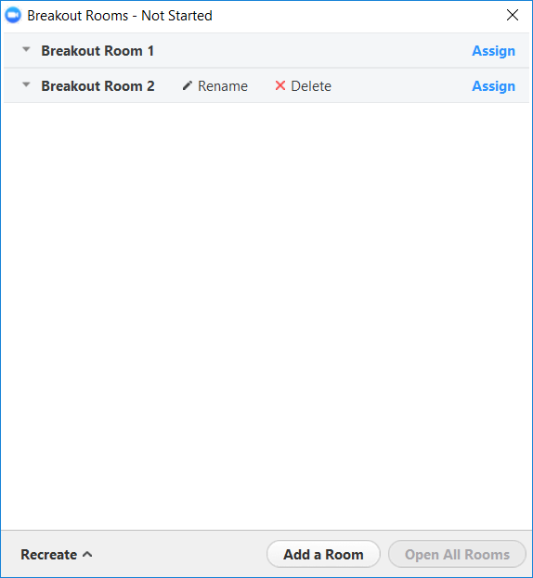
Breakout Rooms
If you are manually assigning participants to the rooms, make your selections for each breakout.
Click on “Open All Rooms”.
Students will see a pop-up window and will need to click on join breakout room.
As a facilitator, you can gain access to the breakout rooms to see how the conversation is going and provide support. On the main page you will see the breakout list and click on join room to the right of each group
Let’s practice!
Notes:
Here is the option if you would like to manually assign your rooms during your meeting it can be very helpful.
Here are the steps to create your breakout room.
Now let’s get some practice in. Let’s take a moment and breakout into our breakout rooms. Let’s discuss some helpful practices or tools that you have found for remote work. Once I create your rooms, please don’t by shy. Make sure to take yourselves off of mute and start a discussion. Once we hit (give a time frame) please click on the exit breakout room to go back to the main page.
In the chat box please tell me your thoughts, how did that go?
Let’s take a moment and respond to any questions.

Slide 7
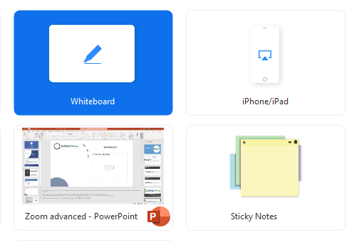
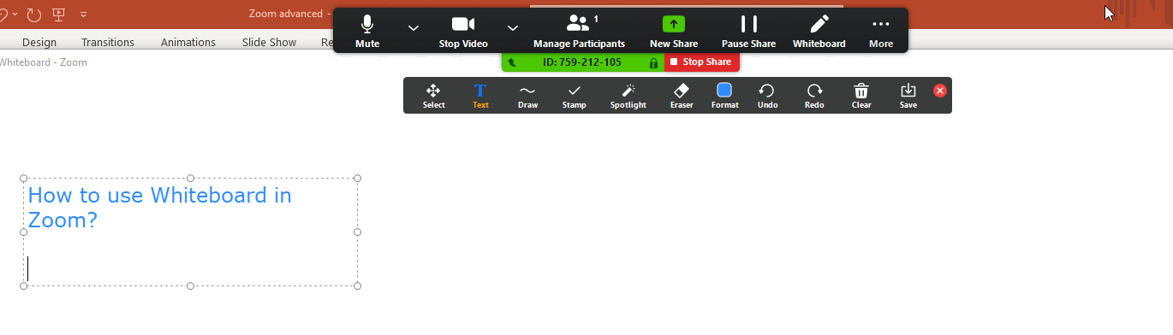
Whiteboard
How to access the Whiteboard
Benefits of using the Whiteboard
Available Icons on the Whiteboard
How to save your work
Let’s practice!
Notes:
Okay everyone, so let’s talk about whiteboard. Whiteboard is quite literally your classroom board for writing. This can be helpful when writing down notes, lists, or highlighting areas of importance for staff or students. In order to access whiteboard, click on your share screen button at the bottom of your zoom window.
You will see several screen sharing options. Whiteboard will automatically pop up for you. Go ahead and click on Share screen. At this point, don’t click on anything else, but you should see the whiteboard option.
Available Icons on whiteboard:
Text, draw, erase. The most important icon is the save button. One you are done with the whiteboard feature; you can save your work for future reference or to send out to attendees.
Practice time: So let’s have a quick discussion about ways to keep staff or students engaged by through our whiteboard sessions. I will be listing all of the items on the whiteboard! If you feel comfortable, please take your line off of mute to share your thoughts.
Let’s take a moment and respond to any questions.

Slide 8
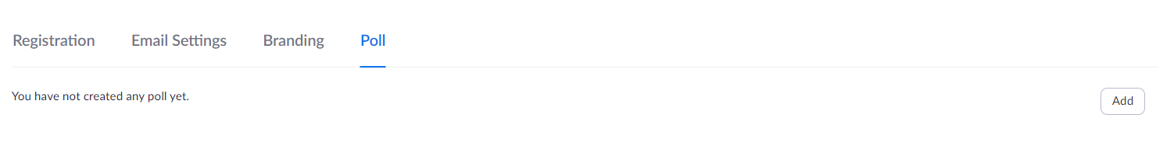
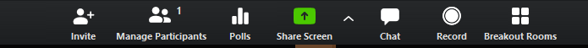
Polling in Zoom
First step in using the Poll feature is checking your settings and making sure Polls is turned on
Go to Meetings > My Meetings > Click on the meeting you wish to add a Poll to > Scroll down to the bottom and Click on “Add”
Polling in Zoom
Notes:
Go to settings to update your polling feature!
Share screen, go to settings,
First step in order to use your poll, check your settings
Then go to meeting,
Click on your scheduled meetings (meeting you have already scheduled) and click on the meeting in which you want to have a poll.
Scroll down to the bottom and you will see POLL and a button that says add. Click on Add
Type in your question and potential responses
Click on save in order to save your new poll
Once you start your meeting, you will have the polls icon on your zoom toolbar

Slide 9
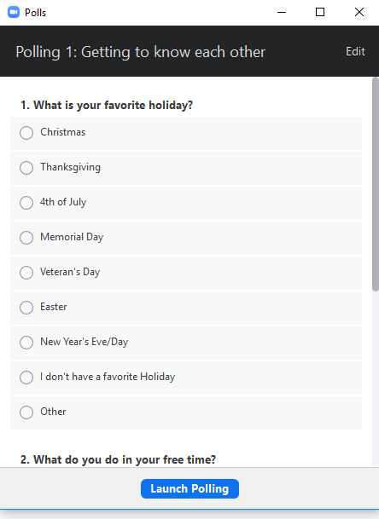
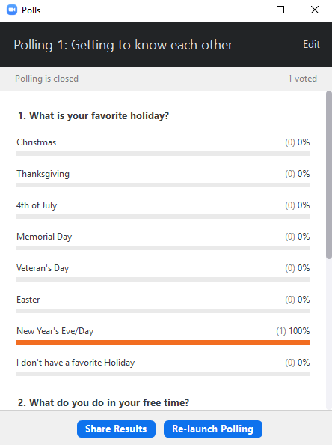
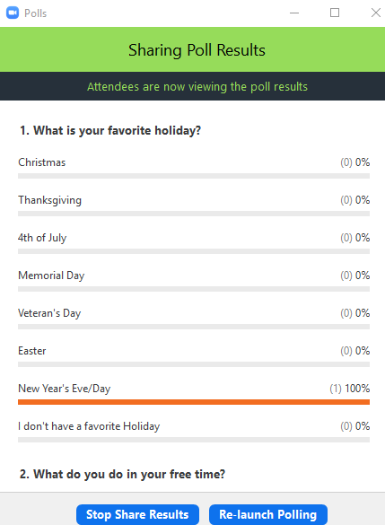
Polling in Zoom
Once you click on the Poll icon, this box will appear
Launch Poll view
Sharing Results
Notes:
Before you start your meeting, you can do a practice run. If the poll icon shows up on your meeting toolbar, then you know you added the poll correctly.
When you are ready to start your poll during your meeting, click on the poll icon in your zoom toolbar.
Once you have initiated your polls, you will see this first screen and click on launch polling. As attendees are respond you will be able to see the number of responses on your screen.
All the responses will appear, and when you are ready, you will have the ability to share your results.
Now, let’s see what a poll looks like on your end. I am going to initiate a poll. Please respond to all the questions. Once you are done with your session you can find your poll results under your report tab on the zoom site.
I am going to launch a poll so you can see how your attendees will view and respond to a poll. Once you are done, I will also show the poll results!
Let’s take a moment and respond to any questions.

Slide 10
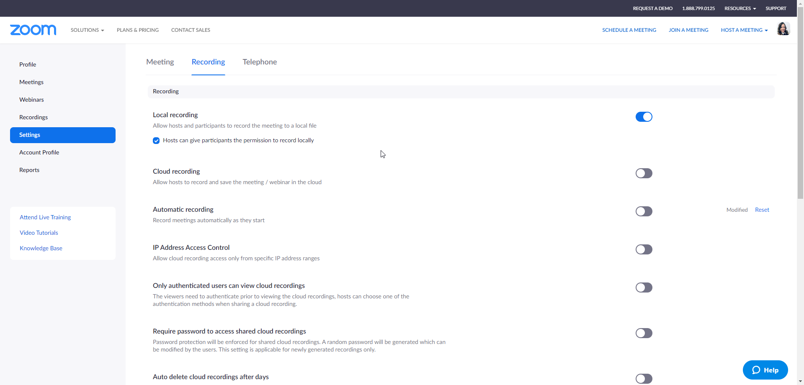
Recording in Zoom
Notes:
We discussed recording in zoom in our previous zoom session, however, let’s take some time to review. There are two ways you can record your session.
In settings, you can click on the setting to auto record so when you start your meeting, it will automatically record. If you would like to do it manually, you can click the record button. If you are manually recording, then once you are done with your meeting you will need to click stop record in your toolbar and your video will be saved under documents or under your recording tab in zoom.

Slide 11
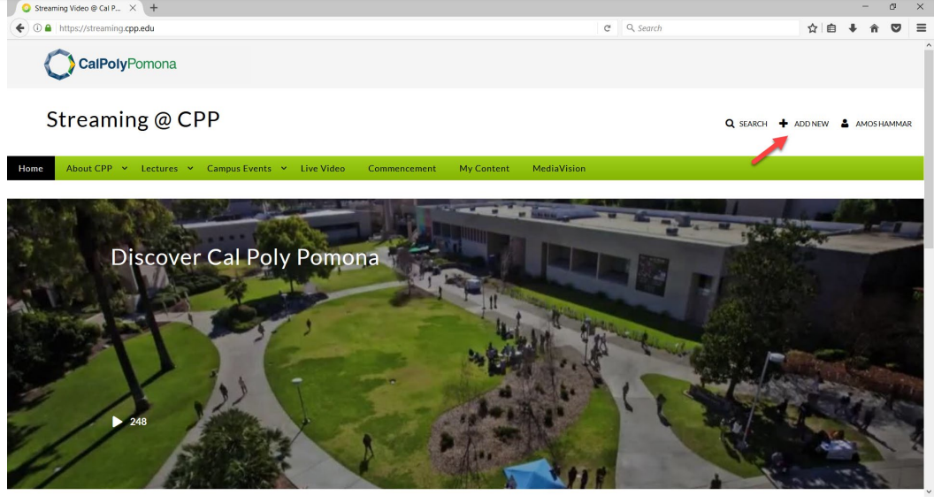
Kaltura: Getting Started
To get started, navigate to https://streaming.cpp.edu/ Hover your mouse over the Guest icon on the left of the screen and select “Login”
Click the “+ Add New” option next to your name in the top left of the screen.
Notes:
If you are going to post your video for your attendees/students, you may need to convert your video file into something that is compatible. Faculty already will have access to Kaltura. If you need this and you are not faculty, you can submit a IT ticket and they will determine access on a case by case basis.
In order to access Kaltura please go to https://streaming.cpp.edu/
Click on Guest and login using your bronco username and password

Slide 12
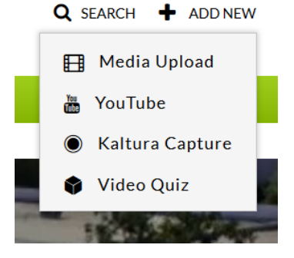
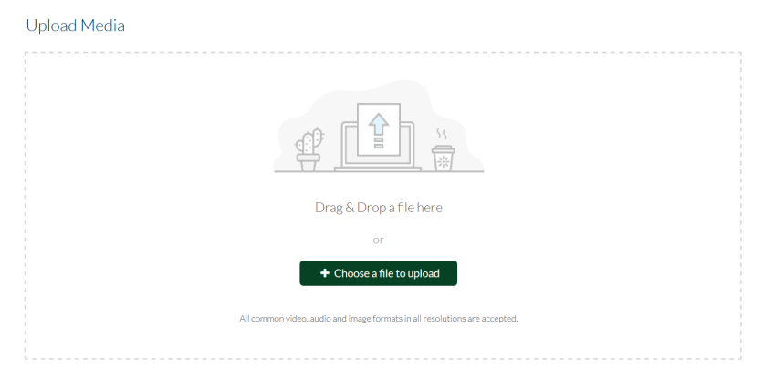
Kaltura: Uploading Media
From the options menu, select the Media Upload feature.
Next, drag and drop a video file or select + Choose a file to upload button.
Notes:
In order to upload a video you will need to click on the plus sign (add new). From the drop-down menu, click media upload. You can either select upload or drag your video to upload.

Slide 13
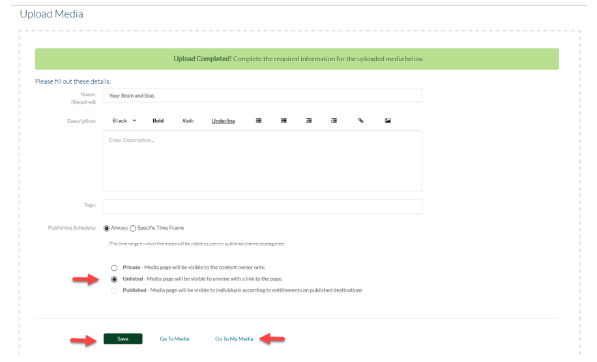
Kaltura: Saving & Viewing Uploads
Once your video has been uploaded to Kaltura, you will see a message at the top of the screen indicating its completion. If you want your video to be viewable by anyone, select the option under Publishing Schedule that says: Unlisted – Media page will be visible to anyone with a link to the page and then click “Save”.
To view your new video, click “Go To My Media”, next to “Save”.
Notes:
Once your video has been uploaded to Kaltura, you will see a message at the top of the screen indicating its completion. If you want your video to be viewable by anyone, select the option under Publishing Schedule that says: Unlisted – Media page will be visible to anyone with a link to the page and then click Save.
To view your new video, click Go To My Media, next to Save.

Slide 14
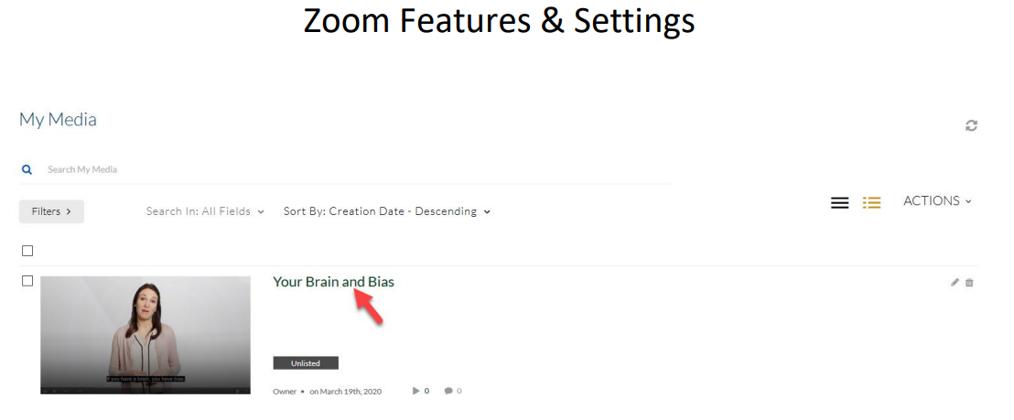
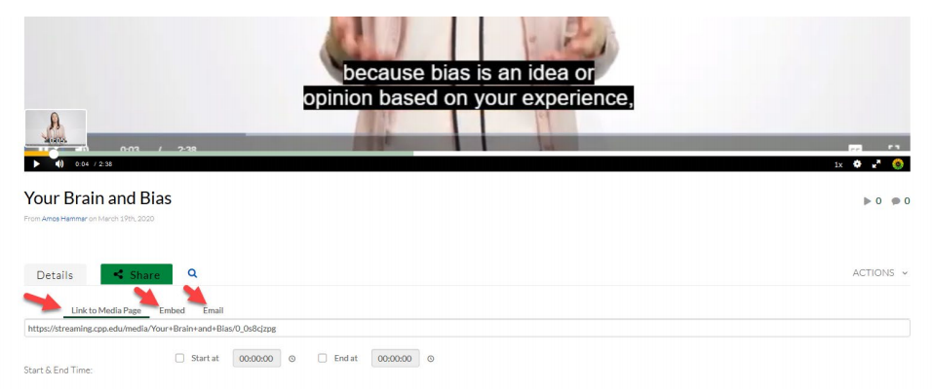
Kaltura: Sharing Content
From the “My Media” screen, you can click on the name of your video to view this content.
Just below the video player, click the “Share” button to see shareable options for your video.
Notes:
From the My Media screen, you can click on the name of your video to view this content. Just below the video player, click the Share button to see shareable options for your video.

Slide 15
Questions?
Thank you
Questions?

