Slide 1
ZOOM
Going Over the Basics
Notes:
The purpose of this meeting is to learn how to use and implement Zoom to support communication with our students, faculty, and staff.
1. Introduction of Host and Moderator
2. Moderator, please discuss your role in the meeting: To make certain all questions are answered in the chat box and/or responded to.
Host, please place links in the chat box for reference: https://www.cpp.edu/od/resource-kits/virtual-instruction-remote-work/zoom-support.shtml
For the first time, you can it will ask you to download the app. It is much easier if you have not already had ZOOM downloaded.
Sign in using your Bronco email and download the app: https://cpp.zoom.us/
This is the EODA site where you can find a pre-recorded zoom training session, detailed guides, and the FAQ’s from all of the previous Zoom sessions
To download and install the Zoom Application: Go to https://zoom.us/download and from the Download Center, click on the Download button under “Zoom Client For Meetings”. This application will automatically download when you start your first Zoom Meeting

Slide 2
AGENDA
Getting started
Setting up Zoom, audio, and video
Setting up your profile and photo in Zoom
Scheduling a meeting and assign a co-host
Discovering the icons and sharing your screen
Practice makes perfect
Notes:
Agenda:
Getting Started
Setting up Zoom, Audio, and Video
How to set up your photo in zoom?
How to schedule a meeting and assign a co-host?
Discover the ICONS and How to Share Your Screen
Practice time!
As we go through the presentation today, if you are comfortable, please log into the Zoom site so you can follow along while we are going over the details.

Slide 3
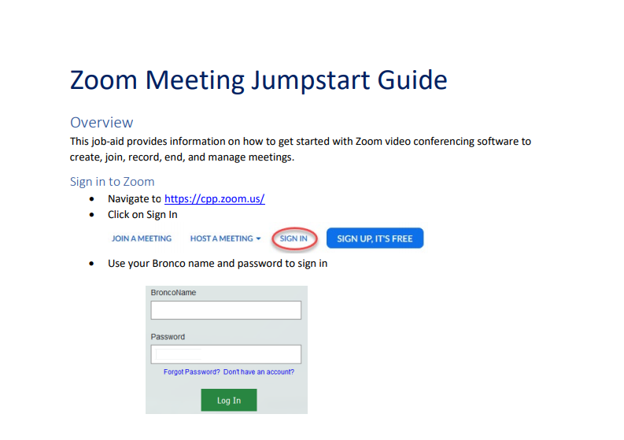
Getting Started
Notes:
For the first time, you can it will ask you to download the app. It is much easier if you have not already had ZOOM downloaded.
Sign in using your Bronco email and download the app: https://cpp.zoom.us/
If you can, please try and go to this website and login. Try to follow along while we go through our presentation today.

Slide 4
Setting Up Zoom, Audio, and Video
Best Practices
If you are using headphones, your best option is to use a pair that have a built-in microphone and will cancel the noise that are around you.
You may have to mute your laptop to use the headphones. If you use your laptop audio instead of headphones, keep in mind you will need to be in a quiet area.
Test phone connection and camera before the meeting starts.
Notes:
When you first enter your meeting, there will be various options for setting up Zoom Audio. If you haven't enabled the setting to automatically join by computer audio, you can test your speaker and microphone before joining a meeting.
There are some best practices to consider for a better audio and visual experience. If you do not have access to video, remember you can always join in just using audio
Alright, before we move on, please go ahead and take yourself off of mute and say hello to the group!

Slide 5
Setting Up Your Profile and Photo in Zoom
Uploading your photo
What is a personal ID?
Your Zoom link for meetings
Notes:
On the home page, in zoom, on the top right-hand side of your screen, you will see a circle with a person icon. Click on that and click on my profile. Here you can upload a picture and set up your personal meeting ID.
A personal ID can be changed, to make it easier to recall. You can set it up so that you don’t have to enter your ID and it be automatic.
The link that you see is your personal meeting link. You can use this to send to people for meetings, however we will show you an easier way to do so.
HOST: Can start sharing your screen to toggle back and forth amongst the PPT and the Zoom website
Go over the profile section:
How to update a picture
What is a personal meeting ID? Why is it helpful
Time zones/language
Check for questions
Host, please place links in the chat box for reference: https://www.cpp.edu/od/resource-kits/virtual-instruction-remote-work/zoom-support.shtml
For the first time, you can it will ask you to download the app. It is much easier if you have not already had ZOOM downloaded.
Sign in using your Bronco email and download the app: https://cpp.zoom.us/

Slide 6
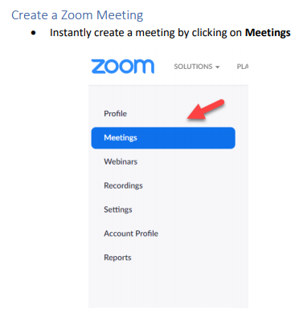
Scheduling a Meeting and Assigning a Co-Host
Start date and time
Recurring meeting
What is a Personal Meeting?
Click on Advanced Options: This is where you can enable a waiting room and designate co-hosts. (If you have Teaching Assistants, this is where you can add their addresses, enabling them to assist in facilitating the meeting.)
Notes:
Share your screen:
Click on meetings: Go over the difference of personal meeting and scheduling a new meeting
Start with personal meeting:
Set the time/date
How to add a host
How to copy the invitation and how to send it to people
Click on Schedule a new meeting and then click on advanced to go over relevant settings
Recurring
Set the time/date
How to add a host
How to copy the invitation and how to send it to people
Click on Settings:
Go through basic settings
Advanced settings
Cover some of the most important settings
Such as:
Enable join before host
Mute participants upon entry
Enable waiting room
Only authenticated users can join
Breakout Room pre-assign

Slide 7
Discovering the Icons and Sharing Your Screen
Unmute/Mute
Video
Invite
Participants
Share Screen
Chat
Record
Breakout
Notes:
Discuss that the icons the participants will see is different then the one displayed. The one displayed is what the host or facilitator will see. Cover each icon individually.
Unmute/Mute: This is helpful as background noises can cause interference. So if you are not the one speaking, muting yourself will give the best quality.
Video: This will allow your students to see you and you see them
Invite: If you would like to invite additional people during the meeting you can, however everyone who needs access will have the ability to join with your link, which we will discuss in a moment.
Participants: This will allow you to see who is in the class and helpful for when you would like to call on people.
Share Screen: This is important for when you would like to share a PPT or details with your students. We will also be putting this into practice.
the arrow in the middle of icons? multiple people can share at the same time. So if you have assigned a group project or perhaps have teaching assistants, this may come in handy.
Chat: This gives you the ask questions to the group and get multiple responses. You also can post questions to the class in this area. This is like skype messaging or messenger, so everyone can see the questions and responses
Record: You can record your sessions for your students who may not have been able to watch it live. You will want to practice recording and saving the sessions before your first zoom session. Once you click start record, it will continue to record the entire session. Click on stop, then once you leave the meeting your recording will be converted to an MP4 and accessible through your downloads on your computer.
You can also select the automatic record option under settings.
Breakout rooms are available for people to work in groups; however, we would recommend using this once you feel more comfortable with ZOOM. It is exciting to learn, but we want to take it one step at a time for our students.
Reactions: this will allow you to ask basic understanding questions and the students can give you a thumbs up! This can also promote positivity in the classroom by giving a round of applause for one another.

Slide 8
Practice Makes Perfect
Annotate
Share your screen
Video – On and Off
Mute and Unmute
Chat box
Raise your hand
Notes:
Annotate section: Discuss how to access annotate and have them draw on the screen then explain how it works The annotate section the facilitator is on the tool bar. For participants they can click on the view options tab (near the green tab) on their screen. Then click view options, annotate
Let’s first practice sharing our screens. Who would like to go first? If no one volunteers, then pick a few volunteers.
Can I have everyone turn one their video and then turn off their video? If you have a red line through your video, that means that it is not on.
Click on the microphone icon to mute and unmute your mic.
Perfect, please mute your lines.
In the chat box, please tell me your favorite vacation spot?
If you have a quick question to your students, they can click on the thumb’s up icon at the bottom: If you can see these icons, please click on the thumbs up.
Click on participants at the bottom. On the right side you can click on unmute me or raise hand. If you see this, please click on raise hand!

Slide 9
Additional Support is Available
Questions?
You can also access Zoom support on the CCP EODA Site: https://www.cpp.edu/eoda/index.shtml
Notes:
You can also access the zoom support on the CCP EODA Site: https://www.cpp.edu/eoda/index.shtml

