Slide 1
Welcome! We will start at 4:00.

Slide 2
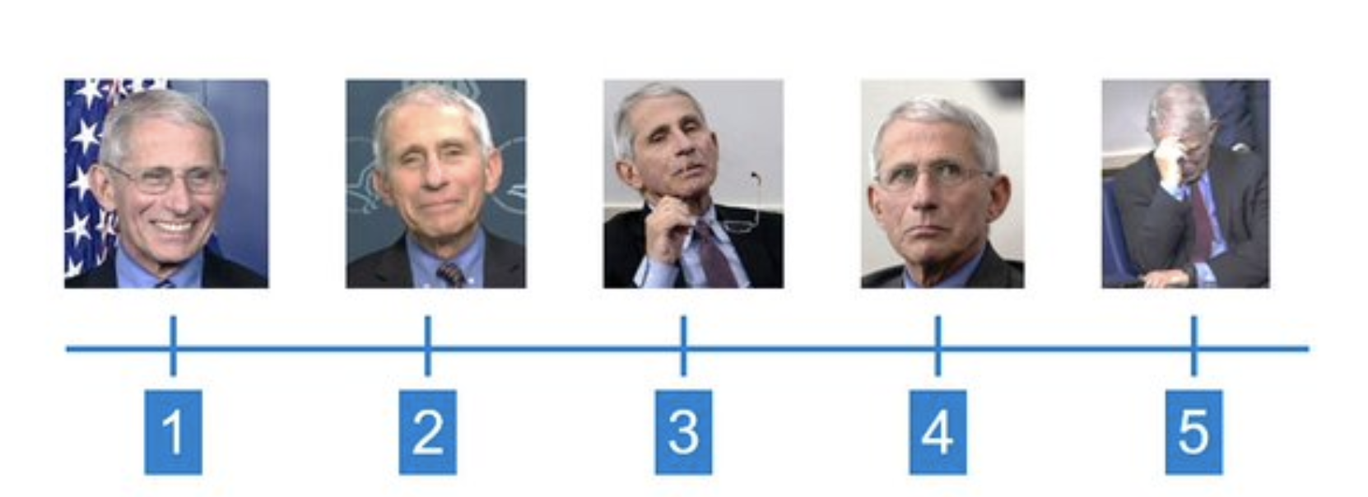
How are you today? Place in your Fauci Level in chat!

Slide 3
Peer review and student ratings for remote teaching
Victoria Bhavsar, Cal Poly Pomona CAFE

Slide 4
Peer review: Three good ideas to start
Schedule observations Weeks 4-7
When you schedule an observation (1-2 hr), at that moment also calendar, that week:
0.5 – 1 hour to meet/talk/email ahead of time
At least 2 hours to review online materials, preferably ahead of time
At least 1 hour to write up your report afterwards
Consider how seriously YOU want your teaching to be treated, and reciprocate

Slide 5
Comparing in-person and remote peer review
Same
Different
Basic process
Basic best practices
Policies
Time to do a good job
Some of what to look for and places to look for it
Some of what to look for and places to look for it
Much less able to use direct student behavior as evidence
It will probably feel much more intrusive
Materials review is more extensive and critical
Impact
Notes:
Ask if there are other comparisons

Slide 6
Summative vs formative peer review
Summative observation means “graded for quality.”
Formative observation is for one’s own benefit, to improve.

Slide 7
We require summative peer review
CPP Policy 1328.3.3.B for tenure line faculty:
“Peer evaluation of teaching shall include classroom visits and a review of course syllabus and related material….”
CPP Policy 1336 for lecturer faculty:
Student evaluations
Review of materials
Statement by dept chair
Many departments specify classroom observation

Slide 8
Process for synchronous class observation & review of materials

Slide 9
The Ideal Process
Pre-visit convo
Visit
Post-visit convo
Construc-tive report
Written response to report
Review of course materials

Slide 10
The Normal Process from Face to Face Days:
Visit
Materials review
Emails to schedule
Hasty Report
Notes:
Give me a thumbs up if this is you. It’s totally normal!

Slide 11
Recommended remote protocol
Steps | Instructions
1. Brief pre-observation documentation | Completed by the Instructor. Sets the context and teaching philosophy.
2. Pre-meeting | Meeting between the Peer-observer and Instructor to clarify pre-observation materials and arrange for access to the course. Discuss “Plan B” for tech failure.
3. Observation of course: Materials & synch mtng | Completed by the Peer-observer. Use the instrument adopted by the department.
4. Complete report | Completed by the Peer-observer using data gathered in Steps 1-3.
Notes:
What parts of these are in your dept. policy or practice?

Slide 12
For synchronous observation: Setting up
Join on time
Mute microphone (of course)
Turn off camera but ensure there is a picture of you
Make sure your correct name shows on the tile
If instructor introduces you, turn camera on and wave. Say hi in the chat
Concentrate on the job – no email!
Stay the whole time*
Implement your Plan B for tech failure if needed
Notes:
Anything else people think of?

Slide 13
Instruments for remote review

Slide 14
Overview of suggested instruments
Quality Matters
Seven Principles
Mix and Match
Specific, long
Non-specific, short
Choose elements of each or others
Materials & meetings
Materials & meetings

Slide 15
Suggested Instruments
See OneDrive “Step 3: Observation of Blackboard Course Site, Module or Lesson, and Synchronous Meeting”
Link
Notes:
Take some time, look through these. Go into breakout rooms to discuss.
POLL at end

Slide 16
After observing: Writing a useful report
Be organized, clear, and concise
Be honest, accurate, and constructive
Focus on controllable things

Slide 17
Four departmental best practices
Devote a faculty meeting (or more) to discussing the purpose of peer observation, essential elements of excellent remote teaching, and agreement about what counts as evidence
Train faculty on observing and reporting
Designate experienced faculty with established good teaching reputations as observers, and visibly appreciate their efforts
Give criteria at the beginning of the semester; have it posted somewhere so instructors always have access
Notes:
POLL

Slide 18
Elements for a non-damaging peer review program
Clarity on essential elements of excellent teaching, with flexibility for individual academic freedom
Agreement about what counts as evidence for excellence
Consistent instruments and reporting templates
Bonus: Trusted, expert, trained peer reviewers

Slide 19
Elements for an outstanding peer review program
Clarity of purpose – what do we want to achieve?
Clear policies in congruence with the purpose
Clarity on essential elements of excellent teaching, with flexibility for individual academic freedom
Agreement about what counts as evidence for excellence
Consistent instruments and reporting templates
Trusted, expert, trained peer reviewers

Slide 20
Pandemic student ratings are likely to be disappointing. Student ratings are blunt instruments, like BMI. Understand their limitations, AND...

Slide 21
…Treat them seriously as data.
High quality instruments
Good deployment practices
Appropriate data analysis and reporting

Slide 22
Good student rating instruments
Pedagogically neutral items
Well-constructed items
Useful items
Specific items
Center the student experience, i.e., are written about the student experience
Have students assess things the instructor can influence

Slide 23
Student rating deployment – getting responses http://www.schreyerinstitute.psu.edu/IncreaseSRTERespRate/
Make sure students are aware of the SR’s
Explain the SR process to students
Provide reminders when the SR’s are active
Make clear that you value student feedback
Mention improvements made to the course in response to past SR’s
Schedule time in your synchronous class for completing SR’s
Create a feedback culture (e.g., collect other feedback during the semester)
Build rapport with students throughout the semester

Slide 24
Student rating analysis & reporting
Overall performance rating of this instructor,
2015 vs 2019
NOTE: SR’s are not often normally distributed; they are skewed. Normal distribution would indicate a problem
DO: Look at results across the scale, not exclusively at mean, median, and mode
DO: Use a criterion-based approach, not norm-referenced
DON’T: Include “control” items in overall mean or median
REMEMBER: Blunt instrument. Do not make faculty explain small changes or be worried about a small number of students.

Slide 25
Supporting faculty to improve when needed
Educate yourself about student ratings (Linse, 2017, https://doi.org/10.1016/j.stueduc.2016.12.004)
Speak up early
Be developmental rather than prescriptive; faculty must lead their own work
Encourage focus on changes that will affect students’ overall experience, rather than small tweaks
Transparency, organization, engagement
Encourage and reward engagement with other faculty

