Slide 1
What outcome of peer observation would make doing PO’s of teaching not only worth your time, but a very good use of your time?

Slide 2
How to do a good observation of teaching
Victoria Bhavsar, Cal Poly Pomona Faculty Center
https://tinyurl.com/PeerReviewFeb20

Slide 3
Three good ideas to start
Schedule observations Weeks 4-7
When you schedule an observation (1-2 hr), at that moment also calendar, that week:
0.5 – 1 hour to meet/talk/email ahead of time
At least 1 hour to review materials ahead of time
1 - 1.5 hours to write up your report afterwards
Consider how seriously YOU want your teaching to be treated, and reciprocate

Slide 4
Four departmental best practices
Devote a faculty meeting (or more) to discussing the purpose of peer review, essential elements of excellent teaching, and agreement about what counts as evidence
Train reviewers on observing and reporting
Designate experienced faculty with established good teaching reputations as reviewers, and visibly appreciate their efforts
Give people review criteria at the beginning of the semester; have it posted somewhere so they always have access

Slide 5
Summative vs formative PRT
Summative review means “graded for quality.”
Formative review is for one’s own benefit, to improve.

Slide 6
We require summative PRT
CPP Policy 1328.3.3.B for tenure line faculty:
“Peer evaluation of teaching shall include classroom visits and a review of course syllabus and related material….”
CPP Policy 1336 for lecturer faculty:
Student evaluations
Review of materials
Statement by dept chair
Many departments specify classroom observation

Slide 7
Process for observation & review

Slide 8
The Ideal Process
Pre-visit convo
Visit
Post-visit convo
Construc-tive report
Written response to report
Review of course materials

Slide 9
The Normal Process:
Visit
Materials review
Emails to schedule
Hasty Report

Slide 10
The Effective Process
Visit
Optional but good: Post-visit convo
Constructive report
Pre-review convo
Review of materials

Slide 11
How to make ONLINE observation work well:
NOT OPTIONAL:
Pre-review convo
Review
Constructive report
Optional but good: Post-review convo
CSU Chico online course rubric

Slide 12
Observing strategies and instruments for face to face classes

Slide 13
Setting up
Be in place before class begins
Sit in the back or far to one side
Smile and nod, but just observe, don’t participate
Agree about taking notes on a laptop or not
Concentrate on the job – no email!
Stay the whole time*

Slide 14
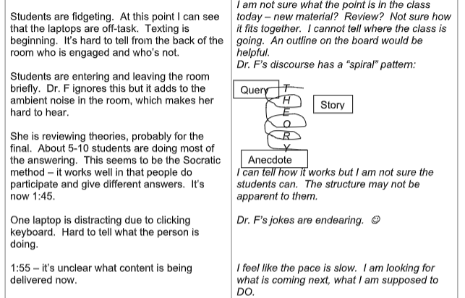
Taking notes: Write detailed observations in a 2-column format – left for evidence, right for reflection

Slide 15
What to look for:
Note the time frequently. What is happening?
What are the students doing? How many of them are doing it?
What is the professor doing? How are the students behaving?
What is the room like? What’s the light, sound, smell, etc.?
Is there anything interesting, such as a class of 20 women and 2 men or vice versa?
Is there evidence that this characteristic influences the class dynamic?
And anything else you can think of.

Slide 16
Two frameworks when there’s no instrument:
Preparation & organization
Clarity
Perceived outcome or impact (relevance)
Stimulation of interest
Encouragement & openness
Feldman, K. A. (1998). Identifying exemplary teachers and teaching: evidence from student ratings. pp. 391-414. Teaching and Learning in the College Classroom 2nd ed., K. A. Feldman and M. B. Paulsen, eds. Needham Heights, MA: Simon & Schuster.
Contact between students & faculty
Reciprocity & cooperation among students
Active learning
Prompt feedback
Time on task
High expectations
Respect for diverse talents & ways of learning
Chickering, A.W., and Z.F. Gamson. 1987. Seven principles for good practice in undergraduate education. AAHE Bulletin pp. 3-7, March 1987.

Slide 17
When there’s an instrument, use it to guide evidence-taking Make sure you each understand and agree about the criteria and standards
 | Excellent | Good | Satisfactory | Poor | Unacceptable
Instructor well prepared
Session well organized
Effective communication of ideas
Enthusiasm
Attitude toward students
Stimulation of student interest
Level of student participation
Quality of answers to questions

Slide 18
After observing: Writing a useful report
Be organized, clear, and concise
Be honest, accurate, and constructive
Focus on controllable things

Slide 19
Samples of good observation instruments
Ethnic & Women’s Studies
Liberal Studies
Psychology & Sociology
Physics & Astronomy

Slide 20
Discussion of issues: What’s needed for good peer review

Slide 21
Elements for a non-damaging PRT program
Clarity on essential elements of excellent teaching, with flexibility for individual academic freedom
Agreement about what counts as evidence for excellence
Consistent observation instruments and reporting templates
Bonus: Trusted, expert, trained peer reviewers

Slide 22
Elements for an outstanding PRT program
Clarity of purpose – what do we want to achieve?
Clear policies in congruence with the purpose
Clarity on essential elements of excellent teaching, with flexibility for individual academic freedom
Agreement about what counts as evidence for excellence
Consistent observation instruments and reporting templates
Trusted, expert, trained peer reviewers

Slide 23
Resources
Vanderbilt: Peer Review of Teaching
Ethnic & Women’s Studies
Liberal Studies
Psychology & Sociology
Physics & Astronomy
CSU Chico online course rubric

