Slide 1
Lecturer Evaluations
Presented by Dr. Jill Hargis
Interim AVP for Faculty Affairs
November 2021

Slide 2
Definitions
Annual evaluations - evaluations covering the preceding year.
Cumulative evaluations – evaluations covering the preceding 3 or 6 years. These evaluations end with an evaluation by the Dean.
TFEC – Temporary Faculty Evaluation Committees. Tenured faculty, including FERP, elected by department probationary and tenured faculty. Minimum two faculty members.

Slide 3
Who must be evaluated according to Policy 1336?
Policy 1336 says:
Any lecturer who does not have a 3-year entitlement, and who has taught at CPP for two semesters (even if non-consecutive), must receive an annual evaluation.
a. Lecturers in this group who teach periodically must receive an annual evaluation for those calendar years when they teach.
After 6 years of consecutive employment with at least one semester in each year, a lecturer should receive a cumulative evaluation of those past 6 years in the spring of the 6th year. A satisfactory evaluation will result in a 3-year entitlement. (Article 12. CBA)
Lecturers with 3-year entitlements must be evaluated in the spring of their 3rd academic year appointment.
Notes:
Lecturers in this group who teach periodically must receive an annual evaluation for those calendar years when they teach. (This group is the most challenging for everyone to get the evaluations done.)

Slide 4
What period of time do the evaluations cover?
The period of time covered by annual evaluations is the preceding calendar year.
Annual evaluations are due in the spring, but they cover teaching done in the preceding calendar year.
This spring 2022, annual lecturer evaluations will cover teaching done in spring 2021 and fall 2021.
The period of time covered by cumulative evaluations is
6 years for faculty eligible for the first 3-year entitlement, and
3 years for faculty eligible for additional 3-year entitlements.
Cumulative evaluations are conducted in the spring of the 6th year (for the first 3-year entitlement or the spring of the 3rd year for consecutive 3 year entitlements.)
*If you are unsure of what kind of evaluation you should get, email your department chair.

Slide 5
When are evaluations due?

Slide 6
Office of Faculty Affairs
ACADEMIC YEAR 2021-2022
Temporary Faculty (Lecturers) Evaluation Calendar
Unit 3 Collective Bargaining Agreement (CBA) and University Policy #1336
Evaluation | Reviewers | Lecturer Evaluation Package Deadline | Review Begins | Review Begins | Review Deadline | Rebuttal Deadline
One-year reviews of part-time temporary faculty Evaluation period: calendar year 2021 | TFEC* | 3/1/22 | 3/1/22 | 3/1/22 | 4/4/22 | 4/14/22
 | Department Chair** |  | 4/5/22 | 4/5/22 | 4/25/22 | 5/5/22
One-year reviews of full-time temporary faculty Evaluation Period: calendar year 2021 | TFEC | 3/1/22 | 3/1/22 |  | 4/4/22 | 4/14/22
 | Department Chair |  | 4/5/22 |  | 4/25/22 | 5/5/22
 | Dean |  | 4/25/22 |  | 5/13/22 | 5/23/22
6–year cumulative review prior to first 3-year appointment Evaluation Period: 6 years*** | TFEC | 4/1/22 | 4/1/22 |  | 4/25/22 | 5/5/22
 | Department Chair |  | 4/26/22 |  | 5/13/22 | 5/23/22
 | Dean |  | 5/24/22 |  | 7/6/22 | 7/16/22
3-year cumulative review prior to subsequent 3-year appointment Evaluation Period: 3 years*** | TFEC | 4/1/22 | 4/1/22 |  | 4/25/22 | 5/5/22
 | Department Chair |  | 4/26/22 |  | 5/13/22 | 5/23/22
 | Dean |  | 5/24/22 |  | 7/6/22 | 7/16/22
*TFEC: Temporary Faculty Evaluation Committee
**Review by Department Chair only if Chair is not a member of TFEC. Without separate review by Chair, TFEC can follow the Chair Review deadline.
***The Dean/Director will review spring semester 2022 student evaluation results prior to deciding on issuing a 3-year contract.

Slide 7
Elements of the Periodic Evaluation Report
1. An updated curriculum vitae.
2. A self-assessment narrative including a teaching philosophy statement, not to exceed two pages.
Not to exceed four pages if evaluation is prior to the award of an initial 3-year contract or its renewal
3. All peer classroom observations during the evaluation period.
4. Statistical summaries of student survey scores from the current evaluation period for all courses taught during the period of evaluation, as defined in Policy #1329.
(note exceptions for Spring 2020, Fall 2020, Spring 2021 – link to Faculty Affairs)
5. Syllabi, exams, and other course materials for each different course taught during the evaluation period, as required by the department.
6. Any responses to written student input, as defined by Policy #1329, received by the department during the evaluation period.
7. For those with non-instructional assigned duties, include supplementary documents directly related to the assignment, as appropriate.

Slide 8
Department Lecturer Evaluation Criteria
Use the Department Evaluation Criteria to develop your narrative.
Link to criteria from Faculty Affairs:
https://www.cpp.edu/faculty-affairs/temporary-faculty/lecturer-evaluation-criteria.shtml

Slide 9
Peer Classroom Observations
One peer observation per calendar year should be conducted unless otherwise decided by the department. Additional peer observations shall also be conducted upon the request of the temporary faculty member.
Although the Department Chair or the faculty member conducting the observation should contact you to set up the observation, it is okay to be proactive. Classroom observations are an important element of your evaluation, and you may want to request one if you think student evaluations do not reflect your work accurately, or if you want feedback on your teaching.

Slide 10
Peer Classroom Observations cont’d
When classroom visits are utilized as part of the evaluation, (according to department criteria) the individual faculty unit employee being evaluated shall be provided a notice of at least five (5) days that a classroom visit, online observation, and/or review of online content is to take place.
There shall be consultation between the faculty member being evaluated and the individual who visits his/her class(es) regarding the classes to be visited and the scheduling of such visits.
CBA 15.14

Slide 11
Interfolio Demo
Email to Lecturers with Link to their Case
California State Polytechnic University Pomona has initiated a review on your behalf.
VIEW CASE

Slide 12
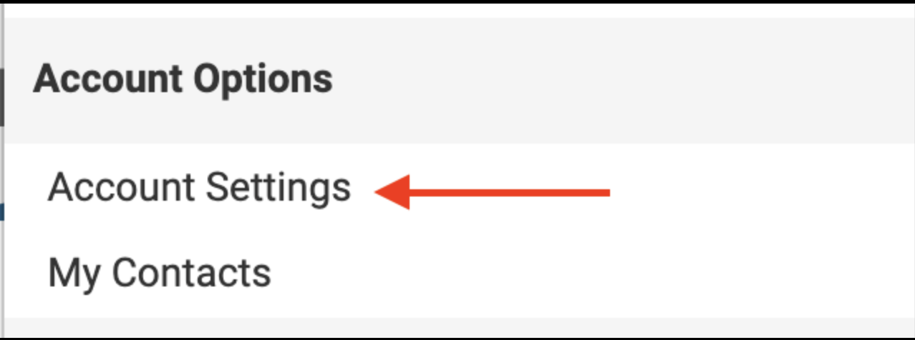
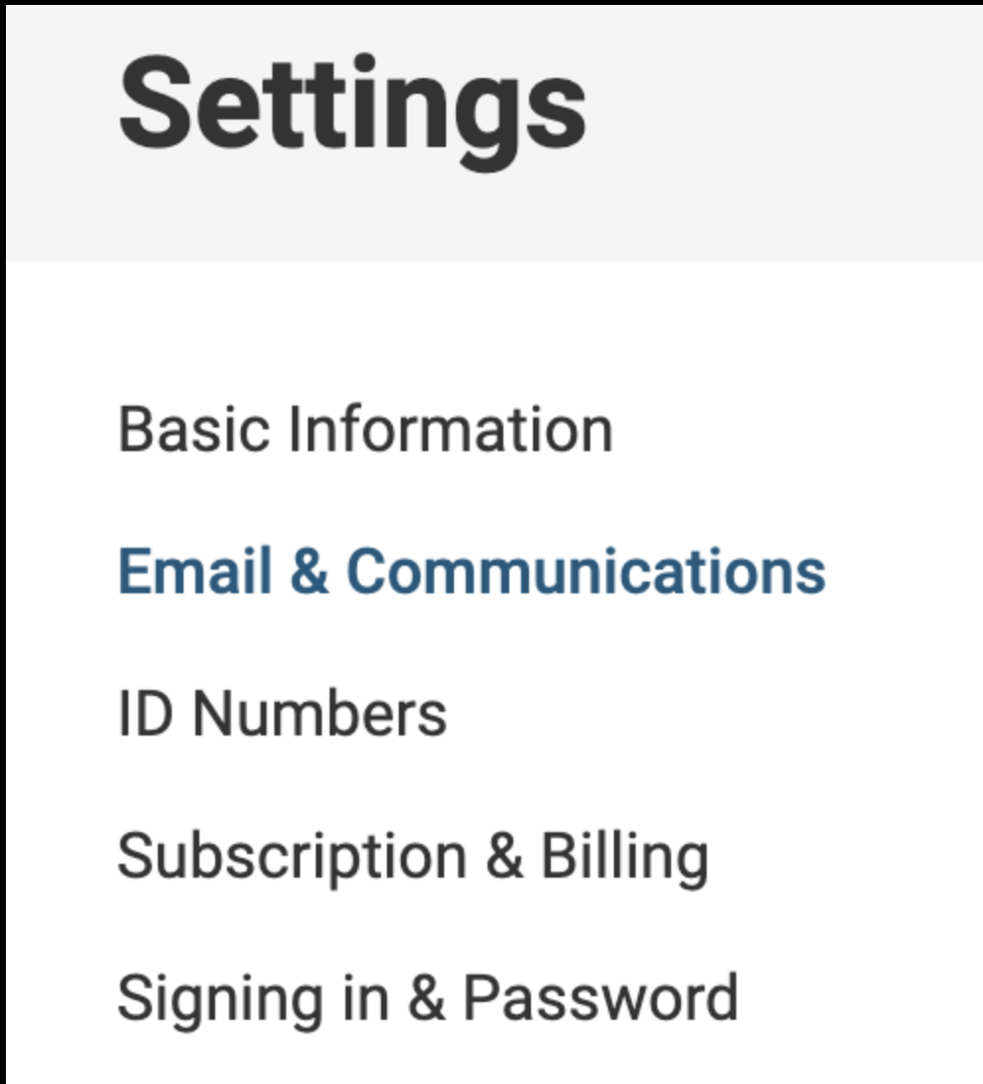
Maintaining Access to Interfolio while not employed at CPP
Below are the steps candidates can take to update their primary email in their Interfolio account along with some screenshots.
1. Log into Interfolio Account
2. Select name from top right-hand corner
3. Select Account Settings from drop-down option
4. Select Email & Communication from left side

Slide 13
Maintaining Access to Interfolio while not employed at CPP, cont’d.
5. Select Add Email and enter new email address
6. Once the new email has been added, select Make Primary next to the newly added email
If you receive an error that states there is already an account associated with the new email, call Interfolio (877-997-8807) and they can merge the two accounts together and assist in updating the primary email.

