Slide 1
Lecturer Entitlements and Evaluations: who gets evaluated?

Slide 2
Definitions Policy 1336
Annual evaluations - evaluations covering the preceding year. (12.3 appointment)
Cumulative evaluations –evaluations covering the preceding 3 or 6 years. Satisfactory evals result in a 3-year entitlement. These evaluations end with an evaluation by the Dean. (12.12 appointment
Temporary faculty – not tenure-line faculty, also known as lecturers or adjuncts.
TFEC – Temporary Faculty Evaluation Committees. Tenured faculty, including FERP, elected by department probationary and tenured faculty. Minimum two faculty members.

Slide 3
Who must be evaluated according to Policy 1336?
CBA 12.12 and Policy 1336 say:
Any lecturer who does not have a 3-year entitlement, and who has taught at CPP for two semesters (even if non-consecutive), must receive an annual evaluation.
- Lecturers in this group who teach periodically must receive an annual evaluation for those calendar years when they teach.
After 5 years of consecutive employment with at least one semester in each academic year, a lecturer, who is rehired for a sixth year, must receive a cumulative evaluation of those past 5 years. This evaluation will happen in the spring of the 6th year and will include materials from the 6th year.
Lecturers with 3-year entitlements must be evaluated in the spring of their 3rd academic year appointment. They must be evaluated at least once in the three year period (but it is recommended this occur more often).
Notes:
Lecturers in this group who teach periodically must receive an annual evaluation for those calendar years when they teach. (This group is the most challenging for everyone to get the evaluations done.)

Slide 4
Importance of the cumulative evaluation (first 6th and consecutive 3rd years)
Cumulative evaluations end with the dean’s review.
The cumulative evaluation must result in a satisfactory or unsatisfactory evaluation from the dean. If unsatisfactory, the faculty member is not rehired.

Slide 5
What period of time do the evaluations cover?
The period of time covered by annual evaluations is the preceding calendar year.
Annual evaluations are due in the spring, but they cover teaching done in the preceding calendar year.
This spring 2023, annual lecturer evaluations will cover teaching done in spring 2022 and fall 2022.
The period of time covered by cumulative evaluations is
the preceding 6 academic years (the evaluation is completed in the spring of the 6th year) for faculty eligible for the first 3-year appointment, and
the preceding 3 academic years (the evaluation is completed in the spring of the 3rd year) for faculty eligible for a subsequent 3-year appointment.
*Please let your lecturers know what period their evaluation will cover so they know what to include in the evaluation. They may also need to know how to get documents.

Slide 6
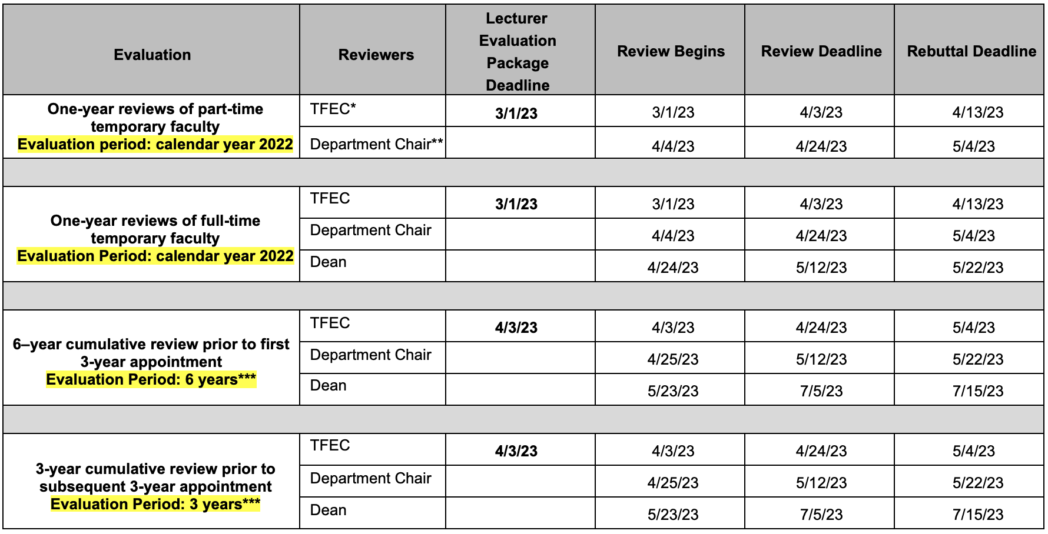
Office of Faculty Affairs
ACADEMIC YEAR 2022-2023
Temporary Faculty (Lecturers) Evaluation Calendar
Unit 3 Collective Bargaining Agreement (CBA) and University Policy #1336
*TFEC: Temporary Faculty Evaluation Committee
**Review by Department Chair only if Chair is not a member of TFEC. Without separate review by Chair, TFEC can follow the Chair Review deadline.
***The Dean/Director will review spring semester 2023 student evaluation results prior to deciding on issuing a 3-year contract.

Slide 7
Interfolio cases and lecturer notification
After confirmation from the department chairs about the TFEC committee members and the lecturers to be evaluated, we will create an Interfolio case for each lecturer.
Lecturers will receive an email from Interfolio (see screenshot) notifying them that their case is available for them to begin uploading documents as part of their review.

Slide 8
How to understand the list of lecturers
We have marked the ones we know need evaluations:
Peach – Annual evaluations
Blue – consecutive cumulative evaluation
Purple – first cumulative evaluation
(new 3 year appointment/entitlement)
But this list does not included everyone who needs an evaluation.

Slide 9
Reviewing the list
Please check that the annual and cumulative evaluations are correct. The Interfolio cases and the requirements are different.
Department policy and practice may require more evaluations than the policy.
Faculty Affairs doesn’t know if a lecturer will be hired only for spring term.

Slide 10
What to look for:
If a lecturer has not been hired for fall, but will be hired for spring, please note that they need to be evaluated
(Policy does not require first time lecturers to be evaluated, but depends on your Temp Faculty Eval Guidelines - should be evaluating them to see if they should be rehired.)
If you evaluate lecturers every year regardless of entitlement, please indicate that they should receive annual evaluations.
If you evaluate lecturers with three year-appointments every year, they will receive an annual evaluation in the first two years of their appointment.

