Slide 1
TIPS ON APPLYING FOR AID
Office of Financial Aid & Scholarships
Saul Ramirez & David Jimenez

Slide 2
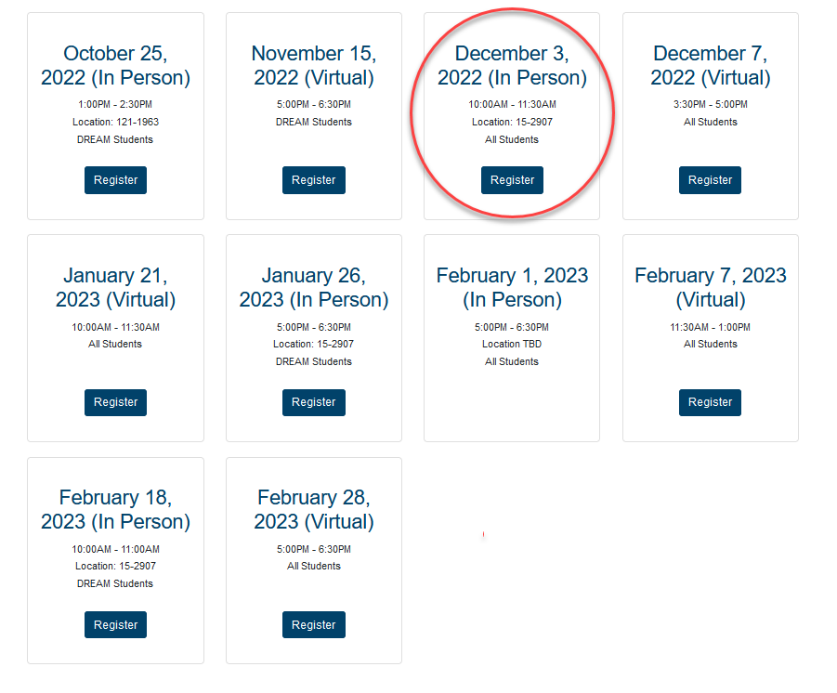
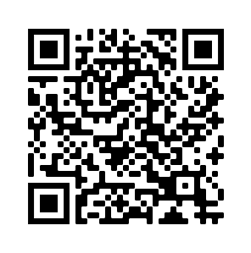
https://www.cpp.edu/financial-aid/resources/fafsa-dream-workshops.shtml

Slide 3
WHICH APPLICATION DO I FILE?
The 2023-2024 financial aid applications are now live! Submit or renew your financial aid application by October 1 and March 2, 2023 for the following academic year.

Slide 4
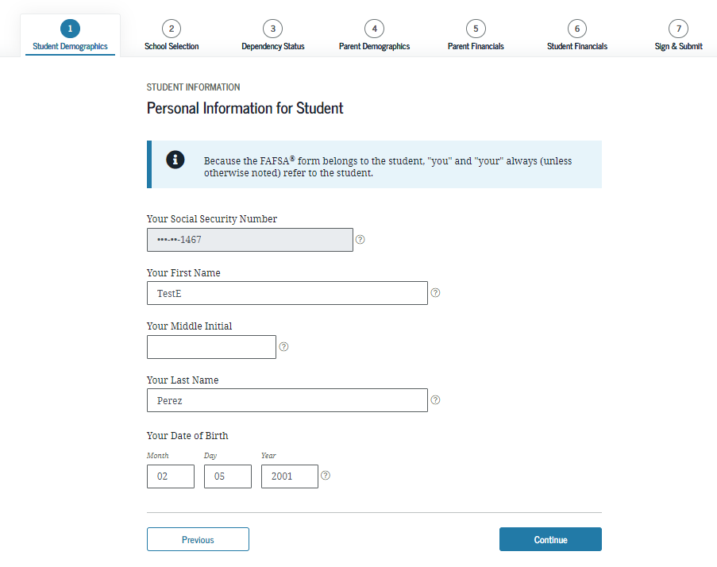
COMMON ERRORS & FAQs
Incorrect biographical information
Name, SSN, DOB
Must be legal name
As it appears with Social Security Admin (for FAFSA filers)
Correct DOB
Notes:
- very common with students that have two last names and only using their preferred name
- recently married students that haven't legally changed their name w/ SSA

Slide 5
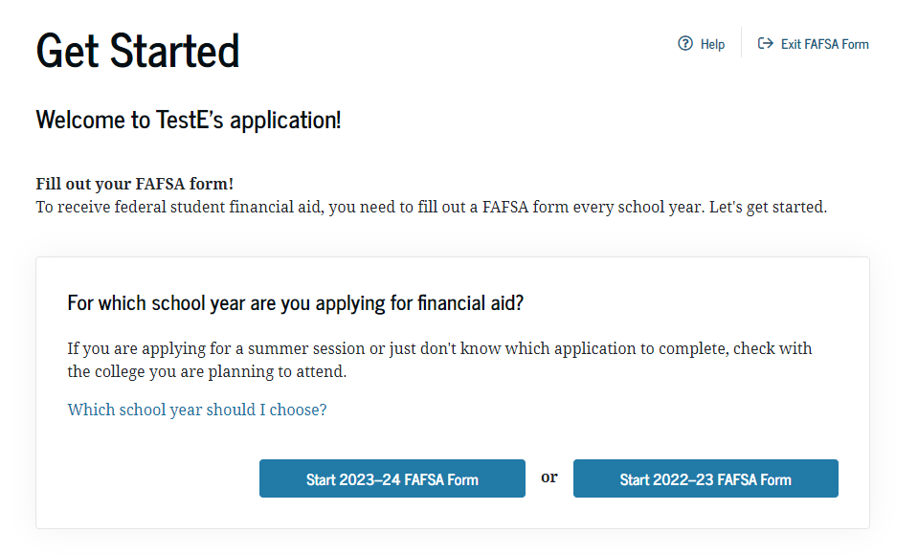
COMMON ERRORS
Not completing the correct year
2022/2023 Application (current year)
Fall 2022
Spring 2023
Summer 2023
2023/2024 Application (Deadline – March 2, 2023)
Fall 2023
Spring 2024
Summer 2024
Notes:
- 2022/23 will require 2020 income information
-2023/24 will require 2021 income information

Slide 6
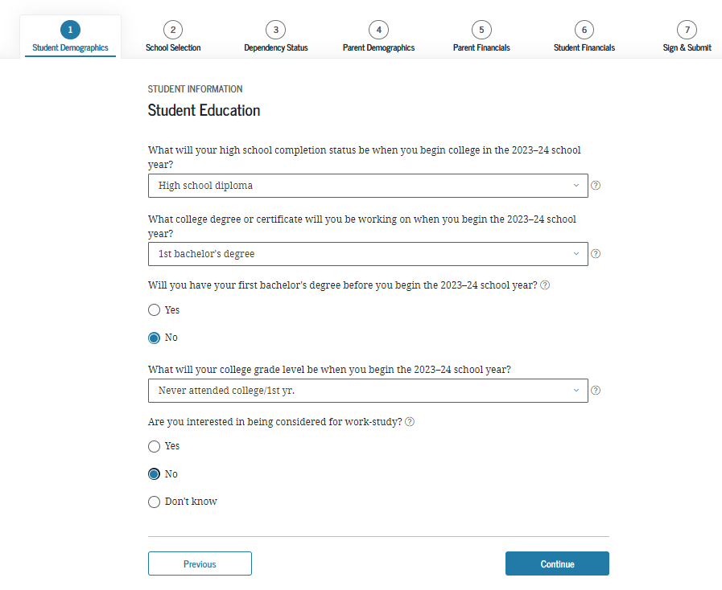
COMMON ERRORS
Notes:
- Credential students selecting "grad/prof"

Slide 7
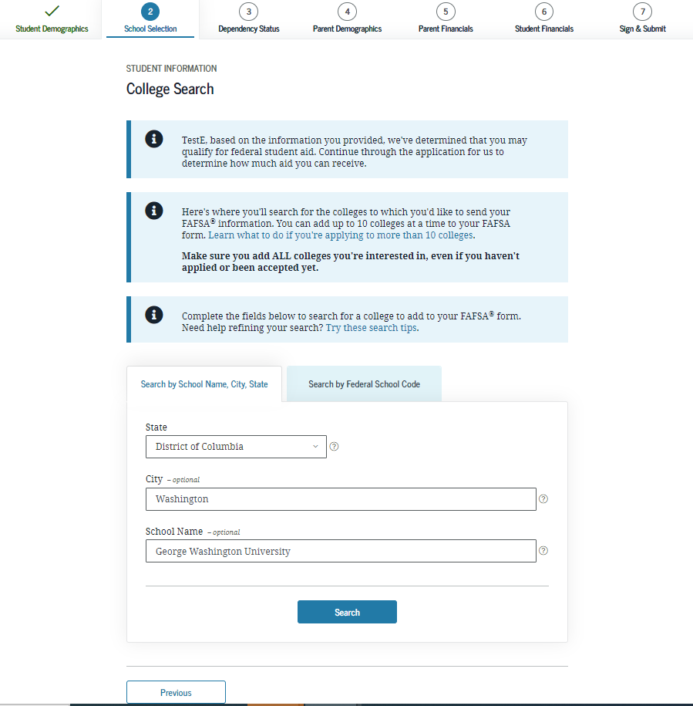
COMMON ERRORS
Not including Cal Poly Pomona’s school code: 001144

Slide 8
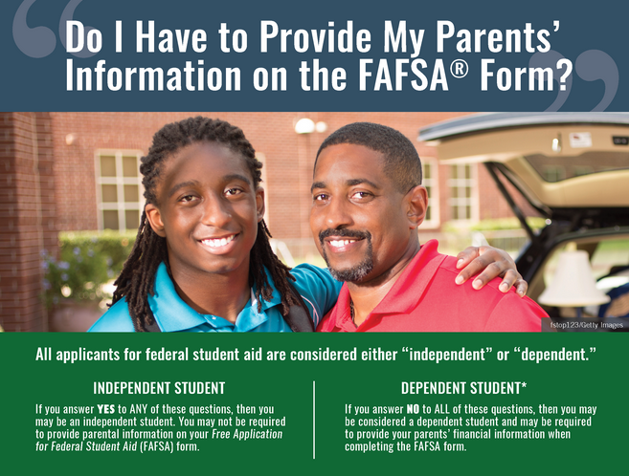
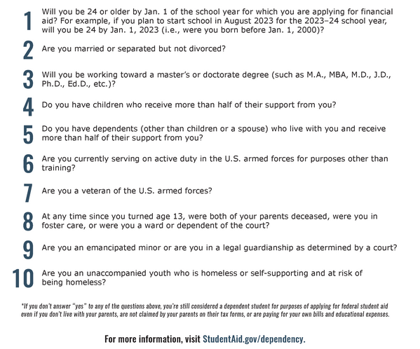
I AM INDEPENDENT
Notes:
- Myth: Some students believe they are Indep for some of these reasons:
- I file my own taxes
- my parents don't claim me
- I pay my own rent and support myself

Slide 9
FAFSA TIP
If parents don’t have SSN: enter 000-00-0000
If student's or parent's income has recently changed from the tax year requested (2020 or 2021), they are still required to input their tax year information and request to meet with a FA counselor in April to request a possible Professional Judgement
If dependent students are unable to provide their parent(s) information, they can still submit their FAFSA prior to the March 2nd priority date but it will get rejected. Our FA Office will reach out to these students in April

Slide 11
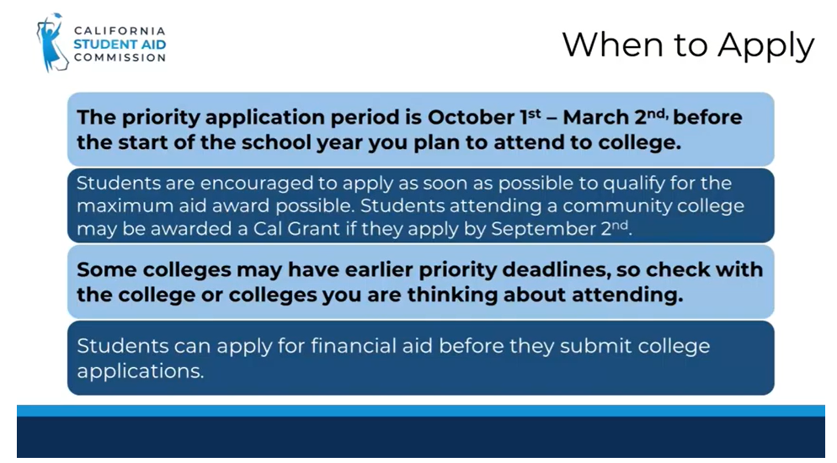
March 2nd is a hard deadline not like FAFSA's Priority deadline

Slide 13
Notes:
- If students have questions regarding AB540, please refer them to CPP Residency

Slide 15
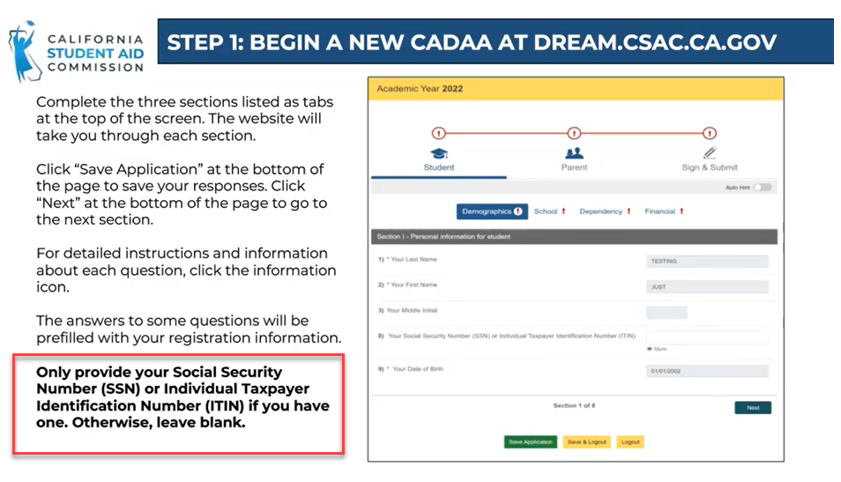
Notes:
- Some CA Dream Act applicants will have "work authorization" SSNs ot ITIN numbers

Slide 16
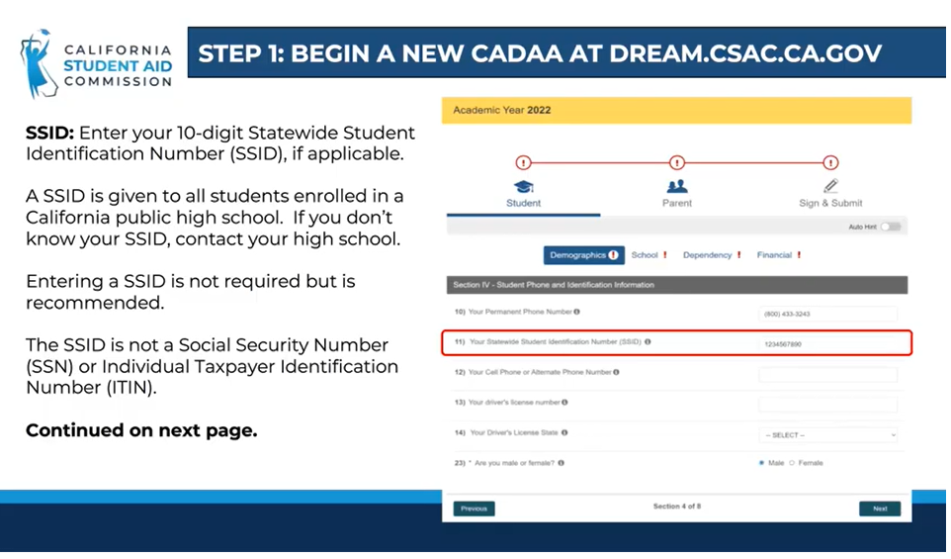

Slide 17
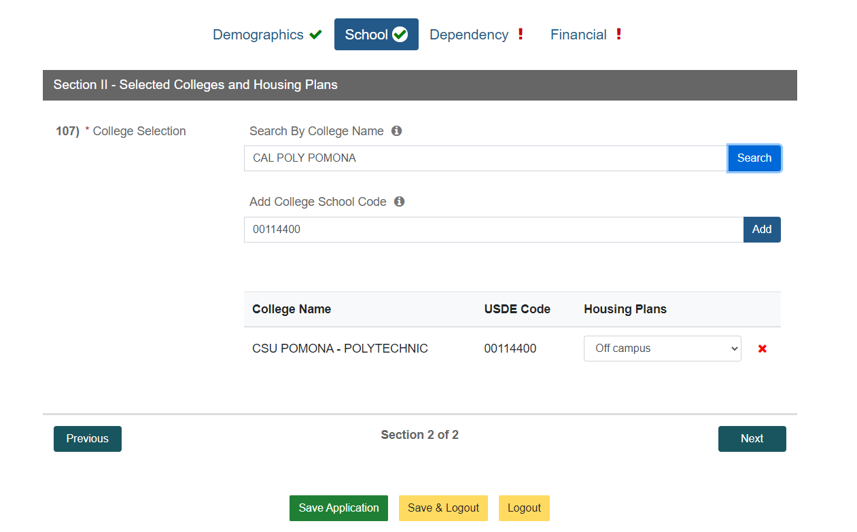
Adding Cal Poly Pomona
School name: CSU Pomona
(searching Cal Poly Pomona won’t work)
School code: 00114400
(001144 won’t work)

Slide 20
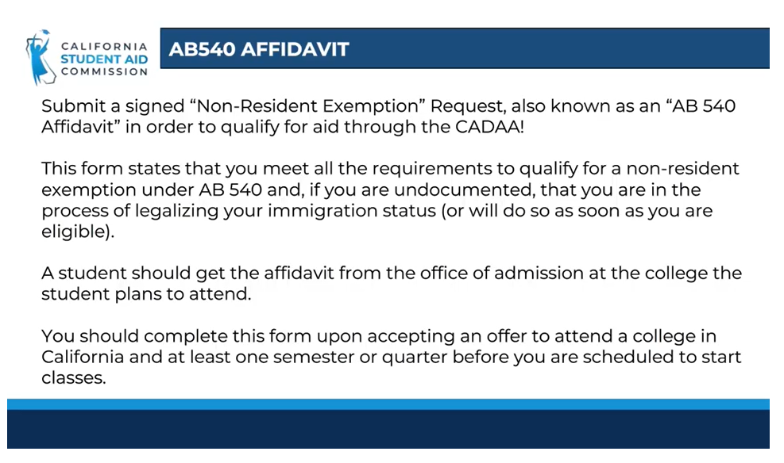
Notes:
- If students have questions regarding AB540, please refer them to CPP Residency

Slide 21
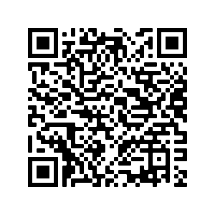
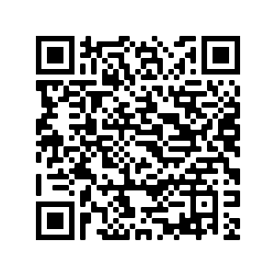
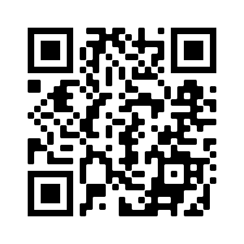
CA DREAM ACT APPLICATION RESOURCES
Video Tutorial
Paper Application
FAQs

Slide 22
001144
SCHOOL CODE
WWW.CPP.EDU/FINANCIAL-AID
Questions?

