Slide 1
Cal Poly Pomona Transit Lane Design Concepts
Paul Herrmann, PE
FehR & Peers

Slide 2
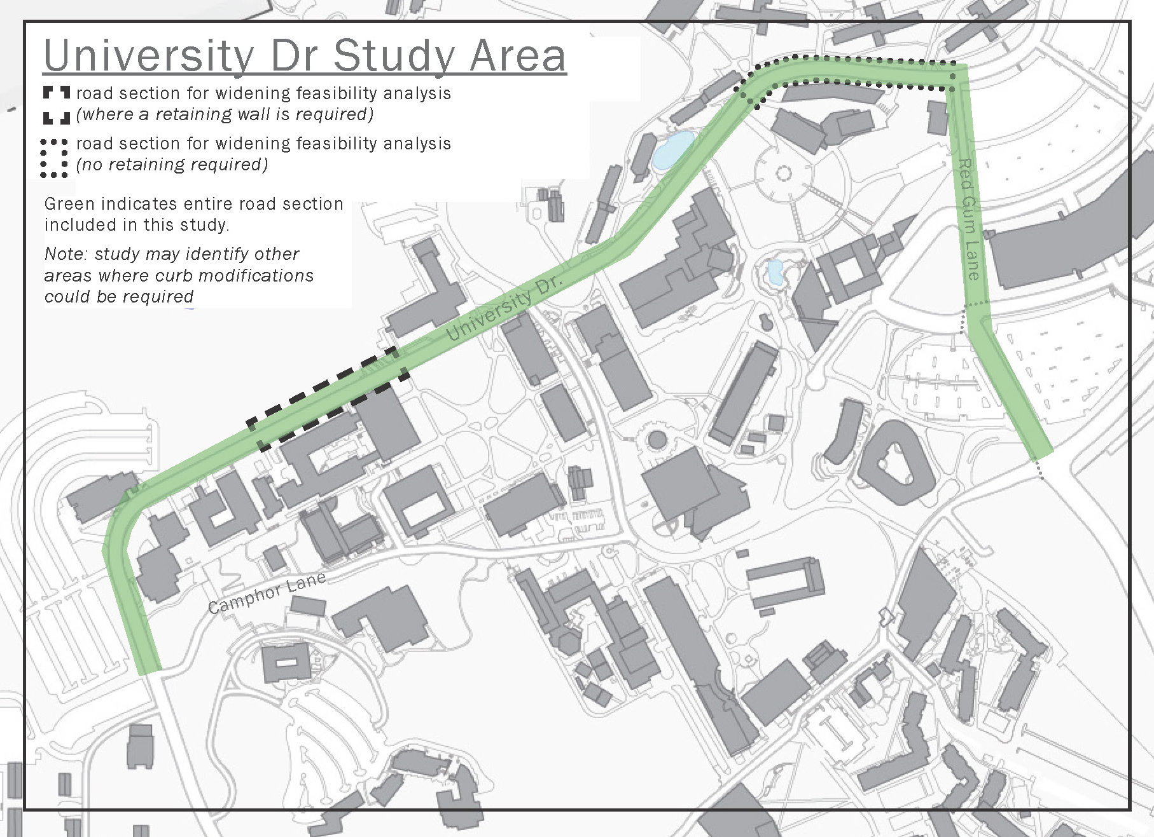
Project Goals
What will design look like?
How will buffers/vertical delineation look?
How do we approach sections that are currently too narrow?
How do we open and close transit lane?
How do we handle bicyclists?
What do we do with on-street parking?

Slide 3
Cross Sections
Vertical Delineation Options
Typical / Ideal Cross Sections
Constrained at College of Science Cross Section
Constrained at College of Business Cross Section
College of Business
College of Science

Slide 4
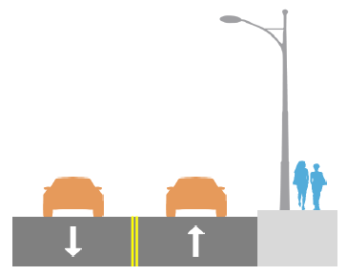
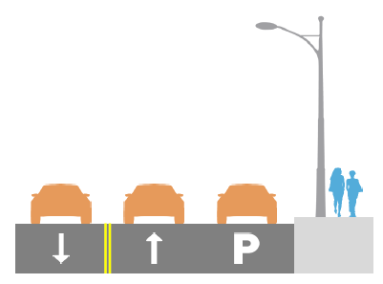
Existing Cross Sections
Typical ROW 38’
Ranges from 27’-30’ in constrained sections
Bikes allowed in travel lanes
Shuttles use travel lanes

Slide 5
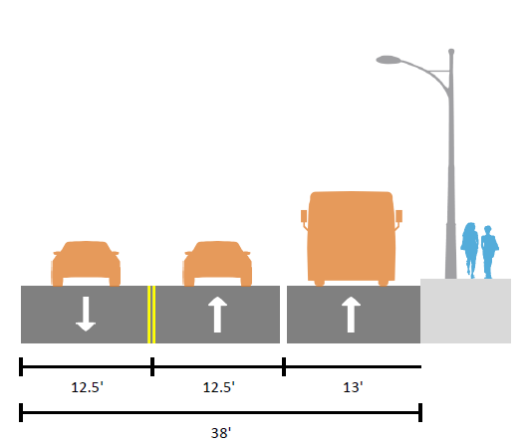
Typical Transit Lane Cross Section Concept 1
University Drive (typical section, 38 feet wide)
Striping only
Bikes ride in outside lanes with vehicles (Class III)

Slide 6
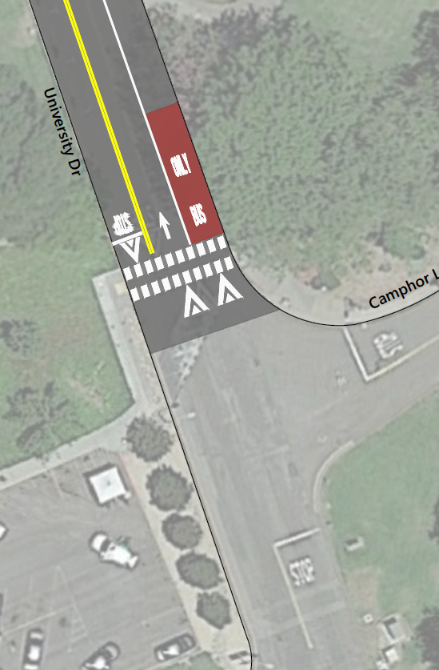
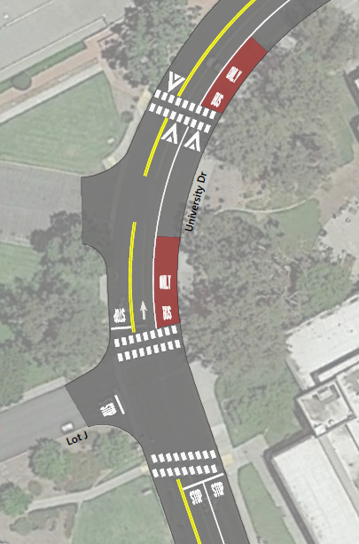
Design Concepts
Transit Lane Openings
Typical Transit Lane Layout

Slide 7
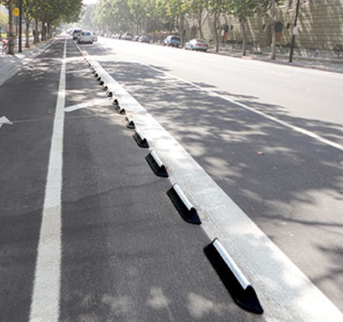
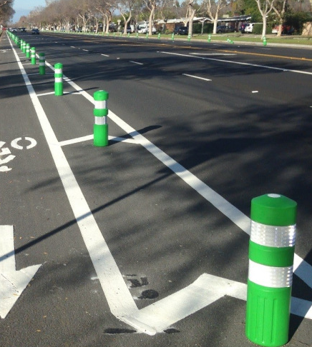
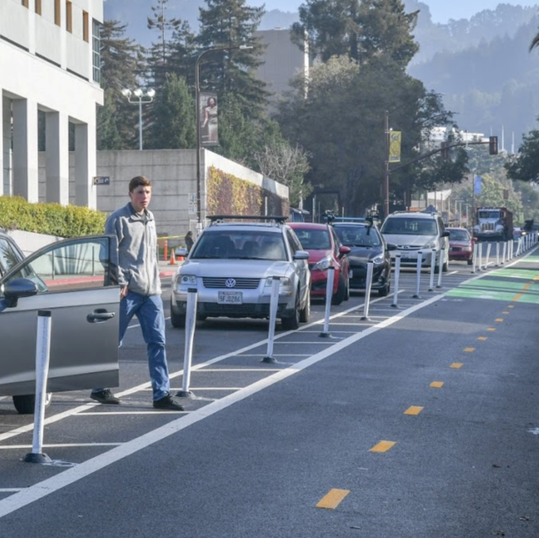
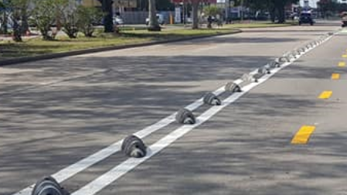
Vertical Delineation

Slide 8
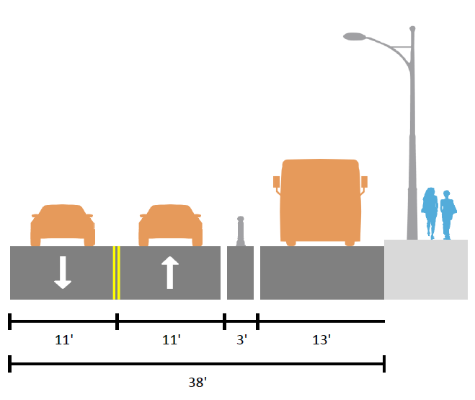
Typical Transit Lane Cross Section Concept 2
University Drive (typical section, 38 feet wide)
With vertical delineation
Bikes ride in outside lanes with vehicles (Class III)

Slide 9
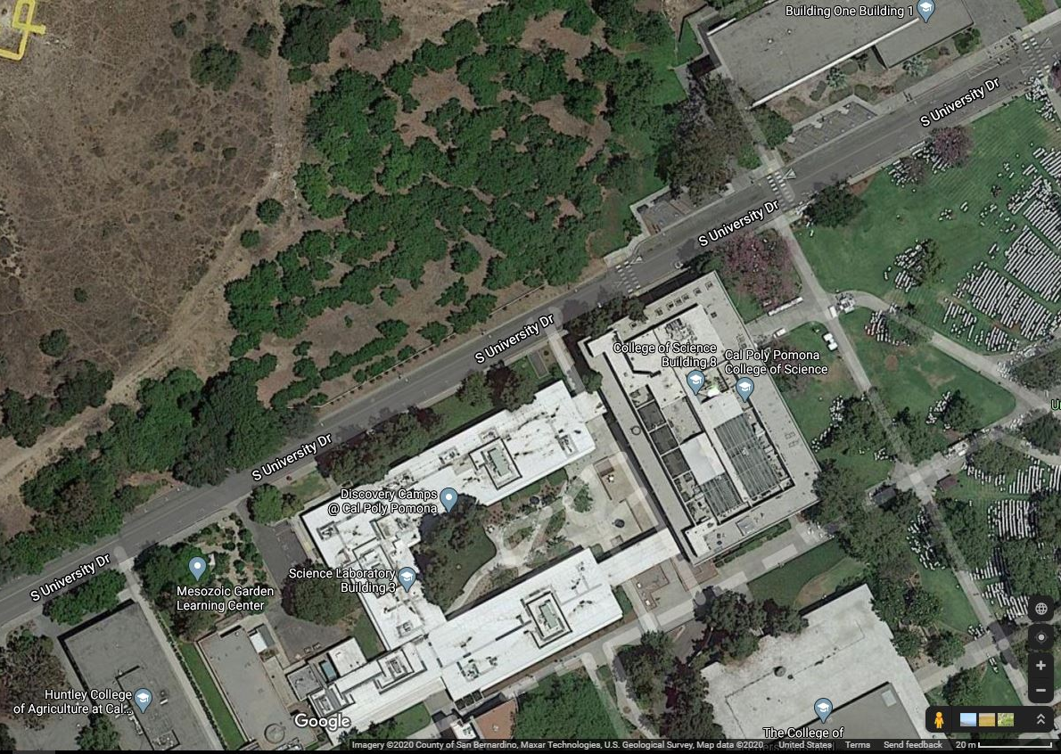
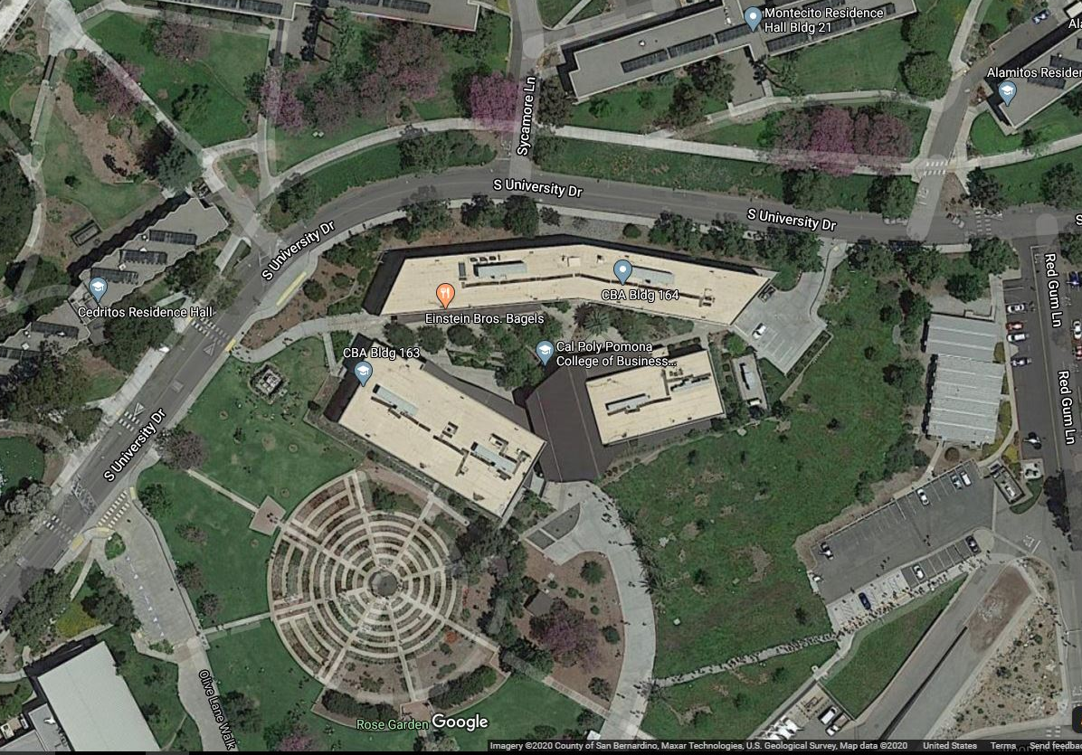
Constrained ROADWAY areas

Slide 10
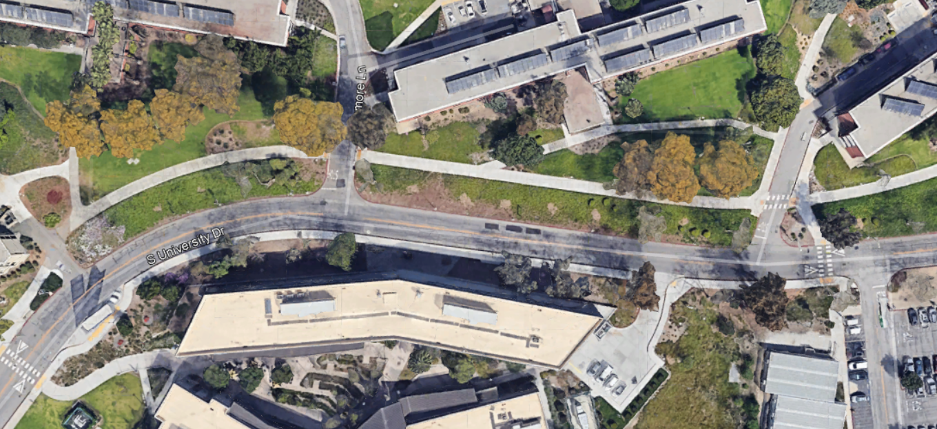
Constrained Section: University Dr near College of Business

Slide 11
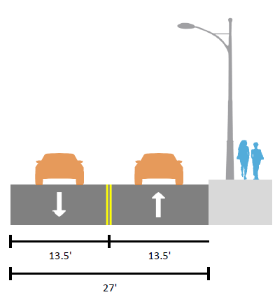

Constrained Cross Section
University Drive near College of Business Building Constrained Section
Buses could merge with general purpose flow
Ideal to widen by 11’ to fit transit lane
ROW constraints include curb, gutter, land scaping, light poles, utilities
Widening
Existing Cross Section

Slide 12
Constrained Section: AREA of PROPOSED WIDENING University Dr near College of Business

Slide 13
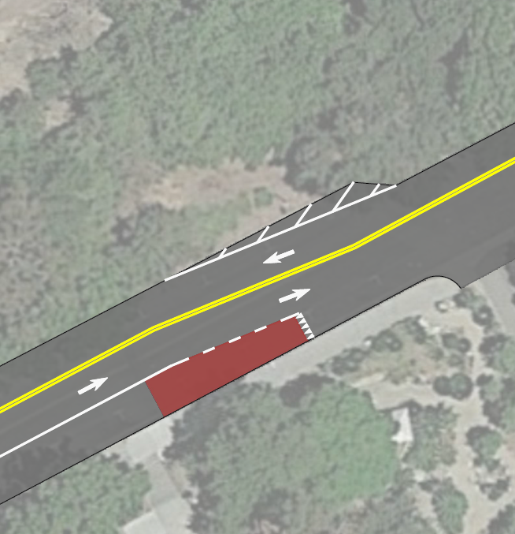
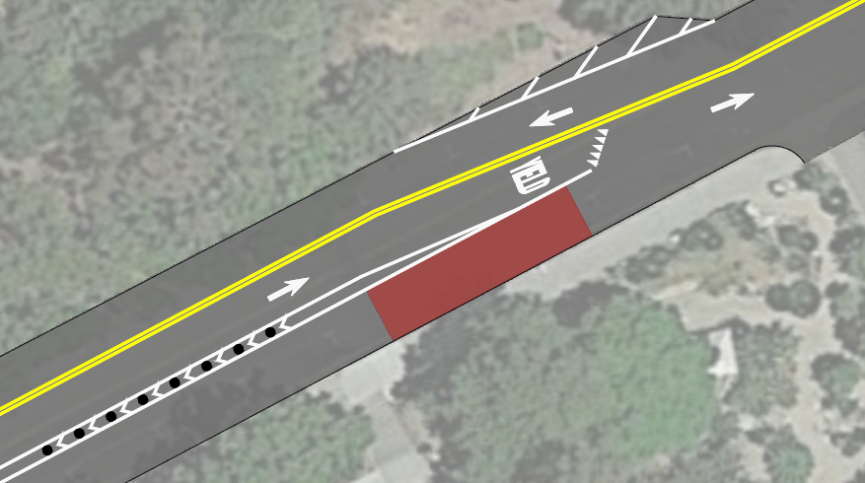
Design Concepts
Concept 1: Transit lane yields to general purpose lane
Concept 2: General purpose lane yields to transit lane – recommended

Slide 14
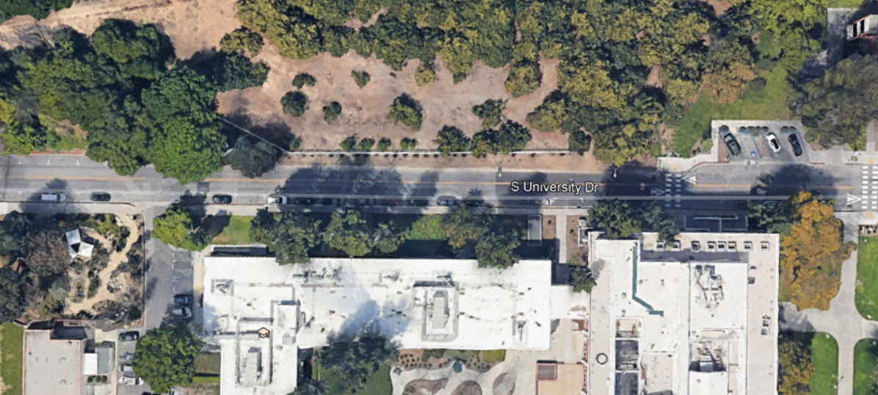
Constrained Section: University Dr near College of Science

Slide 15
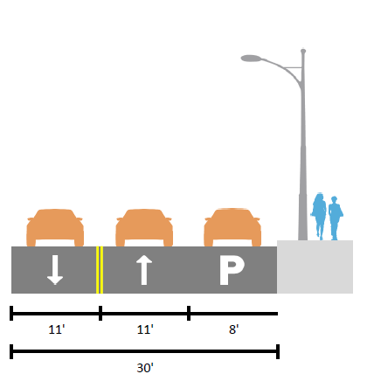

Constrained Cross Section
University Drive near College of Science Building Constrained Section adjacent to hill
Buses could merge with general purpose flow
Project goals remove parking
Ideal to widen by 8’ to fit transit lane, requires retaining wall
Widening
Existing Cross Section

Slide 16
Constrained Section: AREA of PROPOSED WIDENING University Dr near College of Science

Slide 17
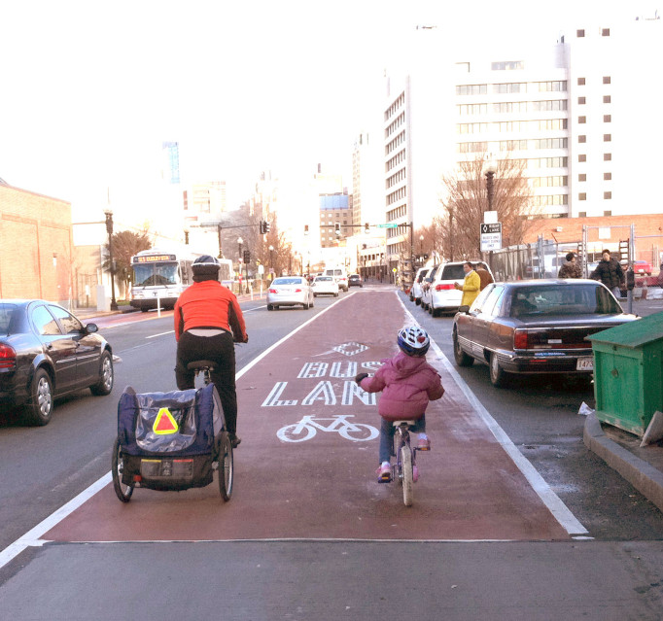
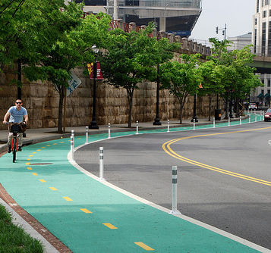
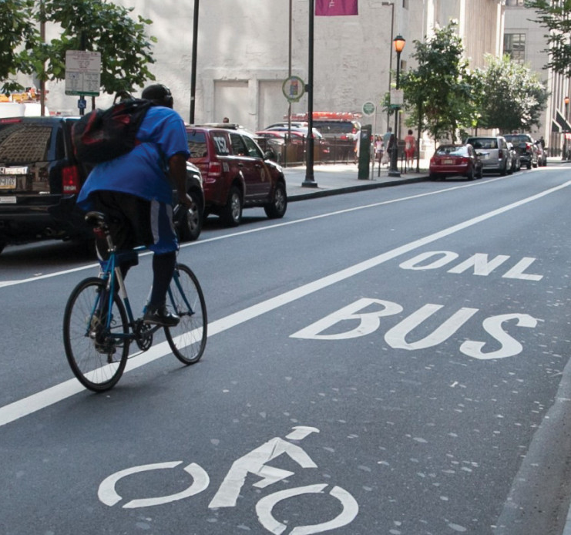
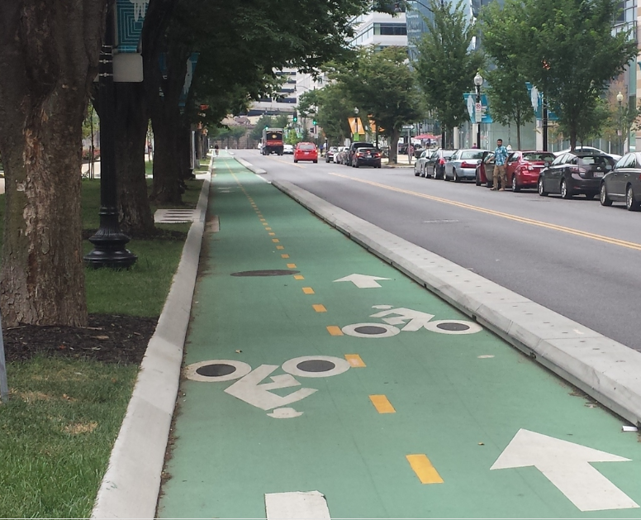
Accommodating Bikes

Slide 18
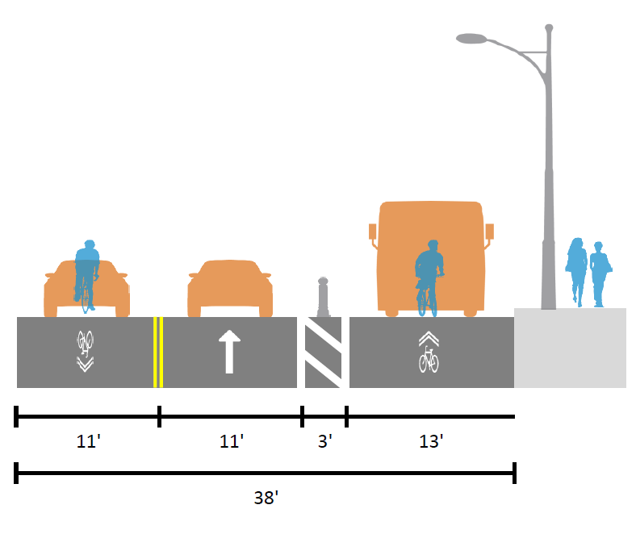
Typical Transit Lane Cross Section
University Drive (typical section, 38 feet wide)
With vertical delineation for bus lane and one direction of bikes
This is the more likely direction of regional bike travel
Bikes ride in outside lanes with vehicles (Class III)

Slide 19
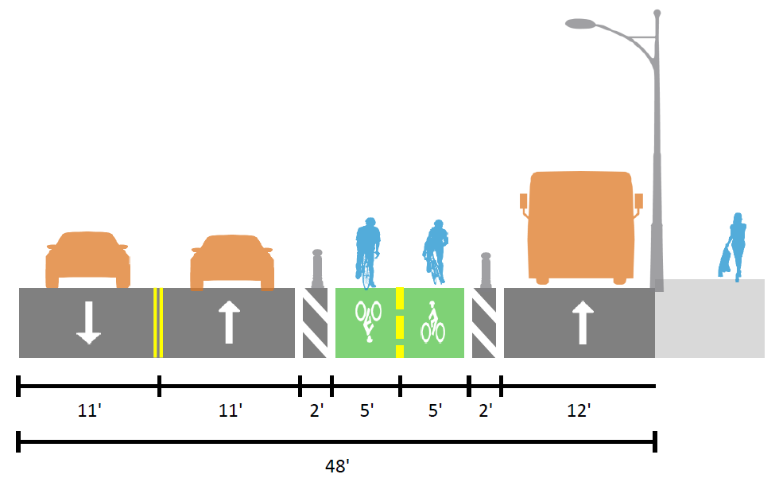
All-Modes Cross Section Concept I
Includes protected paths for all modes
Requires at least 10’ in ROW width
Incudes vertical delineation buffer

Slide 20
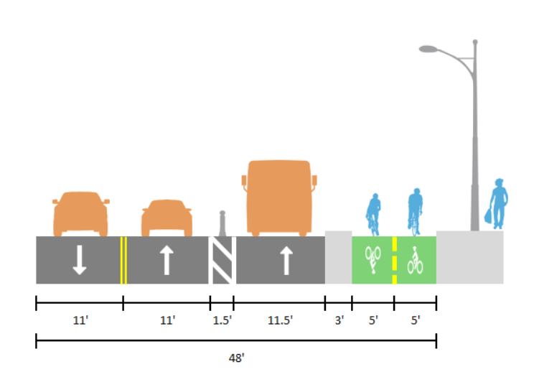

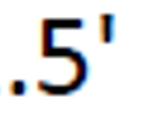
All-Modes Cross Section Concept II
Includes protected paths for all modes
Requires at least 10’ in ROW width
Incudes vertical delineation buffer

Slide 21
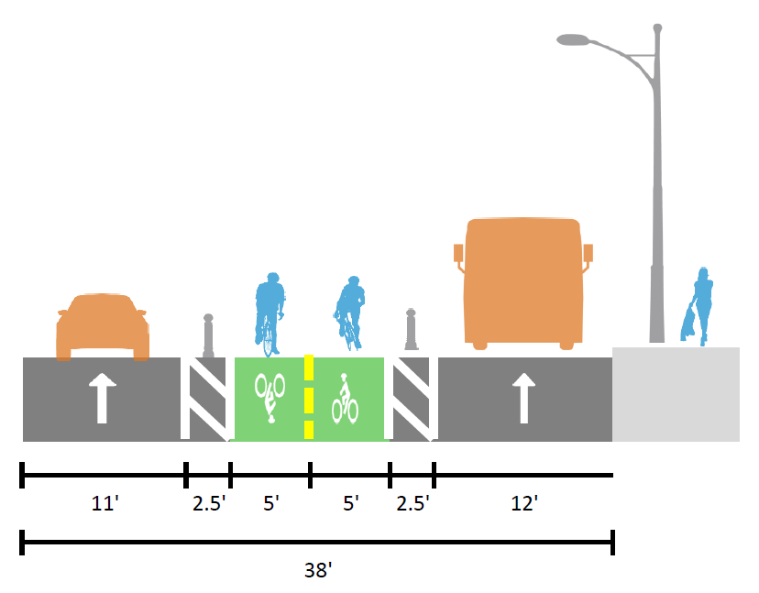
Clockwise Cross Section Concept 1
Includes lanes for all modes – only in clockwise direction for vehicles
Fits within the typical ROW
Vertical delineation buffer

Slide 22
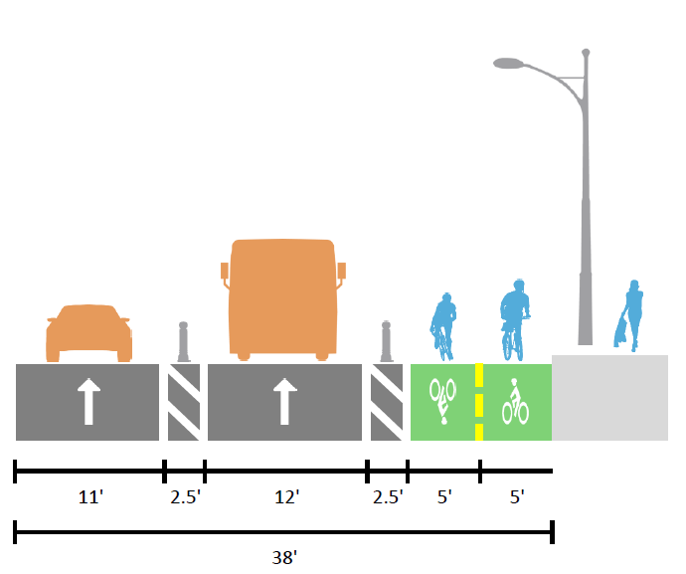
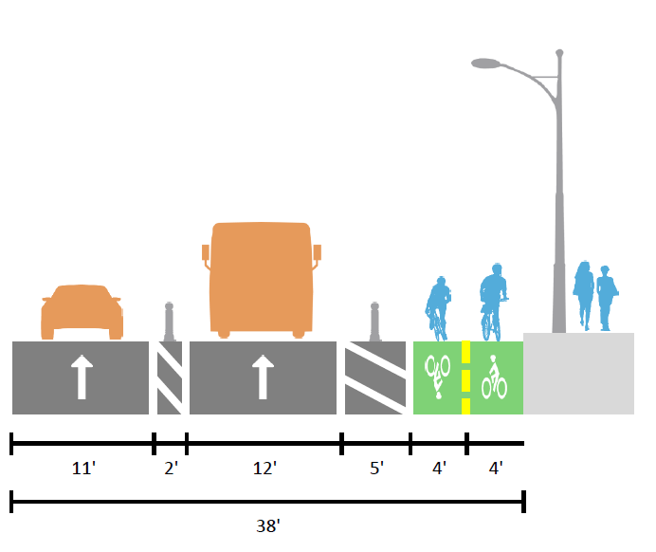
Clockwise Cross Section Concept 2
Includes lanes for all modes – only in clockwise direction for vehicles
Fits within the typical ROW
Vertical delineation buffer
Treatment for bus loading zone
Bus loading zone

Slide 23
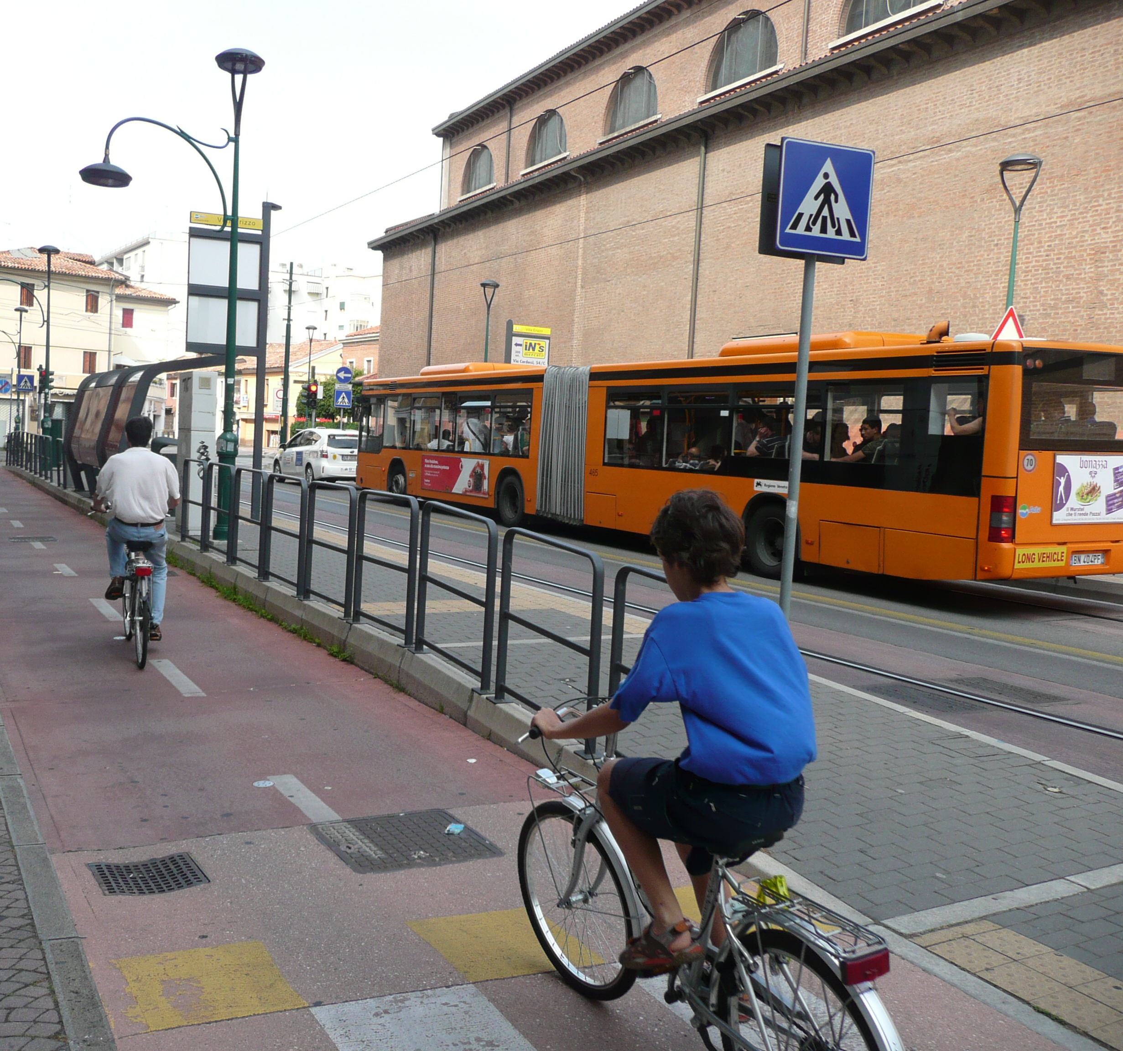
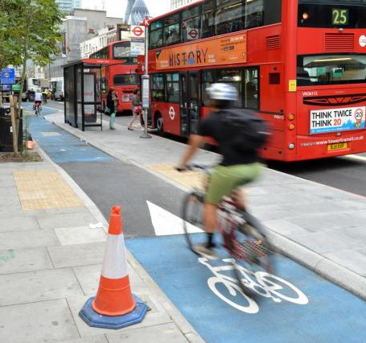
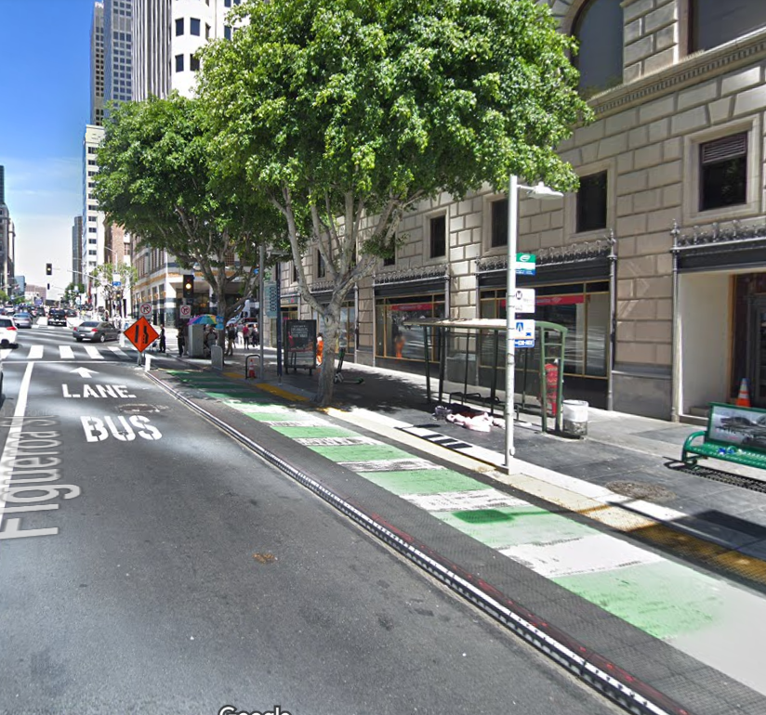
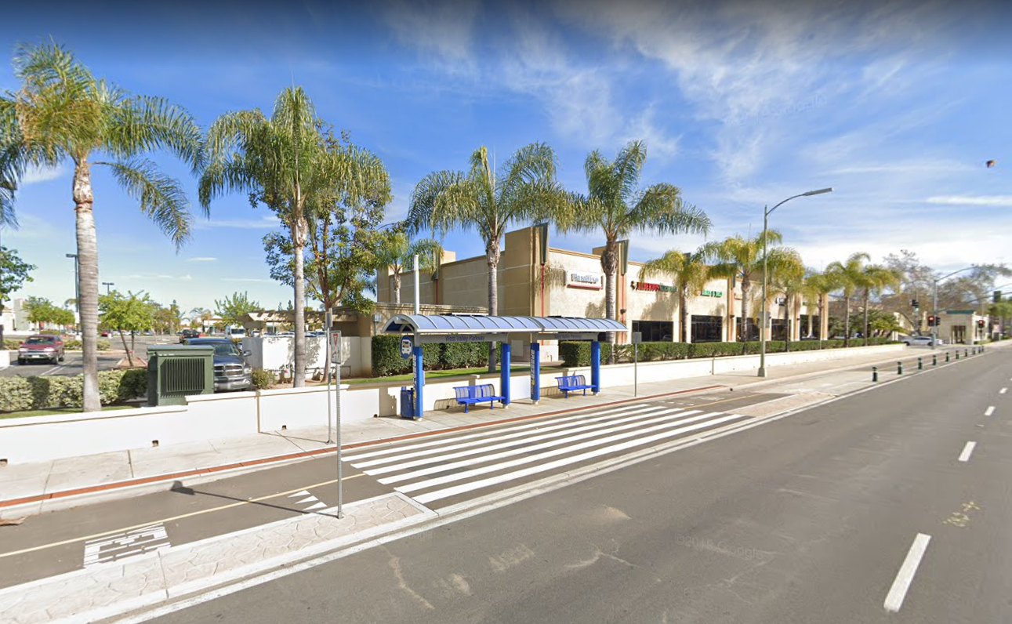
Example Bus Stops with cycle track loading

