Slide 1
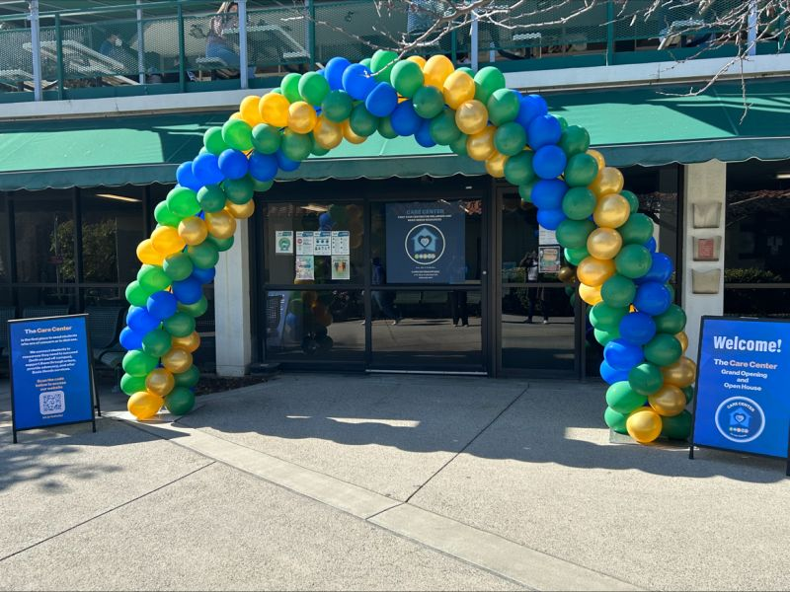
Culture of Care Care Center

Slide 2
Agenda
Overview of Care Center
Questions
How to Access
Emergencies
Who is a Student of Conern
Location
Case Management
Basic Needs Resoures

Slide 3
Care Center
The Care Center is the first place to send students who are of concern or in distress.
We connect students to:
Resources they need to succeed
Support them through crises
Provide advocacy
Offer Basic Needs services

Slide 4
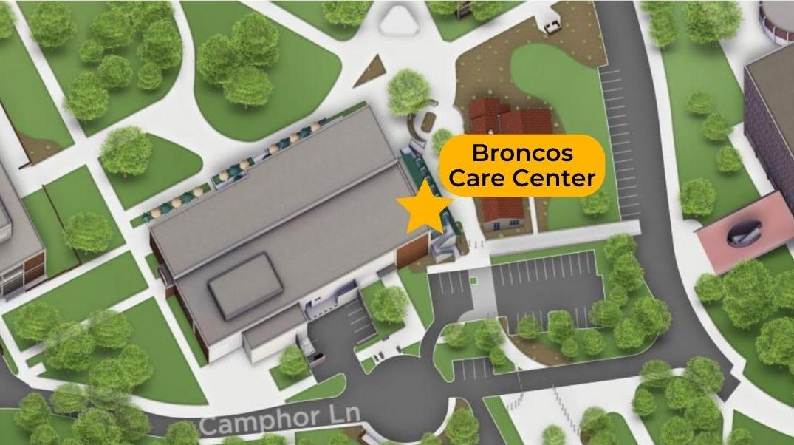
Location
Care Center
Located in Building 97 (directly in front of the Cultural Centers) and under the Marketplace

Slide 5
Case Management
Mental Health Support Coordination
Support students who require non-clinical interventions (i.e. anxiety, neurodivergent)
Connect students to CAPS or off-campus providers as needed
Absence & Withdrawal Support
Assist students who miss class due to serious and compelling reasons
Provide letters of support for students going through the withdrawal process
University Navigation
Assist students in navigating university processes (i.e. withdrawals, fees, tuition, COVID)
Provide warm handoff to variety of university partners
Campus reintegration support for post-hospitalization
Refer to Bronco Advising Center (BAC) as needed
Insurance Support
Notes:
Weston

Slide 6
Basic Needs Resources
Housing
Short-term emergency housing
Referral to rapid rehousing partner and community-based organizations
Financial
One-time grant, up to $500
Project Mailbox
Partnerships with the VRC, RS and College of Environmental Design
CalFresh Support
CalWORKs Benefits
Meal Assistance
Poly Pantry (ASI) Partnership
Clothing
Clothing Closet
Mobile Clothing Closet
Food
Care Packages
Tech Support (Hotspots and Laptops)
Personal Shopping Experience
Food Tasting/Demos
Notes:
Weston

Slide 7
Who is a student of concern?
Any student who is experiencing stressors that result in distress or crisis.
Examples of stressors:
•Basic needs insecurities (food, housing, financial)
•Mental health
•Physical health
•Family emergencies
Academic challenges

Slide 8
How to access to Care Center
Referral:
Care Center receives referrals through Student of Concern Form found on our website www.cpp.edu/carecenter
Walk-ins:
Students can be seen during walk-in hours; Monday-Friday 9:00 am – 4:00 pm
Consultations
Call (909) 869-5071 or email carecenter@cpp.edu

Slide 9
Emergencies
The Care Center is NOT for emergencies.
If there is an immediate threat to a student (either through self-harm or interpersonal violence), call (909) 869-3070 or 9-1-1 and follow your housing protocols.
The Care Center coordinates student care after an emergency.

Slide 10
Questions
Thoughts or areas you would like to further discuss
www.cpp.edu/carecenter
carecenter@cpp.edu
Building 97, M-F 8am-5pm

