Slide 1
REGISTRAR’S OFFICE
Physical Location:
SSB 121, 1st Floor – Blue Counter
http://www.cpp.edu/registrar
(909) 869-3000
registrar@cpp.edu
Connie Kuang
University Registrar
Jennifer Andelin
Associate Registrar
Lanto Razafimanantsoa
Associate Registrar
Camry Carls
Lead Transfer and Graduation Advisor
Notes:
CK

Slide 2
Registrar’s Office Overview
Student Center
Registration Window
Academic Policies
Transfer Credit
Degree Progress Report (DPR)
Graduation Process
Notes:
CK The Registrar’s Office provides services to students from the time that they matriculated with the university to the time after they graduated.

Slide 3
STUDENT CENTER
Demo for Student Center
Registration Window
Registration Holds/checklists
Permission to Add
FERPA Authorize to Release
Emergency Contact
Notes:
LR

Slide 4
REGISTRATION WINDOW (ENROLLMENT DATES)
Future registration windows are assigned by Registrar’s Office and viewable in your Student Center shortly before registration opens
Fall: starts in mid-April Spring: starts in mid-October Summer: starts in mid-March
Limited to 16 units during Priority & General Registration, then 18 units during Add/Drop, Petition to Exceed Unit Cap must be submitted
Check for pre-requisites or co-requisites
Add/Drop for Fall 2024 August 12 – September 5
Notes:
LR

Slide 5
ACADEMIC POLICIES Academic Standing/Time Limit
3.0 minimum GPA required (“B” average)
Overall/Cumulative (includes any transferred courses)
CPP courses
Program of Study courses
NOTE: 1000-2000 level courses (lower division) do NOT count towards your graduate GPA
Falling below a 3.0 GPA overall leads to Probation (PRP) or Probation with Contract (PRC), which ultimately lead to disqualification
There is no repeat/course forgiveness option available for graduate students
NOTE: The 7-year time limit does not stop during this period.
Notes:
JA

Slide 6
ACADEMIC POLICIES Leave of Absence
Students are permitted to “stop out” (not be enrolled) for 1 semester (not including summer) and not applicable to 1st term students
Note: stop-out is not available to F-1 international students
If a student needs to be away longer than 1 semester (financial, medical, emergency reasons) an Leave of Absence can be filed with the Registrar’s Office for up to 4 semesters (not including summer) – form available online
NOTE: The 7-year time limit does not stop during this period.
Notes:
JA

Slide 7
TRANSFER CREDIT
A total limit of 9 transfer and/or extension units petitioned for graduate credit may be applied toward a graduate degree.
Lower division level transfer courses may not be applied toward a graduate degree (including courses completed at a community college).
Official transcripts and approved petitions are required to be on file prior to having the units posted to the record.
Notes:
CC

Slide 8
Degree Progress Report (DPR)
Advising tool for graduate students
Admitted Fall 2022 and forward
Helps students/departments track progress towards degree
Does not prevent registration or applying for graduation
Follows program requirements set forth in the University Catalog
Any catalog deviations made by students may not automatically display
Graduate Academic Petitions may be required
Notes:
CC

Slide 9
Degree Progress Report (DPR)
Access your DPR via BroncoDirect
my.cpp.edu
Student Center
"other academic" drop-down menu
Select Degree Progress Report
Questions about your DPR?
Review the 2024-2025 University Catalog: https://catalog.cpp.edu/
Check with your Graduate Coordinator
Notes:
CC

Slide 10
GRADUATION PROCESS
Apply for Graduation
Visit the Registrar's Office website to view Application dates/timelines
Apply for the term you will have all program requirements completed
Determine graduation term w/your Graduate Coordinator
Graduation Reminders
Report of Culminating Experience
Check your transcript at the end of each term to verify your final grades have been submitted by your instructors
Verify you have satisfied the minimum unit total & G.P.A. required for your program
Notes:
CC/JA

Slide 11
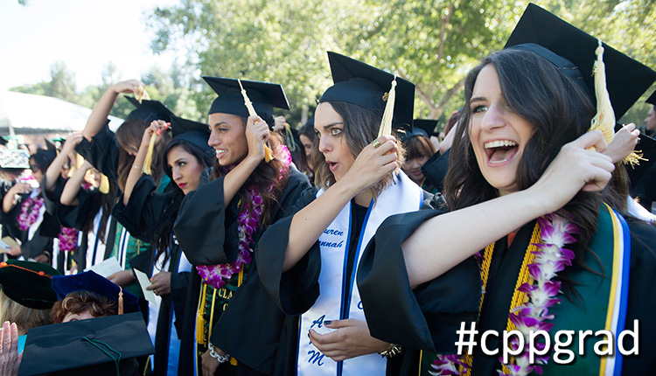
Welcome Broncos! We look forward to your graduation day!
Cal Poly Pomona - Graduate Student Orientation
The Registrar’s Office
Notes:
All

