Slide 1
Graduate Student Welcome
Office of Graduate Studies
August 17, 2024
Notes:
Add date

Slide 2
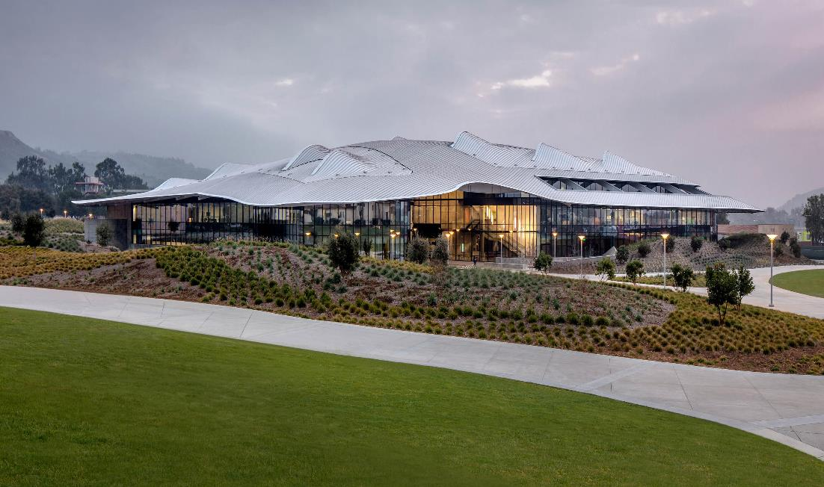
Office of Graduate Studies
Student Services Bldg. #121,
first floor,
orange counter
2

Slide 3
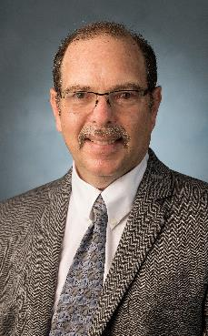
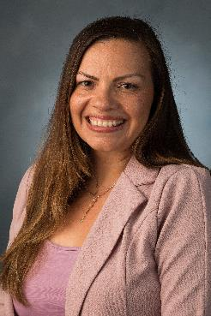
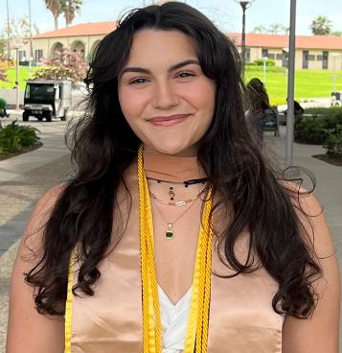
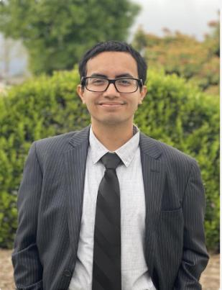
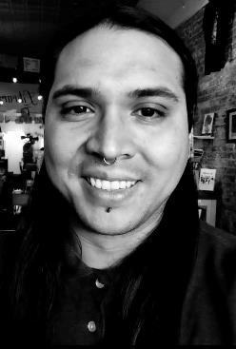
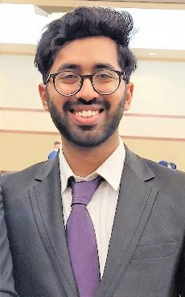
Graduate Studies Team
Dr. Salomon Oldak, Faculty Director of Graduate Studies
Rebecca Rivas, MPA, Graduate Studies Analyst
Nour Saleh, MBA, Graduate Resource Center, Graduate Student Advisor
Adrian T. Quintanar, Program Coordinator, Project LOGRAR
Jacob Reyes, MPA, Student Assistant
Amir Mohideen, MS Computer Science, Student Assistant

Slide 4
Role of Graduate Studies
Guide prospective and current graduate students
Support Key steps in graduation process advisement
Promote student awareness and pursuit of graduate education & research
Review and process graduate student petitions and oversee the submission process for your project or thesis.
Implement and guide policies and procedures in graduate student affairs.

Slide 5
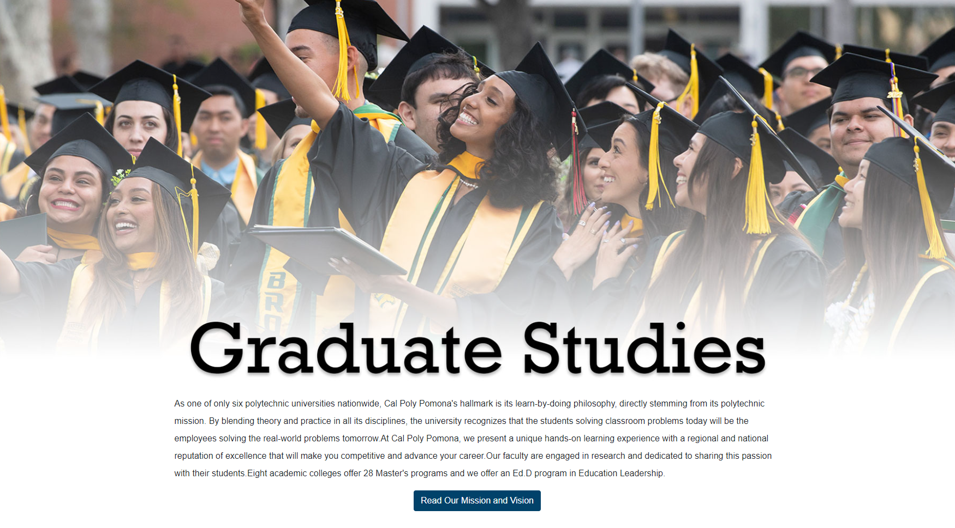
Graduate Studies Website
www.cpp.edu/gradstudies
Notes:
High light some

Slide 6
C A L P O L Y
P O M O N A
Graduate Coordinators & Advisors
Oversees advising for degree program
Assist with:
First semester advisement
Program Plan/ Petition filing
Any other questions you may have about academic status, courses to take, professional goals

Slide 7
C A L P O L Y
P O M O N A
Checklist for Incoming Graduate Students
Access MyCPP portal (campus portal and gateway to campus online services).
Protect your CPP account security by installing 2-Step Authentication, DUO
Complete Title IX Training
Meet with your Graduate Program Coordinator
Attend your department orientation
Register for Classes (Registration Guide)
Purchase your CPP Bronco One Card Photo ID
Purchase your parking permit (if applicable)
Become familiar with your Degree Progress Report
Access Canvas
Learn about CPP’s Policies and Procedures and Graduate Studies Policies
Become familiar with the Graduate Student Handbook (policies and resources which pertain to graduate students)
Become familiar with the Office of Graduate Studies and Graduate Resource Center Website to learn about events, workshops, financial support, online tutoring, deadlines, and other resources which apply to graduate students.
Incoming Graduate Student FAQs: https://www.cpp.edu/grc/academic-support/faq.shtml

Slide 8
Comments or Questions
Contact us at: gradstudies@cpp.edu
or
Email me at rrivas1@cpp.edu

