Slide 1
Navigating Library Resources
2024 Graduate Student Orientation
Sally Najera Romero, Education Librarian

Slide 2
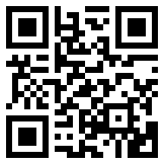
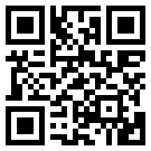
Services
Research Help
Interlibrary Loan
Course Reserves
How to Get Help
Databases
Database Accessibility
My Library Account
Borrow,
Renew
Research Tutorials
Library Tips
Fines/
Fees
Tech Lending
Contact Subject Librarians
Special Collections
Recommend a Purchase
Returning Materials After Hours
Frequently Asked Questions
Research Guides

Slide 3
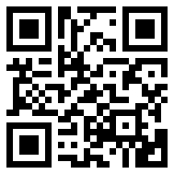
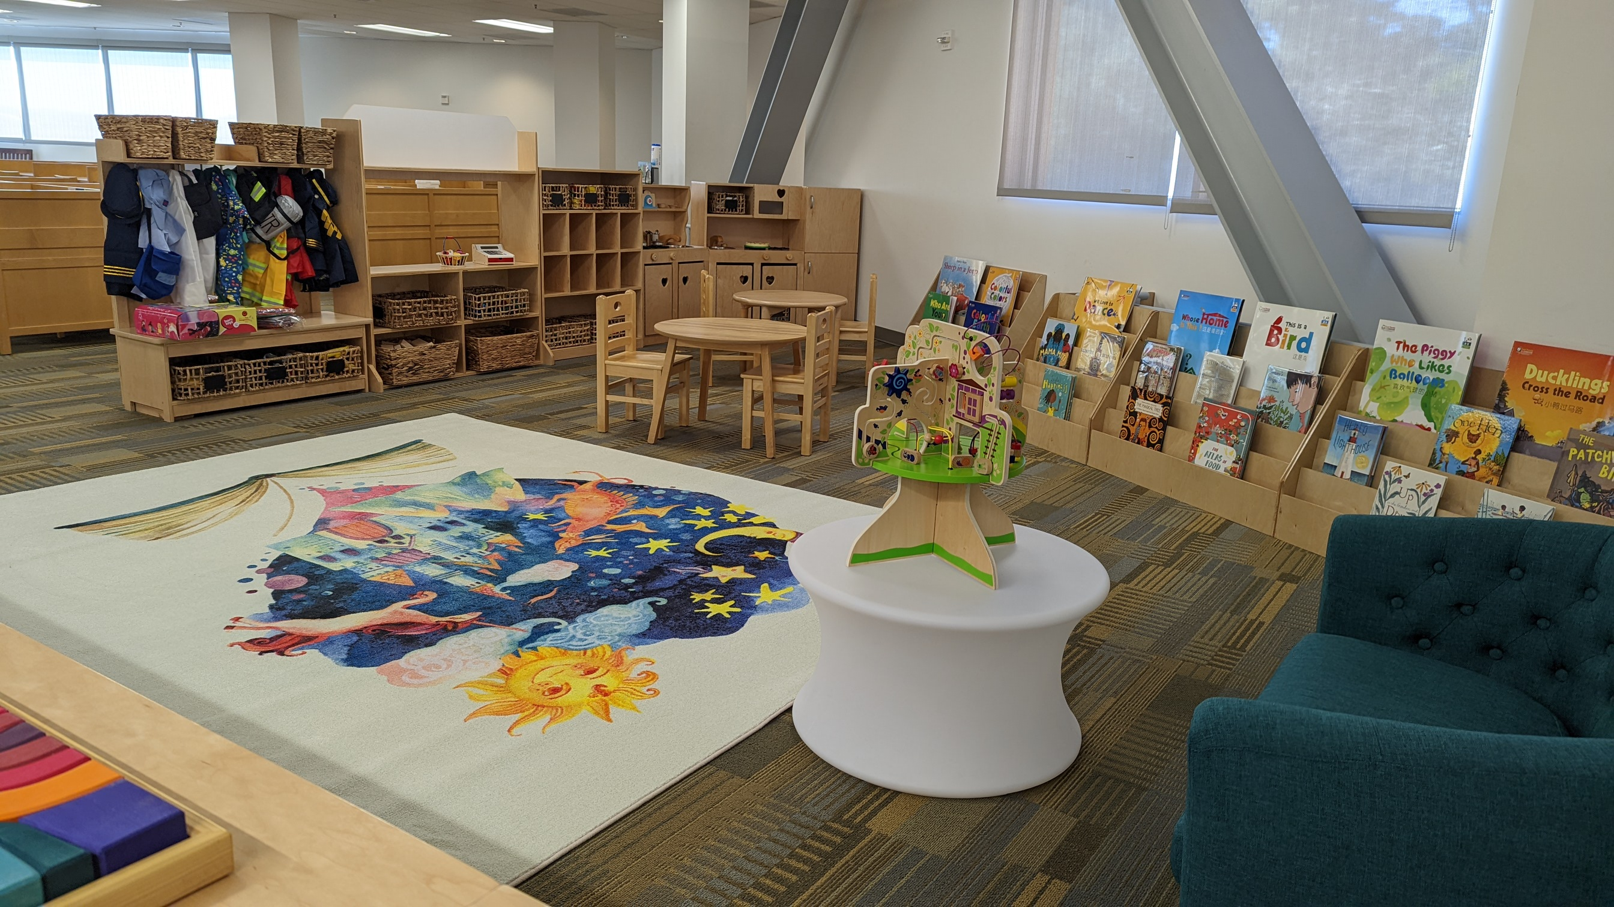
Library Spaces
Study Rooms
The Maker Studio
Bronco Computer Lab
Bronco Family Space
Quiet Floors
Reflection Room
Learning Resource Center
Writing Center
Graduate Resource Center

Slide 4
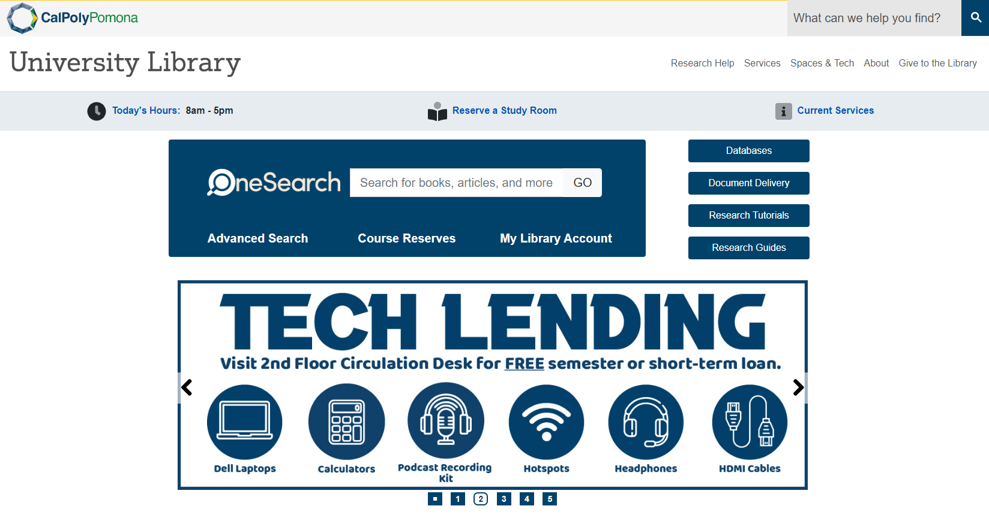
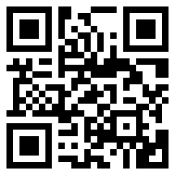
Starting Your Research
https://www.cpp.edu/library
Start researching here

Slide 5
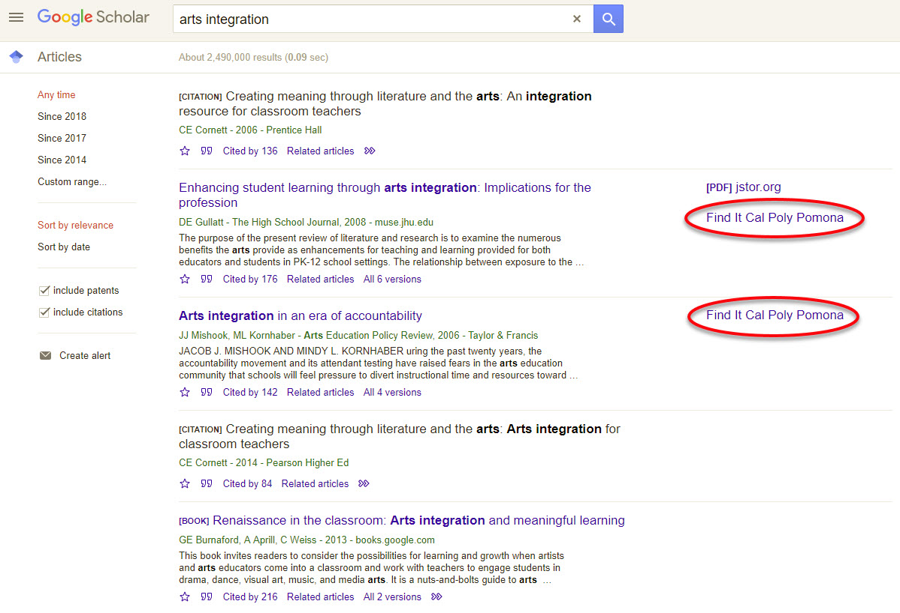
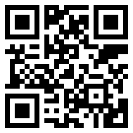
Connect to Google Scholar
Tutorial: Accessing Library Materials Using Google Scholar

Slide 6
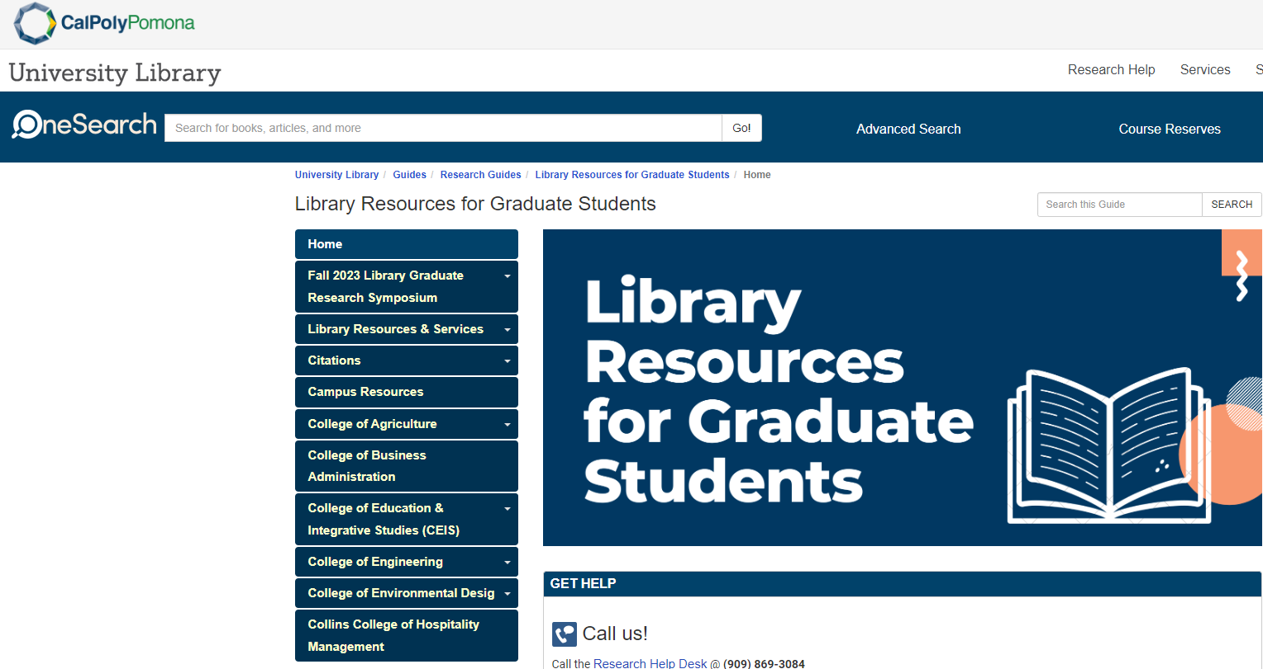
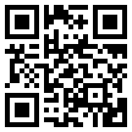
Library Resources for Graduate Students
https://libguides.library.cpp.edu/graduatestudies

Slide 7
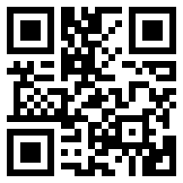
CPP Theses, Projects, & Dissertations
CPP Bronco ScholarWorks
2015+ (online)
CSU theses & dissertations collection

Slide 8
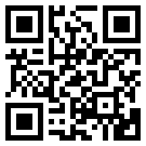
Contact Us!
Huntley College of Agriculture
Freda Lin, fwlin@cpp.edu
College of Business Administration
Julie Shen, jshen@cpp.edu
College of Education & Integrative Studies
Sally Romero, sallyromero@cpp.edu
College of Engineering
Paul Hottinger, prhottinger@cpp.edu
College of Environmental Design
Rayheem Eskridge, raeskridge@cpp.edu
Collins College of Hospitality Management
Julie Shen, jshen@cpp.edu
College of Letters, Arts, and Social Sciences
Shonn Haren, smharen@cpp.edu
Hannah Cole, hannahcole@cpp.edu
College of Science In-recruitment
libraryhelp@cpp.edu 909-869-3074

