Slide 1
Understanding Financial Aid:
Brandi Blair
Office of Financial Aid & Scholarships
August 17, 2024

Slide 2
Financial Aid: Who We Are
Partners in the process
Students have the primary responsibility to pay for postsecondary, graduate-level education expenses
Financial Aid helps bridge the funding gap
Eligibility for aid is based on individual circumstances / resources.
Most financial aid for Graduate students is in the form of federal loans.
Financial Aid & Scholarships
The Student
Student Accounting & Cashiering Services

Slide 3
Financial Aid: What We Do
Determine Student Aid Eligibility
Package Financial Aid Funds
Coordinate Aid
Federal & Cal Poly Pomona
Scholarships & Stipends
Tuition Waivers
Prizes & Awards
Release Financial Aid funds (to Student Accounting)

Slide 4
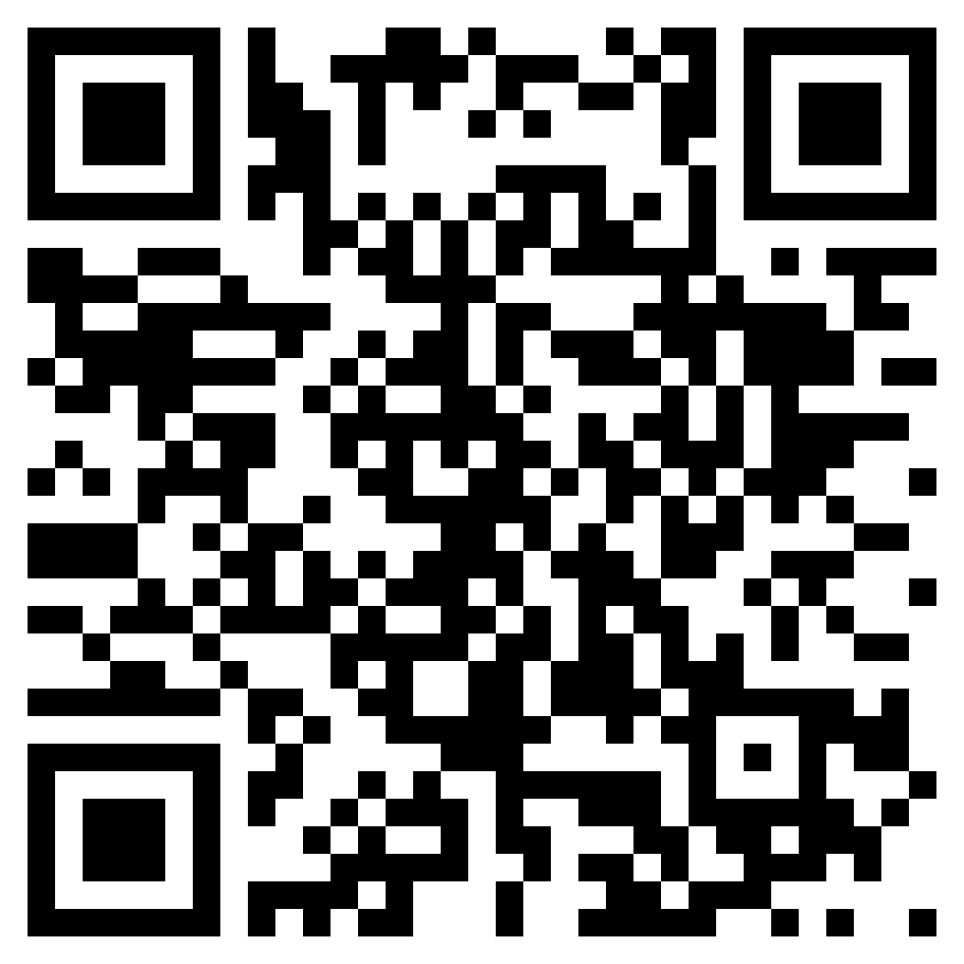
Student Accounting & Cashiering Services: What They Do
Place charges on Student Account
Receive and Apply Payments
Individual Payments
Payment Plans
Financial Aid
Fee Waivers
Third-Party Organizations
Place & Release Financial Holds
Process Refunds – sign up for Direct Deposit
Tax Documents (1098-T)
https://www.cpp.edu/student-accounting/understanding.shtml

Slide 5
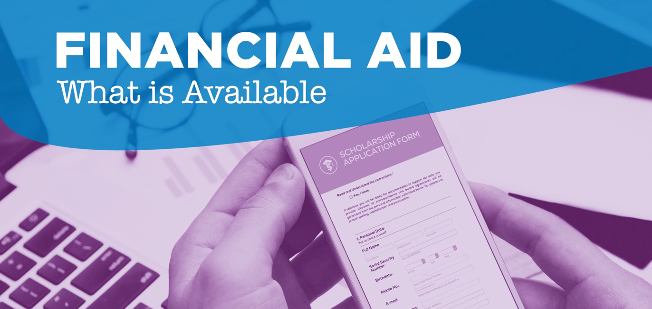

Slide 6
Financial Aid Package
Grants
Work
Aid Package
Loans
Completing the FAFSA/CAL DREAM ACT is used for consideration for 3 types of aid
Notes:
Charles – DREAM Students eligible for State & Dream Loan only

Slide 7
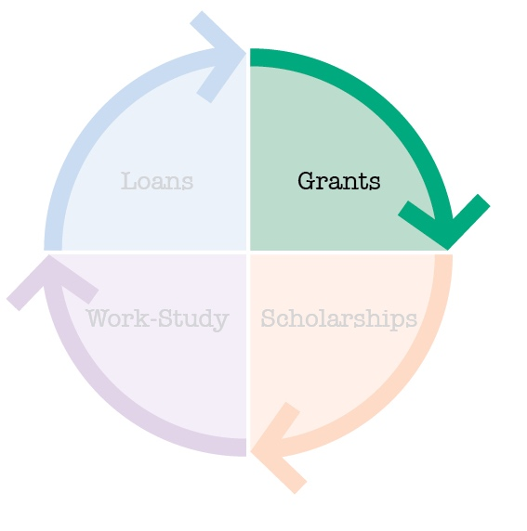
Grants (Free Money)
Degree Programs through CPGE
Currently no grants available
These programs are considered self-supporting programs, meaning the programs operate entirely on student fees.
Cal Poly Pomona does not receive any state aid in support of these programs; they are therefore not eligible for the State University Grant.
They are, however, eligible for Federal Direct Student Loans.

Slide 8
Grants (Free Money)
Cal Poly Pomona Institutional Grants State University Grant:
Covers State Assessed Tuition Fee Only*
Must be enrolled at least ½ time (3 units)
Must meet eligibility criteria
Adjusted to the tuition fee being charged
3 – 6 Units = $2,208
7 or more Units = $3,804
* Even though 6 units is considered “Full-Time,” SUG is based on tuition fee charged.
CPGE Degree Programs
No Grants available

Slide 9
Grants (Free Money)
Cal Poly Pomona Institutional Grants Graduate Business Grant:
Students in programs charged per-unit Professional Program Fee
MBA
MS Accountancy (non-accelerated)
MS Information Security
Fixed amount = $1,710 per semester
Must be in at least 6 units of courses charged Professional Program Fee
Must meet eligibility criteria
Added to Aid Package retroactively (after Spring Census)
CPGE Degree Programs
No Grants available

Slide 10
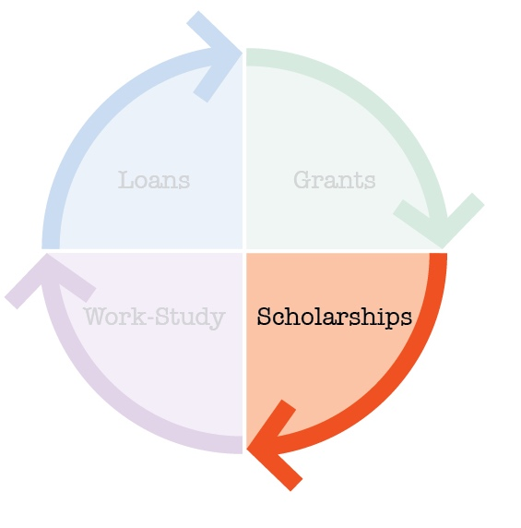
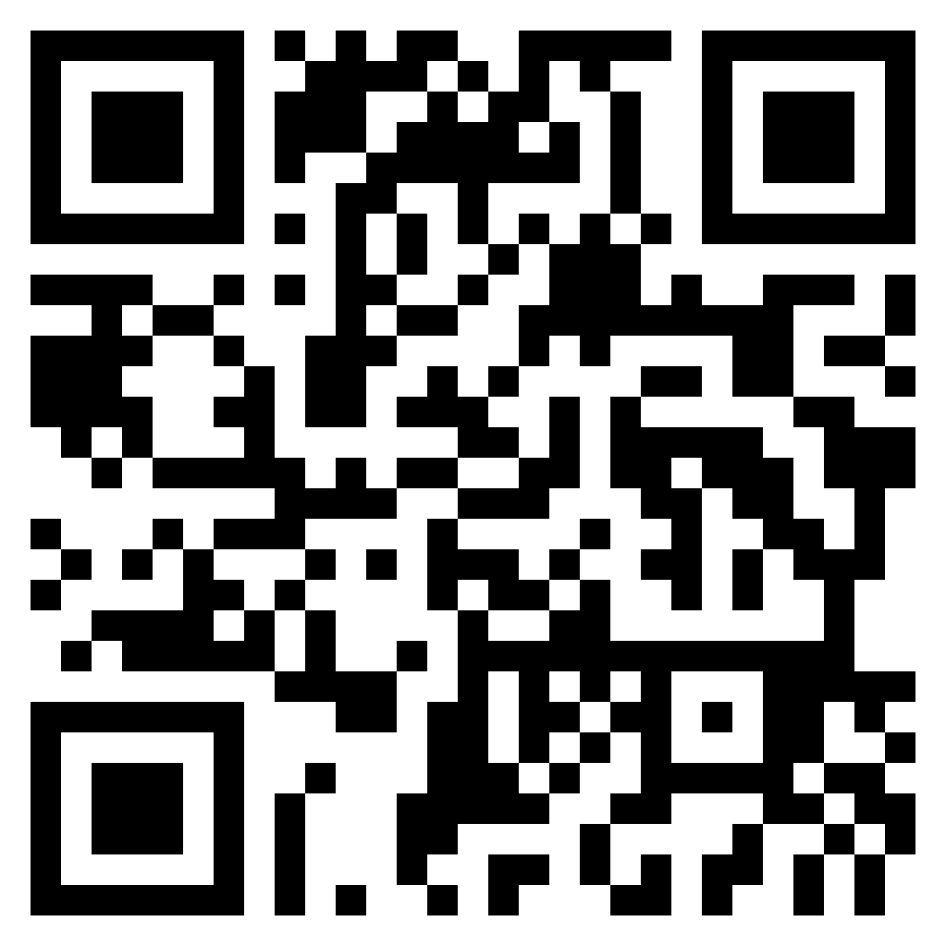
Scholarships (More Free Money)
Athletic, Academic, Leadership, Theatre, Music
Usually Competitive
Institutional
National
State, Local, or Civic

Slide 11
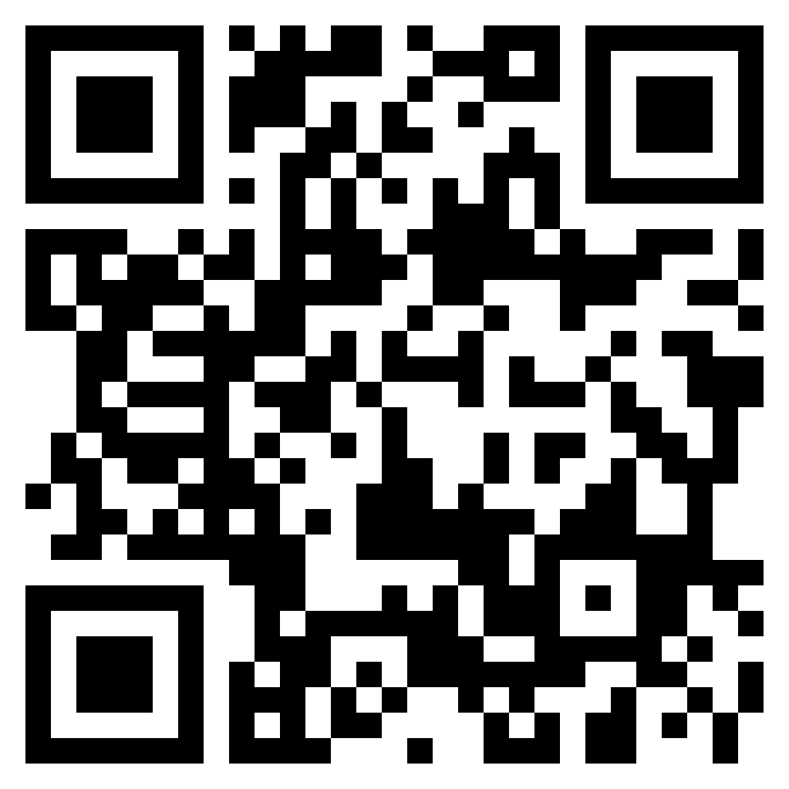
Be Smart About Scholarships
Applications for 2025 – 2026 Academic Year to open October 1, 2024 (and close March 3, 2025)

Slide 12
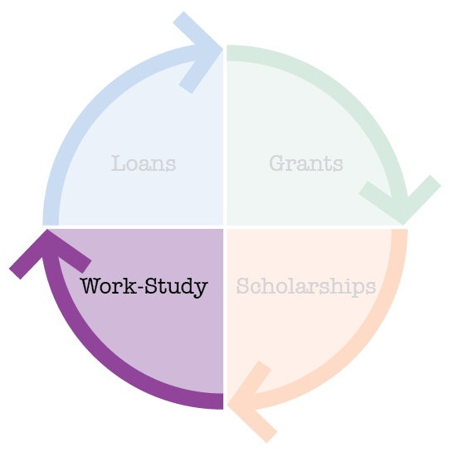
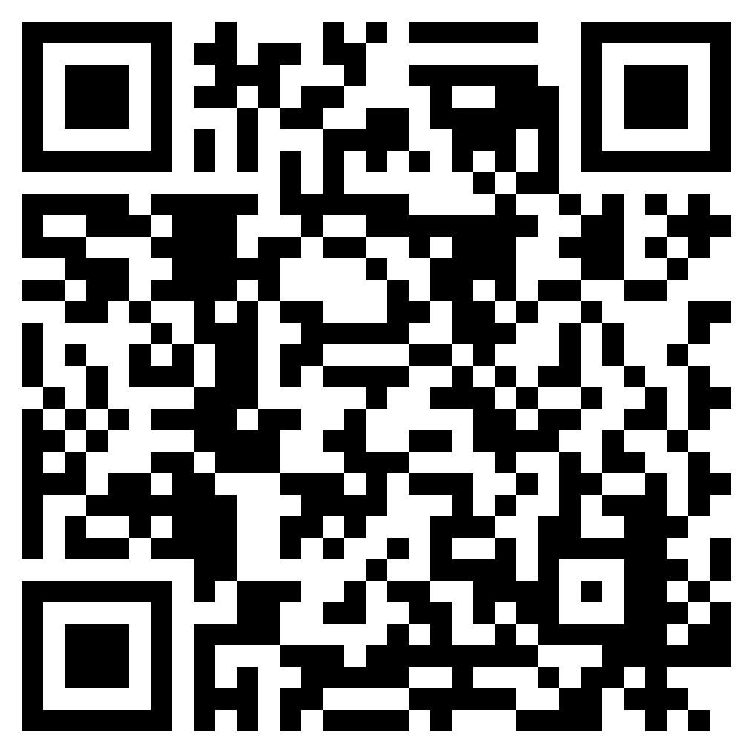
Federal Work Study (Money you Earn)
Eligibility based on demonstrated need
Student must find a Work-Study job (many on-campus offerings)
10 – 15 hours per week and paid directly to student
At least the minimum wage, never below

Slide 13
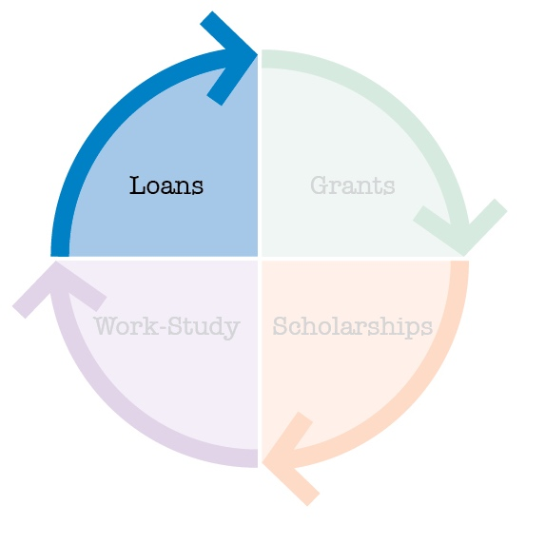
Loans (Money you pay back)
You must be enrolled at least Half-Time (3 units) to be eligible to receive your Direct Loans.
Direct Unsubsidized Loan
UN-Subsidized: Interest the whole time
Interest rate for loans borrowed in 2024-25: 8.083%
Direct Graduate PLUS
UN-Subsidized: Interest the whole time
Apply online at studentaid.gov
Interest rate for loans borrowed in 2024-25: 9.083%
CA Dream Loan
Dream Students only
Interest rate for loans borrowed in 2024-25: 8.083%
Private Loans

Slide 14
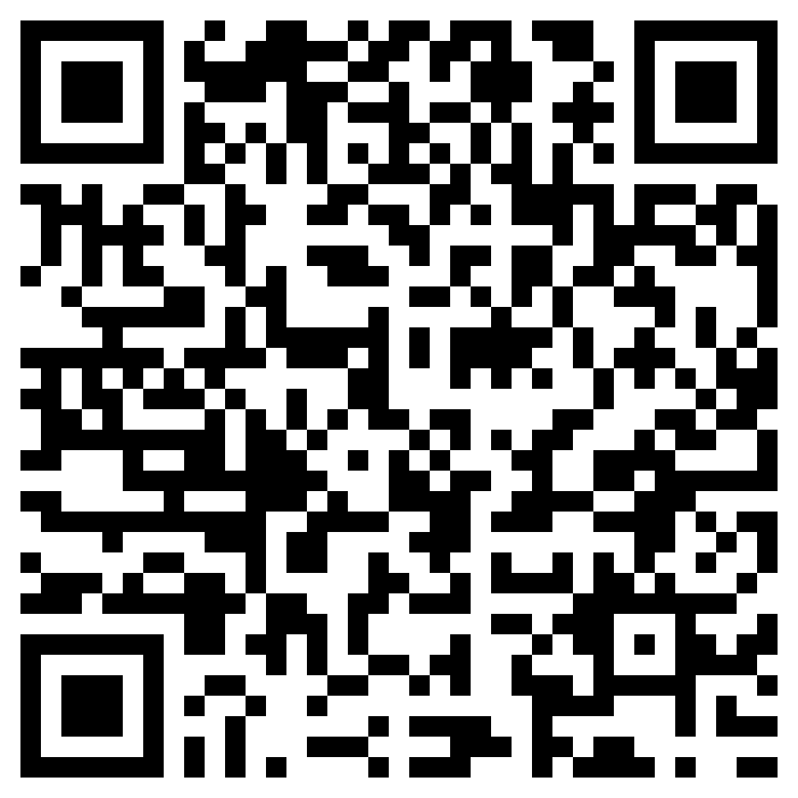
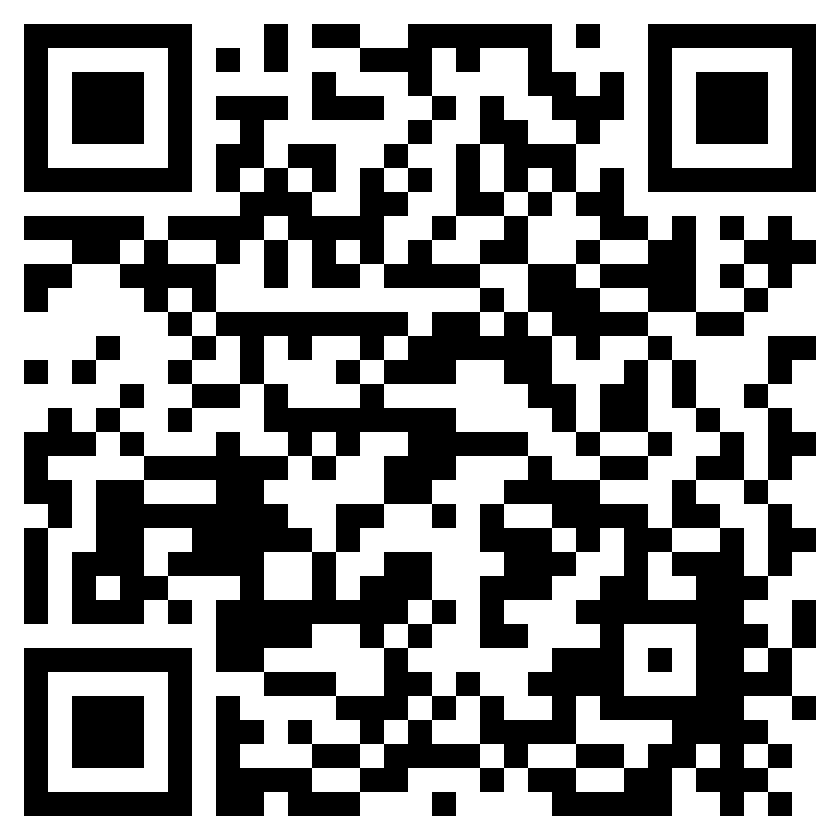
International Students – Limited Free Resources are Available
On-campus employment:
It is your responsibility to research and understand your on-campus work eligibility. Eligibility, definitions, etc. are found on the international student website.
Work with your international student advisor if you have concerns or questions.
Scholarships:
Year round non-CPP: check professional organization resources
Outside Scholarships
CPP ScholarshipFest: October 1, 2024 – March 3, 2025)
Very few for graduates in general even fewer for International students
Notes:
Charles – DREAM Students eligible for State & Dream Loan only

Slide 15
Financial Aid Availability Resources
College Professional & Global Education https://www.cpp.edu/financial-aid/other-programs/college-of-professional-and-global-education.shtml Graduate Aid Programs https://www.cpp.edu/financial-aid/graduate/newly-admitted-and-current1/aid-programs.shtml
Understanding State University Grant https://www.cpp.edu/financial-aid/resources/understanding-state-university-grant-eligibility.shtml
Scholarships https://www.cpp.edu/financial-aid/scholarships/ Career Center Website: Jobs & Internships https://www.cpp.edu/career/students/jobs_and_internships.shtml Direct Loan interest rates: https://studentaid.gov/understand-aid/types/loans/interest-rates International Student Center: https://www.cpp.edu/international/students/u-s-employment/on-campus-employment.shtml

Slide 17
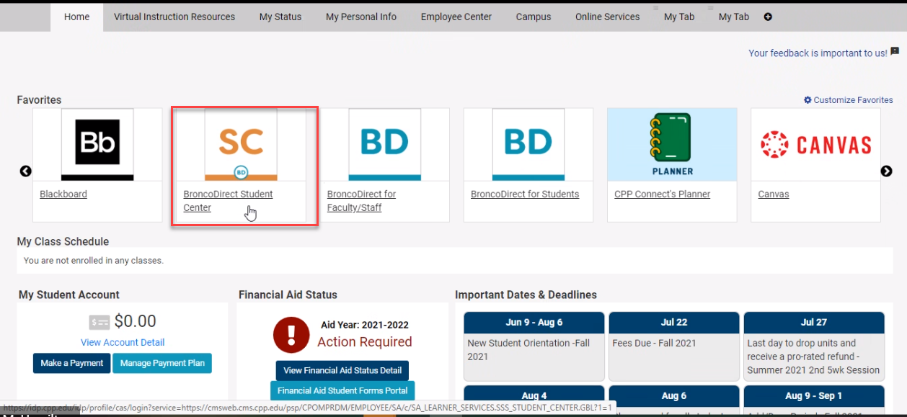
Accessing Your Financial Aid

Slide 18
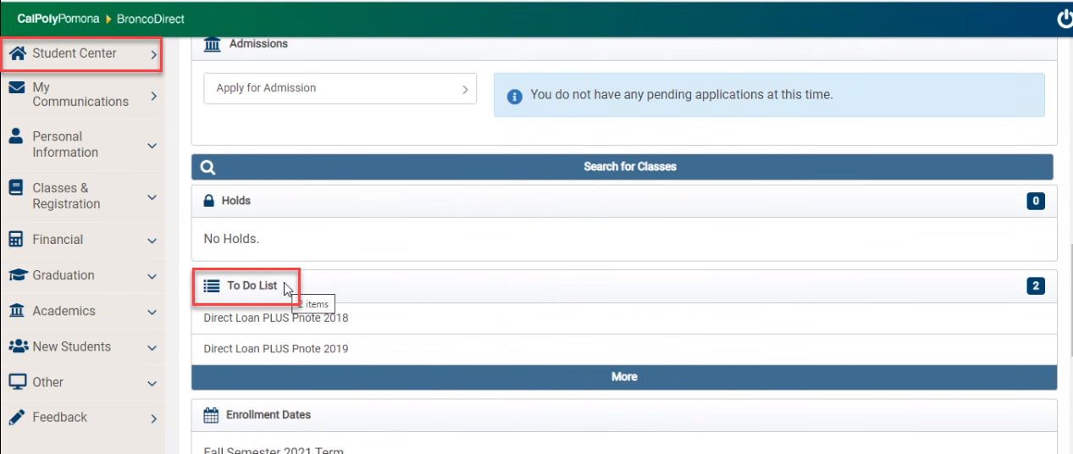
Accessing Your Financial Aid

Slide 19
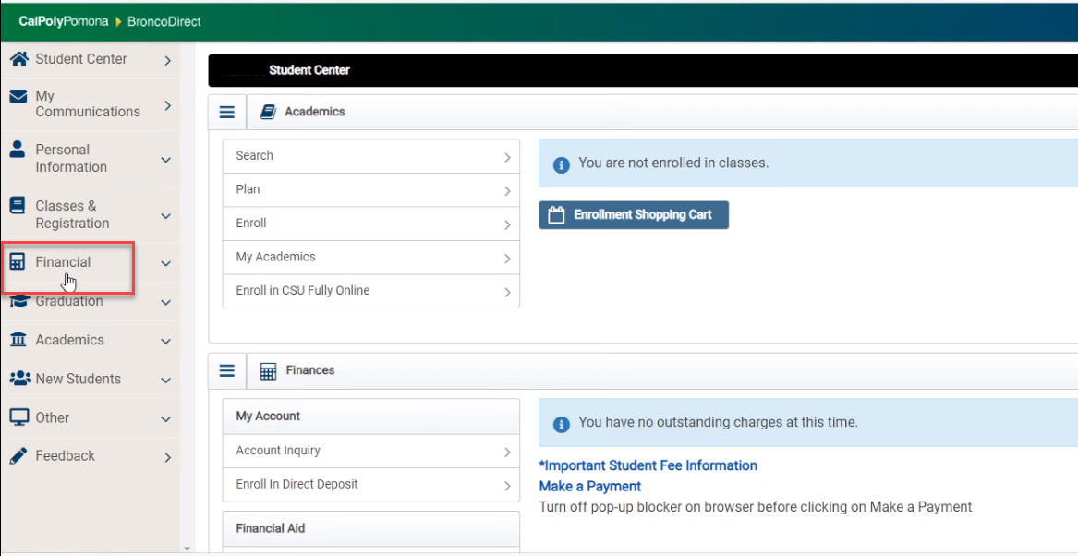
Accessing Your Financial Aid

Slide 20
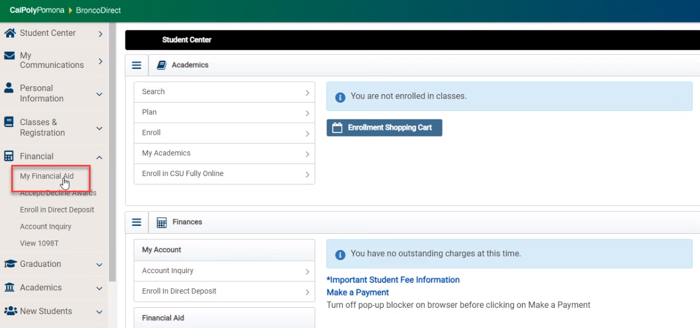
Accessing Your Financial Aid

Slide 21
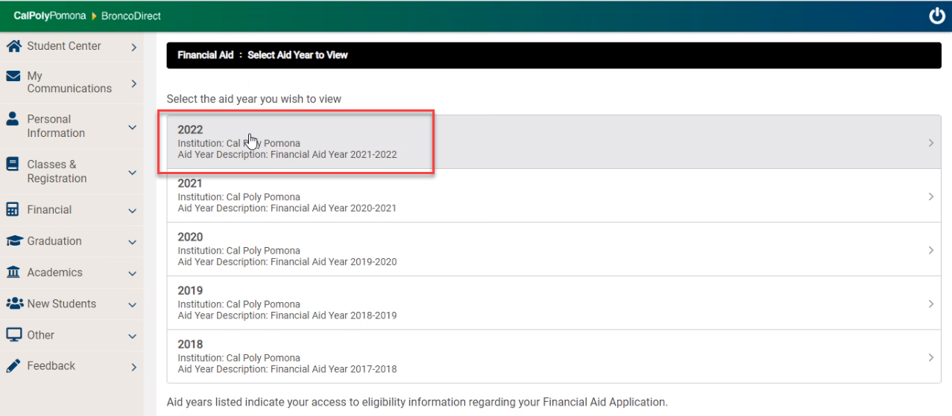
Accessing Your Financial Aid
Select the year you want to review:
This year is 2025

Slide 22
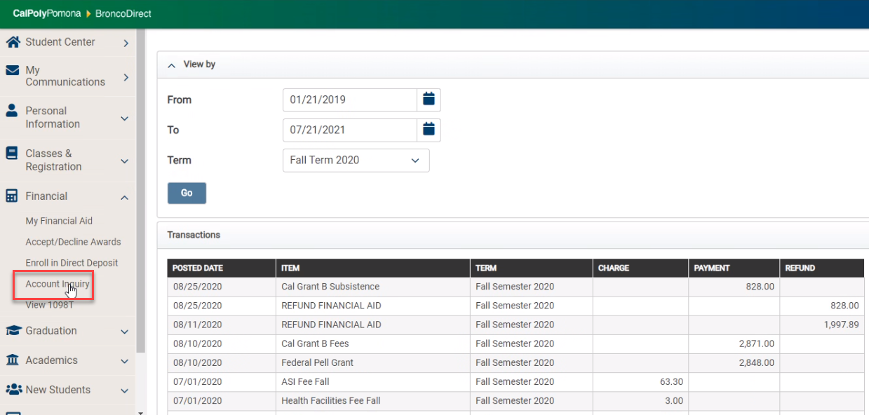
Viewing Your Account (Charges & Aid)

Slide 24
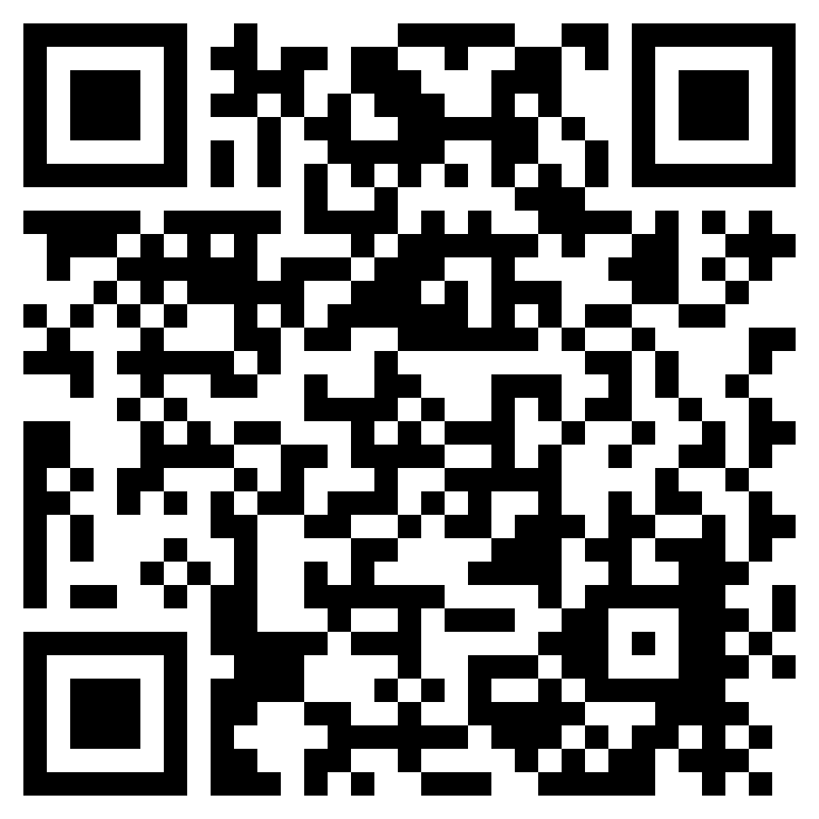
Fee Schedule – CPGE Programs
Tuition charged on a per-unit basis
Most programs are also charged CPP Mandatory Campus Fees (Auxiliary Fees)
CPP Mandatory Campus (Auxiliary) Fees | Amount Per Semester
ASI Fee (Associated Students Incorporated) | $ 63.30
Student Union Fee (ASI Facilities and Operations) | $403.97
Health Facilities Fee (HFF) | $ 3.00
Student Health Center Fee | $134.34
IRA Fee (Instructionally Related Activities) | $ 20.00
Student Success Fee | $223.50
Total | $848.11

Slide 25
Fee Schedule- Fall 2024
Tuition and Fees Schedule
 | 0-6 units | 6.1 units and above
Tuition Fee | $2,208.00 | $3,804.00
Auxiliary Fees ($848.11)
Medical Facility | $3.00 | $3.00
ASI Facilities and Operations Fee | $403.97 | $403.97
ASI Fee | $63.30 | $63.30
IRA Fee | $20.00 | $20.00
Student Health Fee | $134.34 | $134.34
Student Success Fee | $223.50 | $223.50
Total Tuition and Fees | $3,056.11 | $4,652.11
In addition to the Tuition Fees and Mandatory Fees listed above, Non-residents must also pay $420 per unit for out-of-state tuition (No NRT Annual Cap)

Slide 26
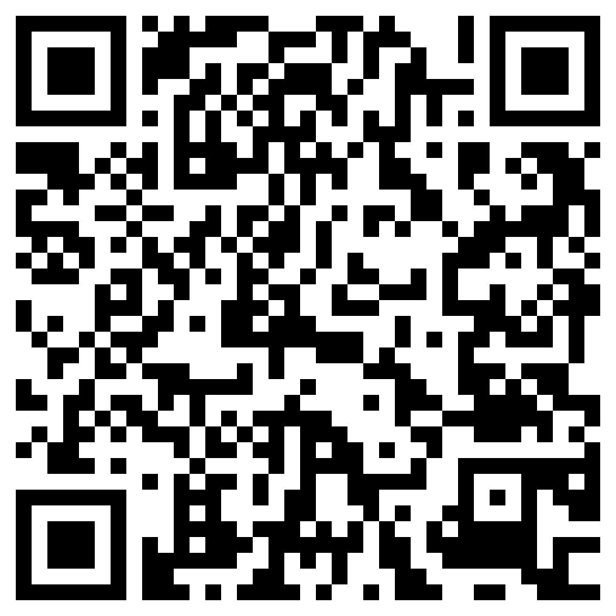
Financial Aid Cost of Attendance
Financial Aid Cost of Attendance Elements
Tuition & Mandatory Fees (based on average for students in program)
Living Expenses (Food and Housing*)
Books Course Materials. Supplies, & Equipment
Transportation
Personal Expenses
Federal Direct Loan Fees
* For informational purposes only: In accordance with California Assembly Bill 990, Cal Poly Pomona provides the typical market cost of a one-bedroom apartment in the Pomona area:
$1,644 per month (per www.apartments.com), as of January 1, 2024.

Slide 27
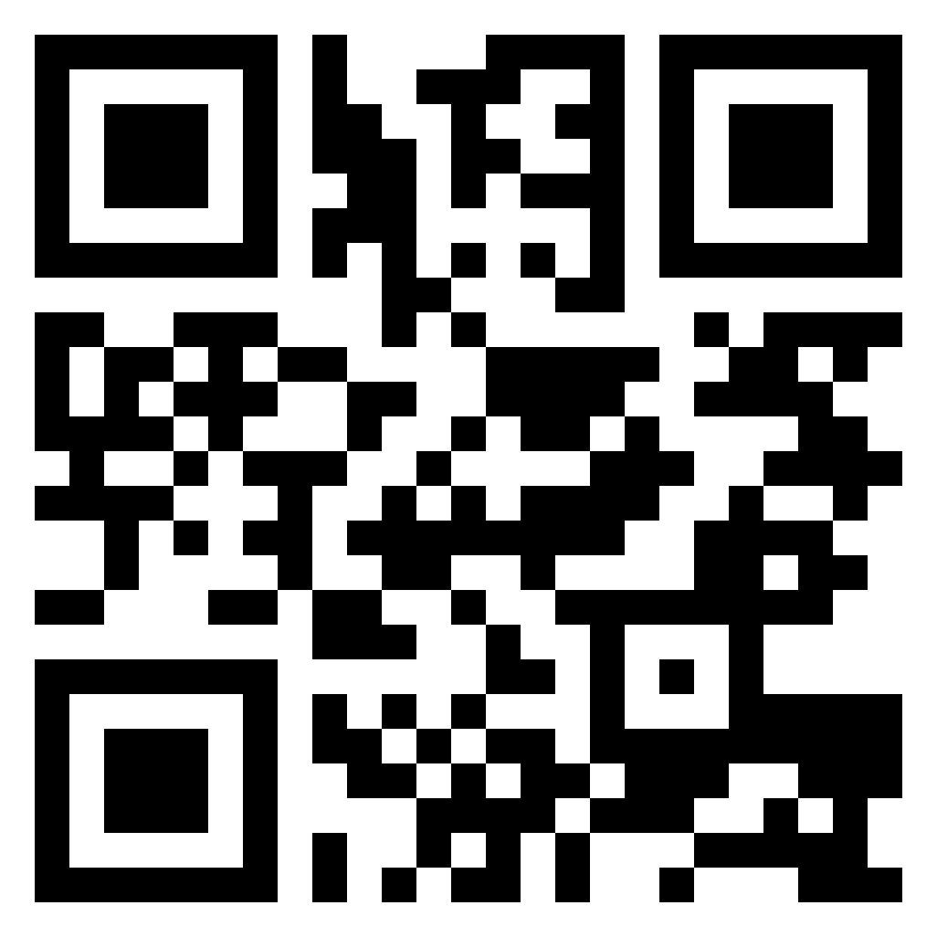
Steps for Receiving Direct Unsubsidized Loan
1) View & Accept loans on Bronco Direct
2) Complete Entrance Counseling
3) Sign Master Promissory Note (MPN)
Steps 2 & 3 completed at: https://studentaid.gov

Slide 28
Satisfactory Academic Progress (SAP)
SAP is evaluated at the end of every semester, once grades have been finalized and posted.
Cumulative evaluation of Academic Performance
Academic Objective (Degree) | Minimum Cumulative GPA | Minimum Cumulative Pace of Progress | Maximum Time Frame of Aid Eligibility
Graduate Degree | 3.0 | 66.67% | 150% of published length of degree – measured in attempted units

Slide 29
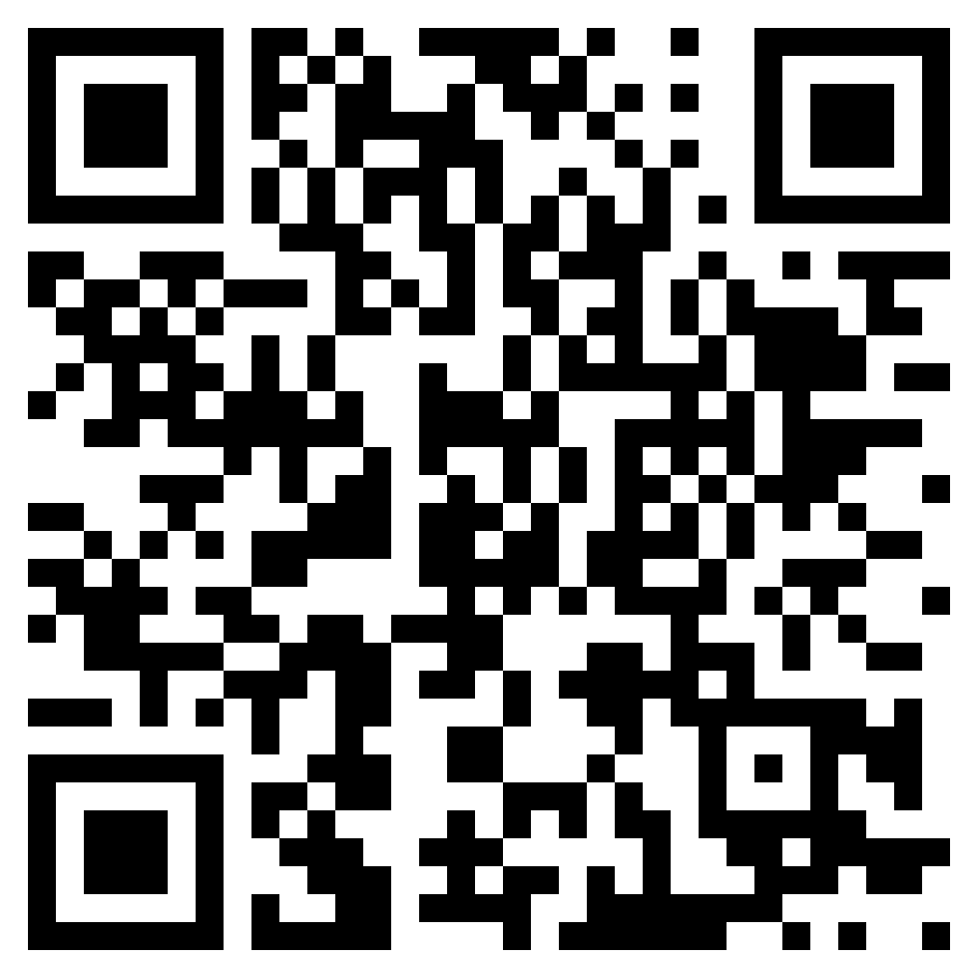
Satisfactory Academic Progress (SAP)
Maximum Time Frame Examples:
Academic Objective (Degree) | Published Length | Maximum Time Frame of Aid Eligibility
Engineering, M.S. Computer Science, M.S. Geology, M.S. Systems Engineering, M.S. | 30 units | 45 units (attempted)
Accountancy, M.S. (Accelerated) | 31 units | 46.50 units (attempted)
Business Analytics, M.S. | 33 units | 49.5 units (attempted)
Hospitality Management, M.S. | 36 units | 45 units (attempted)
Landscape Architecture, M.L.A. (Advanced Standing) | 48 units | 72 units (attempted)

Slide 30
Financial Aid Course Eligibility
Process that reviews enrolled courses for applicability toward degree.
Goal is to ensures students have sufficient financial aid to complete their degree
Monitors enrollment to confirm students are utilizing aid for courses that contribute to the completion of their degree
Alerts student which course(s) fall outside their program requirements.​
Reads the Degree Progress Report to determine whether courses meet the following Financial Aid requirements:
Applicable towards Degree
Within Repeat Limits

Slide 31
When is a course Outside Degree Requirements?
The course eligibility tool uses a student’s Degree Progress Report to confirm a course is required for their program of study
To account for electives, we allow grad students up to 15 units of electives to be considered financial aid eligible.
1000/2000 level courses for grad students will always be ineligible
Any grad student enrolled in a 1000/2000 level course OR that has exceeded their elective allotment will receive an ineligible status for that course

Slide 32
When is a course an Ineligible Repeat?
Financial aid may only be awarded once for a previously passed course (i.e., one repetition per class).
Exception: Courses that are repeatable for credit will continue to be financial aid eligible.
Until the student has passed the course, there is no limit on the number of attempts allowed.

Slide 33
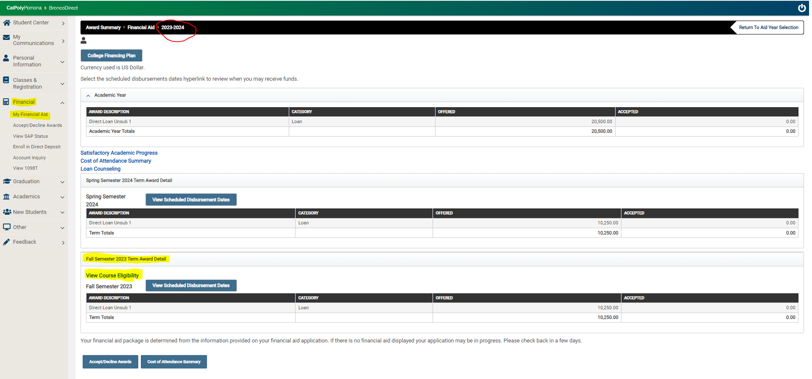
What information will Students see?

Slide 34
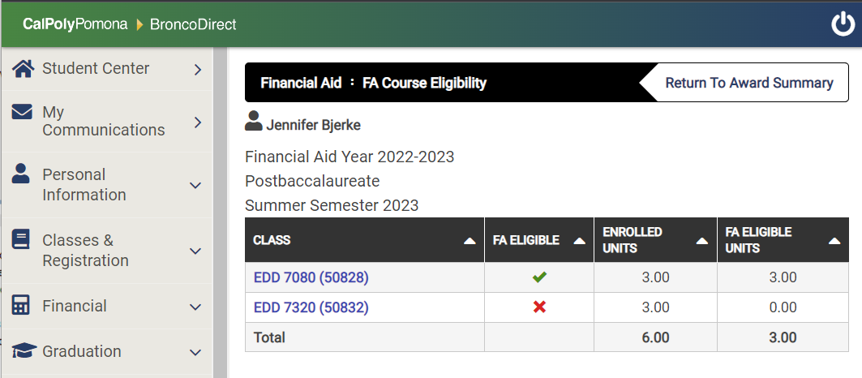
What information will Students see?
Billy Bronco

Slide 35
What information will Students see?
Billy Bronco

Slide 36
Important Rules of Financial Aid
PAY ATTENTION to deadlines
Must Apply EVERY Year
FAFSA & DREAM Application available every October 1
2025-2026 = “By beginning” of December
Cal Poly Pomona priority deadline = March 2nd
Include Cal Poly POMONA on list of schools
Cal Poly Pomona School Code = 001144
Pay attention to document deadlines
Deadlines refer to being considered an “Aid Applicant”
Deadlines DO NOT guarantee receiving specific funds
WAITING UNTIL THE LAST MINUTE COULD COST YOU MONEY!!

Slide 37
Financial Aid Account Resources
Explanation of Auxiliary Fees https://www.cpp.edu/student-accounting/mandatory-auxil-fees.shtml Details on CPGE Tuition https://www.cpp.edu/cpge/degree-programs/index.shtml
Fee Schedule https://www.cpp.edu/student-accounting/tuition-fees/graduate.shtml
Graduate Costs
https://www.cpp.edu/financial-aid/graduate/newly-admitted-and-current1/costs.shtml
Understanding SAP
https://www.cpp.edu/financial-aid/resources/understanding-sap.shtml

Slide 39
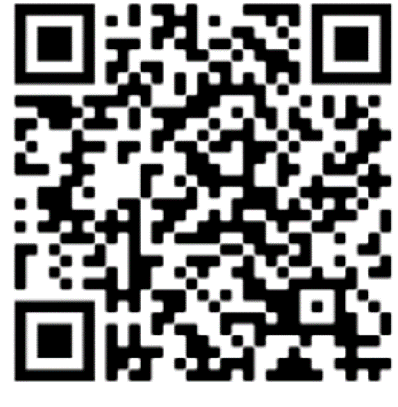
Connect with us
Located in Bldg. 121-1st Floor, Blue Counter
Monday - Friday 9:30 am-4:30 pm
Billy Chatbot – Visit www.cpp.edu/financial-aid
Setting up a 1-1 appointment with a Financial Aid Counselor through CPP Connect
*Access to CPP Connect is available after you attend Orientation
Joining a virtual queue for in-person or zoom meeting https://www.cpp.edu/studentsuccess/bronco-advising-center/ssb-queue.shtml
Email: finaid@cpp.edu
* Always include the student’s full name AND Cal Poly Pomona Bronco ID Number

Slide 40
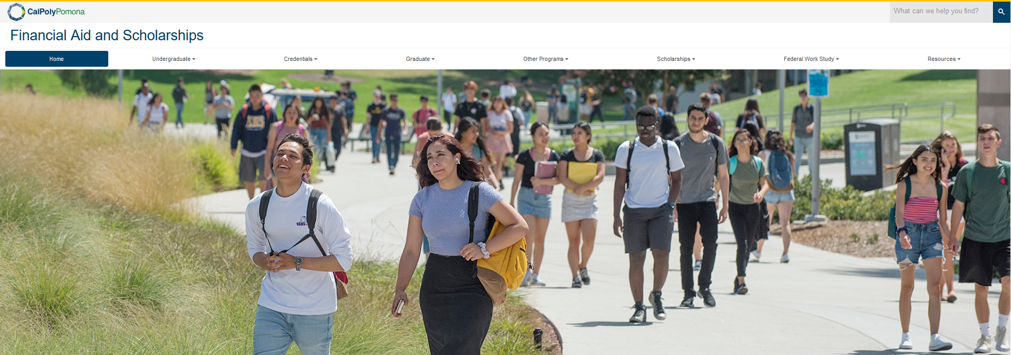
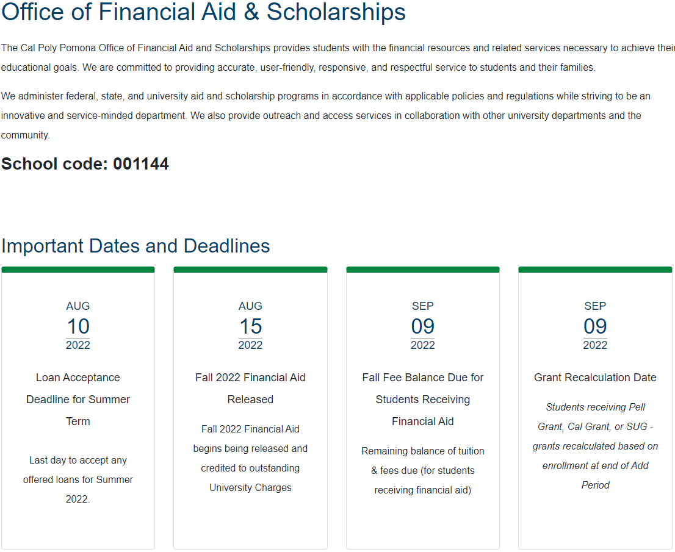
Financial Aid: Trusted Sources
Cal Poly Pomona Office of Financial Aid & Scholarships cpp.edu/financial-aid

Slide 41
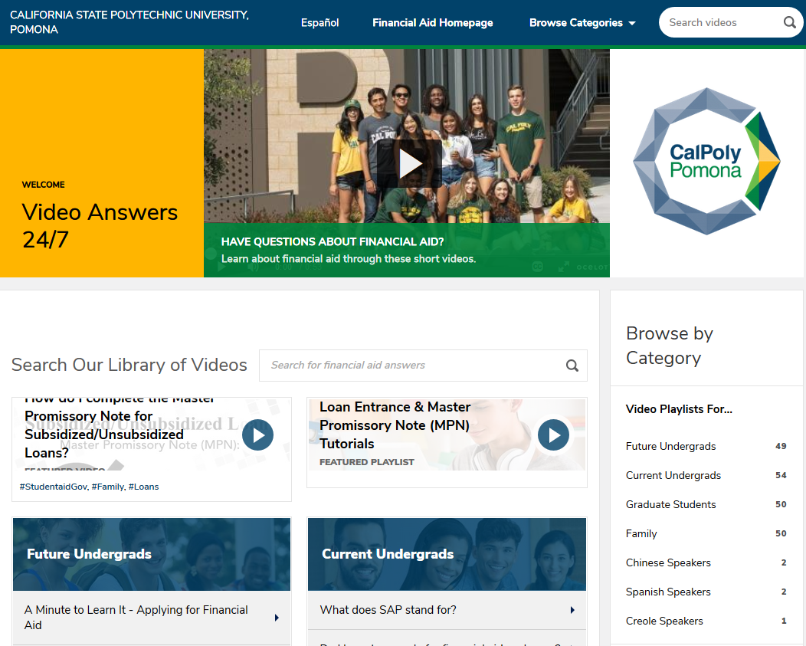
CPP GetAnswers Video Service
cpp.financialaidtv.com

Slide 42
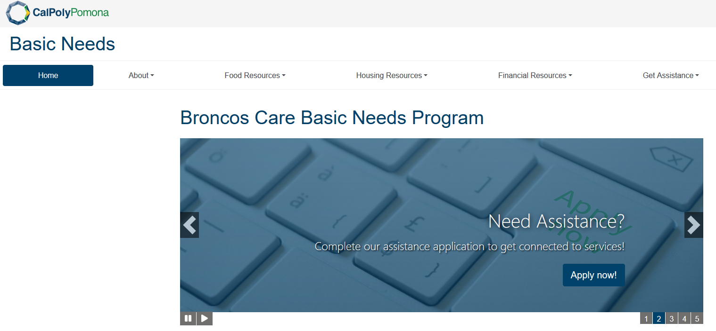
Broncos Care Basic Needs Program
Food Resources
Food Pantry, Cal Fresh
Meal Assistance
Housing Resources
Emergency Housing
Emergency Grant
Community Resources/Referrals
https://www.cpp.edu/basicneeds/index.shtml

