Slide 1
Navigating
Library Resources
2025 Graduate Student Orientation
Sally Najera Romero, Ed.D.,
Education Librarian
August 16, 2025

Slide 2
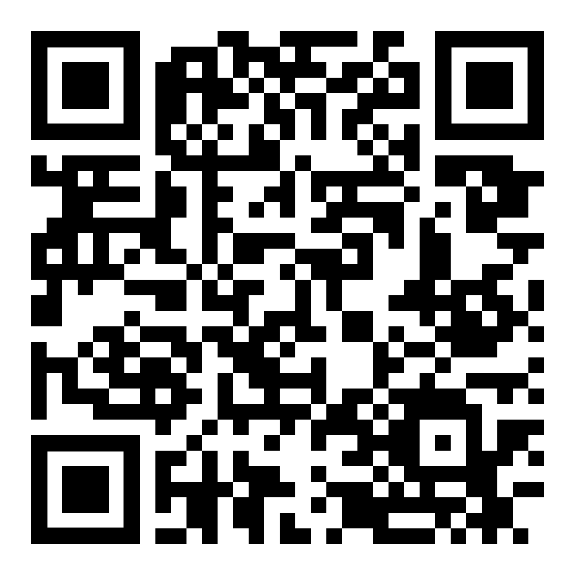
Services
My Library Account
Borrow, Renew
Interlibrary Loan
Course Reserves
Recommend a Purchase
Tech Lending

Slide 3
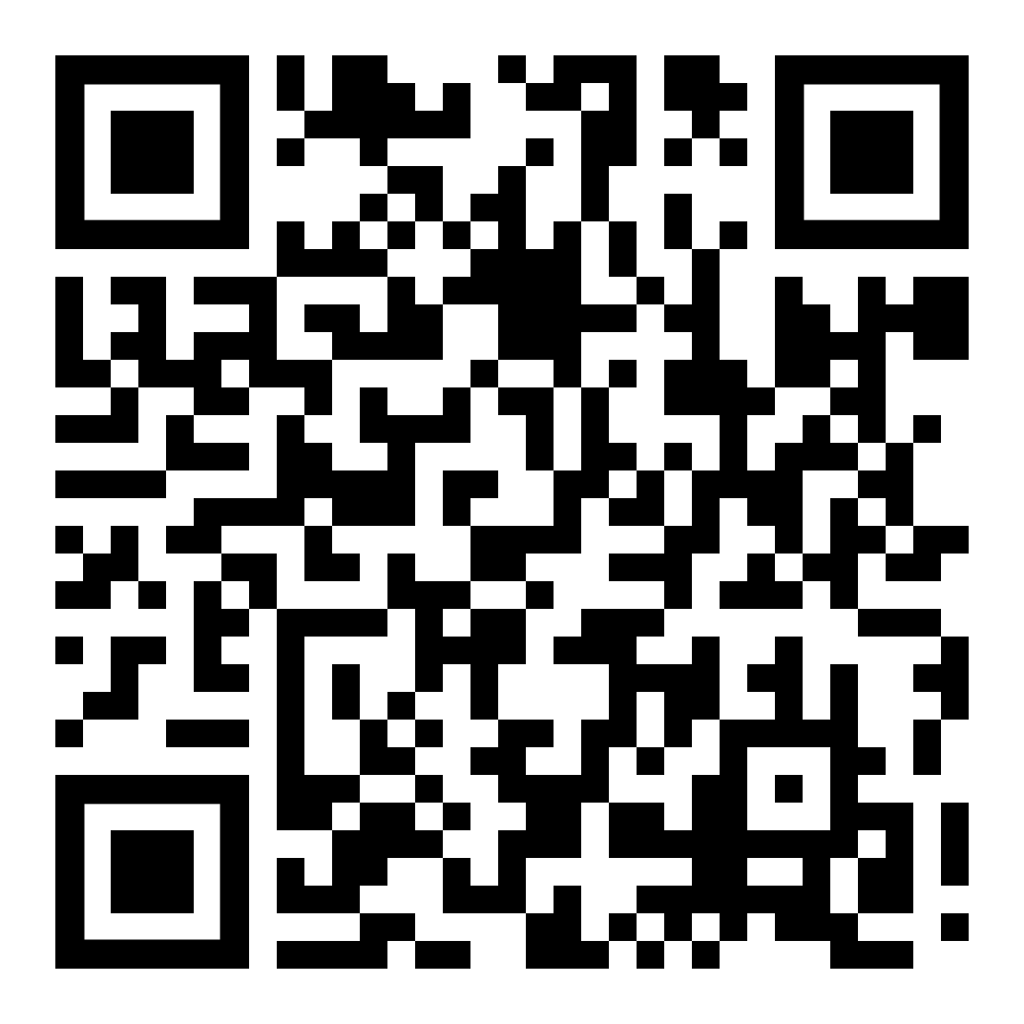
Research
Help
In-Person Help
Subject Librarians
Research Guides
Research Tutorials
Databases
FAQ

Slide 4
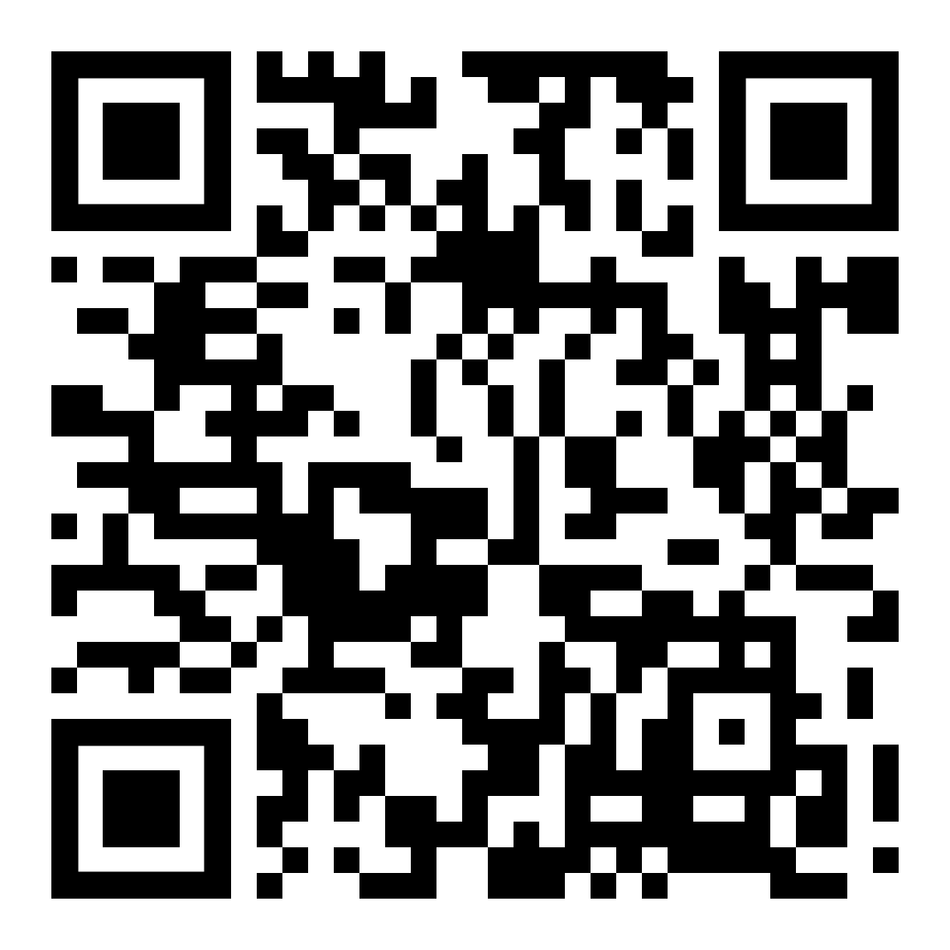
Spaces & Tech
Quiet Floors 1,5,6
Study Rooms
Graduate Resource Center
Learning Resource Center
Bronco Family Space
Reflection Room
24/7 Bronco Computer Lab
Media Studio
Maker Studio

Slide 5
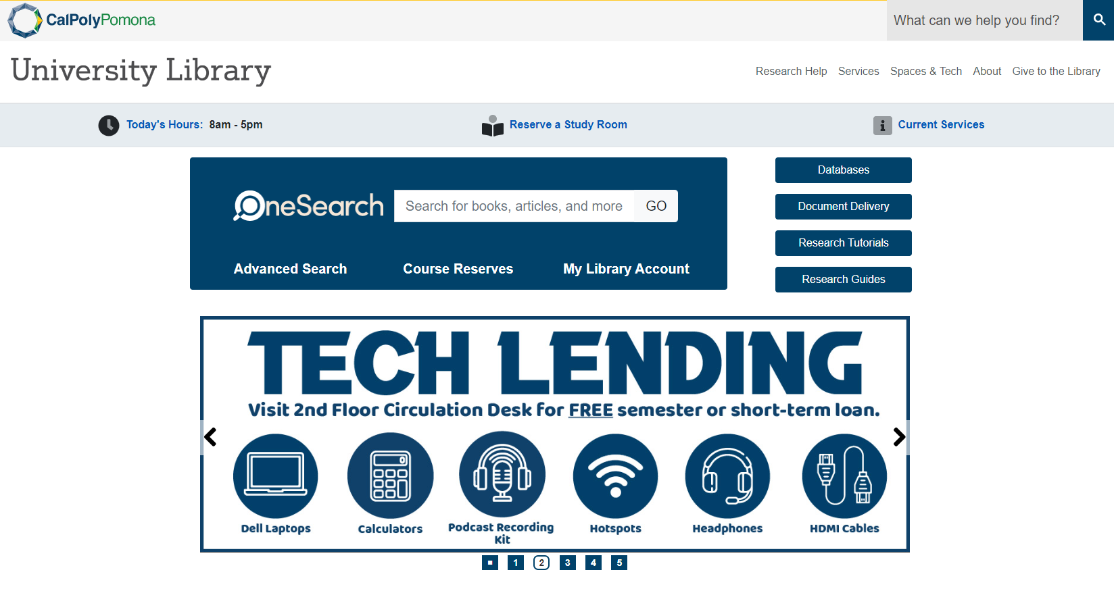
Starting Your Research

Slide 6
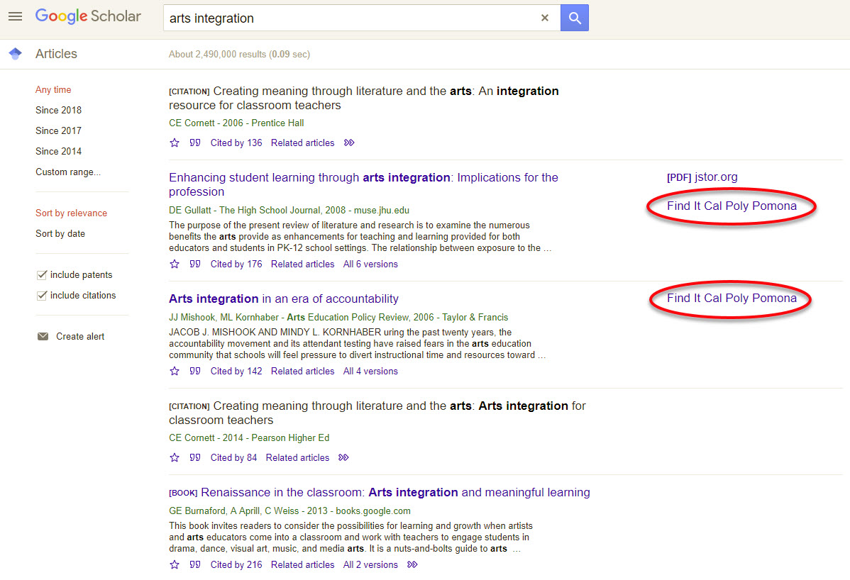
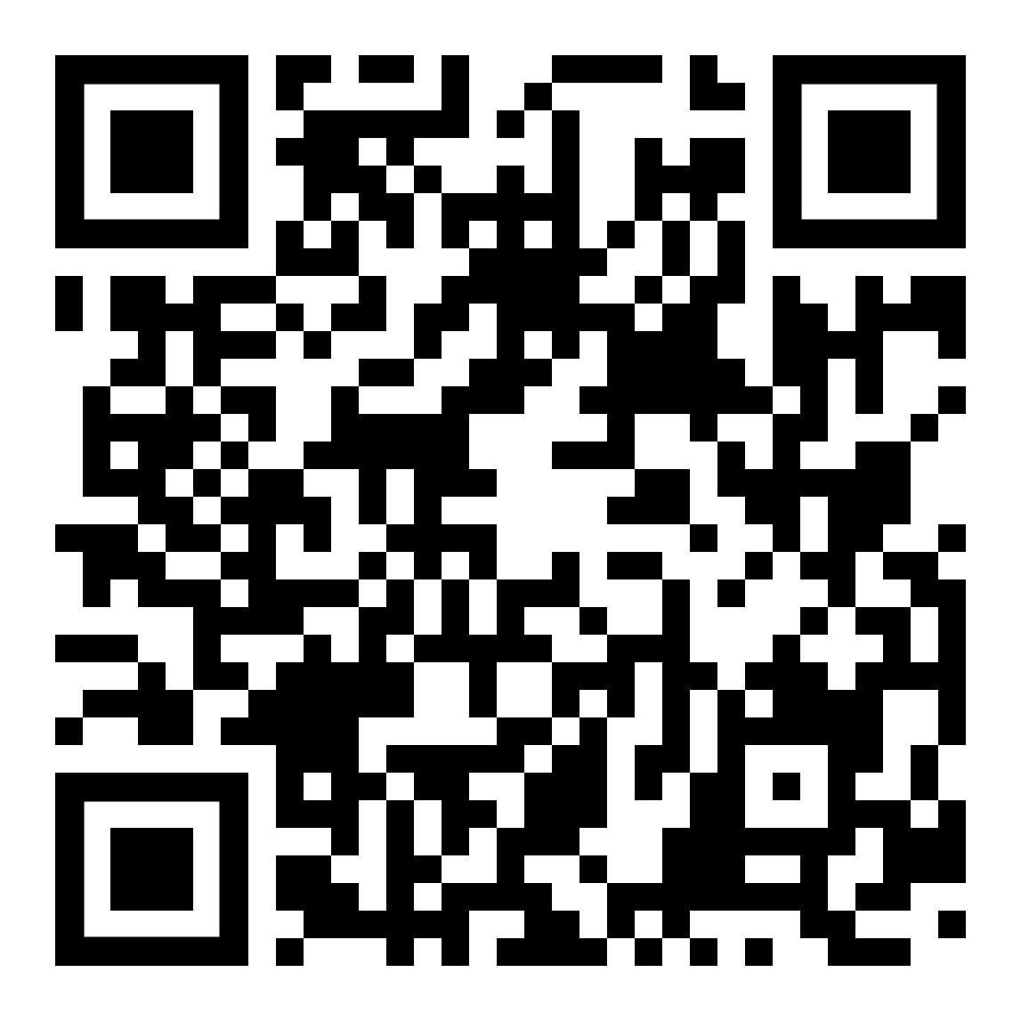
Connect to Google Scholar

Slide 7
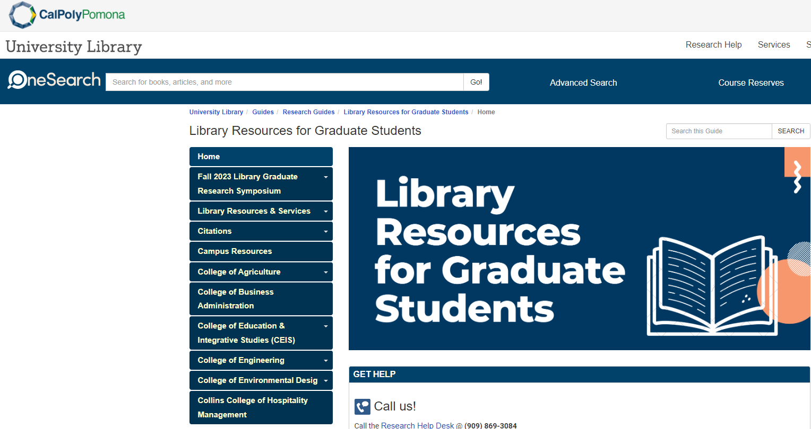
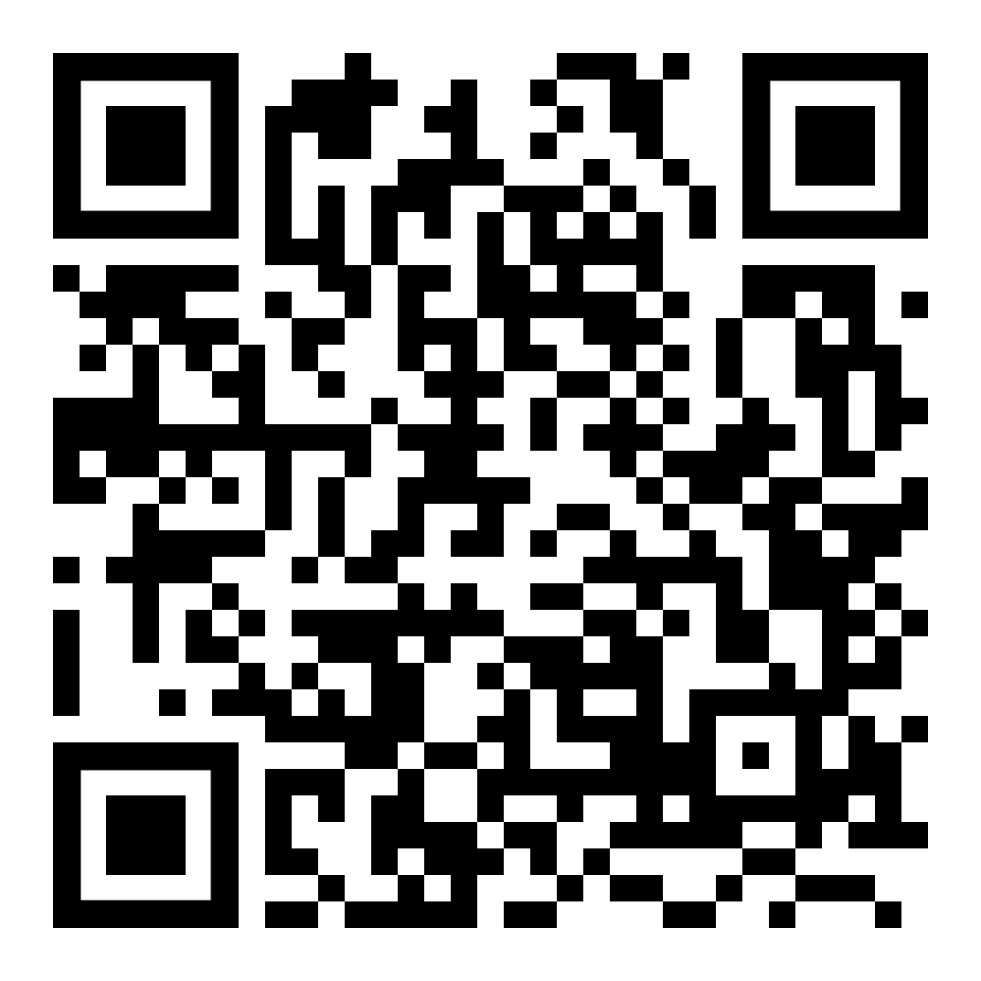
Library Resources for Graduate Students

Slide 8

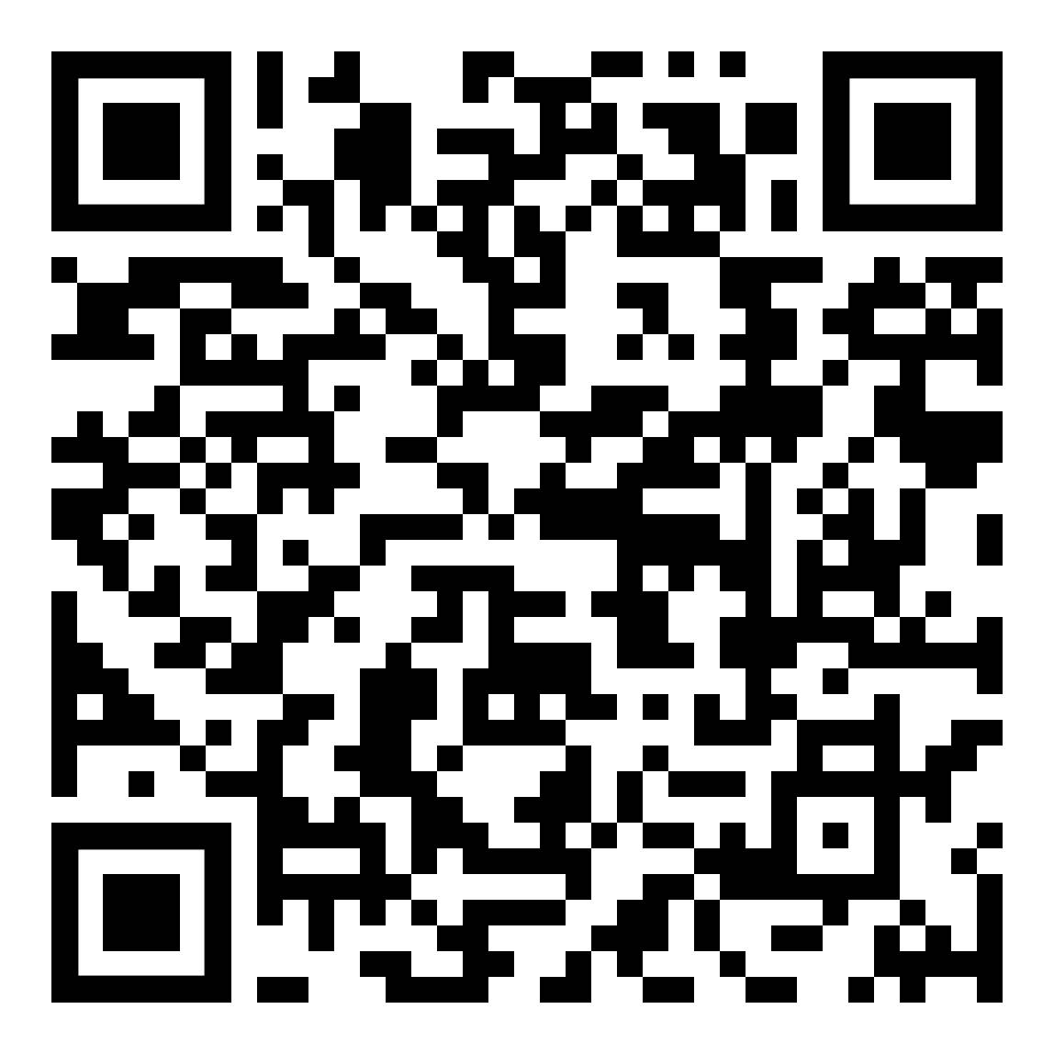
CPP Theses, Projects,
& Dissertations

Slide 9
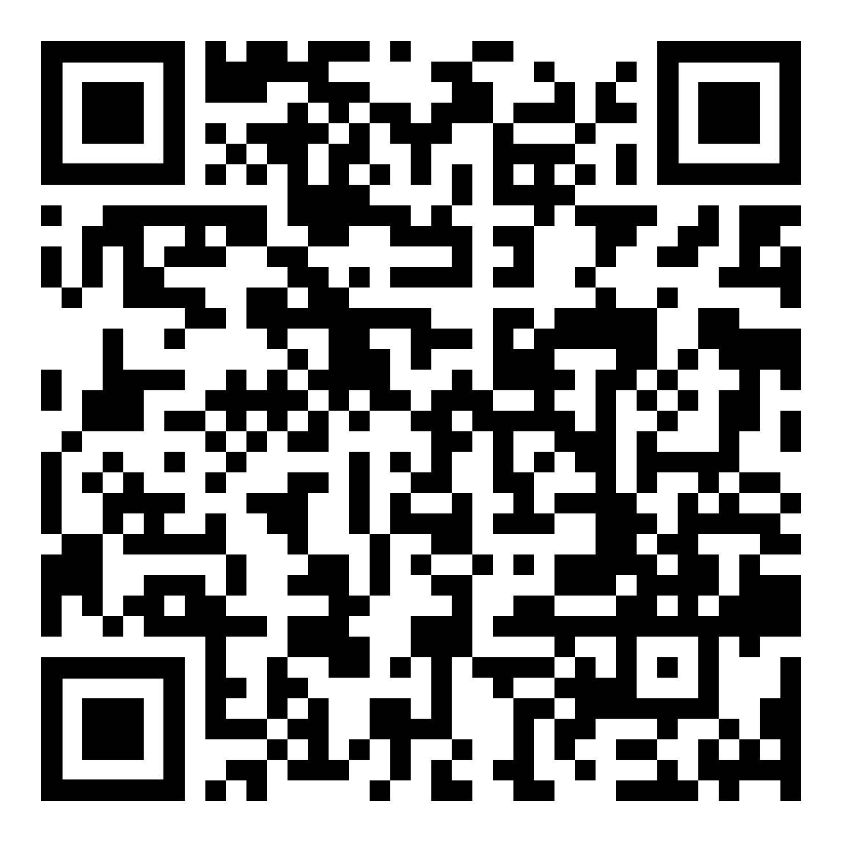
Contact Us
Huntley College of Agriculture Vacant
College of Business Administration Julie Shen, jshen@cpp.edu
College of Education & Integrative Studies Sally Romero, sallyromero@cpp.edu
College of Engineering Paul Hottinger, prhottinger@cpp.edu
College of Environmental Design Vacant
Collins College of Hospitality Management Julie Shen, jshen@cpp.edu
College of Letters, Arts, and Social Sciences Shonn Haren, smharen@cpp.edu
Erik Valenzuela, erikv1@cpp.edu
College of Science
Sydney Burke, sburke@cpp.edu
Libraryhelp@cpp.edu
909-869-3074

