Slide 1
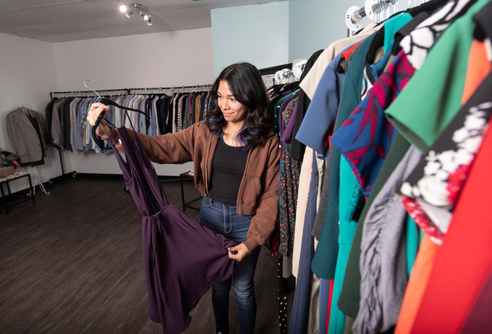

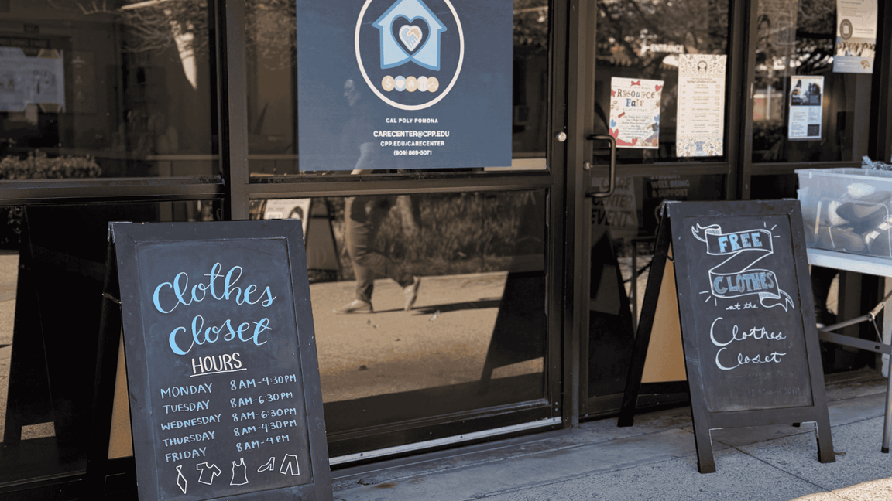



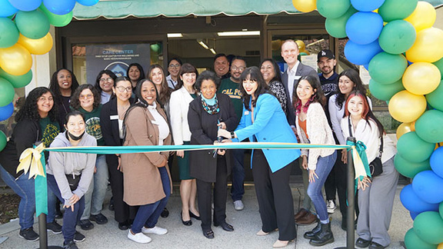

Culture of Care
Care Center

Slide 2

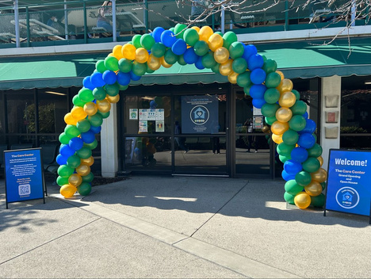





AGENDA
Bronco
Wellness
Case
Management
Basic Needs
Resources
Location
How to
Access
Emergencies
Events
Questions

Slide 3
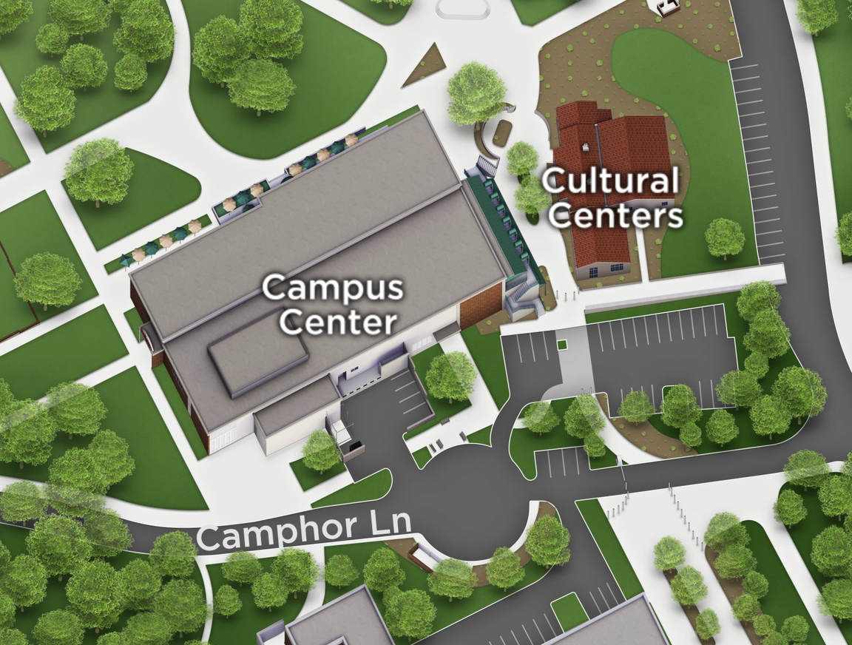

LOCATION
Located in Building 97 (directly in front of the Cultural Centers) and under the Marketplace​

Slide 4

BRONCO WELLNESS
HEALTH & WELLNESS RESOURCES
ALCOHOL, TOBACCO, & OTHER DRUGS
SEXUAL & REPRODUCTIVE HEALTH
WELLBEING
COACHING
  Hygiene Products
    Hand Sanitizer
    Sunscreen
    Lip Balm
  Dental, cold, sleep kits
  Scantrons and Bluebooks
  Wellness Card
  Nicotine Gum, Patches, Lozenges
  Narcan and Fentanyl Testing Strips
  Smart Recovery
  Internal & External Latex Barriers
  Dental Dams
  Lubrication
  Birth Control Options Counseling
  Menstrual Products
  Pregnancy Options Counseling
  Free & Confidential HIV Testing
  Physical Activity
  Nutrition
  Smoking, Vaping, Cannabis Use
  Alcohol, Other Drugs
  Sexual & Reproductive Health
  Stress/Time Management

Slide 5
CASE MANAGEMENT
MENTAL HEALTH SUPPORT COORDINATION
ABSENCE & WITHDRAWAL SUPPORT
UNIVERSITY NAVIGATION
  Support students who require non-clinical interventions (i.e. anxiety, neurodivergent)
  Connect students to CAPS or off-campus providers as needed
  Campus reintegration support for post-hospitalization
  Insurance Support
  Assist students who miss class due to serious & compelling reasons
  Provide letters of support for students going through the withdrawal process
  Refer to a Bronco Advising Center (BAC) as needed
  Assist students in navigating university processes (i.e. withdrawals, fees, tuition, COVID)
  Provide warm handoff to variety of university partners

Slide 6
BASIC NEEDS RESOURCES
HOUSING
FINANCIAL
FOOD
CLOTHING
  Short-term emergency housing
  Referral to rapid rehousing partner & community-based organizations
  Project Mailbox
  One-time grant, up to $500
  Partnerships w/ VRC, Project Rebound & College of ENV
  CALWORKS Benefits
  Tech Support
  CalFresh Support
  Meal Assistance
  Poly Pantry (ASI) Partnership
  Food Tastings/Demos
  Clothes Closet
  Mobile Clothes Closet
  Chest Binder Program
  Personal Shopping Experience
  Care Packages

Slide 7


HOW TO ACCESS
REFERRAL
WALK-INS
CONSULTATIONS
  The Care Center recieves referrals through the Student of Concern Form on our website https://www.cpp.edu/broncoscarecenter/
  Students can be seen during walk-in hours; Monday-Friday, 9:00 AM - 4:00 PM
  After Hours Wednesdays from 5:00 PM - 7:00 PM
  Call (909) 869-5071 or email carecenter@cpp.edu

Slide 8

EMERGENCIES
  The Care Center is NOT for emergencies
  If there is an immediate threat to a student (either through self-harm or interpersonal violence), call (909) 869-3070 or 9-1-1 and follow your housing protocols
  The Care Center coordinates student care after an emergency

Slide 9



QUESTIONS
Thoughts or areas you would like to further discuss?
EMAIL
WEBSITE
VISIT US
Building 97
(Marketplace),
1st Floor
Monday-Friday
8:00 a.m. - 5:00 p.m.
carecenter@cpp.edu
cpp.edu/carecenter

