Slide 1
Paying for College –Financial Aid as a Graduate Student
Financial Aid & Scholarships
August 16, 2025

Slide 2
Financial Aid:
Who Are We

Slide 3
Financial Aid: Who We Are
Students have primary responsibility to pay for postsecondary, graduate-level education expenses
Financial Aid helps bridge the funding gap as partners in the process
Eligibility for aid is based on individual circumstances / resources.
Most financial aid for Graduate students is in the form of federal loans.
Financial Aid & Scholarships
The Student
Student Accounting & Cashiering Services

Slide 4
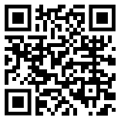
Financial Aid
& Scholarships
Determine student aid eligibility
Package financial aid funds
Coordination of different aid sources
  Federal, State, & Institutional
Professional Judgement/Appeals
Release of financial aid funds to Student Accounting & Cashiering Services

Slide 5
Student Accounting & Cashiering Services (SACS)
Posting of University Charges
  Tuition & Fees
  Housing
  Bookstore
  Etc.
Receive and Apply Payments
  Individual payments (cash, check, etc.)
  Payment Plans
  Third-Party Organizations
  Tuition/Fee Waivers
  Financial Aid & Scholarships
Process Refunds
Place and release Financial Holds
Annual IRS 1098-T Reporting
Collections (non-payment)

Slide 6
What Is
Financial Aid?

Slide 7
What is
Financial Aid?
Financial Aid helps cover education expenses:
  Tuition & Fees
  Food & Housing (Living Expenses)
  Books, Supplies, Equipment
  Transportation
  Personal Expenses

Slide 8
Tuition & Fees (2025-26)
Expenses | 0 – 6 units | 6.1 + Units
Systemwide Tuition Fee | $4,680 ($2,340 / semester) | $8,064 ($4,032 / semester)
Mandatory Campus Fees | $1,698 ($848.11 / semester) | $1,698 ($848.11 / semester)
Total Tuition & Fees | $6,380 ($3,190 / semester) | $9,764 ($4,882 / semester)
Tuition Fee at CSU
  Systemwide tuition fee is not charged ‘per unit’ (other than CPGE programs)
  Whether in 7 units or 15 units – the Tuition fee is the same
*Non-resident tuition is in addition to the Systemwide tuition fee and is charged on a per-unit basis $444 per unit for 2025-26

Slide 9
Mandatory Fees
CPP Mandatory Campus (Auxiliary) Fees | Amount Per Semester
ASI Fee (Associated Students Incorporated) | $ 63.30
Student Union Fee (ASI Facilities and Operations) | $403.97
Health Facilities Fee (HFF) | $ 3.00
Student Health Center Fee | $134.34
IRA Fee (Instructionally Related Activities) | $ 20.00
Student Success Fee | $223.50
Total | $848.11
Explanation of Auxiliary Fees: https://www.cpp.edu/student-accounting/mandatory-auxil-fees.shtml

Slide 10
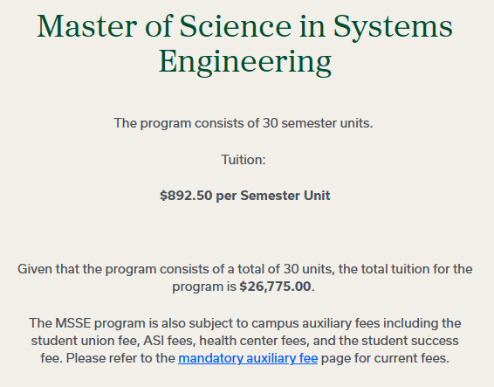
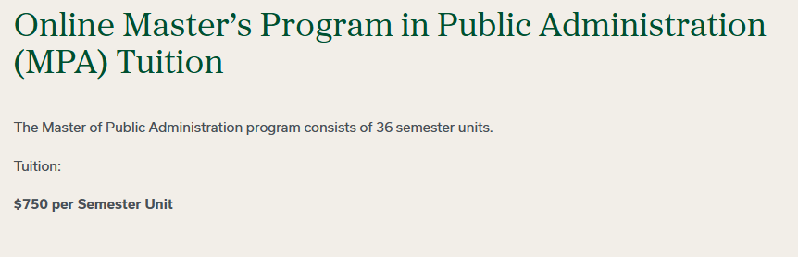
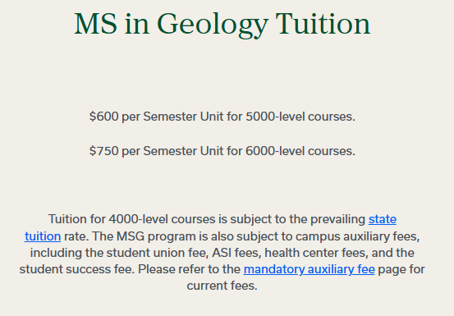
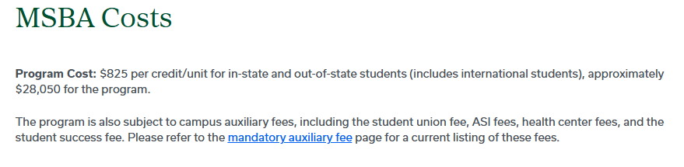
Fee Schedule – CPGE Programs
Tuition charged per unit - Many programs are charged CPP Mandatory Campus (Auxiliary) Fees
Details on Per Unit Tuition: https://www.cpp.edu/cpge/degree-programs/index.shtml

Slide 11
Financial Aid Applications
FAFSA – Free Application for Federal Student Aid
  US Citizen or eligible non-citizen
  Social Security Number
  Application for federal grants, federal loans, state grants, CSU grants
CADAA - CA Dream Act Application – priority filing deadline, March 2
  AB540 eligibility
  Application for state aid and CSU grants
University Scholarship Application – application period Oct 1 – March 2

Slide 12
Types of Financial Aid
Grants
Scholarships
Loans
Work Study
Free Money
  No Grants Available for CPGE
  State University Grant
  Graduate Business Grant
More Free Money
  Merit
  Need-based
  Interest-based
Sources include:
  Cal Poly Pomona
  CSU
  Outside Organizations
Money you repay
Federal or Private Options
  Unsubsidized
  Grad PLUS
Can help cover expenses
Borrow smart!
Money you earn
Positions on-campus or off-campus
At least minimum wage
Typically 10-15 hours per week

Slide 13
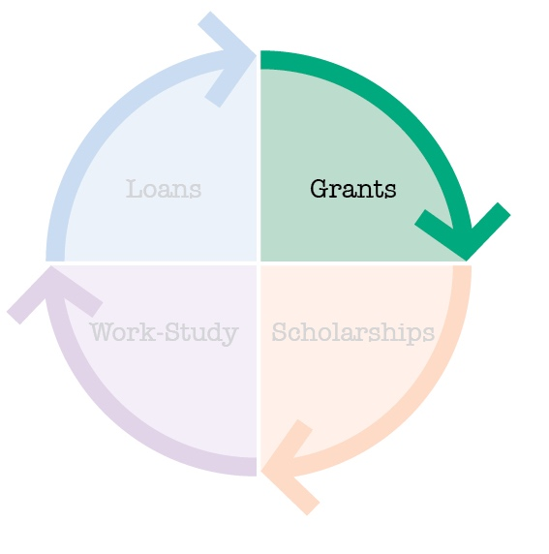
Grants (Free Money)
No Grants Available for CPGE
  These programs are considered self-supporting programs, meaning the programs operate entirely on student fees.
State University Grant
    Must be enrolled at least ½ time (3 units)
    Must meet eligibility criteria
  Graduate Business Grant
  Students in programs charged per-unit Professional Program Fee
    MBA, MS Accountancy (non-accelerated), MS Information Security
  Must meet eligibility criteria
  Added to Aid Package retroactively (after Spring Census)

Slide 14
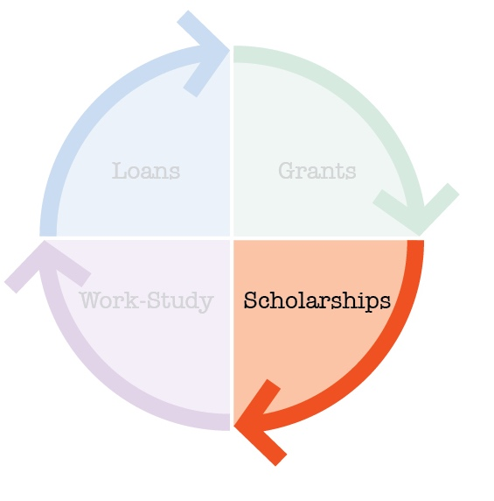
Scholarships (More Free Money)
Athletic, Academic, Leadership, Theatre, Music
Usually Competitive
Institutional
National
State, Local, or Civic

Slide 15


Scholarships
Applications for 2026 – 2027 Academic Year will open on Oct. 1st! Check the website for deadlines and non-CPP opportunities

Slide 16
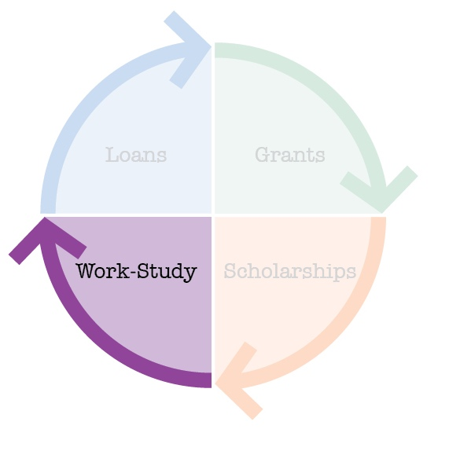
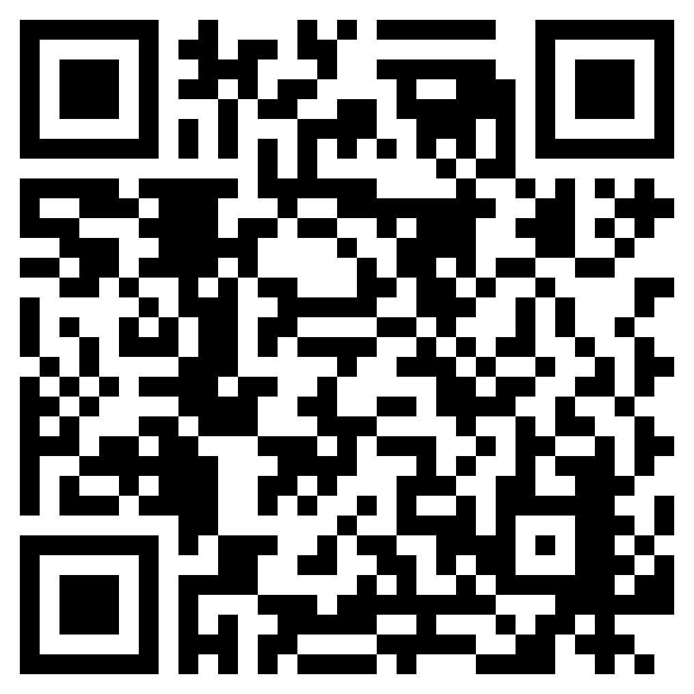
Federal Work Study (Money You Earn)
Based on demonstrated need
Student must find a Work-Study job (many on-campus offerings)
10 – 15 hours per week and
paid directly to student
At least the minimum wage, never below
Visit the Career Center Website: Jobs & Internships
https://www.cpp.edu/career/students/jobs_and_internships.shtml

Slide 17
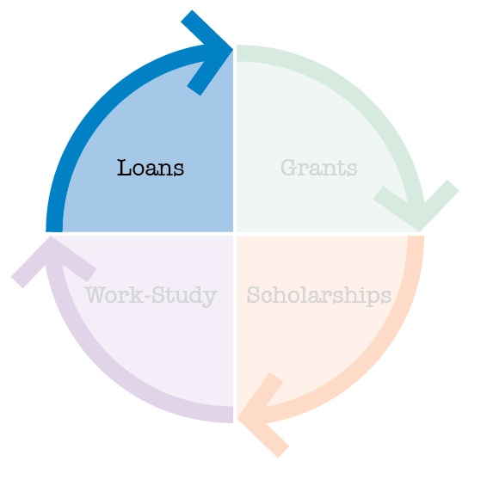
Loans (Money You Pay Back)
Direct Unsubsidized Loan
  Interest once money is released toward student account
    Interest rate for loans borrowed in 25-26: 7.94%
Direct Graduate PLUS
  Also, an unsubsidized loan, builds interest once released
    Interest rate for loans borrowed in 25-26: 8.94%
CA Dream Loan
  Dream Students only
Private Loans

Slide 18
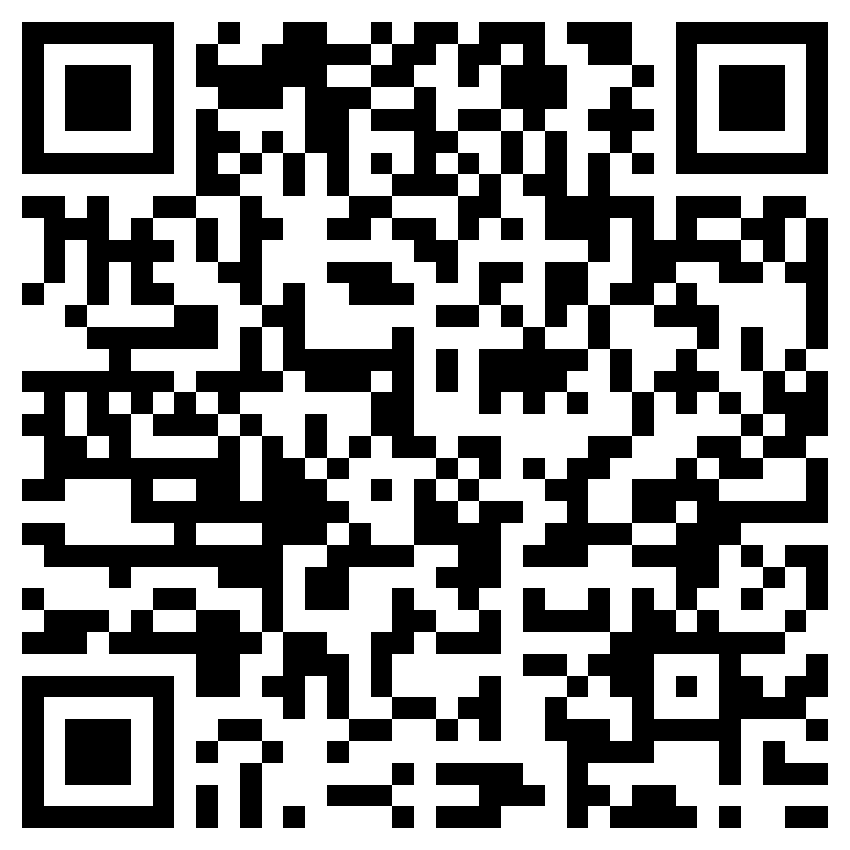
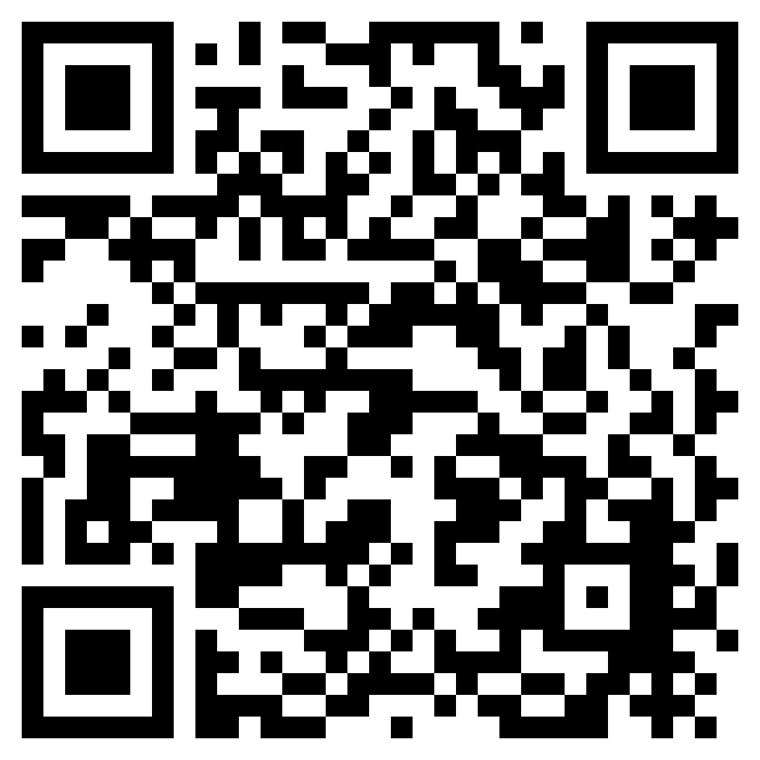
International Students – Limited Free Resources are Available
On-campus employment:
It is your responsibility to research and understand your on-campus work eligibility. Eligibility, definitions, etc. are found on this website.
Work with your international student advisor if you have concerns or questions.
https://www.cpp.edu/international/students/u-s-employment/on-campus-employment.shtml
Scholarships:
Year round non-CPP: check professional organization resources
Outside Scholarships
CPP ScholarshipFest: October 1 – March 2
  very few for graduates in general
  even fewer for International students
https://www.cpp.edu/financial-aid/scholarships/outside-scholarships.shtml
Notes:
Charles –
DREAM Students eligible for State & Dream Loan only

Slide 19
Accessing Your Account

Slide 20
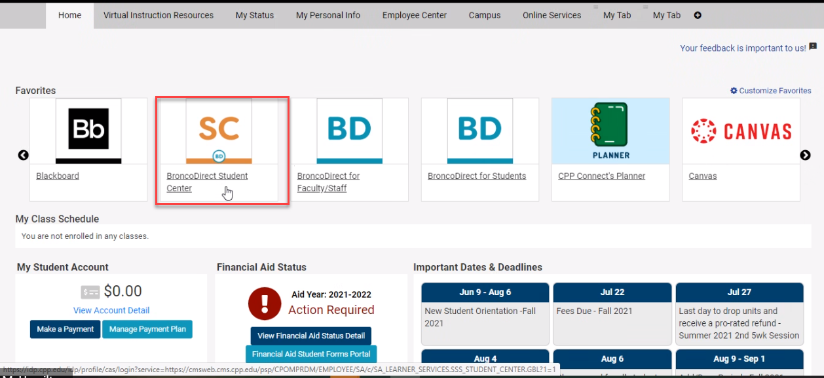
Accessing Your Information
https://my.cpp.edu
Access Your Bronco Email
BroncoDirect Student Center – To Do List
Financial – My Financial Aid
  Accept/Decline Awards
  Account Inquiry
  Enroll in Direct Deposit
Communication emails

Slide 21
Accessing Your Financial Aid
https://my.cpp.edu

Slide 22
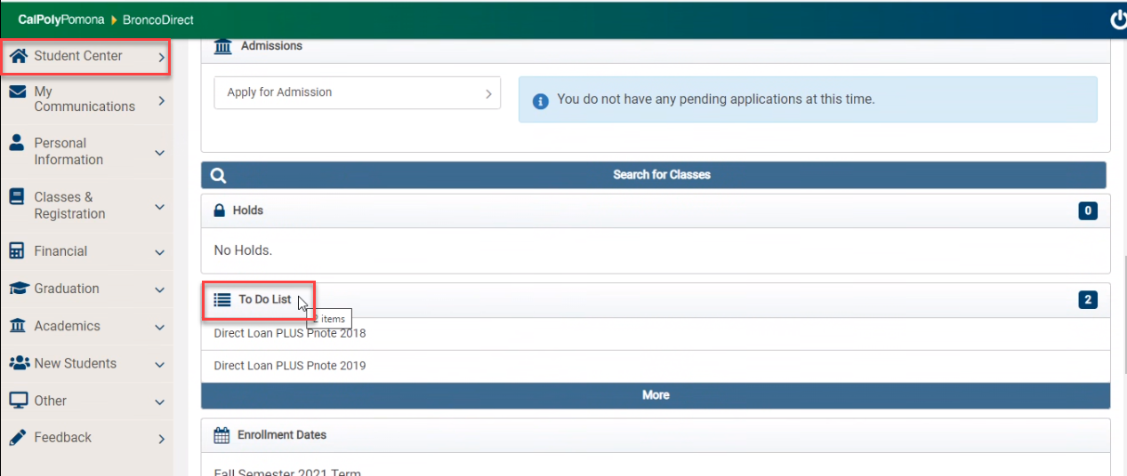
Accessing Your Financial Aid
https://my.cpp.edu

Slide 23
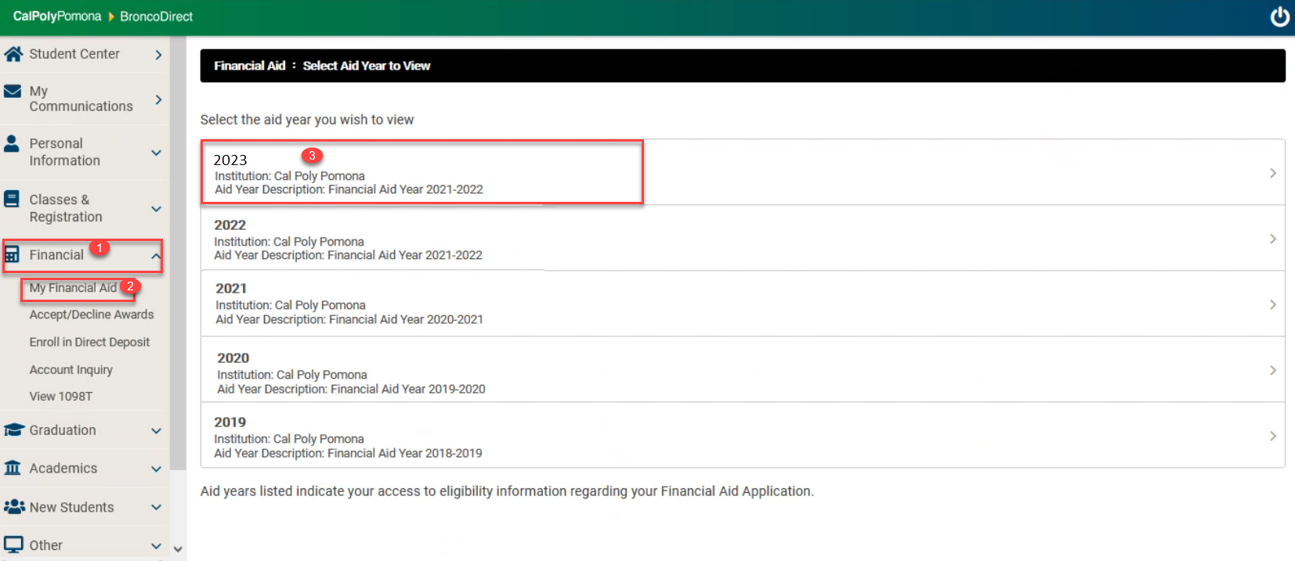
Accessing Your Financial Aid
https://my.cpp.edu

Slide 24
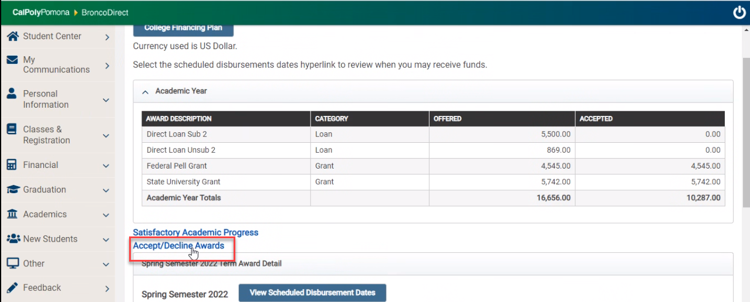
Accessing Your Financial Aid
https://my.cpp.edu

Slide 25
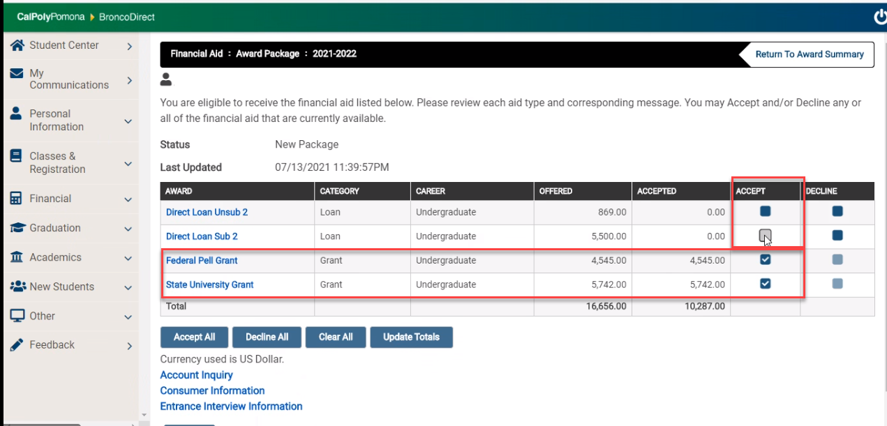
Accessing Your Financial Aid
https://my.cpp.edu

Slide 26
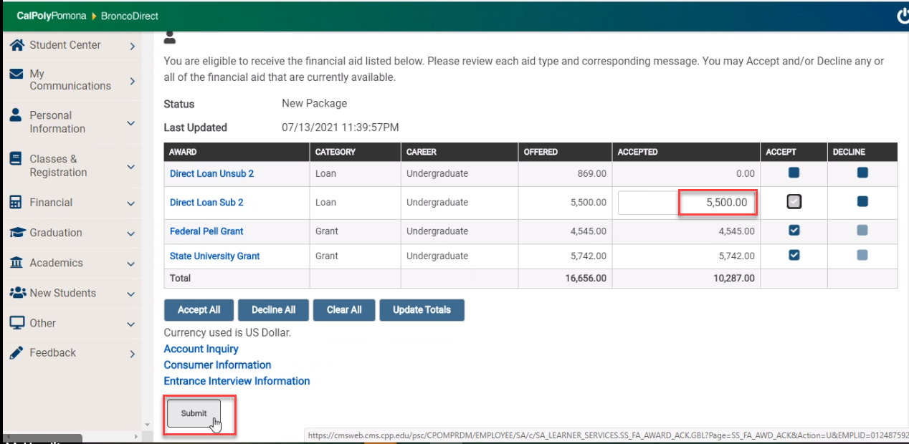
Accessing Your Financial Aid

Slide 27

Receiving the Unsubsidized Loan – First Time Borrowers
  1) View & Accept loans on Bronco Direct
  2) Complete Entrance Counseling
  3) Sign Master Promissory Note (eMPN)
  Both steps 2 & 3 completed at
  https://studentaid.gov

Slide 28
Things To Know

Slide 29
Things to Know
Enrollment Impacts on Financial Aid
Special Circumstance Appeals
Satisfactory Academic Progress
Reminders

Slide 30
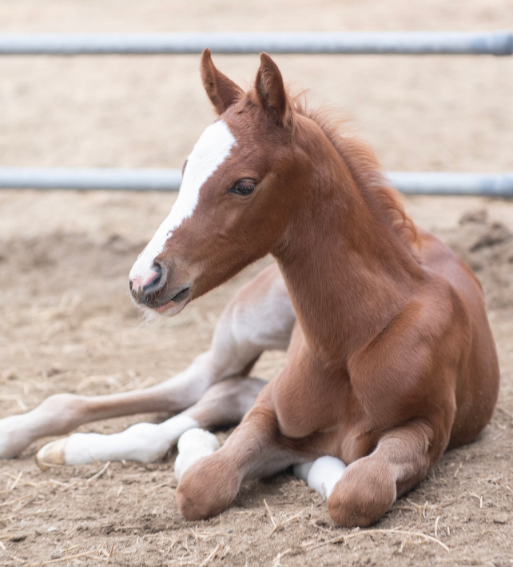
Enrollment choices impact your aid eligibility
To receive loans, you must be enrolled in at least 3 units (1/2 time)
State University Grant (SUG) Covers State Assessed Tuition Fee Only
      3 - 6 Units = $2,340
      7 or more Units = $4,032
Less than 3 units, your SUG will be cancelled for the semester.
To receive the Graduate Business Grant, if eligible, you must be in at least 6 units of courses charged Professional Program Fee

Slide 31
Financial Aid Course Eligibility
  Process that reviews enrolled courses for applicability toward degree.
  Intended to ensures students have sufficient financial aid to complete their degree
  Monitor enrollment to confirm students are utilizing aid for courses that contribute to the completion of their degree
  Alert student which course(s) fall outside their program requirements.​
  Reads the Degree Progress Report to determine whether courses meet the following Financial Aid requirements:
  Applicable towards Degree
  Within Repeat Limits

Slide 32
When is a course Outside Degree Requirements?
The course eligibility tool uses a student’s Degree Progress Report to confirm a course is required for their program of study
To account for electives, we allow grad students up to 15 units of electives to be considered financial aid eligible.
1000/2000 level courses for grad students will always be ineligible
Any grad student enrolled in a 1000/2000 level course OR that has exceeded their elective allotment will receive an ineligible status for that course

Slide 33
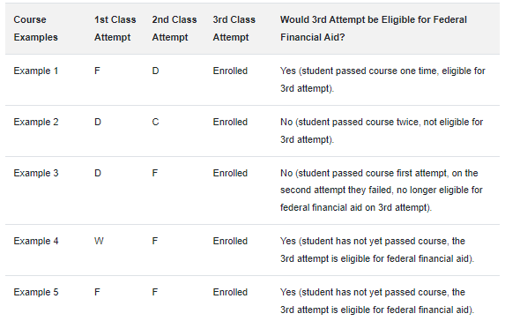
When is a course an Ineligible Repeat?
Financial aid may only be awarded once for a previously passed course (i.e., one repetition per class).
Exception: Courses that are repeatable for credit will continue to be financial aid eligible.
Until the student has passed the course, there is no limit on the number of attempts allowed.

Slide 34
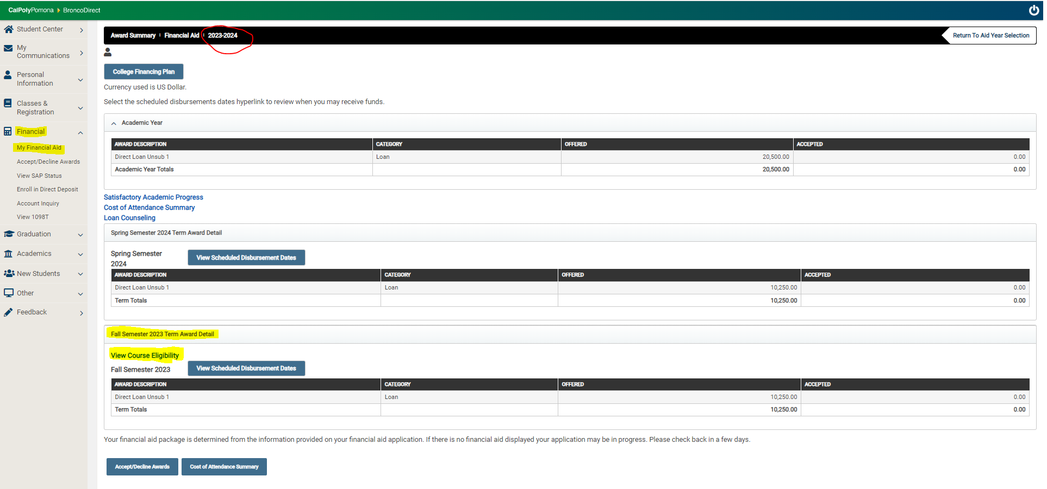
What information will Students see?

Slide 35
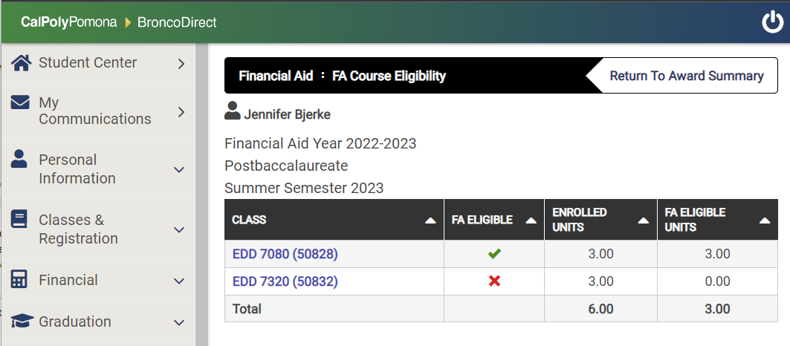
What information will Students see?
Billy Bronco

Slide 36
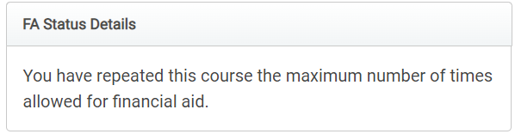
What information will Students see?
Billy Bronco

Slide 37

Maintain Eligibility
Maintain a Cumulative GPA of 2.0 or higher
3.0
Avoid the SAP Trap!
Complete at least 66.67% of all units attempted
66.67%
Complete your program within 6 years (150% of published length)
Grades matter!
Attempted but not completed grades:
  W, WU, WX, F, I, NC, and RD
150%

Slide 38
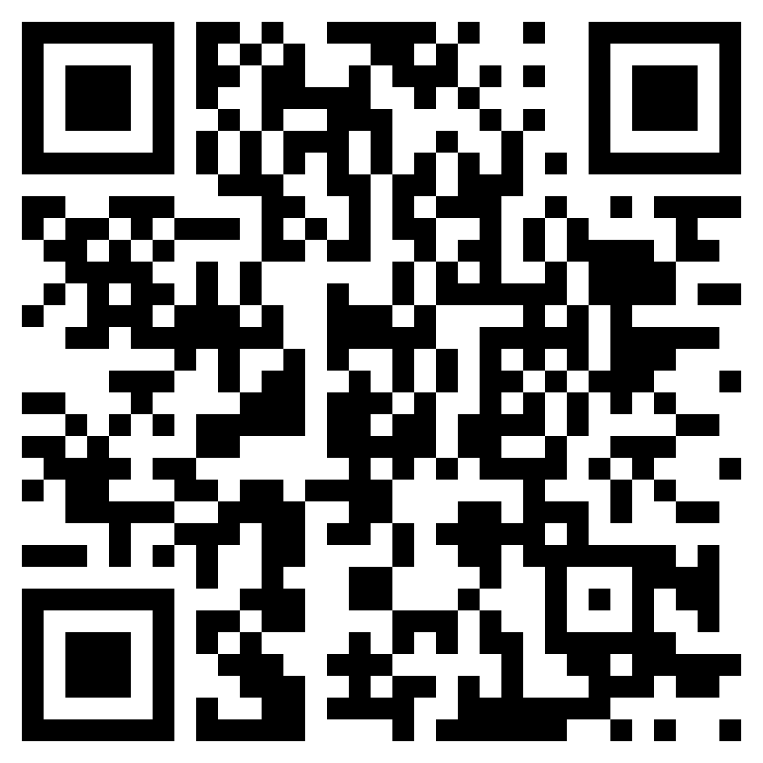
Satisfactory Academic Progress (SAP)
Maximum Time Frame Examples:
Academic Objective (Degree) | Published Length | Maximum Time Frame of Aid Eligibility
Engineering, M.S. Computer Science, M.S. Geology, M.S. Systems Engineering, M.S. | 30 units | 45 units (attempted)
Accountancy, M.S. (Accelerated) | 31 units | 46.50 units (attempted)
Business Analytics, M.S. | 33 units | 49.5 units (attempted)
Hospitality Management, M.S. | 36 units | 45 units (attempted)
Landscape Architecture, M.L.A. (Advanced Standing) | 48 units | 72 units (attempted)
https://www.cpp.edu/financial-aid/resources/understanding-unit-maximums.shtml

Slide 39
Special Circumstances - Appeals
Circumstances may arise throughout the year that affect financial aid eligibility. These have been classified as Special Circumstances and have two corresponding appeals.
  Cost of Attendance Appeals
    For loans and scholarships, does not change eligibility for grants
  SAI Appeal
    Divorce, Loss of Job, Reduction in Hours

Slide 40
Reminders
  Must Apply EVERY Year
  FAFSA & DREAM Application available every October 1
  State and CPP priority deadline is March 2
  Include Cal Poly POMONA on list of schools
    CPP School Code = 001144
  Check your @cpp.edu email regularly
  Pay attention to document deadlines
WAITING UNTIL THE LAST MINUTE
COULD COST YOU MONEY!!

Slide 41
Reminders
Include Bronco ID in all communications
Review Student Account Information
Check CPP email regularly
Enroll in Direct Deposit for quicker refunds of FA

Slide 42
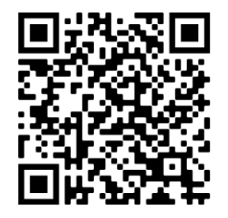
Connect with Financial Aid & Scholarships
  In-person – Bldg 121 1st floor, Blue Counter
    Mon-Thurs 9:00am-4:30pm
    Fri – 9:30am-4:30pm
  Billy ChatBot – 24/7 for general questions
  Live Chat: Mon – Fri 9:30am-4:30pm
  QLESS: Virtual or Drop-In appointments
  Email: finaid@cpp.edu scholarships@cpp.edu workstudy@cpp.edu
  Phone: 909-869-3700
  Website: www.cpp.edu/financial-aid

