Slide 1
Registrar’s Office
August 16, 2025
Notes:
Connie

Slide 2
Physical Location: SSB 121, 1st Floor – Blue Counter http://www.cpp.edu/registrar (909) 869-3000 registrar@cpp.edu Connie Kuang University Registrar Jennifer Andelin Associate Registrar Lanto Razafimanantsoa Associate Registrar Camry Carls Lead Transfer and Graduation Specialist Fernando Colin Transfer and Graduation Specialist (TGS)
Notes:
Lanto

Slide 3
Registrar’s Office Overview
Student Center
Registration Window
Academic Policies
Transfer Credit
Degree Progress Report (DPR)
Graduation Process
Notes:
Connie

Slide 4
Registrar’s Office Overview
STUDENT CENTER DEMO
Registration Window
Registration Holds/checklists
Permission to Add
Personal Information Update
FERPA Authorize to Release
Emergency Contact
Notes:
Lanto

Slide 5
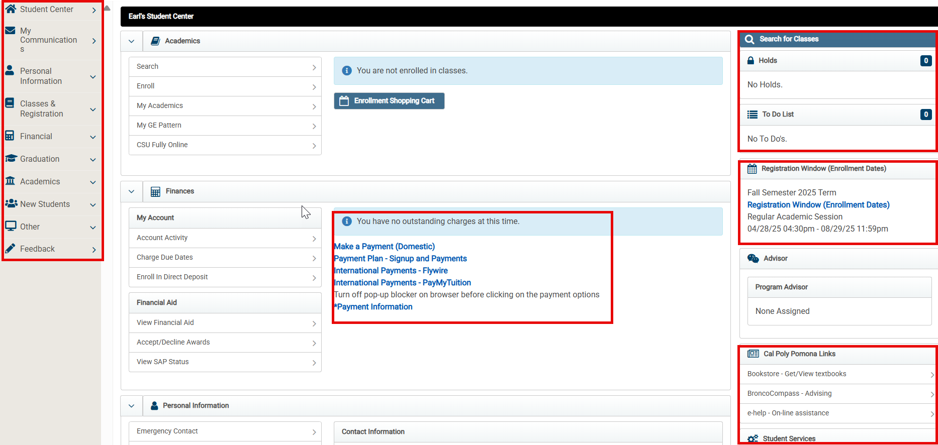
Notes:
Lanto - Student Center – Holds, To List, Registration Window, Payment information, update Emergency Contact, FERPA authorize to release

Slide 6
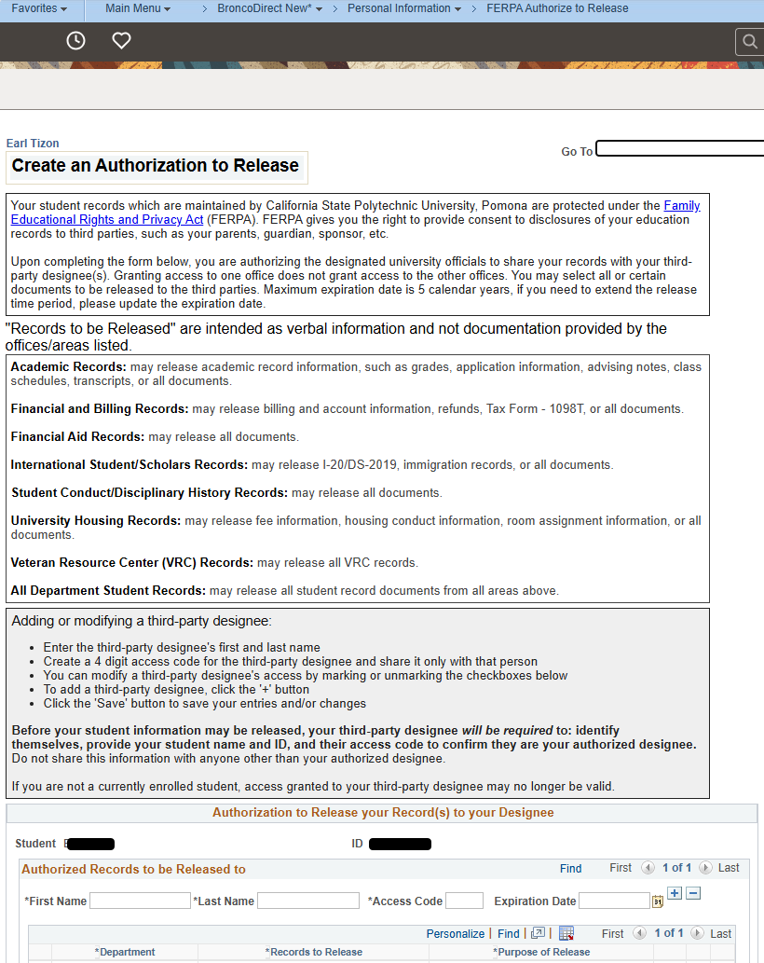
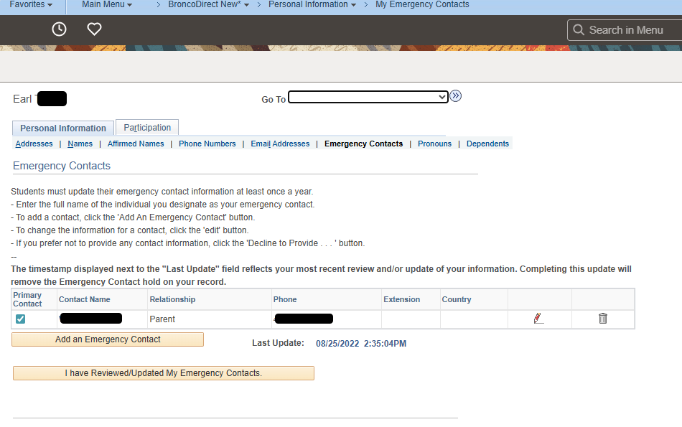
BroncoDirect: FERPA Authorization to Release &Emergency Contact
Notes:
Lanto

Slide 7
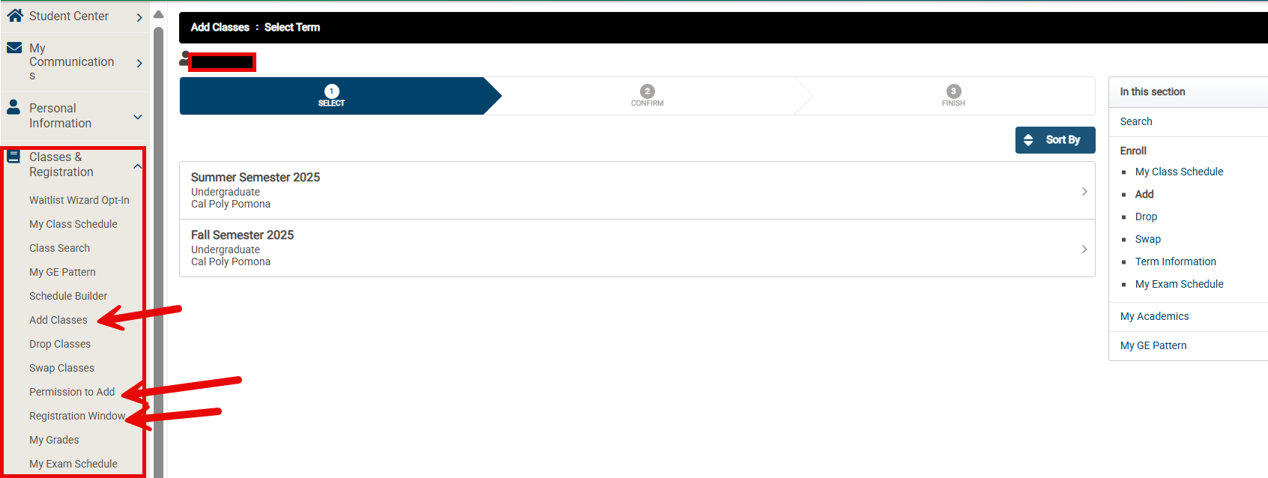
Notes:
Lanto - Class and Registration: Add, Drop, Class Search, Permission to Add for schedule conflict or late add, Registration Window

Slide 8
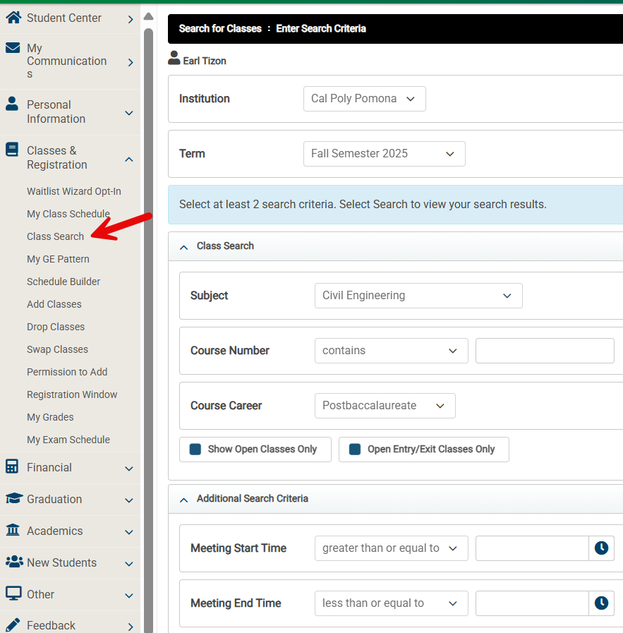
Notes:
Lanto - Class and Registration: Class Search

Slide 9
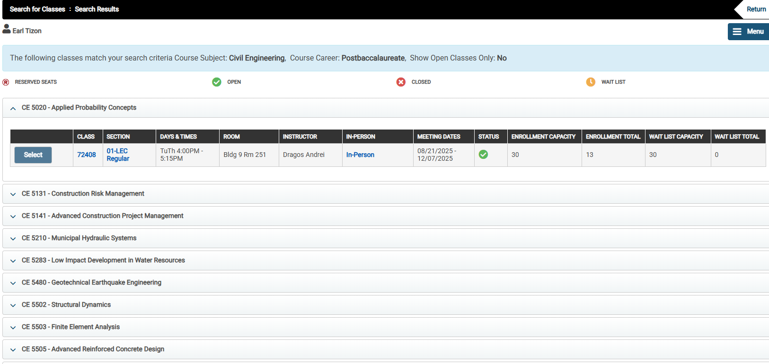
Notes:
Lanto - Class and Registration: Class Search- search results

Slide 10
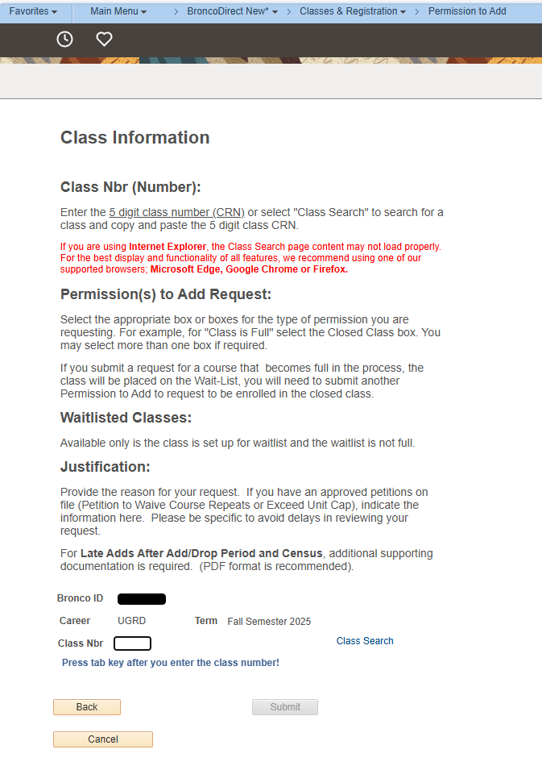
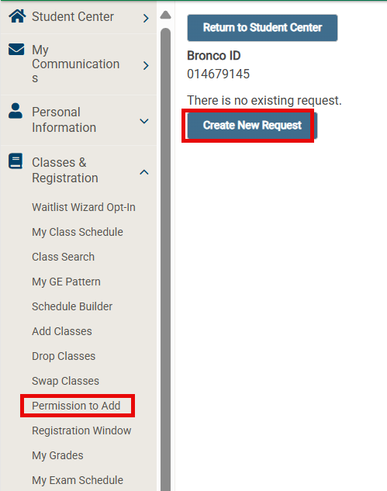
Permission to Add
Schedule Conflict
- Late Add after the Add/Drop Period
Notes:
Lanto - Permission to Add for Schedule Conflict or late add after the add/drop period

Slide 11
REGISTRATION WINDOW (ENROLLMENT DATES)
Future registration windows are assigned by Registrar’s Office and viewable in your Student Center shortly before registration opens
Fall: starts in mid-April Spring: starts in mid-October Summer: starts in April
Limited to 16 units during Priority & General Registration, then 18 units during Add/Drop, Petition to Exceed Unit Cap must be submitted
Check for pre-requisites or co-requisites
Add/Drop for Fall 2025 August 11 – September 4
Notes:
Lanto

Slide 12
ACADEMIC POLICIES Academic Standing/Time Limit
3.0 minimum GPA required (“B” average)
Course grade of “C” or higher is required to fulfill the requirements of the degree. A “C-” grade or lower would not be acceptable and the course would have to be repeated.
Overall/Cumulative (includes any transferred courses)
CPP courses
NOTE: 1000-2000 level courses (lower division) do NOT count towards your graduate GPA
Falling below a 3.0 GPA overall leads to Probation (PRP) or Probation with Contract (PRC), which ultimately lead to disqualification
There is no repeat/course forgiveness option available for graduate students
NOTE: The 7-year time limit does not stop during this period.
Notes:
Jennifer

Slide 13
ACADEMIC POLICIES Leave of Absence
Students are permitted to “stop out” (not be enrolled) for 1 semester (not including summer) and not applicable to 1st term students
Note: stop-out is not available to F-1 international students
If a student needs to be away longer than 1 semester (financial, medical, emergency reasons) an Leave of Absence can be filed with the Registrar’s Office for up to 4 semesters (not including summer) – form available online
NOTE: The 7-year time limit does not stop during this period.
Notes:
Jennifer

Slide 14
TRANSFER CREDIT
A total limit of 9 transfer and/or extension units petitioned for graduate credit may be applied toward a graduate degree.
Lower division level transfer courses may not be applied toward a graduate degree (including courses completed at a community college).
Official transcripts and approved petitions are required to be on file prior to having the units posted to the record.
Notes:
Camry

Slide 15
DEGREE PROGRESS REPORT (DPR)
Advising tool for graduate students
Shows degree requirements met & unmet
Helps students/departments track progress towards degree
Does not prevent registration or applying for graduation
Follows program requirements set forth in the University Catalog
Any catalog deviations made by students may not automatically display
Graduate Academic Petitions may be required
Notes:
Camry

Slide 16

DEGREE PROGRESS REPORT (DPR)
Access your DPR via BroncoDirect
my.cpp.edu
Student Center
"other academic" drop-down menu
Select Degree Progress Report
Questions about your DPR?
Review the 2025-2026 University Catalog: https://catalog.cpp.edu/
Check with your Graduate Coordinator
Notes:
Camry

Slide 17
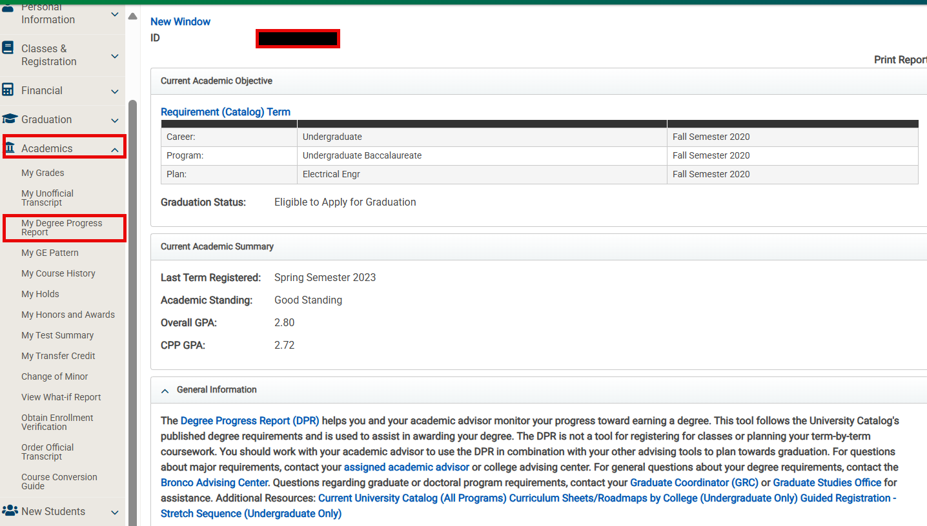
Notes:
Camry – click on Academics – My Degree Progress Report

Slide 18
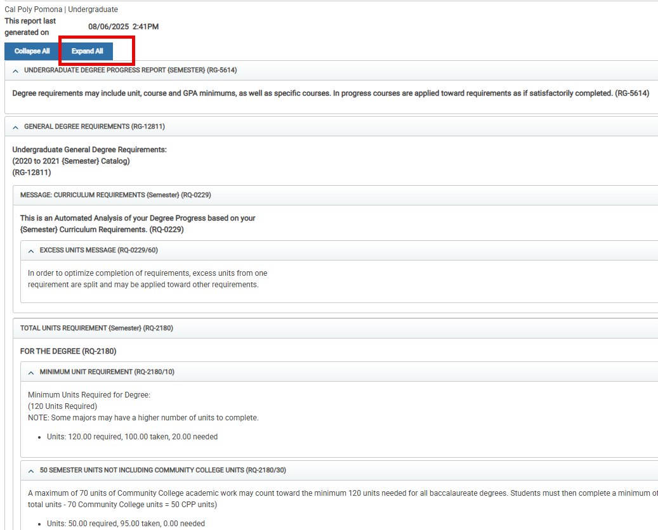
Notes:
Jennifer/Camry – click on Expand All to display the DPR

Slide 19
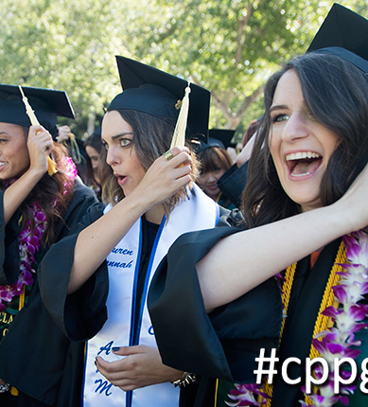
Welcome Broncos! We look forward to your graduation day!
Notes:
all

