Slide 1
---
Cayuse Protocol Walkthrough
----
Presented by
Dr. Bonny Burns-Whitmore, RD. MCHES®
California State Polytechnic University, Institutional Review Board, Member and former Chair/Vice Chair 7/18/2025

Slide 2
Introduction
Our IRB goal is to make the application process as easy for you as possible.
We will:
Review the procedure, provide guidelines and guiding resources
Provide hints, help, and examples
Before you start the process, you will:
Complete CITI training/National Institute of Health training (if you have an NIH grant)
Request authentication for Cayuse
Institutional Review Board (IRB)

Slide 3
Guidelines/Procedures/Policies/FAQs
Is mine a human research study?
To find out, please answer these questions:
I am going to collect information/measurements (interviews, questionnaires, surveys, body composition/blood pressure, waist/hip measurements, brainwaves, energy expenditure, etc.), or biospecimens/samples from people or human cells to discover new knowledge or understand existing knowledge better? Answer: Yes or no, or I don’t know.
Will other people see or read the results of the data collected in a poster, article, or presentation? Answer: Yes or no, or I don’t know.
Is this research being funded-and if so, who is funding it? Answer: Yes or no, or I don’t know.
Institutional Review Board (IRB)

Slide 4
Guidelines/Procedures/Policies
Do I need to fill out a protocol?
If you answered “yes” to any of those you will need to fill out a protocol in Cayuse (our online review process software). If you answered or “I don’t know” please contact the IRB office at irb-office@cpp.edu
All research performed at CPP faculty, staff, students, performed on this campus must be reviewed by the IRB for applicability of federal and state policies.
Research done off campus by CPP faculty, staff, students, performed on this campus must also be reviewed by the IRB
Institutional Review Board (IRB)

Slide 5
Approval Review Process Overview
Submission: Researchers must submit their research protocols through the Cayuse IRB system.
Emails or hardcopies will not be accepted.
Pre-Review: Your submission is initially reviewed by an IRB Analyst, who may request
additional information from you (sending the protocol back to you), waiting for your response,
before sending it to the reviewer(s).
Review Assignment: The protocol is then assigned to one or more IRB members for review.
Review by IRB Members: IRB member(s) review the protocol, potentially requesting changes.
They have 10 days-2 weeks to review the protocol
Post-Review: When the reviewer's assessment is complete, the submission is returned to the
IRB Office and the office might send it back to the PI if changes are required. If needed, this process
may happen several times until the questions/requests are answered. If needed, ask the office for help.
Decision and Approval: The IRB/IRB reviewer makes a decision, either approving the protocol or
requesting revisions. If revisions are needed, the submission is sent back to the researcher.
Approval: Once approved (email notification are sent), the PIs can proceed with the study.
Note that ongoing reviews may be required for some studies, modifications, renewals,
and/or incident reports or adverse incident reports.
Processing time: Most protocols take 3-7 weeks, provided the protocol packet is complete. Full Board
Reviews may take up to 4-6 months, depending on the complexity.
Institutional Review Board (IRB)

Slide 6
First Step: Beginning the Protocol Process
1) Go to MyCPP Online Services--Search for “Cayuse”
Click on “Cayuse 424” It will take you this site: https://www.cpp.edu/research/sponsored-program/cayuse.shtml
2) Or go directly to the website. Cayuse is located here: https://cpp-orsp.cayuse424.com
The link will take you to a sign-in page. Use the username and password you used to get authorization to enter Cayuse (see previous video entitled “Guidance to the IRB Application Process”).
Once in Cayuse, an announcement will appear at the top part of the screen. Please read the information there. You are now at the Dashboard.
On the right of the screen there is a blue button: + New Study
Clicking on that button will take you here (see next page):
Institutional Review Board (IRB)

Slide 7
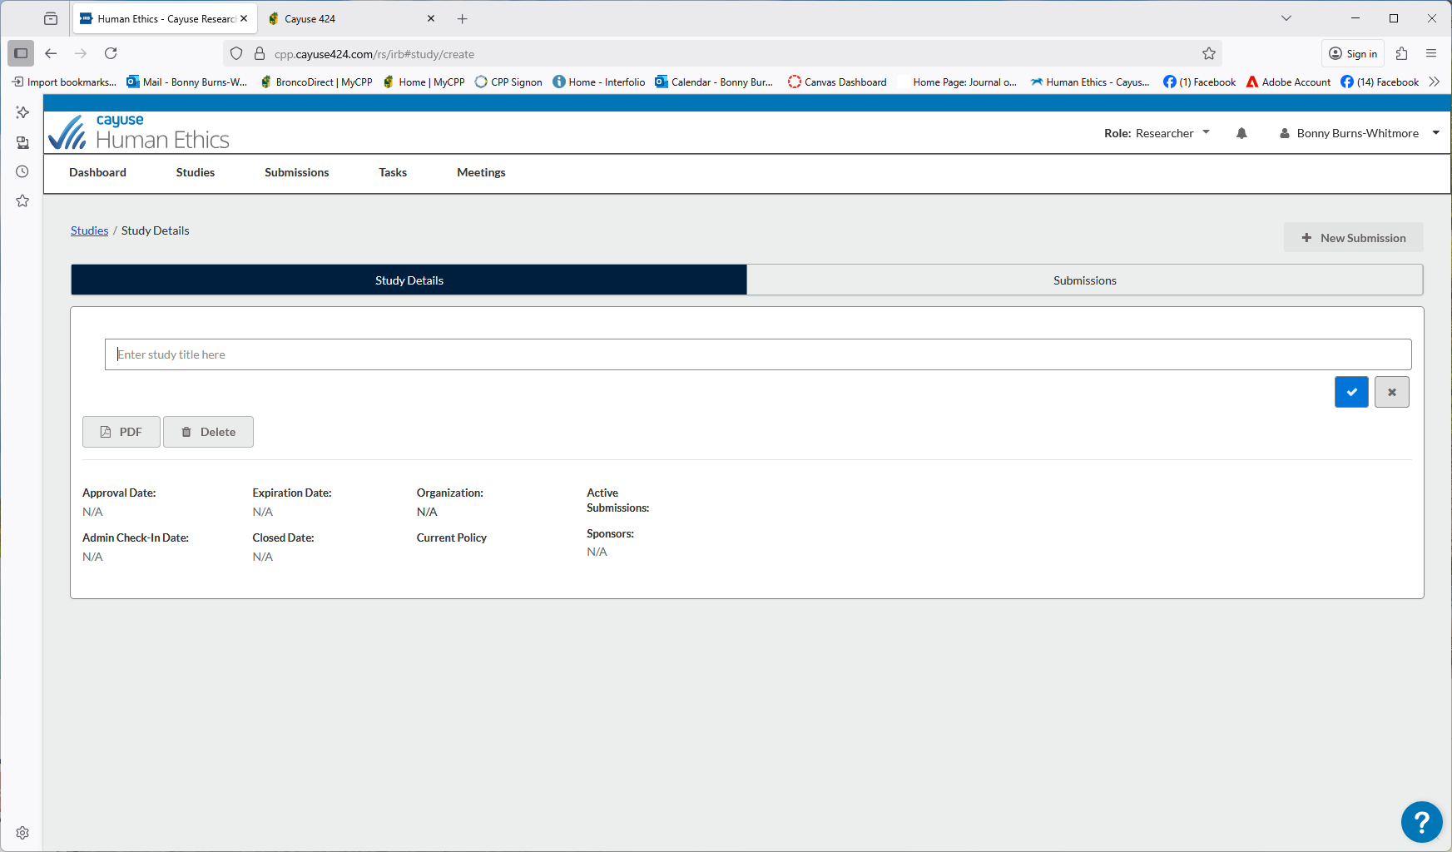
This Page is Where the Title of Your Study is Entered
Institutional Review Board (IRB)

Slide 8
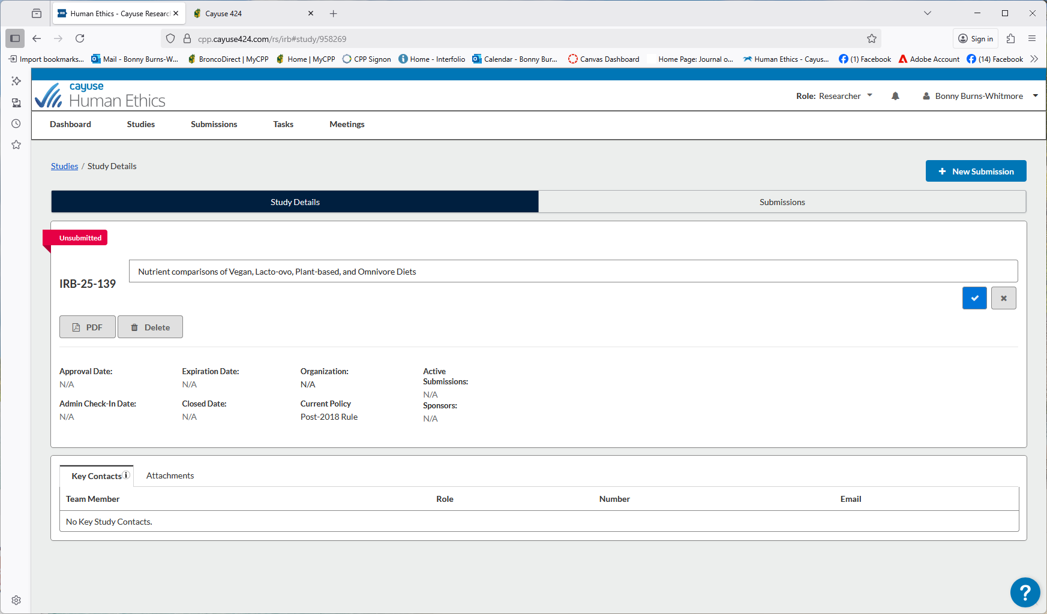
Study Detail Page-New Submission
Institutional Review Board (IRB)

Slide 9
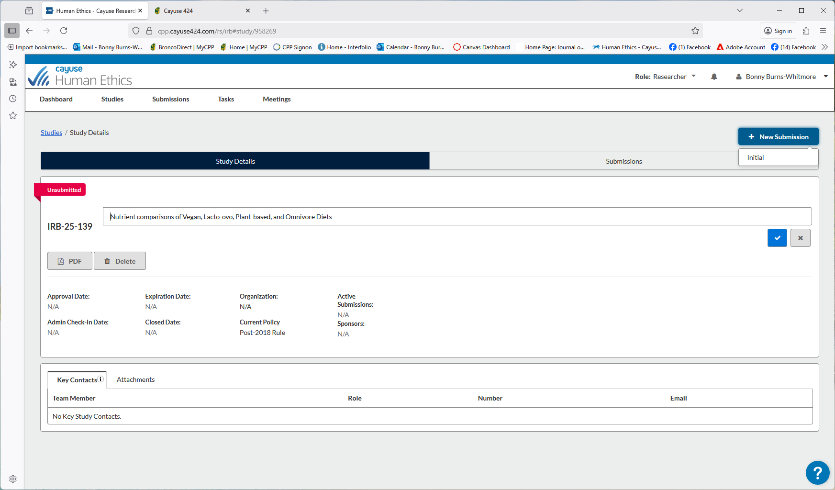

New Submission
Once you click on the button- there will be another button to click on: “Initial”.
Should you have any questions, contact the Office of Research Compliance irb-office@cpp.edu
Institutional Review Board (IRB)

Slide 10
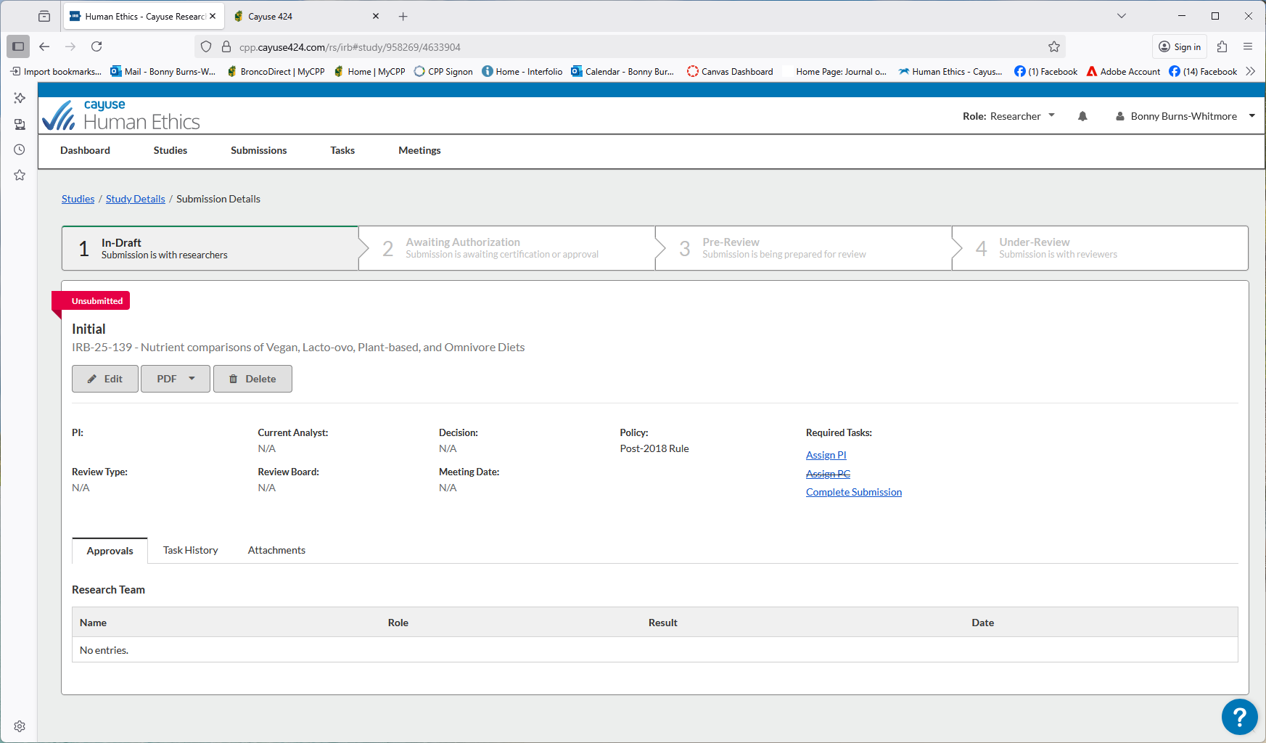
In-Draft “The submission is with researchers”
See the required tasks on the right side of the screen. We will need to add information to this area, Click on the “ Edit” button
Institutional Review Board (IRB)

Slide 11
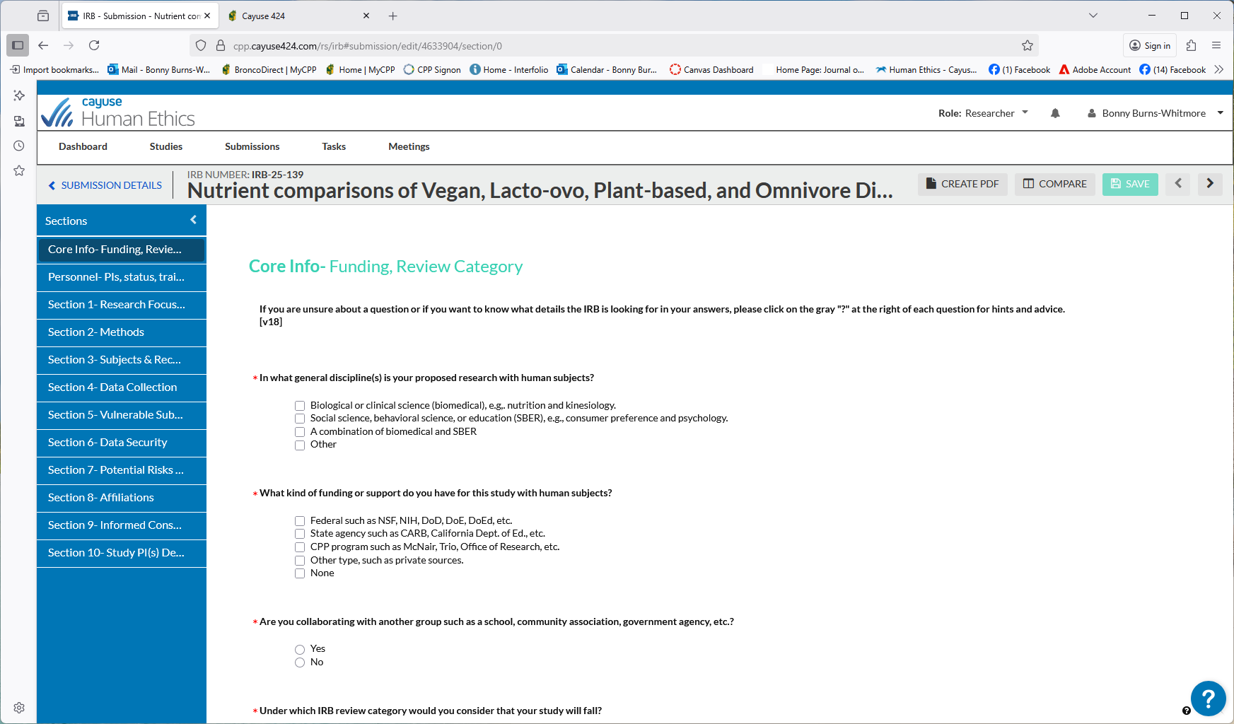
Core Info-Funding, Review Category
This is the first page of the protocol form. If you don’t know what each question is asking-click on the gray circle “?” for hints and advice.
Institutional Review Board (IRB)

Slide 12
Sections in the Protocol
Core Information-Funding
Personnel-PIs, Status Training, Facilitator
Section 1- Research Focus
Section 2- Methods
Section 3- Subjects and Recruitment
Section 4- Data Collection
Section 5- Vulnerable Subjects
Section 6- Data Security
Section 7- Potential Risks
Section 8-Affliations
Section 9-Informaed Consent
Section 10 Study PIs Signature Page

Slide 13
Core Info- Review Category
Exempt: Research using existing data or samples
Example: Observation of public behavior
Research involving surveys or questionnaires where no personally identifiable information is gathered or retained
Eligibility for exemption will be determined by the IRB.
Expedited: Poses no more than minimal risk to the subject, i.e., no more than those ordinarily encountered in daily life or during the performance of routine physical or psychological examinations or tests
Approvable by review of two members of the Board
Doesn’t necessarily mean quick or fast review (most studies are Expedited)
Full board: Involves vulnerable populations. Research that is neither exempt nor expeditable must receive review by the full committee. This means a convened meeting of the IRB quorum for face-to-face discussion

Slide 14
Walkthrough of a Cayuse Protocol
We will go through each question on the real protocol in Cayuse now.
We will come back to the ppt slides after we go through the protocol.
I’ll start screen sharing now.
Institutional Review Board (IRB)

Slide 15
After you Complete the Proposal in Cayuse
PI Revision/PI Revise: After your Cayuse protocol has been submitted to the IRB office, it will most often be returned to the PIs with comments. If your protocol was approved the first time-Congratulations! You provided clear answers to the questions/requirements, you provided the required documents/documentations, you were thorough, and you answered every part of every question.
The Procedure:
Fix/address the comments in Cayuse.
After the IRB Office receives the proposal, the Office will send the proposal to the original reviewers.
They will have 10 days to two weeks to review it.
Institutional Review Board (IRB)

Slide 16
Reason to Use Cayuse Again for Your Study
Renew: When the protocol is close to the expiration date, the PI may receive notification from Cayuse. If the PI wishes to renew the approval period for an additional year (the usual amount of time), a Renewal Submission must be submitted before the expiration date (earlier is better!).
Amend/amendment (also called a modification): After IRB approval, when the PI(s) would like to change anything to the approved protocol, they must submit an Amendment in Cayuse.
Institutional Review Board (IRB)

Slide 17
Approval-YAY!
The approval email (everyone gets happy when they receive this ☺)- When the protocol review has been completed, an approval email memo to conduct the research study will be issued. A copy is kept within the "Letters" tab of a protocol.
If you need more time…or you need a renewal - The Cayuse system will send reminder notices at 45, 30 and 15 days before a protocol expires, so that the PI(s) have adequate time and opportunity to renew it. It is the PI’s, not the IRB’s, responsibility to renew their protocol before it expires.
More information go to: www.cpp.edu/research/research-compliance/irb/protocol.shtml
Institutional Review Board (IRB)

Slide 18
Problems That Occur During Your Research
If there are problems that happen during your research that is not addressed by a solution that was proposed in Cayuse-contact the IRB office ASAP. This might be called an adverse event.
Adverse Event (Incident): Sometimes things in research just don't go as planned. Researchers may encounter "adverse events" and unanticipated problems.
Adverse events must be reported to the IRB within 48 hrs. through the Cayuse system. According to federal regulation, it is the PI's responsibility to report adverse events of any kind to the IRB.
Institutional Review Board (IRB)

Slide 19

Questions? FAQs https://www.cpp.edu/research/research-compliance/irb/protocol.shtml Contact the IRB Office at: irb-office@cpp.edu for more information-please see: https://www.cpp.edu/our-cpp/students/irb.shtml 909-869-3713 909-869-4215 Best of luck on your research!

