Slide 1
---
------Starting the
IRB Application Process-
Guidance for New Principle Investigators (PIs)
---I
Presented by
Dr. Bonny Burns-Whitmore, RD. MCHES®
California State Polytechnic University, Institutional Review Board, Member and former Chair/Vice Chair 7/18/2025

Slide 2
Introduction
Our IRB goal is to make the application process as easy for you as possible.
We will:
Review the procedure, provide guidelines and guiding resources
Provide hints, help, and examples
You will:
Complete CITI training/National Institute of Health training (if you have an NIH grant)
Request authentication for Cayuse
Learn the Application Process
Graduate Resource Center
Institutional Review Board (IRB)

Slide 3
Guidelines/Procedures/Policies/FAQs
Is mine a human research study?
To find out, please answer these questions:
  I am going to collect information/measurements (interviews, questionnaires, surveys, body composition/blood pressure, waist/hip measurements, brainwaves, energy expenditure, etc.), or biospecimens/samples from people or human cells to discover new knowledge or understand existing knowledge better? Answer: Yes or no, or I don’t know.
  Will other people see or read the results of the data collected in a poster, article, or presentation? Answer: Yes or no, or I don’t know.
  Is this research being funded-and if so, who is funding it? Answer: Yes or no, or I don’t know.
Institutional Review Board (IRB)

Slide 4
Guidelines/Procedures/Policies/FAQs
Do I need to fill out a protocol?
If you answered “yes” to any of those you will need to fill out a protocol in Cayuse (our online review process software). If you answered or “I don’t know” please contact the IRB office at irb-office@cpp.edu
All research performed at CPP faculty, staff, students, performed on this campus must be reviewed by the IRB for applicability of federal and state policies.
Research done off campus by CPP faculty, staff, students, performed on this campus must also be reviewed by the IRB
Okay then….What is the process?
Institutional Review Board (IRB)
Graduate Resource Center

Slide 5
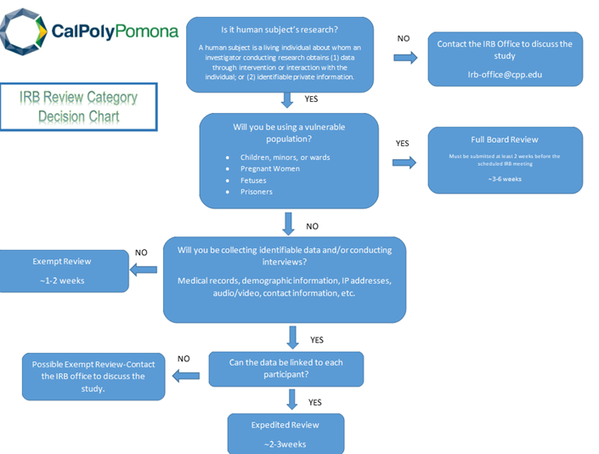
IRB Decision Tree
Institutional Review Board (IRB)
Graduate Resource Center

Slide 6
Approval Review Process Overview
Submission: Researchers must submit their research protocols through the Cayuse IRB system.
Emails or hardcopies cannot be accepted.
Pre-Review: Your submission is initially reviewed by an IRB Analyst, who may request
additional information from you (sending the protocol back to you), waiting for your response,
before sending it to the reviewer(s).
Review Assignment: The protocol is then assigned to one or more IRB members for review.
Review by IRB Members: IRB member(s) review the protocol, potentially requesting changes.
They have 2 weeks to review the protocol
Post-Review: When the reviewer's assessment is complete, the submission is returned to the
IRB Office and the office might send it back to the PI if changes are required. If needed, this process
may happen several times until the questions/requests are answered. If needed, ask the office for help.
Decision and Approval: The IRB/IRB reviewer makes a decision, either approving the protocol or
requesting revisions. If revisions are needed, the submission is sent back to the researcher.
Approval: Once approved (email notification are sent), the PIs can proceed with the study.
Note that ongoing reviews may be required for some studies, modifications, renewals,
and/or incident reports or adverse incident reports.
Processing time: Most protocols take 3-10 weeks, provided the protocol packet is complete. Full Board
Reviews may take up to 4-6 months, depending on the complexity.
Graduate Resource Center
Institutional Review Board (IRB)

Slide 7
First Step: CITI Certification is Required
You can also take the NIH Certification (but it is much more complicated) https://researchtraining.nih.gov/
The CITI company link is available on-line at https://www.citiprogram.org- if you want to see what they offer. Our CITI is free and available 24/7. Our CITI link is here: https://about.citiprogram.org/ and use any name and password you choose.
Select California State Polytechnic University, Pomona as the institution. There will be a space to provide your Bronco ID number so we can further identify you in the future.
You can provide your Bronco ID in the space labeled "employee number" in Step 6 of the registration process. You may also affiliate yourself with other institutions that recognize the CITI training
Institutional Review Board (IRB)
Graduate Resource Center

Slide 8
CITI Certification is Required-Which one?
We ask that you complete the Intro to Human Research 101 as the primary certification
CITI offers 30 modules addressing topics in both social science and bio-medical research with people, followed by quizzes to test your knowledge
  Though you may already have experience and background with human subjects, the IRB could/may ask that you take additional training appropriate to your proposal application as part of the approval process.
Institutional Review Board (IRB)
Graduate Resource Center

Slide 9
Completion Certificates
CITI Program issues course "Completion Certificates" (CCs) that learners may print or share, under the records link in the CITI site.
How do I get my certificate?
  It will be available to you as soon as you pass the quiz with 80% or higher score.
A copy of the certificate of completion will be required as an upload in Cayuse. Please download and save a copy.
Copies are available through Cayuse
Should you have any questions, contact the Office of Research Compliance irb-office@cpp.edu
Institutional Review Board (IRB)
Graduate Resource Center

Slide 10
Completion Reports
A completion certificate is generated each time you complete the required group of modules, which is evidence of training to the IRB, or for a classroom activity.
Five (5) years is the typical length of time for which most human subjects research training is valid.
This is subject to change should there be changes in regulations, campus policies, funding requirements, or research methodology.
They are stored at the CITI site and can be retrieved or downloaded from there.
Institutional Review Board (IRB)
Graduate Resource Center

Slide 11
Requesting Authentication
If this is your first time submitting an IRB protocol in Cayuse and you receive the following message at log-in "We're sorry. This account has been disabled on the Cayuse424 system", please email the following information to irb-office@cpp.edu to be added into the system:
Please include the following information:
  Highest degree attained (PhD, MS, MA, BS, BA, associates, high school, etc., as appropriate)
  First and last name
  Bronco ID (the nine digit number, which will eventually be used to link with CITI training data)
  Bronco email (e.g., billybronco@cpp.edu)
  Status (faculty, staff, student, unaffiliated, etc., as appropriate)
  CPP College and Department
  Once the office creates the authentication, the system needs to update overnight before the PI can access their account in Cayuse IRB.
Institutional Review Board (IRB)
Graduate Resource Center

Slide 12
Starting the Protocol in Cayuse
To submit an IRB protocol, enter the Cayuse IRB site using your Bronco Credentials (from authentication process above) and start a "new study".
Here is an excellent “about Cayuse” video from Diana:
https://streaming.cpp.edu/media/Cayuse+over-OUR+and+IRB/1_qych794b
Institutional Review Board (IRB)
Graduate Resource Center

Slide 13
Cayuse and Submitting an IRB Protocol
Other reasons that you need to go into Cayuse…
Revision/Revise: After your protocol has been submitted to the IRB office, it will most often be returned to the PIs with comments.
Renew: When the protocol is close to the expiration date, the PIs will receive notifications. If they wish to renew the approval period for an additional year (the usual amount of time), a renewal submission in Cayuse must be submitted before the expiration date (earlier is better!).
Amend/amendment (also called a modification): After IRB approval, when the PI(s) would like to change things to the approved protocol, they must submit an amendment submission.
If there are problems that happen during your research that is not addressed by a solution in Cayuse-contact the IRB office ASAP.
Graduate Resource Center

Slide 14
Cayuse (continued)
Adverse Event (Incident): Sometimes things in research just don't go as planned. Researchers may encounter "adverse events" and unanticipated problems.
Adverse events must be reported to the IRB within 48 hrs. through the Cayuse system.
According to federal regulation, it is the PI's responsibility to report adverse events of any kind to the IRB.
Institutional Review Board (IRB)
Graduate Resource Center

Slide 15
Approval-YAY!
The approval email (everyone gets happy when they receive this ☺)- When the protocol review has been completed, an approval email memo to conduct the research study will be issued. A copy is kept within the "Letters" tab of a protocol.
If you need more time…you need a renewal - The Cayuse system will send reminder notices at 45, 30 and 15 days before a protocol expires, so that the PI(s) have adequate time and opportunity to renew it.
It is the PI’s, not the IRB’s, responsibility to renew their protocol before it expires.
More information go to: www.cpp.edu/research/research-compliance/irb/protocol.shtml
Institutional Review Board (IRB)
Graduate Resource Center

Slide 16

Questions?
FAQs https://www.cpp.edu/research/research-compliance/irb/protocol.shtml
Contact the IRB Office at: irb-office@cpp.edu for more information-please see: https://www.cpp.edu/our-cpp/students/irb.shtml
909-869-3713
909-869-4215
Best of luck on your research!
Graduate Resource Center

