Slide 1


Master’s Thesis
Formatting Rules and Adobe Sign guidelines
Notes:
Thank you for joining the tutorial on Master’s thesis formatting and Adobe Sign guidelines provided by Cal Poly Pomona University.
This session will walk you through the rules and procedures for formatting your report to ensure it meets the requirements for final format review approval.

Slide 2
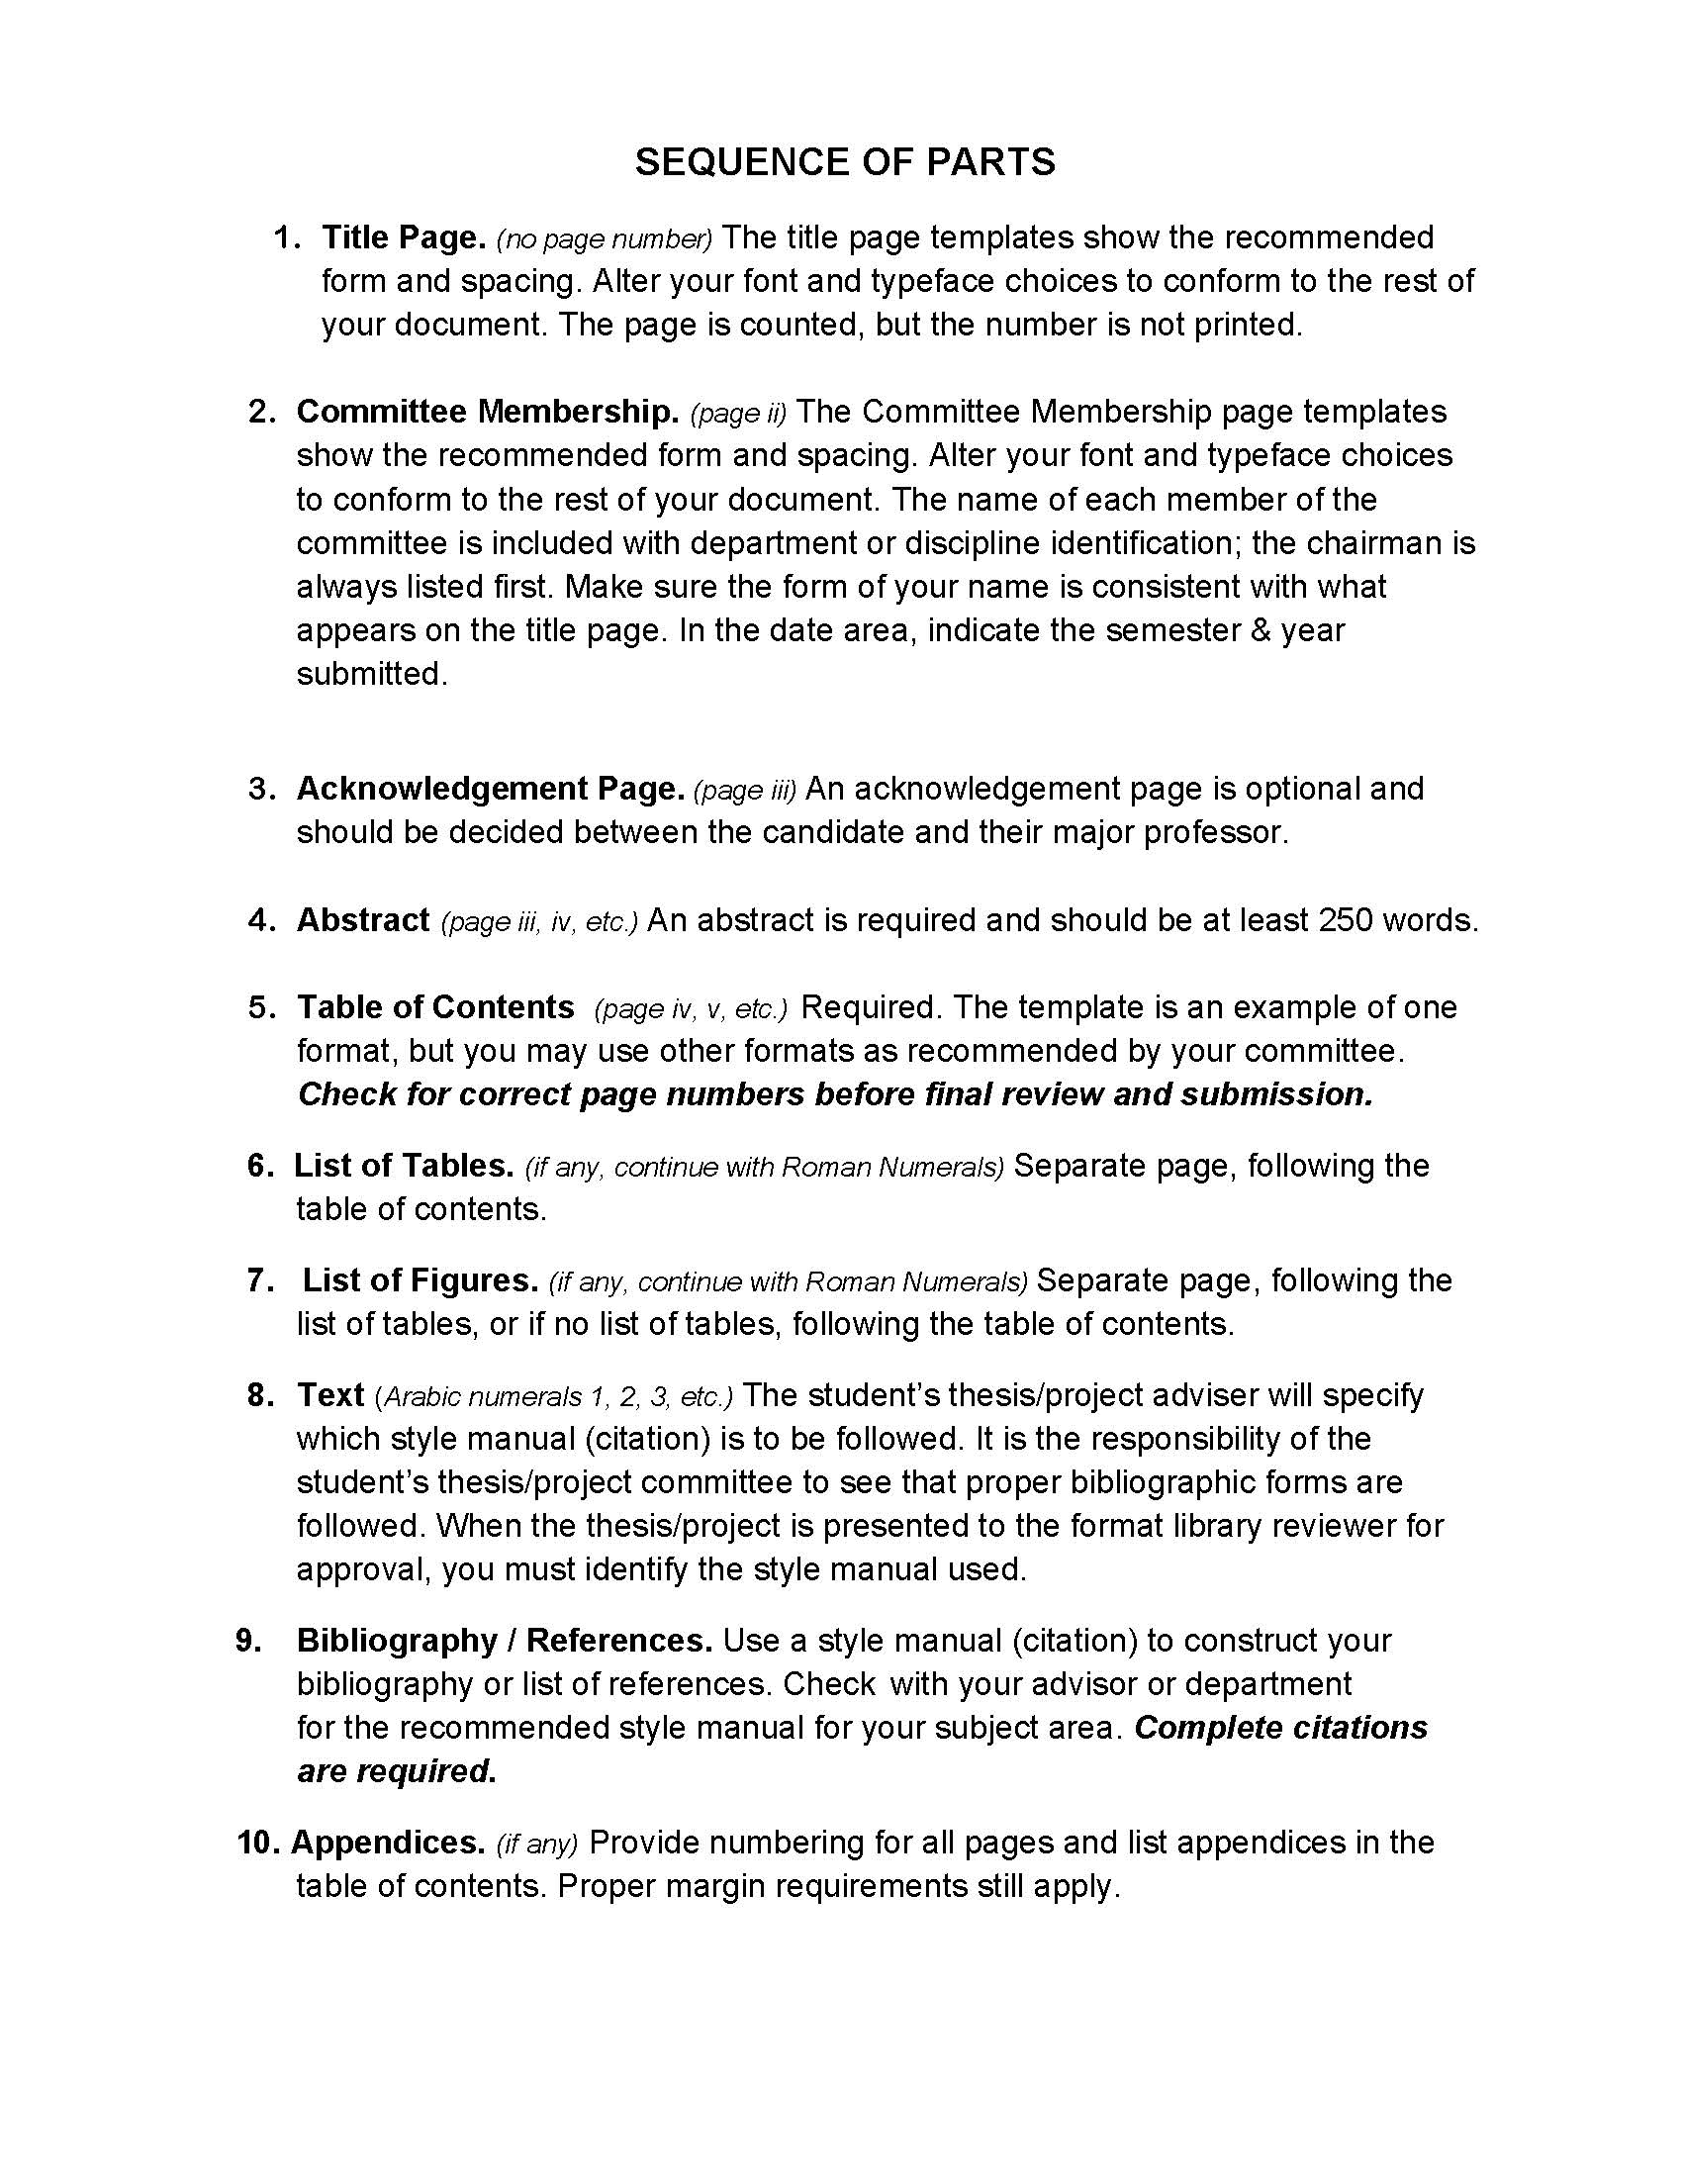
Sequences of Parts
Notes:
We’ll begin with the Sequence of Parts, which you can download from the Graduate Studies website.
This document outlines the required order of each section in your report. The preliminary pages include the Title Page through the List of Figures, while the main content extents from the Text through the Appendices. Each section in the sequence is explained in detail, including its purpose and the formatting rules you need to follow. Please refer to this sheet carefully as it serves as a valuable guide for structuring your report correctly.

Slide 3
Formatting Rules
Typing: (must pick one font size and one typeface)
Font size must be no smaller than 10 points or larger than 12 points.
Typefaces includes Arial, Calibri, and Times New Roman are required.
Double Space through out the entire paper
Margins: Margins for top, right, left, and bottom must be 1“ inch all around.
Pagination: Preliminary pages are lower case Roman numerals (ii, iii, iv, etc.). The title page is counted but the number is not printed on the page.
Beginning with the first page of the main body of the text, pages are numbered consecutively with Arabic numerals (1, 2, 3, 4, etc.).
Notes:
Next, we’ll cover the formatting rules.
Begin by selecting one font size and one typeface for your entire thesis. Acceptable font sizes are 10, 11, or 12 point, and the approved typefaces include Times New Roman, Arial, or Calibri. Your selection must remain consistent throughout your document, including in page numbers, main headings, subheadings, table and figure labels, and captions.
The entire paper must be double-spaced, and margins should be set to 1 inch on all sides.
Pagination is also important:
Preliminary pages use lowercase Roman numerals (i, ii, iii, etc.).
The Title Page is counted as page "i" but does not display a page number.
The main body of the text begins with Arabic numerals (1, 2, 3, etc.), starting on the first page of the introduction or chapter one with page 1.
You’ll see examples of this when we go through the sample pages.

Slide 4
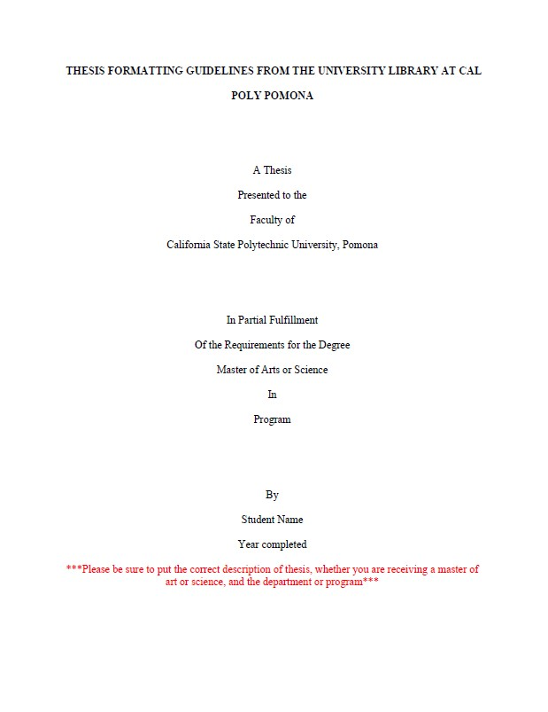
Samples of Formatting
Title Page
1” on top
1” left hand
1” right hand
1” Bottom
No page number
Title should be all CAPS and bold
Make sure the wording is correct
Notes:
From this point on, I will be demonstrating sample pages from the official guide available on the Graduate Studies website.
We’ll start with the Title Page. It must have 1-inch margins on all sides. As you can see, the page number is counted but not printed on the Title Page.
Your Title Page should match the format shown in the sample exactly, with the exception of your personal information such as your name and the year of submission. Be sure to indicate the correct degree—whether it’s Master of Science, Master of Arts, or another designation. If you're unsure, consult your department or refer to previous submissions available on Bronco ScholarWorks.
Additional formatting requirements for the Title Page:
Your thesis title must be in uppercase and bold.
Your name should appear as your full legal name. If you commonly go by a nickname, you may include it in parentheses (e.g., Jonathan “Jon” Smith).

Slide 5
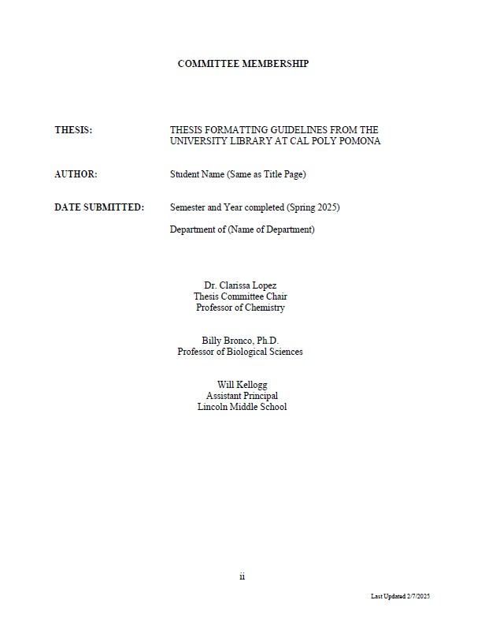
Committee Membership
1” on top
1” left hand
1” right hand
1” bottom
Start with roman number
Page ii(2)
Notes:
Next is the Committee Membership Page.
This page must also have 1-inch margins on all sides. The page number should appear at the bottom of the page, either centered or aligned to the right. This is the second page of your thesis and should be numbered with the Roman numeral ii, as shown on the screen.
This page is crucial and is one of the most common areas where students make formatting errors. Please pay close attention to the following formatting guidelines:
On the left side, all section headings must be in uppercase and bold.
On the right side, all corresponding information should be properly aligned with the section headings.
Your thesis title must match exactly what you entered on the Title Page—uppercase, not bold, and single-spaced.
Now For listing your committee members:
You must include three committee members for a thesis.
Each committee member's information should be listed in three lines:
First line - Full name, including title (ask each member if they prefer to be listed as "Dr." or with "Ph.D."; if neither applies, list their name without any title).
Second line- Their position title (e.g., Professor, Lecturer).
Third line- Their department or affiliation (e.g., Department of Biology or an external organization if they are not affiliated with Cal Poly Pomona).
Only your committee chair should be labeled with the title "Thesis Committee Chair," and this person must be listed first.
Please be sure to follow every formatting detail closely to avoid delays in approval.

Slide 6
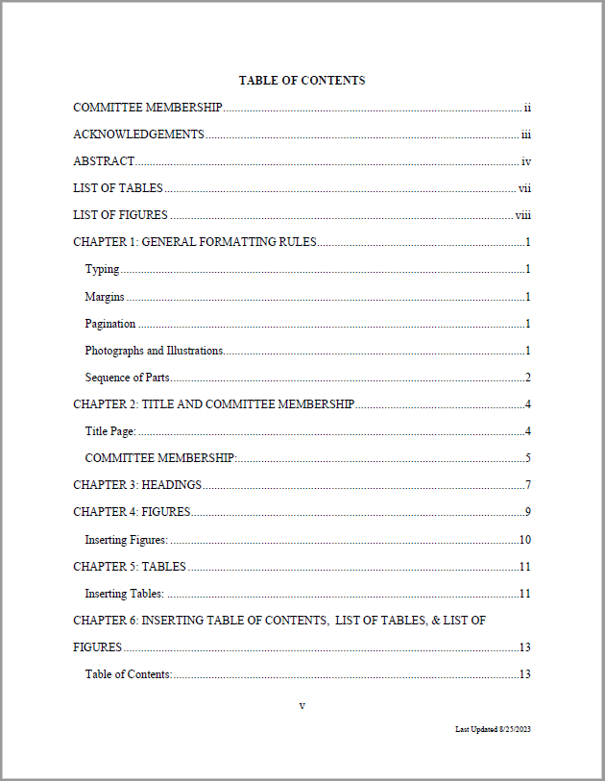
Table of Contents
Notes:
For the next Table of Contents, ensure that all preliminary pages are included in the order specified by the template. Follow the correct sequence of parts exactly as shown. The only section that should not be listed in the Table of Contents is the Table of Contents itself. Make sure the formatting is double-spaced, and all page numbers are aligned vertically. Always double-check that your page numbers are accurate.
There are two acceptable formats for creating the Table of Contents:
Including only the main headings, or
Including both headings and subheadings.
Whichever format you choose, ensure that your use of headings and subheadings is consistent throughout the entire report.
Page numbers should not be italic all page numbers should be regular font.

Slide 7
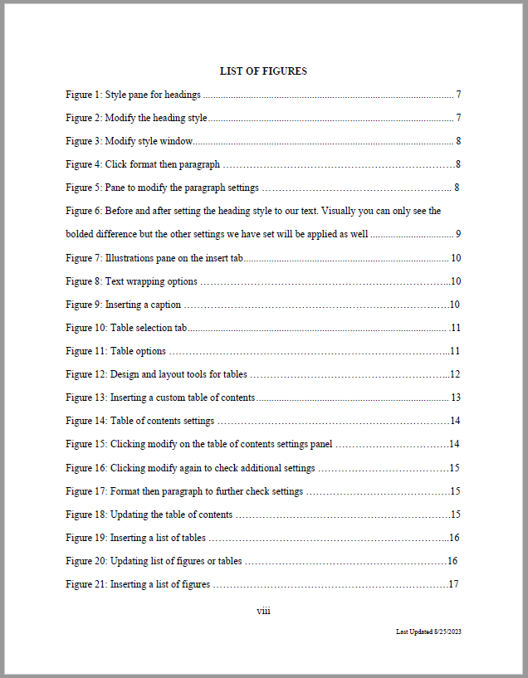
List of Tables and Figures
1” all around
Must have label and caption in the table.
Double check your page numbers
All page #’s should be aligned.
Notes:
Next are the List of Tables and List of Figures. They must appear in that order—List of Tables first, followed by the List of Figures. Each entry should include the table or figure label, its corresponding caption, and the correct page number. The formatting must be double-spaced, with all page numbers vertically aligned and not italicized. Ensure that all content fits within the 1-inch margins.

Slide 8
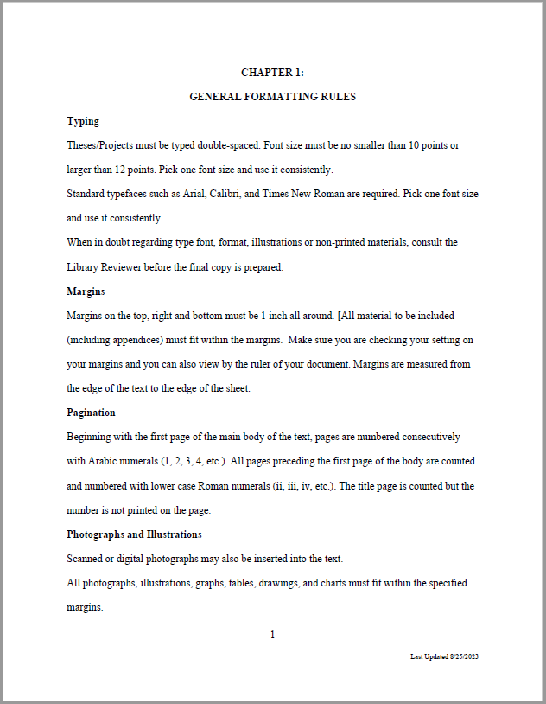
Body Text, Chapters
All pages must follow
Margins 1” all around
Chapter 1 starts with page
1 and on, Arabic numbers.
Make sure your chapter title
Match with table of contents.
There is no blank pages.
Notes:
You are now in the body of your report, beginning with the Introduction or Chapter 1. This is where the page numbering starts over using Arabic numerals, beginning with page 1. From this point forward, ensure that all headings, subheadings, and spacing are consistent throughout the report. The text may be left-aligned; full justification is not required. Additionally, make sure there are no blank pages anywhere in the report.

Slide 9
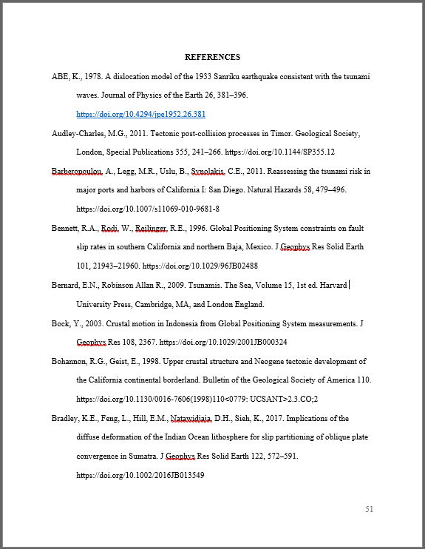
Reference/
Bibliography
Double space
Must follow citation style
We don’t check citation
please make sure you
check with your professor
Notes:
Next, let’s discuss references. Be sure to check in with your chair or committee to confirm which citation style you are required to use. If your professor gives you the option to choose, note that your department has recommended citation style check in the graduate studies website. The most commonly used formats are APA 7th edition and IEEE. Whichever you choose, ensure that you follow the correct formatting guidelines, including using double spacing.

Slide 10
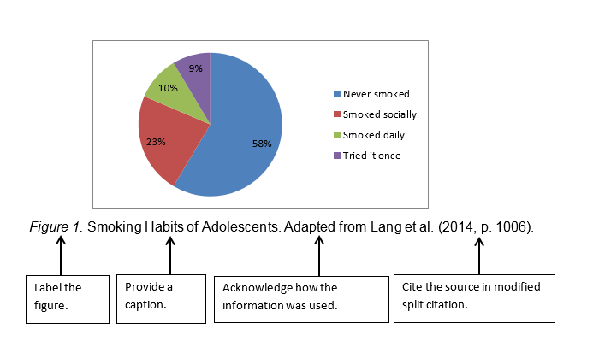
APA 6th edition Citation Figure Sample
Notes:
Now, we will review how tables and figures should be formatted in your report. This example follows APA 6th edition guidelines for figure formatting. The label (e.g., "Figure 1"), the caption (the title or description of the figure), and the acknowledgment (citation/source) should all appear below the figure.
Be consistent in how you position the label and caption—whether left-aligned or centered, choose one format and apply it throughout the entire paper. The font size for captions and labels can be reduced to size 10, but it must match the typeface used in the rest of your report.
The content within the figure or table can vary in font size or typeface, as long as it remains clear and readable. Refer to the image on the powerpoint, which provides a detailed example of what is required for properly formatted figures

Slide 11
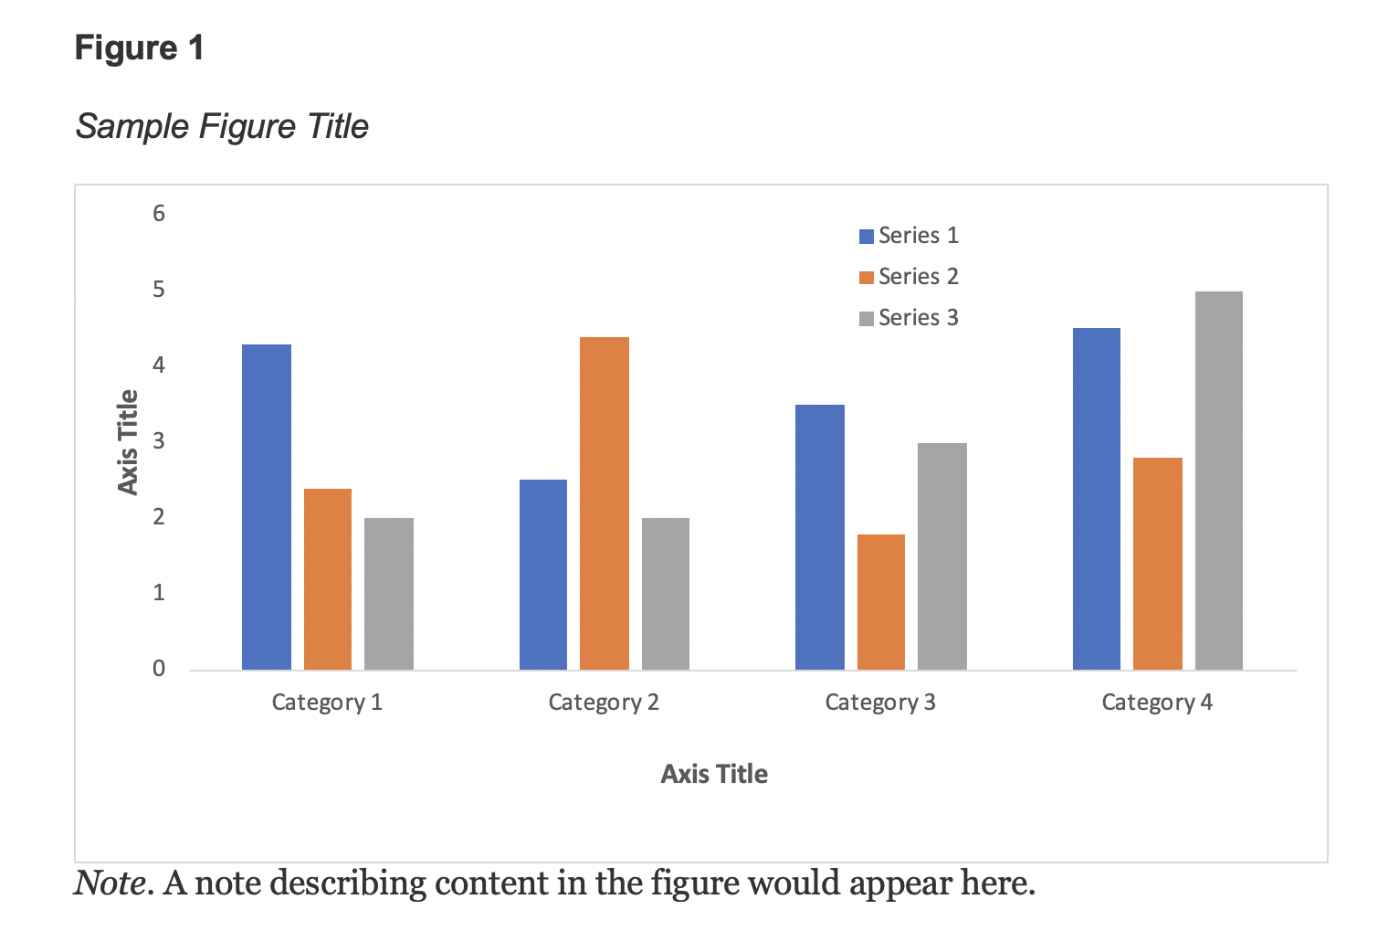
APA 7th edition Citation Figure Sample
Notes:
Here, we provide an example of a figure formatted according to APA 7th edition guidelines. The formatting principles are similar to the previous slide; however, there is a key difference: in APA 7th edition, the label (e.g., “Figure 1”) and caption appear above the figure, while any notes or acknowledgments (e.g., citations or source information) are placed below the figure.
Be sure to confirm which citation style you are using and format your figures and tables accordingly. Consistency and accuracy in citation formatting are essential throughout your report.

Slide 12
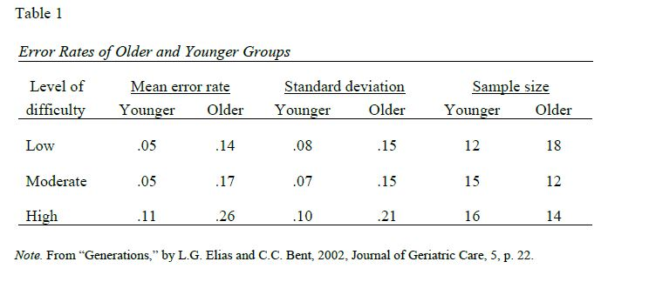
APA 6th and 7th edition Citation Table sample
Notes:
Next, we address table formatting. The table label and caption should be placed above the table, while any notes and source information should be positioned below. Ensure that the font size and alignment are consistent with those used for figures. This formatting standard applies regardless of the citation style. In this example, we are demonstrating the guidelines for both APA 6th and 7th editions.

Slide 13

Need help with Citation?
Contact your Subject Librarian for Help
The Link below will guide you on who is your subject librarian:
https://www.cpp.edu/library/reference-instruction/contact-subject-librarian.shtml
Notes:
If you need assistance with citations, bibliographies, or references, please contact your subject librarian. You can find their information on the University Library website or access the direct link provided in the slide.

Slide 14
Graduate Studies Website
Please visit the website for more details on formatting guidelines:
Graduate Studies Web checklist: https://www.cpp.edu/gradstudies/project-and-thesis/steps-for-project-and-theses.shtml And for Preliminary format review: Thesis/Project Preliminary Format Review (cpp.edu)
If you want more information or want to verify if all your paper has been processed, please contact Graduate Studies office at gradstudies@cpp.edu
Notes:
For more information, please visit the Graduate Studies website or contact their office via email at gradstudies@cpp.edu.

