Slide 1
Steps Towards Graduation
Graduate Studies Office
Registrar’s Office
May 05, 2026

Slide 2
Overview
Graduation vs. Commencement
Graduation Timeline
Key Dates for Graduation/Checklist
Project/Thesis Reminders
Report of Culminating Experience
Diploma/Employment Verification
Additional Resources

Slide 3
Graduation vs. Commencement
Graduation
Commencement
The term in which you successfully complete all your degree requirements (fall, summer, or spring)
The celebratory College ceremonies in May

Slide 4
Commencement 2026
Who is eligible to participate?
Fall 2025 graduates
Spring 2026 graduation applicants
Summer 2026 graduation applicants
For additional information regarding Commencement, please visit their website at https://www.cpp.edu/commencement/index.shtml
If you still have questions, you may email them at commencement@cpp.edu.

Slide 5
Graduation Timeline – Spring 2026
Graduation Application Deadline – March 13th (through BroncoDirect)
Applications accepted through the end of the term (May 15th)
Graduation Pre-Checks
Began in March and continue through the end of the term
Initial review of your academic record and degree requirements
Pending Graduate Academic Petitions will be processed
Email – APPROVED or IN REVIEW will be sent to CPP email
Graduation Clearance Period
June 3rd – July 17th
Post-checks and awarding of degrees
Email – AWARDED or PENDING will be sent to CPP email

Slide 6
IMPORTANT:
Terms must be manually updated (tga@cpp.edu)
Helps maintain student enrollment eligibility and timely grad checks.
One graduation fee only ➡ Eligible for May 2026 Commencement throughout all terms
EXAMPLE/WHAT-IF SCENARIO
Fall 2025 (Applied)
❌ Did not complete requirements
↓
Spring 2026 (Updated Term)
❌ Still incomplete
↓
Summer 2026 (Updated Term)
✅ Final completion
Notes:
A student applies to graduate in Fall 2025 but does not complete all degree requirements. Their expected graduation term is updated to Spring 2026 so they can continue enrolling. When they still need additional time, the term is updated again to Summer 2026. Throughout this process, the student remains eligible to enroll, only pays the graduation fee once, and is still eligible to participate in the May 2026 commencement ceremony.

Slide 7
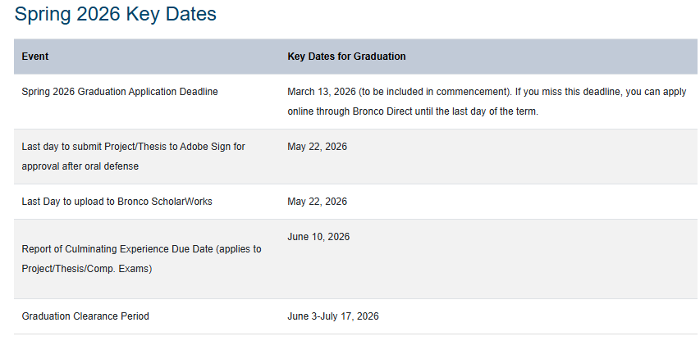
Key Dates for Graduation Spring 2026
https://www.cpp.edu/gradstudies/key-dates/spring.shtml

Slide 8
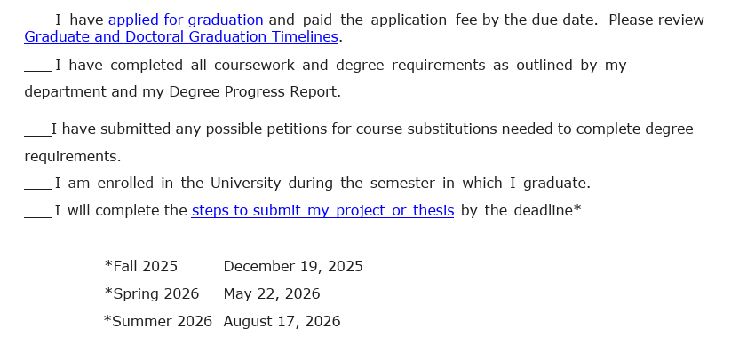
Graduation Checklist https://www.cpp.edu/gradstudies/current-students/graduation-checklist2025-2026_revised.pdf

Slide 9
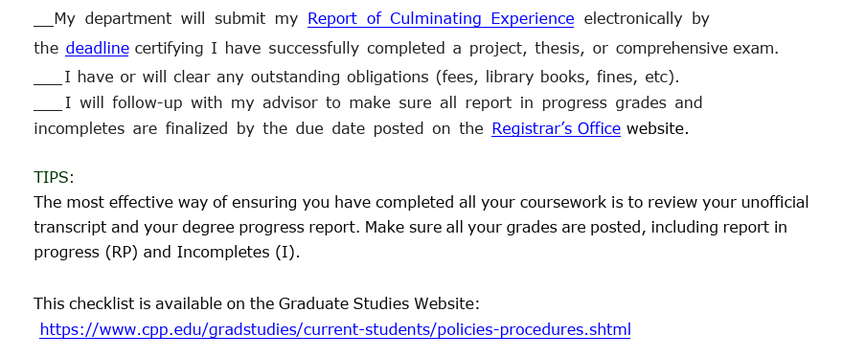
Graduation Checklist

Slide 10
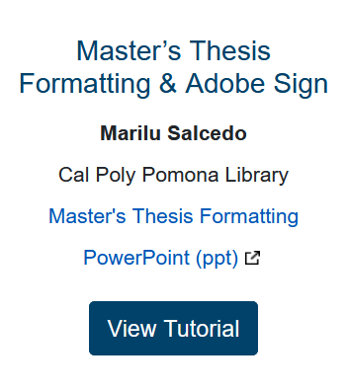
Project and Thesis Reminders
Spring 2026 Submission Deadline: May 22nd
Project/Thesis Submission Checklist:
https://www.cpp.edu/gradstudies/project-and-thesis/steps-for-completion.shtml
Master’s Thesis Formatting & Adobe Sign Online Tutorial:
https://www.cpp.edu/gradstudies/current-students/workshops-and-tutorials.shtml

Slide 11
Report of Culminating Experience (RCE)
Graduation Requirement for all graduate students certifying completion of project, thesis, or comp. exam
Form submitted by faculty/dept. upon successful completion of culminating experience. Link to form: https://www.cpp.edu/gradstudies/current-students/forms.shtml
For project/thesis, RCE will be approved by Graduate Studies so long as these conditions are met:
1.For theses, the following must be completed: library format review approval, committee approval, and submission to library repository (broncho scholarworks)
2.For projects, the following must be completed: committee approval and submission to library repository(bronco scholarworks).

Slide 12
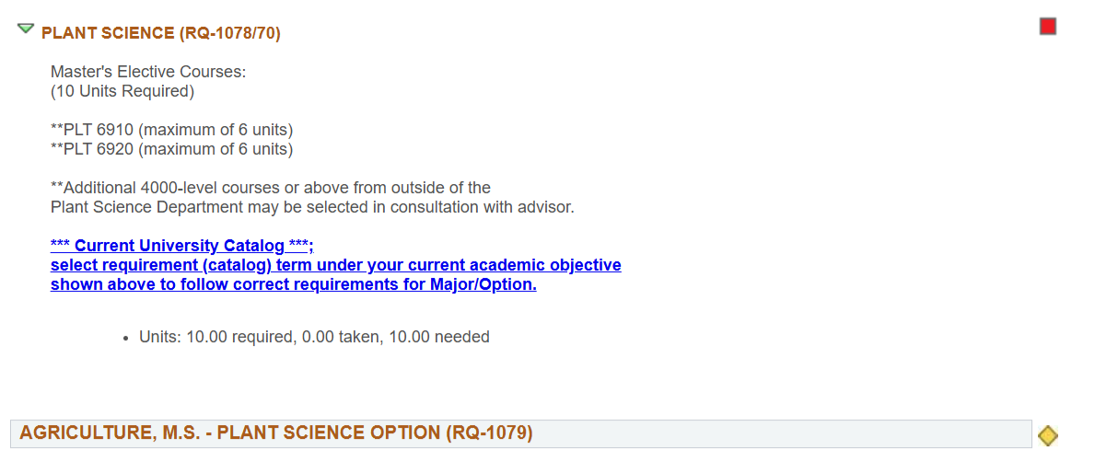
Degree Progress Report (deficiency example)

Slide 13
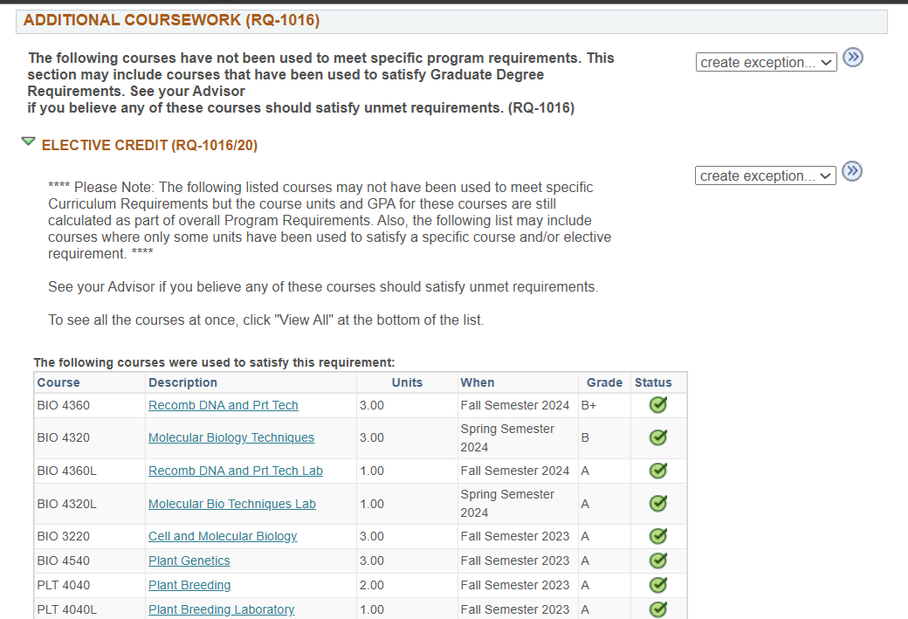
Degree Progress Report (deficiency example)

Slide 14
Diploma/Employment Verification
Diplomas
Ordered after your degree is posted
Ordered weekly – please allow 14-21 days for delivery
Please confirm mailing address and name in Bronco Direct
Diplomas sent internationally are not guaranteed to arrive
Unofficial Transcripts
Degree conferral date automatically displays once degree is posted
Current students may access through BroncoDirect
Official Transcripts
Order via the National Student Clearinghouse (NSC)
Visit the Registrar’s Office for more information
https://www.cpp.edu/registrar/student-records/transcripts.shtml

Slide 15
Diploma/Employment Verification
Expected Degree Verification Letter
To be given to a prospective employer or institution
Can be issued before your degree is officially awarded as proof of expected graduation
Email the Bronco Advising Center to request letter at bac@cpp.edu
Degree Verification Letter
To be given to a prospective employer or institution
Can be issued once your degree is awarded
Email the Bronco Advising Center to request letter at bac@cpp.edu

Slide 16
Additional Resources
Graduate Studies Office: www.cpp.edu/~gradstudies
Contact info: gradstudies@cpp.edu
Project/Thesis submission, Graduate Academic Petitions, Graduate student policies
Registrar’s Office: https://www.cpp.edu/registrar/index.shtml
Applying for Graduation, Graduation Application Dates/Deadlines, Diploma information, ordering transcripts
Graduation status: tga@cpp.edu
Commencement Office: https://www.cpp.edu/commencement/index.shtml

Slide 17
Q&A

