Slide 1
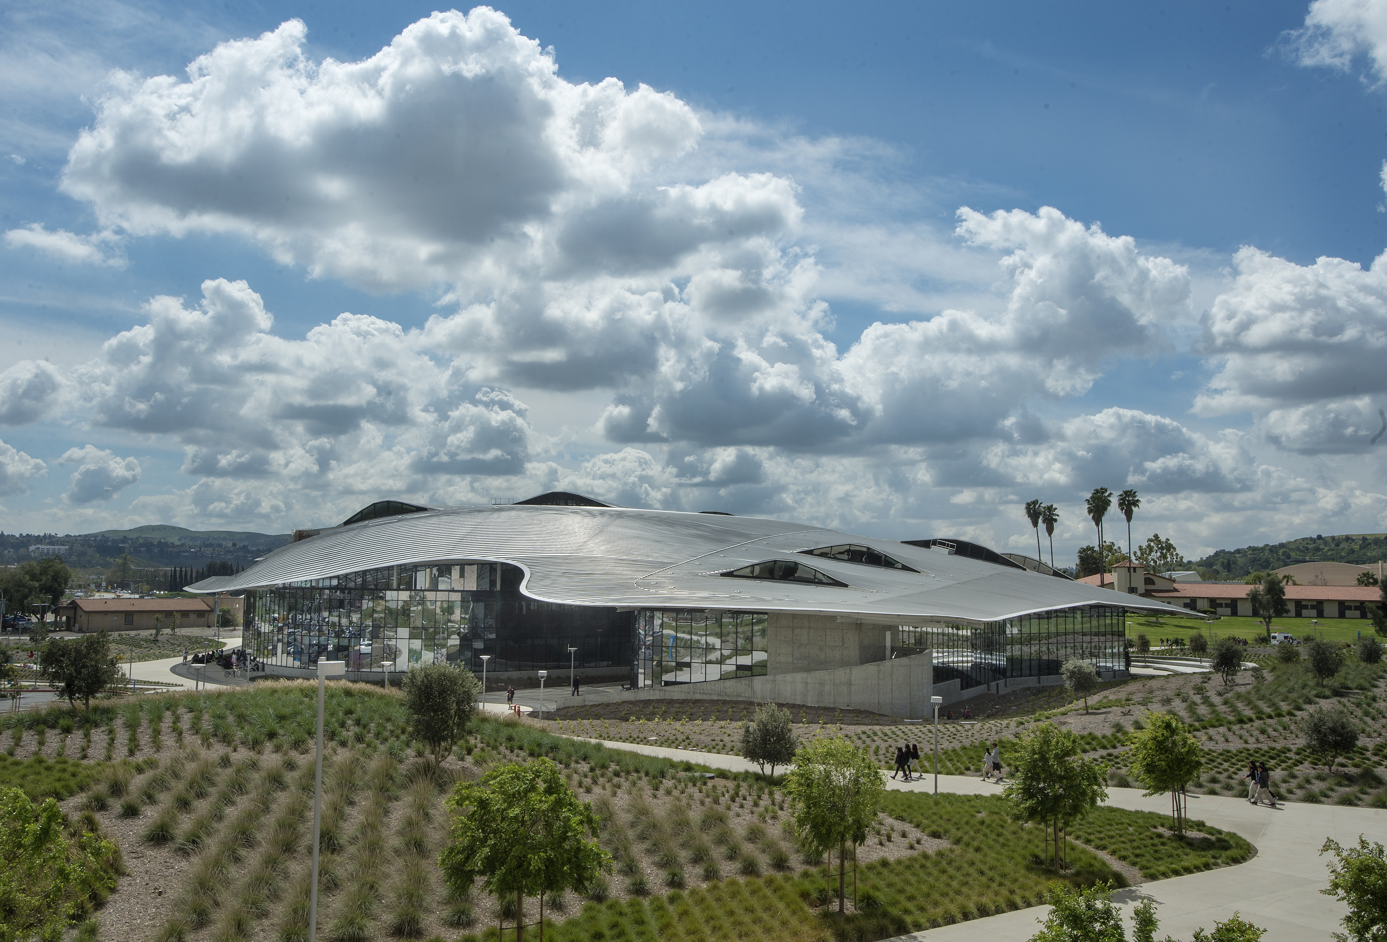
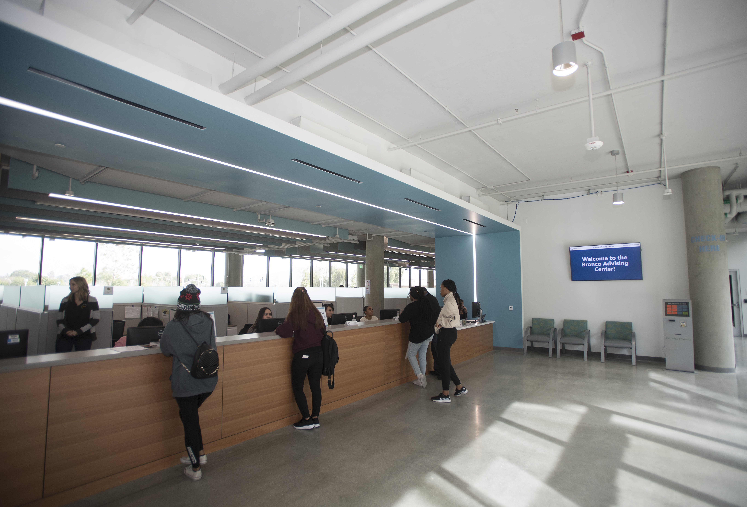
Bronco Advising Center

Slide 2
Bronco Advising Center
General Advising
Financial Aid
Enrollment Services
Student Accounting
(909) 869-4600
bac@cpp.edu
www.cpp.edu/bac

