Slide 1
Financial Aid For Graduate Students
Cal Poly Pomona
Office of Financial Aid & Scholarships

Slide 2
How To Apply
FAFSA
fafsa.ed.gov
U.S. citizen or eligible non-citizen (i.e., permanent resident)
Dream Act
dream.csac.ca.gov
AB540 criteria
Bronco Scholarship Application
csupomona.academicworks.com
Notes:
I hope that most of you have completed some form of an application, however if you have not completed one yet, you are still able to do any of these options. We have the FAFSA application and this is available to those who are U.S. citizens or eligible non-citizens, and non-citizens for example are permanent residents. If you’re not sure if you qualify for the FAFSA, you can visit the FAFSA website to review all eligible citizenship types for this application.
Next we have the California Dream Act application. This application is for those who meet AB 540 criteria and do not qualify for the FAFSA application. If you are an AB 540 student, and would like assistance with the Dream Act application or how to complete your AB 540 affidavit, you can utilize the Dreamers Ally Network, a resource center for those who are AB 540 and DACA.
Lastly we have the Bronco Scholarship Application. This is available for anyone to apply, including international students. It does not require that you complete a FAFSA or Dream application.

Slide 3
Types of Financial Aid Available
State University Grant
CADAA or FAFSA filed by March 2nd deadline
Need-based and first come first served
Cannot receive any other award designated to cover tuition (fee waiver, 3rd party payment)
Scholarships
Bronco Scholarship Application
New scholarships offered throughout year
Requirements vary based on donor specifications
MBA Grant
FAFSA filers only
MBA Grants are awarded to graduate students who have paid the Graduate Business Fee.
Funds are awarded each semester.
Notes:
Now I’d like to go over the different types of financial aid that we offer.
The State University Grant requires a FAFSA or Dream application that is filed on time by March 2nd. This is need-based which means that not everyone will qualify for this grant. It is based on your Expected Family Contribution when you complete your application. It is also first come first served so it is a fund that will be exhausted. This is a tuition paying grant, so if you are receiving any type of tuition waiver or 3rd party payment, you cannot receive the State University Grant at the same time.
Scholarships. These are competitive awards and recipients are chosen by the scholarship donors. This is something you would want to check throughout the year as we list new scholarships as they come in. The majority of awards are posted between January and March for the following academic year.
MBA Grant. This grant is for FAFSA filers only and you have to be enrolled in the MBA program and pay the Graduate Business Fee. Funds are awarded each semester based on the funds available and is automatically applied if you are in the program and meet the FAFSA filing requirement.

Slide 4
Types of Financial Aid Available
Stafford Loan - Unsubsidized
Interest accrues while enrolled
6.08% interest rate and 1.066% origination fees
$20,500 maximum for the academic year
Repayment begins 6 months after graduation
Graduate Plus Loan
Credit based loan
7.08% interest rate and 4.264% origination fees
Up to the cost of attendance minus all other financial assistance
Repayment begins 60 days after the final disbursement of the academic year
Private Loans
Credit based loan
Student chooses lender
Interest rates and repayment terms vary
Notes:
We also have loans available to assist you. Loans are funds that need to be repaid.
The Stafford Loan – Unsubsidized is offered to those who file a FAFSA application. There is no credit check, you qualify just by filling out the application. Interest accrues from your first disbursement until repaid. I’ve listed the current interest rate and origination fees here however they may change if you borrow a loan after October 1st when the Department of Education renews their loan offers. The maximum you can receive in this loan as a graduate student is $20,500 and repayment is not required until 6 months after you graduate.
For those who need additional assistance on top of the Stafford Loan, we offer the Graduate Plus Loan. This is a credit based loan and the amount would be your remaining unmet need up to your Cost Of Attendance. The interest rates and origination fees will be updated after October 1st just like the Stafford Loan. Repayment for this loan is 60 days after your final disbursement.
Private Loans. This is also a credit based loan in which the student chooses the lender. Interest rates and repayment criteria will depend on the lender. If you are interested in this type of loan you would need to find a lender that you would like to take an educational loan with, apply with them, and that lender will work with Cal Poly to process your loan.

Slide 5
Enrollment Requirements
MBA Grant
12+ units: full award
9-11 units: 75% of amount listed for semester
6-8 units: 50% of amount listed for semester
1-5 units: 25% of amount listed for semester
State University Grant
7+ units: full award
4-6 units: Adjusted to match the tuition fee
1-3 units: Cancelled
Notes:
Now I’d like to talk about how to maintain your financial aid.
There are enrollment requirements depending on the type of aid you are receiving. This information you will be able to reference on our website.

Slide 6
Enrollment Requirements
Federal Stafford Loans (Unsubsidized)
4+ units: full award
1-3 units: cancelled
Graduate Plus Loan
4+ units: full award
1-3 units: cancelled
Private Loan
Per Lender Requirements

Slide 7
Satisfactory Academic Progress
3.0 minimum cumulative GPA
Coursework below 3000 level will be excluded from GPA
Complete at least 67% of cumulative units attempted
Courses attempted below 3000 level will be considered “attempted” units but not “completed”
Complete degree program within 150% of the published length of the program
The maximum timeframe is calculated using the published minimum degree requirements. If undergraduate coursework is required to satisfy pre-requisites or program requirements, it is expected that it will be accomplished within the 150% maximum timeframe.

Slide 8
Financial Aid To-Do’s
Submit 2019-2020 applications
Check Bronco Direct To-Do List and CPP email
Complete Loan Disbursement Steps
Entrance Counseling Workshop
Master Promissory Note (MPN)
www.studentloans.gov
Sign up for direct deposit on Bronco Direct

Slide 9
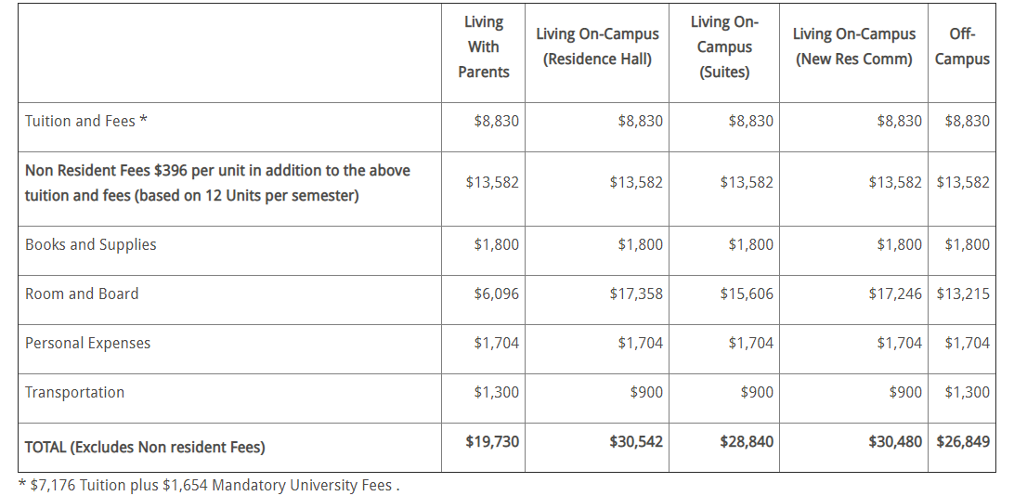
2019-2020 Estimated Total Costs

Slide 10
How To Pay
Fall 2019 disbursement begins August 12th
Automatically disburse based on enrollment requirements
Tuition - Housing - Refund
Student Accounting & Cashiering Services
Payment Plan: cpp.afford.com
Pay online: Bronco Direct
In person: Cashier’s Office Student Services Building 121 1st floor

Slide 11
Questions
Office of Financial Aid & Scholarships
(909) 869-3700
Student Services Building 121 – 1st Floor
www.cpp.edu/~financial-aid
Notes:
This concludes the information I have for you today. If you have any questions please come visit us in the new Student Services Building or you can give us a call at the number listed here. I’ve also provided the link to Cal Poly’s financial aid page. You will be able to reference all of the information I’ve provided to you today and more. Thank you very much and wish you all a successful first year as a graduate student.

