Slide 1
Student Health & Wellness Services
Graduate Orientation 2019

Slide 2
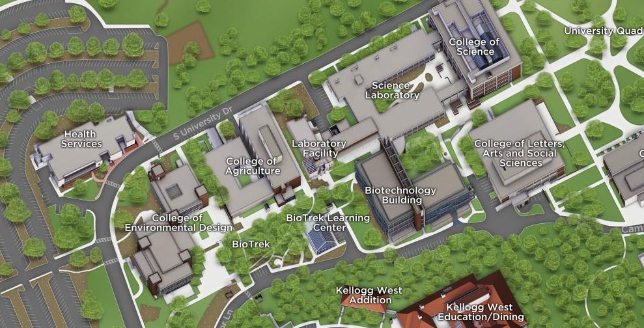
Student Health & Wellness Services, Bldg. 46
Student Health: Main Entrance
Bronco Wellness Center: West Entrance
(by parking lot)
Next to Lot J, Across from Bldg. 7
Fall & Spring Hours: M-F, 8am-5pm
Contact Us: (909) 869-4000
Website: www.cpp.edu/~health
About Us
We provide CPP students with affordable, accessible & high quality healthcare.
How Much Are Services?
Most services are covered by the mandatory Student Health Fee already included in tuition.
How Do I Make An Appointment?
Call (909) 869-4000
Online: My Health Portal (cpp.edu/~health)
In Person

Slide 3
Student Health Services: Bldg. 46
No-Cost Services
Unlimited visits
X-Rays
Travel Consultations (Studying Abroad)
Minor Surgical Procedures
Generic Tylenol through the Pharmacy
Flu Shots
Tdap Vaccine
Tuberculosis Screening
In-House Lab Work
Low-Cost Services
Physical Exams
Cervical Cancer Screening (Pap Test)
Birth Control
Emergency Contraception
Wraps, Braces, Slings, Crutches
Pharmacy Services
Immunizations
Testing for Sexually Transmitted Infections (STIs)
Lab Work, Referred-Out

Slide 4
Notes:
Fun fact: On average, you wait less than 5 minutes for your appointment after checking in at the front desk!
You already pay for most of these services, might as well use them!
Remove?

Slide 5
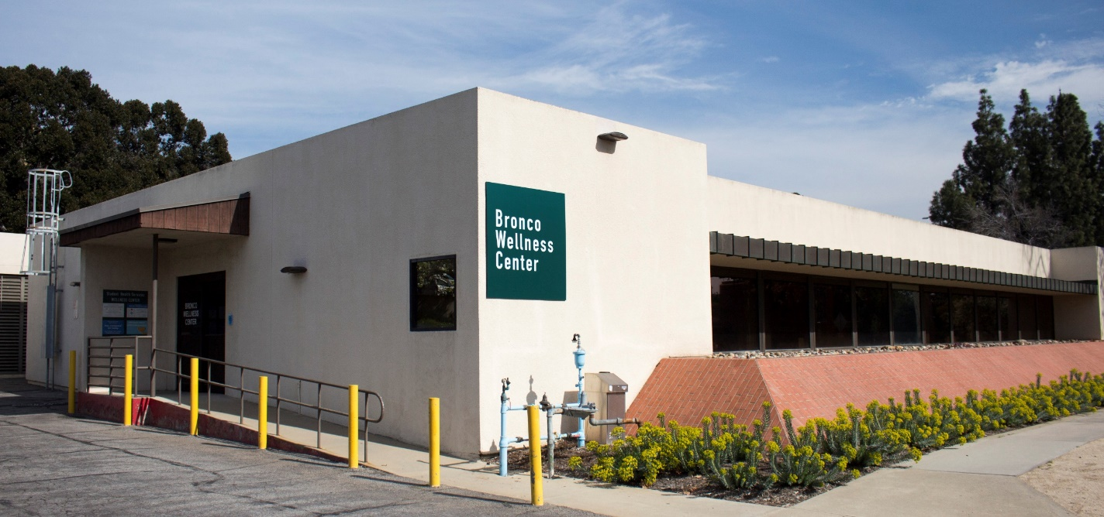
Bronco Wellness Center (West Entrance)
Health & Wellness Resources
Get Well Soon Cold Kits
Health Hut Around Campus
Blood Pressure Screening
Hygiene Products (hand sanitizer, lip balm etc.)
Health Assessments
Wellness Card
Alcohol, Tobacco and Other Drug Resources
Quit Smoking/Vaping Kits
Nicotine Gum, Patches & Lozenges
Follow Us on Social Media!
Free condoms, giveaways, upcoming events, health tips!
Instagram & Facebook: @cpphealth
Twitter: @CalPolyHealth
Sexual Health Resources
External Latex & Non-Latex Condoms
Internal Condoms
Dental Dams
Lubrication
Free & Confidential HIV Testing (every Tuesday)
To Make An Appointment
909-869-5272
Walk-In

Slide 6
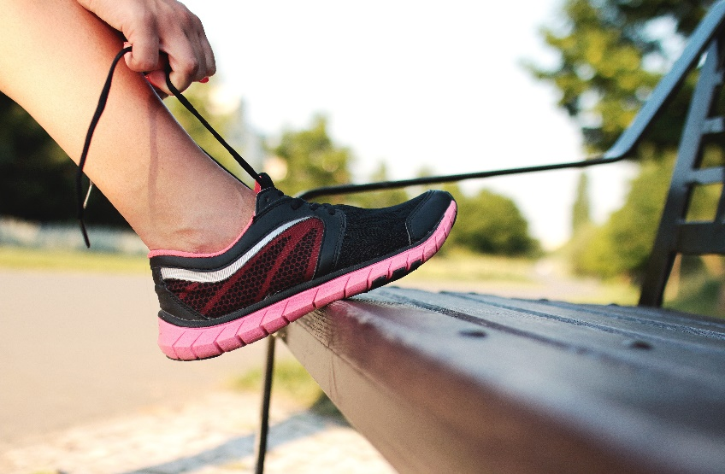
Meet With Us One-on-One
We are not the health police!
Physical Activity
Smoking, Vaping,
Cannabis Use
Nutrition
Alcohol
Other Drugs
Birth Control Options
Stress Management
Notes:
So why would you need to make an appointment with us?
We have Health Educators and Peer Health Educators on staff ready to talk to you one-on-one about your health! We provide individualized sessions on these topics: (click through)
Fact sheet, health assessments
We are a judgement free zone. We are NOT the health police, we work from a harm reduction platform (figure out language). The Wellness Center is a safe, confidential space for you to discuss any health concerns you have. Health at every size
OPTIONAL:
Focus on harm reduction platform
Provide safe, welcoming, confidential space to talk about these or other health topics
Just call to make an appointment

Slide 7
College Life
Types of stressors include:
Physical stressors
Injury, illness, environmental(new room mates, pollen, etc.), trauma
Psychological and emotional stressors
Fears, sadness, anger, worry, guilt, shame, anxiety, our perceptions and worldview
Social stressors
Relationship difficulties, work, new social environment, adapting to new school norms and rules, bullying and discrimination.

Slide 8
College Life
We all experience stress and that’s okay!
We’re bound to encounter stressors in our environment so it is important for us to learn how to manage our stress (come see us for tips!)
Sometimes our stress is too overwhelming, it is important for us to recognize this and seek support.

Slide 9
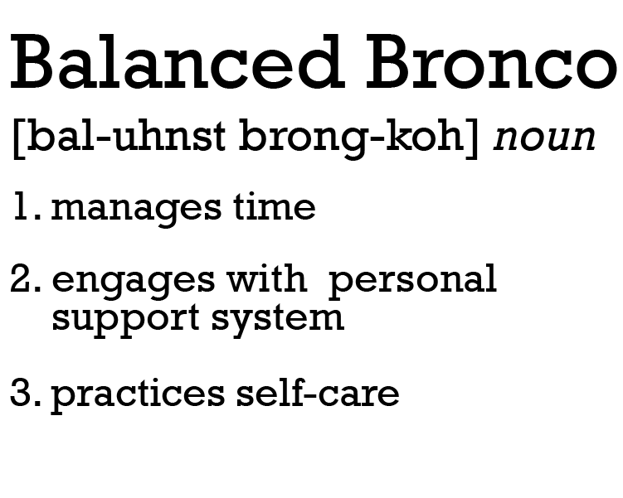
Balanced Broncos
Sleep
Move
Breathe
Pause
Connect
Laugh
Eat
Prioritize

Slide 10
Pause and Breathe
Pause
Count to 10 before responding to an emotional situation
Schedule breaks and time to relax
Breathe
Take 3 deep breaths anytime
Breathe into your belly
Take some time to breathe and stretch throughout the day

Slide 11
Laugh and Connect
Laugh
Watch a comedy or funny video
Share something funny with others
Connect
Reach out to a friend, stay in touch
Find a group or club to nurture your interests
Seek help from a professional if things get overwhelming

Slide 12
Prioritize
Time management
Plan ahead
Learn to say no
Schedule time for yourself

Slide 13
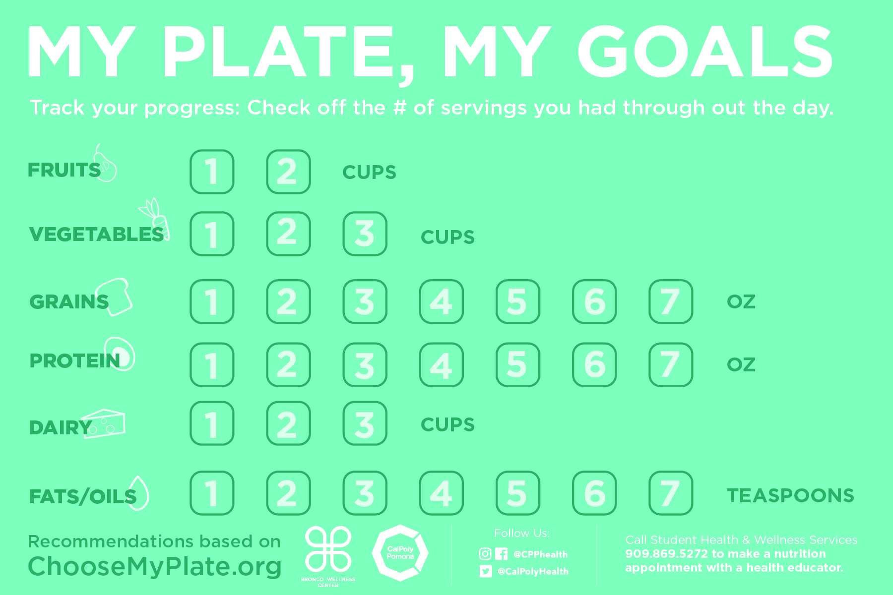
Want to know more?
Schedule a free one-on-one appointment with us to learn more about nutrition and tips on having a balanced diet!

Slide 14
Broncos Care Basic Needs
Need some extra cash for groceries?
CalFresh can help!
Super Market

Slide 15
Broncos Care Basic Needs
5 things to know about
It’s a nutrition assistance program that helps low-income individuals and families buy the food they need.
It’s funded by the USDA, is known as SNAP in other states and was formerly known as “food stamps”
Individuals can receive up to $192 a month for groceries!
Eligibility is based on factors such as income, household size and student status.
We can help you apply for CalFresh! Sign up for an appointment today on our website! www.cpp.edu/basicneeds

Slide 16
Move
Anything that gets you moving!

Slide 17
Benefits Associated with Physical Activity
Boosts energy level
Sharpen your focus
Reduces feelings of stress, anxiety & depression
Improves quality of sleep
And over time, physical activity can help you live a longer, healthier life.
Lower your risk of diseases like type 2 diabetes and some cancers
Control your blood pressure
Health.gov/moveyourway

Slide 18
Are you Team No Sleep?
•Lower GPA
•Increased risk of motor vehicle accidents
•Lower (or lack of) sex drive
•Falling asleep in class= wasting tuition $$$
•More likely to get sick
•Bad mood/difficulty managing social situations
•Long-term sleep deprivation increases risk of stroke, heart disease, diabetes

Slide 19
Join the Dream Team!
•Better Academic Performance (higher GPA): getting more zZz’s leads to getting more A’s.
•Better Mood
•Better Memory and Focus
•Aids in managing Depression, Eating Disorders, Substance Abuse
•Better immunity to illness
•Improved interpersonal relationships
•Improved athletic performance
•Increased reaction time

Slide 20
Additional Campus Resources
Counseling & Psychological Services (CAPS)
Appointments/ Information: 909-869-3220
After-Hours Crisis Support: 909-869-3220 *press 2
https://www.cpp.edu/~caps/index.shtml
Behavioral Intervention Team (BIT)
confidential consultation at cppbit@cpp.edu or 909-869-5286
https://www.cpp.edu/~cppbit/index.shtml

Slide 21
Additional Campus Resources
Disability Resource Center (DRC)
Appointments/ Information: 909-869-3333
https://www.cpp.edu/~drc/index.shtml
Broncos Care Basic Needs
Appointments/ Information: 909-869-2763
https://www.cpp.edu/~basicneeds/about/contact-us.shtml

Slide 22
Additional Campus Resources
Student Health Services
Appointments/ Information: 909-869-4000
After-Hours Nurse Advise Line: 855-272-1723
https://www.cpp.edu/~health/index.shtml
Bronco Wellness Center
Appointments/ Information: 909-869-5272
https://www.cpp.edu/~health/bronco-wellness-services.shtml

Slide 23
Thank You!

