Slide 1
G RADUATE STUDIES @CPP
C A L P O L Y
P O M O N A
STAYING
F R O M
ON TR ACK
S T A R T T O F I N I S H
Rebecca Rivas, Office of Graduate Studies

Slide 2
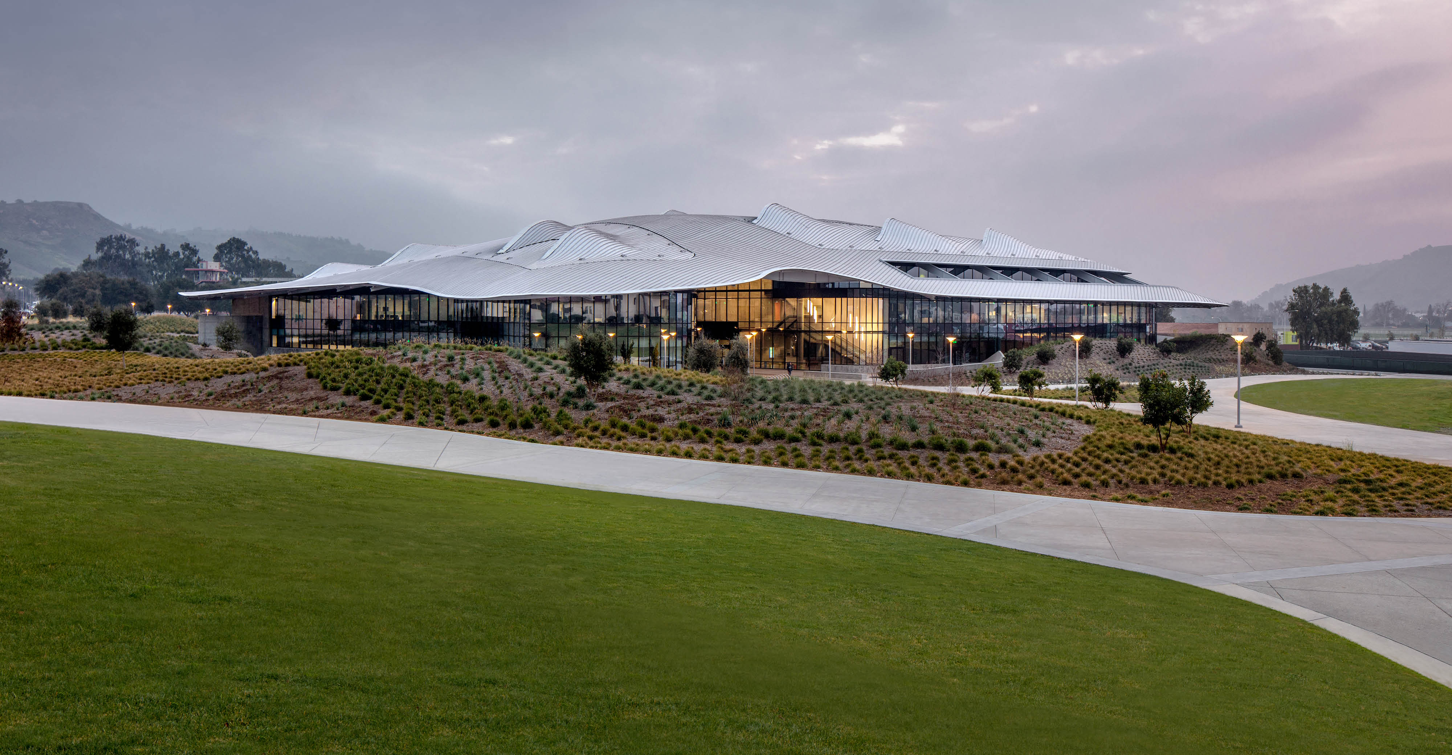
C A L P O L Y
P O M O N A
G R A D U A T E S T U D I E S
OUR LEADERSHIP TEAM
Faculty Advisors/Graduate Coordinators, Dept. Chairs, and Director of Graduate Studies
O F F I C E
OUR ROLE:
Guide prospective and current graduate students Support Key steps in graduation process Advisement
Promote student awareness and pursuit of graduate education & research
Review and process contracts, petitions, and oversee the submission process for your project or thesis Implement and enforce policies and procedures in graduate student affairs.
Student Services Bldg. #121, first floor, orange counter

Slide 3
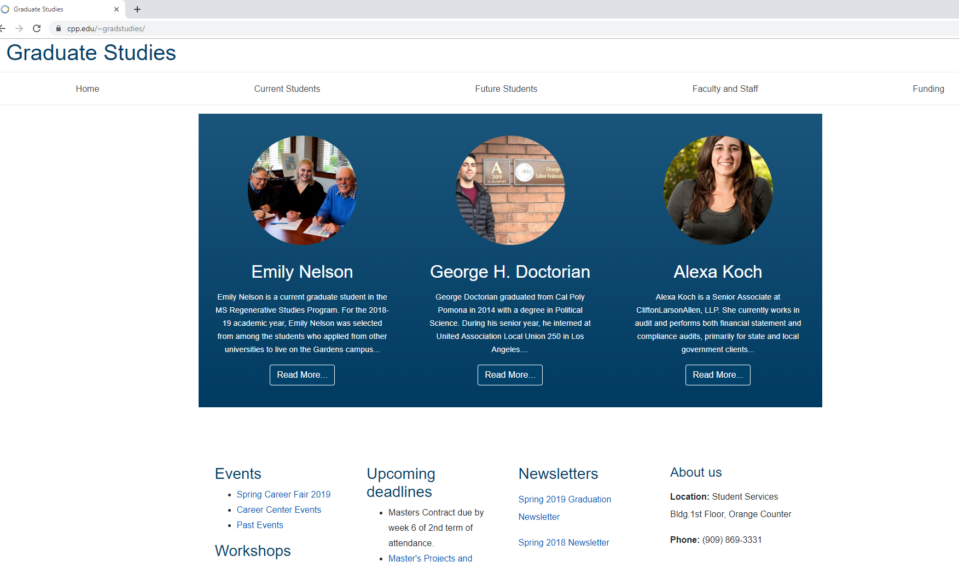

Slide 4
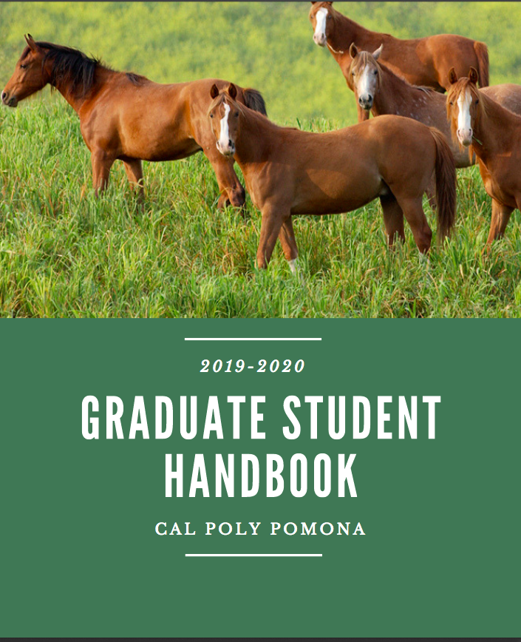

Slide 5
C A L P O L Y
P O M O N A
Y O U R
G R A D U A T E
A D V I S O R
FACULTY MEMBER IN YOUR DEPARTMENT
Oversees the advising for your degree program Full-time faculty member
Also teaches—maintains teaching schedule Varied office hours
Assists you with:
First semester advisement
Study Plan filing
Any other questions you may have about academic status, courses to take, your professional goals

Slide 6
YOUR RESPONSIBILITIES
Check your University email
Keep your contact info updated on Student Portal in Bronco Direct—phone, address Meet your Graduate Program Adviser consistently
Check your academic record in your Student Portal through Bronco Direct Be aware of administrative deadlines
Review your graduate student handbook
Keep your own copy of all papers, homework, documents.

Slide 7
C A L P O L Y
P O M O N A
T I M E L I N E
1 S T
S E M E S T E R :
Meet with your advisor and/or graduate coordinator
Attend department orientation
Visit My CPP
Update your emergency contact information Verify correct Program and option through Bronco Direct
2 N D
S E M E S T E R :
Submit a program of study by the end of the sixth week of the second semester of attendance to avoid registration hold
W E L C O M E T O C A L P O L Y
P O M O N A !

Slide 8
C A L P O L Y
P O M O N A
TIME LINE FROM START TO FINISH
BEGINNING OF SECOND YEAR:
FINAL TWO SEMESTERS
FINAL
SEMESTER
Start establishing a timeline with your advisor to complete your project or thesis
Attend Formatting & Submission Workshops offered by Library
Review University and department Project/Thesis submission process
Apply for Graduation & Pay fees
Verify Program of Study and your unofficial transcripts to stay on track
Review Commencement Information on CPP website and with your department
Submit your final project/thesis documentation by published University Deadline to the Graduate Studies Office and Library

Slide 9
C A L P O L Y
P O M O N A
P O L I C I E S
A N D P R O C E D U R E S
Resources:
University Catalog
Graduate Student Handbook
Graduate Studies Website
TIME LIMIT : 7 YEARS
ACADEMIC STANDING: 3.0 GPA
PROJEC/THESIS SUBMISSION PROCESS & IRB

Slide 10
C A L P O L Y
P O M O N A
Q U E S T I O N S ?
F O R C O M M E N T S
O R Q U E S T I O N S :
P l e a s e c a l l u s a t ( 9 0 9 ) 8 6 9 - 3 3 3 1 o r email us at g r a d s t u d i e s @ c p p . e d u .

